Slide 1

11.4 Gas Law
Mar. 20th, 2026

Slide 2
In this class, we will understand
How does gas behave
What is ideal gas
Differences between ideal gas and real gas

Slide 3
Gaseous behavior
Think: how does gas behave differently from solid and liquid?

Slide 4
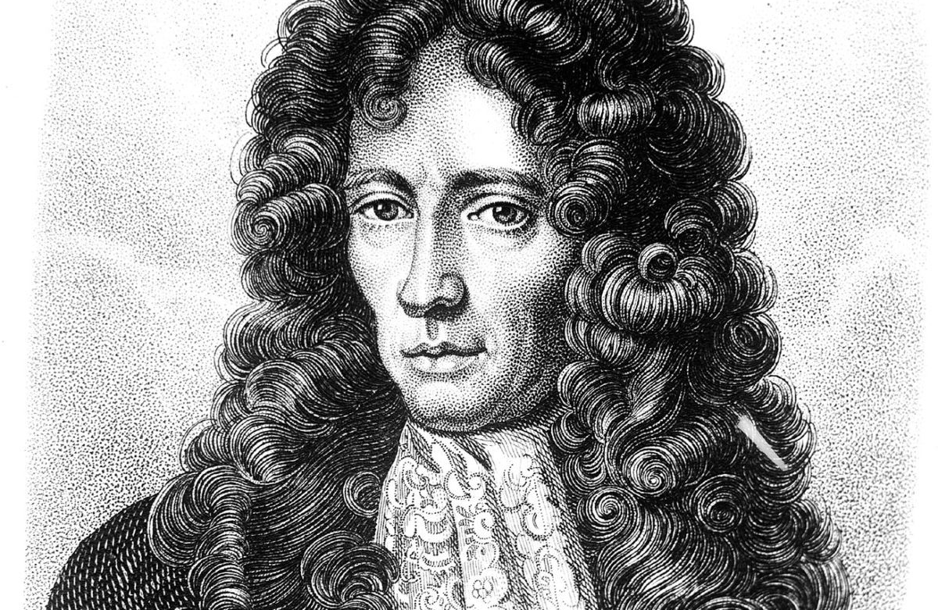
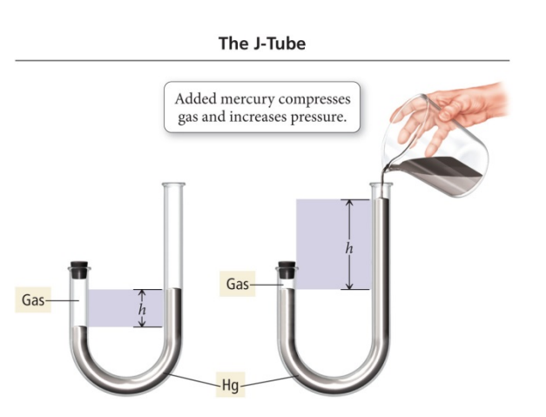
Boyle’s Rule
BOYLE’S LAW: the volume of a confined gas is inversely proportional to the pressure exerted on the gas.
Real life example?
PV=k

Slide 5
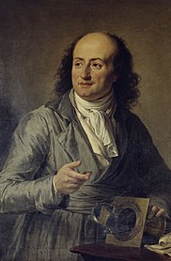
Charles’ Law
If a given quantity of gas is held at a constant pressure, then its volume is directly proportional to the absolute temperature.

Slide 6
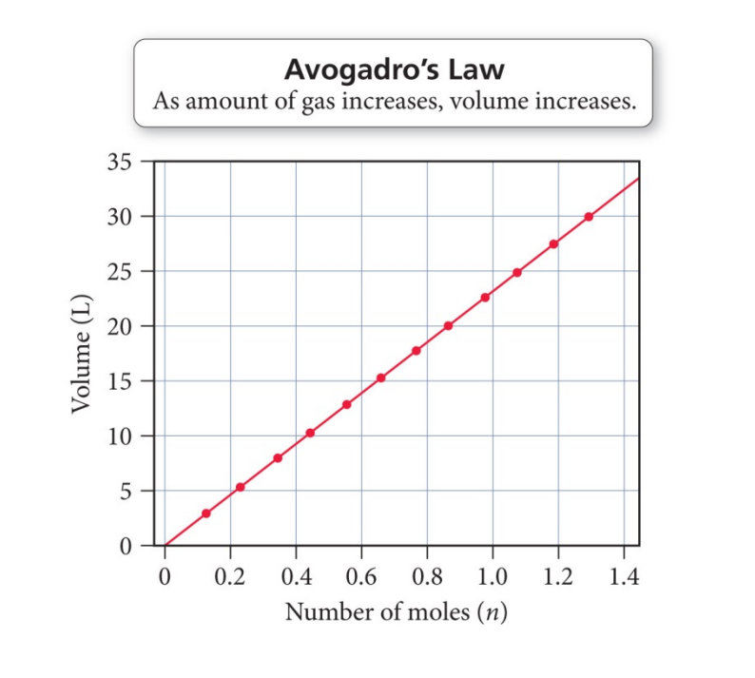
Avogadro’s Law
The volume of a gas, at a given temperature and pressure, is directly proportional to the quantity of gas.

Slide 7
Ideal Gas Equation
PV=nRT
R=0.08206 L atm mol⁻¹ K ⁻¹

Slide 8

Ideal Gas Property
The gas particles have negligible volume.
The gas particles are equally sized and do not have intermolecular forces (attraction or repulsion) with other gas particles.
The gas particles move randomly in agreement with Newton’s Laws of Motion.
The gas particles have perfect elastic collisions with no energy loss.

Slide 9
Discussion
Which of the following gas behaves most ideally?
A. H₂ B. He C. Kr D. Xe

Slide 10
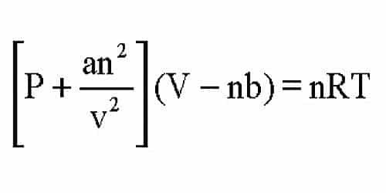
Real Gas Calibration
a: intermolecular force
b: volume of gas molecules
a and b need to be determined experimentally for each gas.

Slide 11
Practice
1: A gas occupies a volume of 4.50 L at a pressure of 1.20 atm and a temperature of 298 K. Calculate the number of moles of gas present.
2: A sample of gas contains 0.250 mol and occupies 3.00 L at a pressure of 0.950 atm. Calculate the temperature of the gas in Kelvin.
3: A gas sample has 0.750 mol at a temperature of 310 K and a pressure of 2.00 atm. Calculate the volume of the gas.
4: Calculate the volume of 1 mol air at 1 atm and 30 ºC.

