Slide 1

12.4 Oxides, and Salts Preparation
Apr.21st 2025

Slide 2

In this class, we will
Understand the different types of oxides
Be able to make a salt based on acid base chemistry
Learn how to write the ionic equations

Slide 3
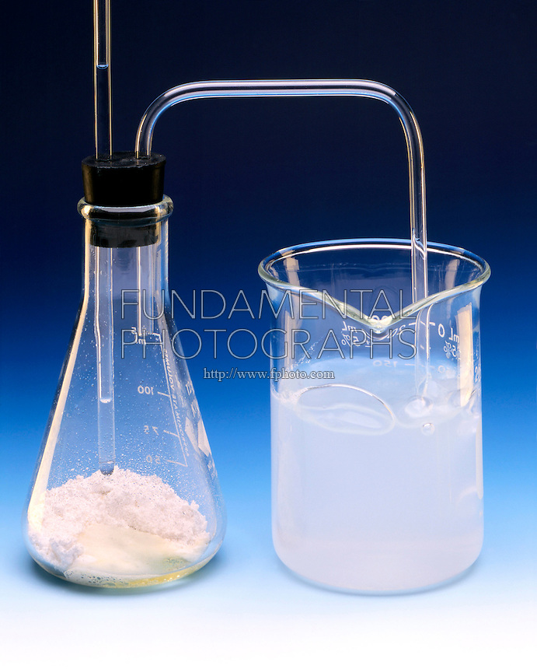
How to experimentally identify an acid or base?
Acids can react with carbonates and produce a gas that turns clear limewater cloudy.
What is the gas?
Bases can react with ammonium salts and produce a gas that turns damp red litmus paper blue.
What is the gas?
Think: Arrhenius, Bronsted-Lowry, Lewis, which type of acid and base are tested here?

Slide 4
Some questions to consider…
Why does acid rain damage buildings?
Why is quicklime (CaO) used in construction?
Why does aluminum not corrode easily?

Slide 5
Oxides
Oxides are chemical compounds with one or more oxygen atoms combined with another element (e.g. Li₂O).
An oxide that combines with water to give an acid is termed as an acidic oxide.
The oxide that gives a base in water is known as a basic oxide.
An amphoteric solution is a substance that can chemically react as either acid or base.
However, it is also possible for an oxide to be neither acidic nor basic, but is a neutral oxide.

Slide 6
Acidic oxides
Acidic oxides are the oxides of non-metals (Groups 14-17) and these acid anhydrides form acids with water:
Sulfurous Acid SO₂+H₂O→H₂SO₃
Sulfuric Acid SO₃+H₂O→H₂SO₄
Carbonic Acid CO₂+H₂O→H₂CO₃
Acidic oxides combine with bases, they produce salts, e.g.,
SO₂+2NaOH→Na₂SO₃+H₂O

Slide 7
Basic oxides
Generally Group 1 and Group 2 elements form bases called base anhydrides or basic oxides e.g.,
K₂O(s)+H₂O(l)→2KOH(aq)
Basic oxides are the oxides of metals. If soluble in water, they react with water to produce hydroxides (alkalies) e.g.,
CaO+H₂O→Ca(OH)₂
MgO+H₂O→Mg(OH)₂
Na₂O+H₂O→2NaOH
These metallic oxides are known as basic anhydrides. They react with acids to produce salts, e.g.,
MgO+2HCl→MgCl₂+H2O
Na₂O+H₂SO₄→Na₂SO₄+H₂O

Slide 8
Amphoteric oxides
Amphoteric oxides exhibit both basic as well as acidic properties. When they react with an acid, they produce salt and water, showing basic properties. While reacting with alkalies they form salt and water showing acidic properties.
For example ZnO exhibits basic behavior with HCl
ZnO+2HCl→ZnCl₂+H₂O(basic nature)
and acidic behavior with NaOH
ZnO+2NaOH→Na₂ZnO₂+H₂O(acidic nature)
Similarly, Al₂O₃ exhibits basic behavior with H₂SO₄
Al₂O₃+3H₂SO₄→Al₂(SO₄)₃+3H₂O
and acidic behavior with NaOH
Al₂O₃+2NaOH→2NaAlO₂+H₂O

Slide 9
Neutral oxides
Neutral oxides show neither basic nor acidic properties and hence do not form salts when reacted with acids or bases.
Carbon monoxide (CO); nitrous oxide (N2O); nitric oxide (NO), etc., are neutral oxides.

Slide 10
Compound oxides
Compound oxides are metallic oxides that behave as if they are made up of two oxides, one that has a lower oxidation and one with a higher oxidation of the same metal, e.g.,
Red lead: Pb₃O₄=PbO₂+2PbO
Ferro-ferric oxide: Fe₃O₄=Fe₂O₃+FeO
On treatment with an acid, compound oxides give a mixture of salts.
Fe₃O₄+8HCl→2FeCl₃+FeCl₂+4H₂O

Slide 11

Salt Preparation
How to prepare pure CuSO₄ hydrated crystal from copper oxides?
Work in small groups to design your synthesis route.

Slide 12
Salt Preparation-Explain all highlighted conditions
Add excess CuO to warm, diluted H₂SO₄
Filter the mixture and collect the filtrate
Boil off the solvent till solids start to precipitate at the bottom
Cool down to room temperature, then sit the flask on ice.
Filter and collect the residue.

Slide 13
Practice
Prepare the FeCl₂ salt, using as many pathways as you can figure out.

Slide 14


Ionic equations
An equation in which dissolved ionic compounds are shown as free ions in the aqueous phase.
Ionic equation format
Eliminate the ions that present on both sides, which are called spectator ions and get the net ionic equation.

Slide 15
Ionic equations- what to separate?
Soluble salts, strong acids, strong bases need to separate into their aqueous ionic form.
Insoluble salts, weak acids, weak base, and molecular compound stay in their molecular or ionic form.

Slide 16
Practice-Write the ionic and net ionic equations
CuO+HCl
CaCO₃+CH₃COOH
NH₄Cl+CuSO₄
CH₃COONa+H₂SO₄

Slide 17
Review
BaO₂ is which of the following: hydroxide, peroxide, or superoxide?
What is an amphoteric solution?
Can you list three acids, three salts, and three bases that do not need to separate in ionic equations?

