Slide 1


14.2 Functional group and Homologous series
May 2026

Slide 2
Warm-up
Draw the electron configuration diagram of Carbon, nitrogen, and oxygen
How many unpaired electrons in the valence shell of each atom?
How many covalent bonds can these atoms form?
4-3-2-1

Slide 3
In this class, you will
Practice the different way of drawing an organic molecule
Be able to build and identify the functional group in a molecule
Deduce the concept of homologues series
Get hands-on experience on isomer construction

Slide 4
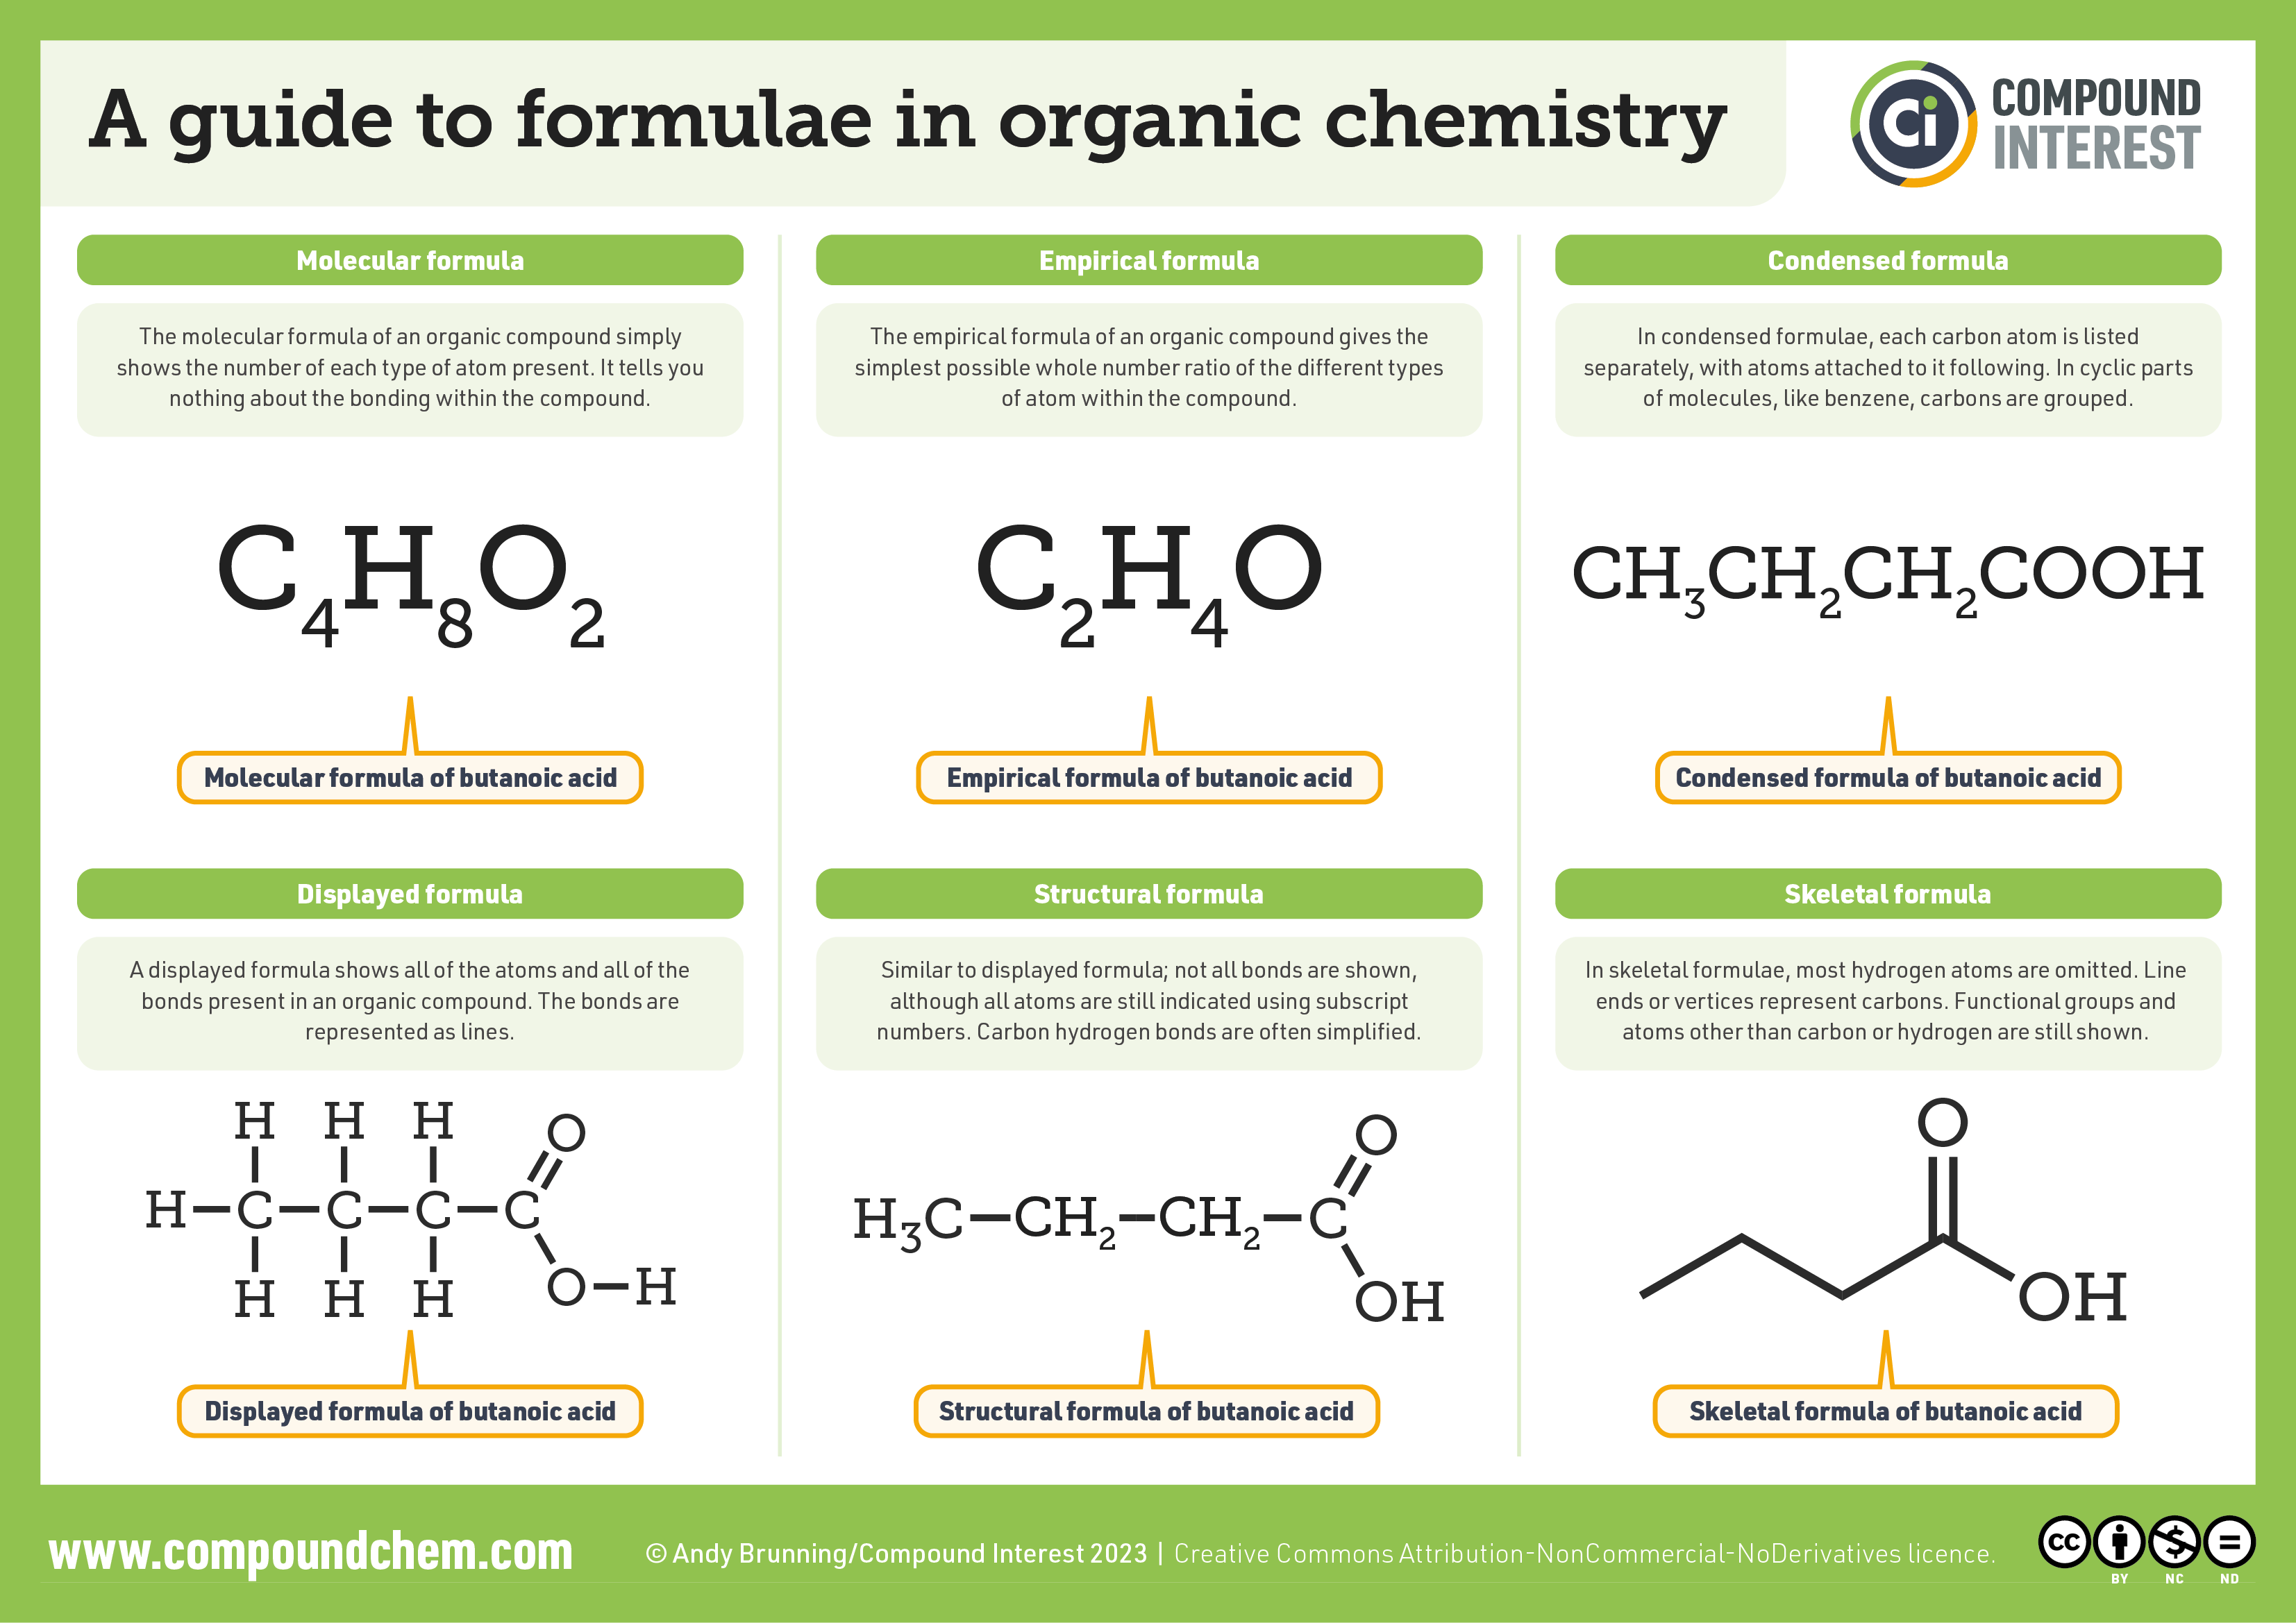
Draw an organic molecule

Slide 5
SO, which is your most favorite way of drawing a molecule?
Does skeletal formula omit necessary details, or add clarity?
Why do I always provide you the condensed formula on the worksheet?
Under what context, do you think a displayed formula is useful?

Slide 6
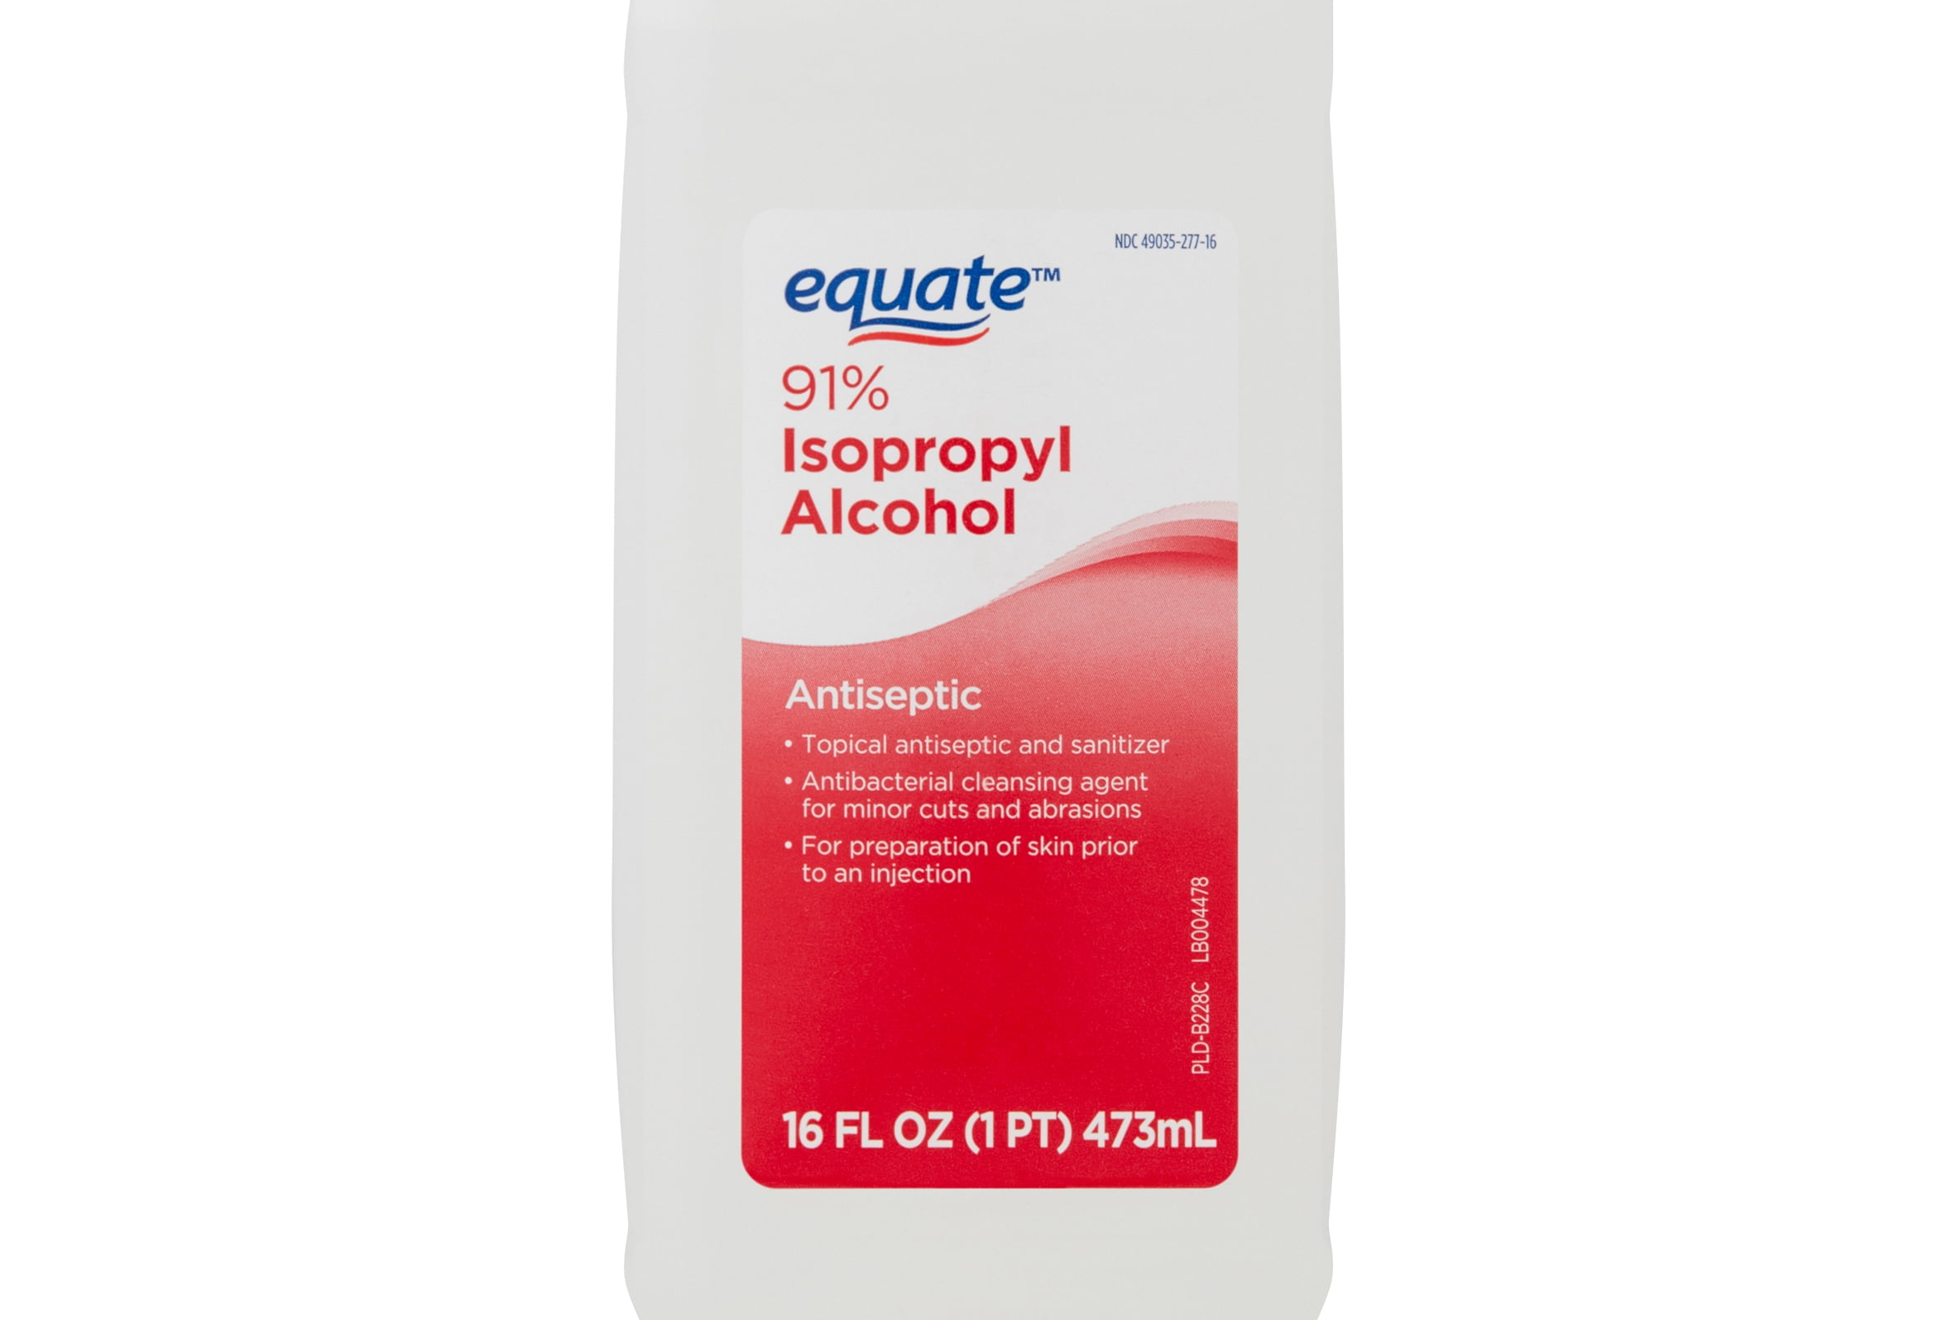
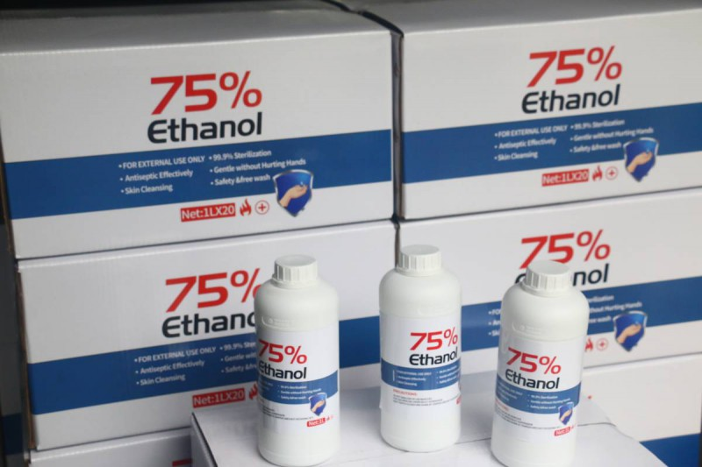
What is the antiseptic alcohol in our daily context?
CH(CH₃)₂OH
CH₃CH₂OH

Slide 7
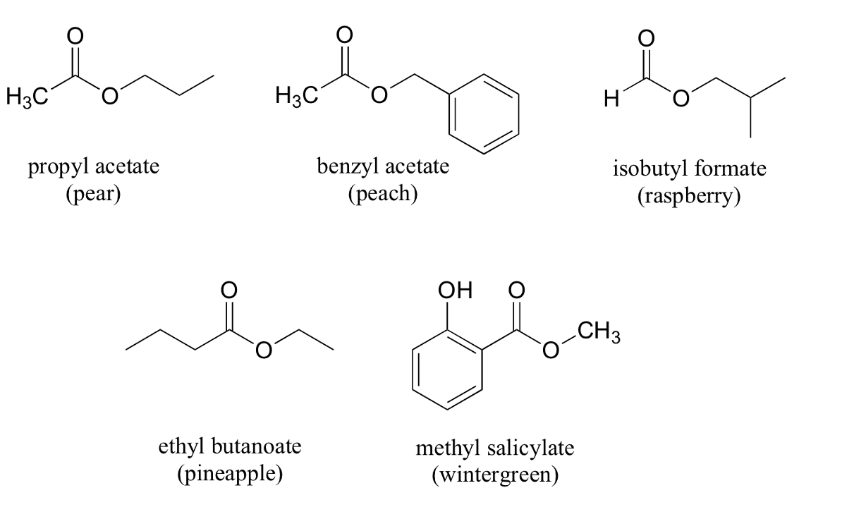
Why does fruit smell so good, and sometimes similar?

Slide 8
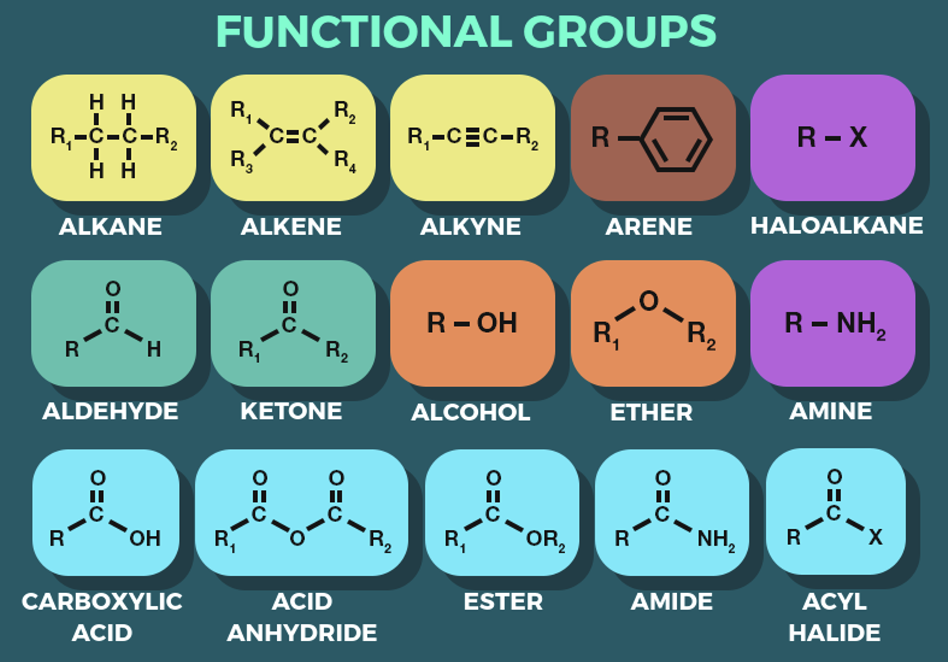
Functional group
A functional group is a specific atom or group of atoms within a molecule that is responsible for the characteristic chemical reactions of that compound.

Slide 9
Activity 2
Using the molecular kit, construct molecules that contain up to 6 carbons that have:
1 functional group
2 functional groups
3 functional groups
Draw it on your worksheet, and write down what type of formula you are drawing
Black=carbon Red=oxygen Blue=nitrogen White=hydrogen
Make it challenging as you want, but keep the 4-3-2-1 rule in mind.
You may share the kit, but return the balls and rods to its original box!

Slide 11
Activity 3
Pass your models to your neighbours
Draw down your neighbours’ molecular structure
Identify the functional group(s) presented in it.
Compare the structures you draw with its original owner’s.

Slide 12
Let’s call-back alcohol
So alcohol has different meaning in daily language and chemistry context.
Construct the alcohol that contains 1,2,3,4,5 carbons.
What are the similarities and difference?
A homologous series is a group of compounds with the same functional group, with successive members differing by -CH₂. Because of the same functional groups, these compounds have similar names and chemical properties.

Slide 13
Let’s work on alcohol again.
Use 4 carbons, 1 oxygen atoms, and as many hydrogen atoms as you need, and make only C-C single bonds
How many different alcohols can you build?
How many other functional-group molecule(s) can you build?
Keep in mind the 4-3-2-1 rule.
Compare and contrast these different molecules, how will you describe their similarities and difference?

Slide 14
Isomers
Isomers are molecules with same molecular formula, but different structural formula or spatial arrangement.
We will talk about isomerism in next class.

Slide 15
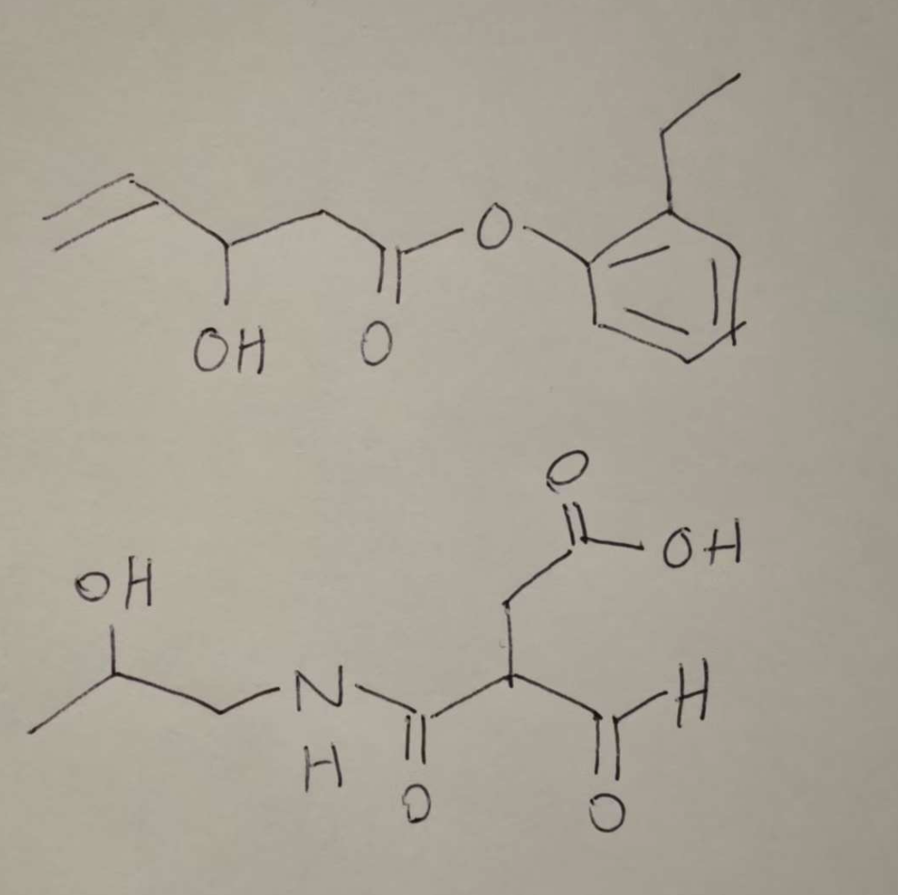
Quality check
Identify the functional group in these two molecules;
What is a homologous series?

