Slide 1
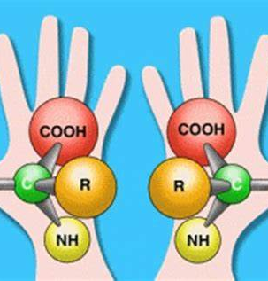

14.3 Isomerism

Slide 2
In this class, we will understand
How different types of isomers different from each other
Be able to sketch the carbon chain isomers
Understand the cis/trans isomer in biology context
Be able to define an optical isomers by identifying chiral center

Slide 3
Structural Isomer-Compounds with same molecular formula but different atomic connectivity.
Structural Isomer
Chain isomer
Functional-group isomer
Position isomer

Slide 4
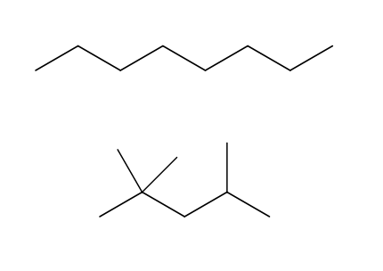
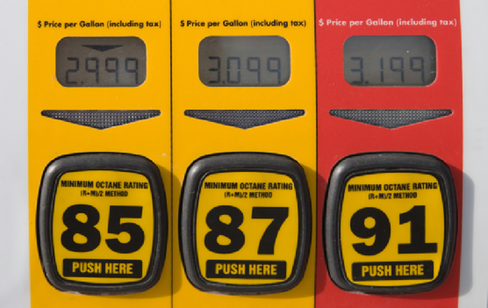
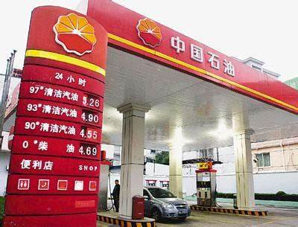
Chain isomer-the different branching pattern of the carbon atom chain
N-octane (0)
2,2,4-trimethyl
Pentane (100)
C₈H₁₈

Slide 5
Chain isomer-homework check
Construct the chain isomers of C₇H₁₆

Slide 6
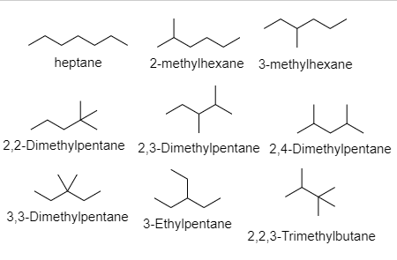
Chain isomers of C₇H₁₆

Slide 7
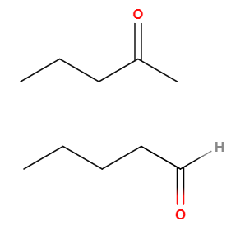
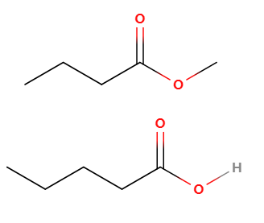
Functional group isomer
Ketone vs aldehyde Ester vs carboxylic acids

Slide 8
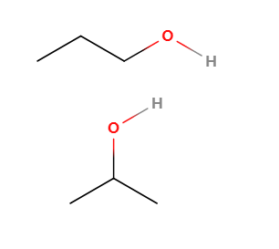
Position isomer
1-propanol vs 2-propanol

Slide 9
Stereoisomer-same molecular formula, same atomic connectivity, but different spatial arrangement

Slide 10
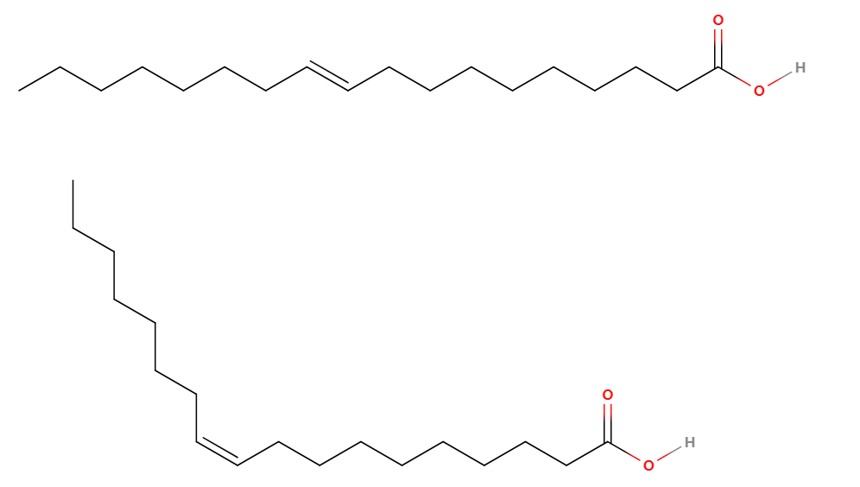
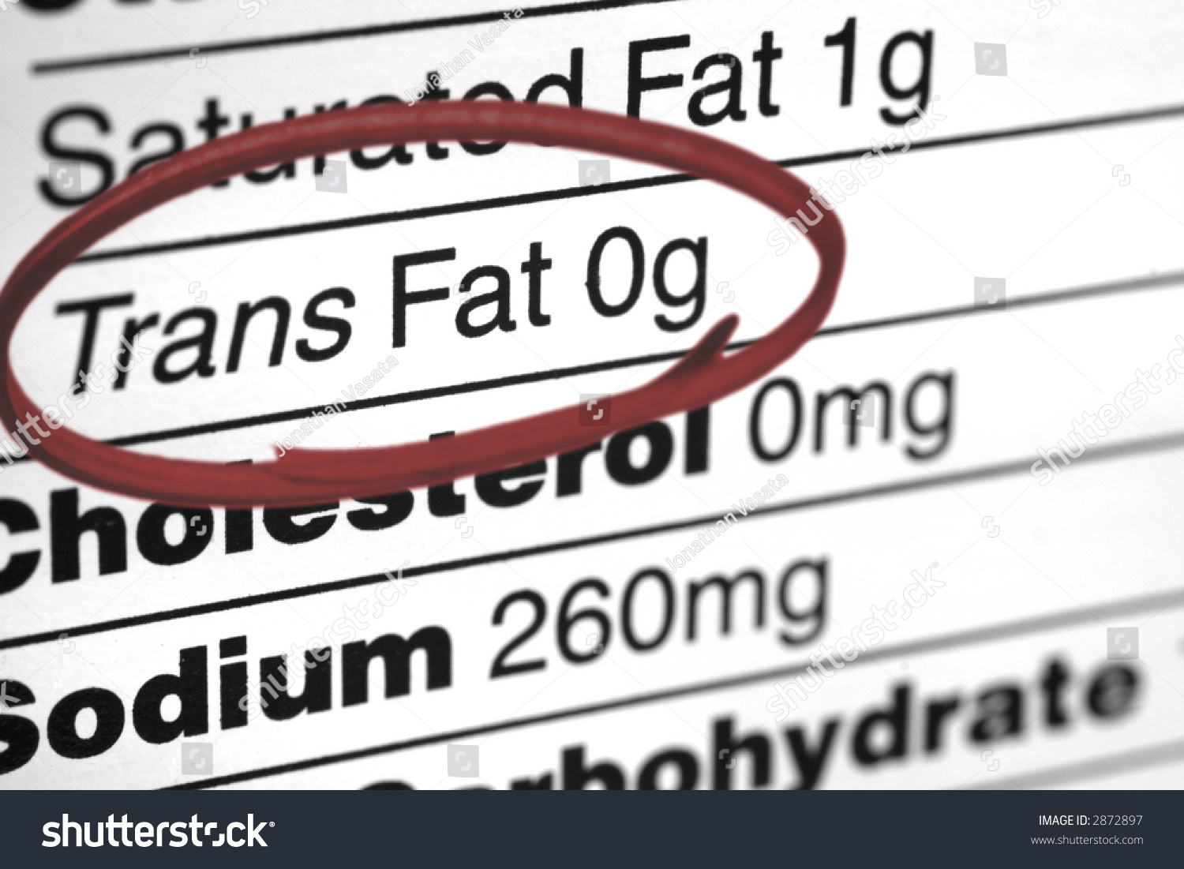
Cis/trans isomer (geometrical isomer)

Slide 11
Optical isomer
Optical isomers are stereoisomers with different light-rotation properties.
Optical isomers require a carbon center that are connected to four different atoms or groups.
This carbon is known as chiral center.

Slide 12
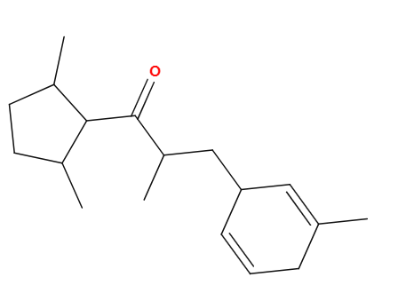
Identify the chiral carbons
How many chiral carbons can you identify in the molecule?

Slide 13
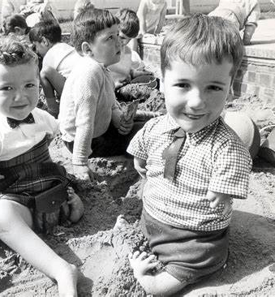
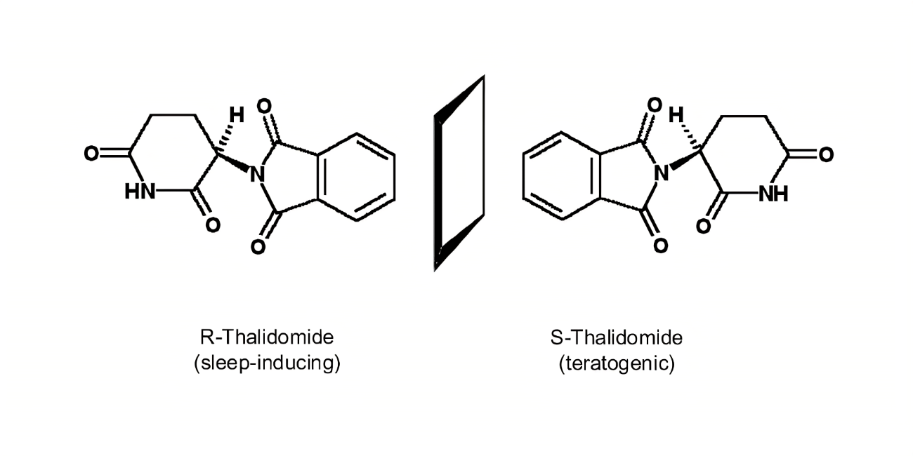
Optical isomer-the Thalidomide tragedy

Slide 14
Plenary
What’s the difference between structural and stereoisomer?
Can you draw a pair of functional group isomer not shown in the slides?
What defines a chiral carbon?

