Slide 1
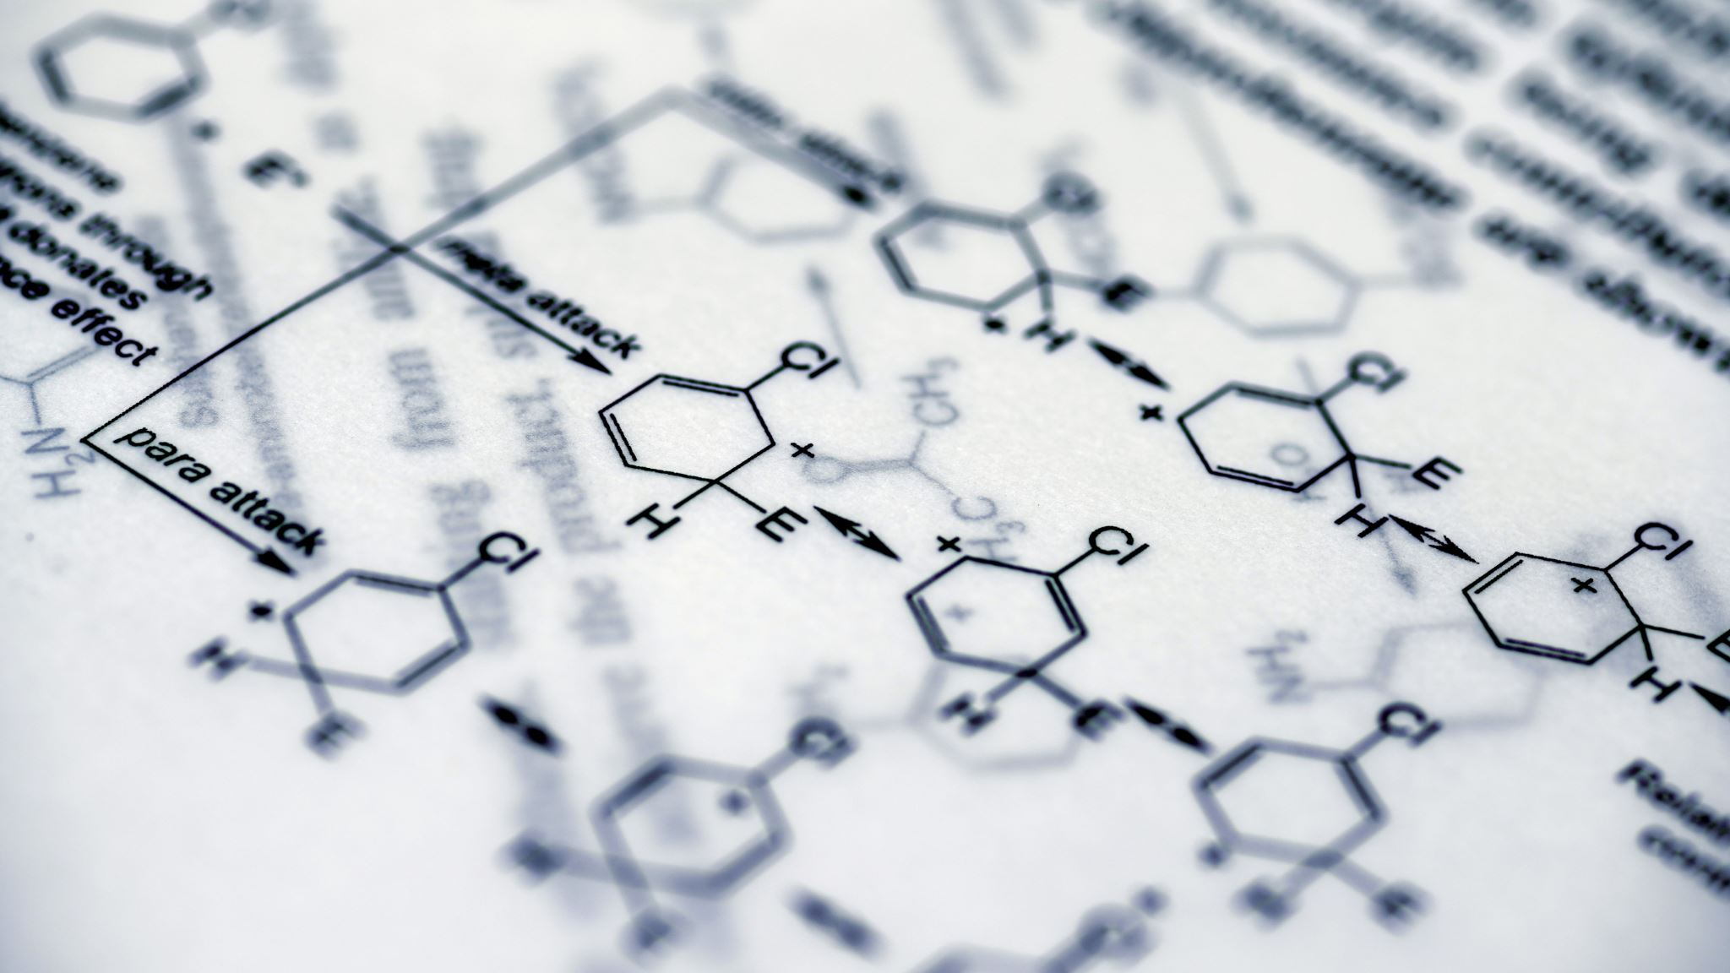
14.4 Naming of organic compounds

Slide 2
In this class, we will learn
How to name organic compounds such as alkane, alkene, alcohol, ketone, aldehyde, carboxylic acid, and ester up to 6 carbons
How to formulate (记口诀）the ways of naming an organic compounds

Slide 3
Naming organic compounds
Naming organic compounds properly can effectively communicate with others.
The name of the compounds and structures should be matched exclusively.
There are different naming conventions (RCS, IUPAC, old “common” names) present, and chemists of different regions and languages can usually understand each other, i.e. glacier acid vs acetic acid vs ethanoic acid.

Slide 4
Number of carbons
No. of carbons | Prefix | Adj. | No. of carbons | Prefix | Adj.
1 | Meth- | methyl | 6 | Hex- | hexyl
2 | Eth- | ethyl | 7 | Hept- | heptyl
3 | Prop- | propyl | 8 | Oct- | octyl
4 | But- | butyl | 9 | Non- | nonyl
5 | Pent- | pentyl | 10 | Dec- | decyl

Slide 5
General numerical prefix
No. | Prefix | No. | Prefix
1 | Mono- | 6 | Hexa-
2 | Di- | 7 | Hepta-
3 | Tri- | 8 | Octa-
4 | Tetra- | 9 | Nona-
5 | Penta- | 10 | Deca-

Slide 6
Test your memory!
4-carbon is called _____
The prefix for 6 is _____
3-carbon is called _____
5-carbon is called _____

Slide 7
Formula in learning
Many times, you can use a verbal formula to facilitate your learning of something that requires systematic memorization.
It doesn’t matter the language or formality you use, as long as it can facilitate with your learning.
I will share mine with you, but you are expected to formulate your own by the end of the class.

Slide 8
Organic naming formula
碳链找最长
老大靠前排
数序要一致
先后ABC
序数和最小

Slide 9
Alkane naming
Alkane is a compound with carbon and hydrogen only, and all C-C bond is single bond.
Alkane usually has a molecular formula of C_{n}H_{2n+2}
Alkane is named as carbon-number prefix+ane
Methane, Ethane, etc.

Slide 10
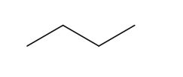

Practice
Name the following alkane.

Slide 11
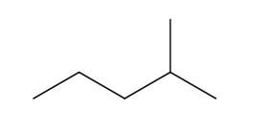
Now let’s look at the side chain
Find the longest carbon chain (碳链找最长）
Label the longest carbon chain in an order that the branch attaches to a lower-numbered carbon (序数和最小）
Describe the side chain using the adjective form of carbon number.
Position of side chain
Type of side chain
Main carbon chain
Suffix
Locant-Multiplier-Substituent prefix-Root-Locant-Functional group suffix

Slide 12
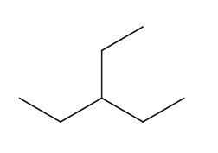
Practice

Slide 13
Multiple side chains
Find the longest carbon chain (碳链找最长）
Number the longest chain so the sum of numbering is the lowest （序数和最小）
Find all side chains and their positions
Put them on the side chain following the alphabetical order (先后ABC）
Put a multiplier in front of the side chain to indicate how many of the same type side chains on the structure. (数序要一致）

Slide 14
Practice-work individually and compare your results with your neighbors

Slide 15
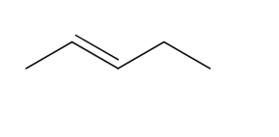
Alkene
Alkenes are carbon hydrogen compounds with carbon-carbon double bond
Alkene uses the suffix –ene
Why not trans pent-3-ene?
You need to number the key functional group in a lowering number. (老大靠前排）
pent-2-ene

Slide 16
Practice

Slide 17
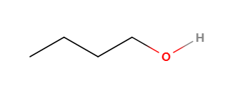
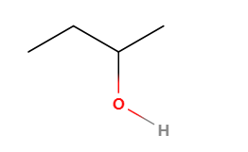
Alcohol
Alcohol contains the hydroxyl group –OH
Alcohol name starts from alkane and converts –ane to –anol
1-butanol or butan-1-ol
2-butanol or butan-2-ol

Slide 18
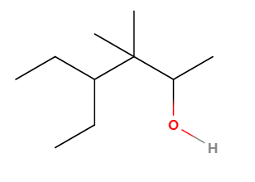
Practice

Slide 19
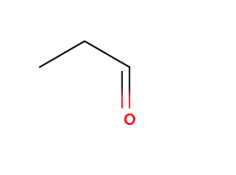
Aldehyde
Aldehyde contains the –CHO group
Aldehyde converts the –ane to –anal
DON’T FORGET THE C IN C=O DOUBLE BOND!
propanal
Why don’t you need to indicate which carbon the aldehyde group attaches to?

Slide 20
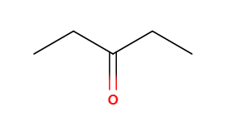
Ketone
Ketone contains C=O double bond on the mid of the carbon chain.
Ketone name converts –ane to –anone
Pentan-3-one

Slide 21
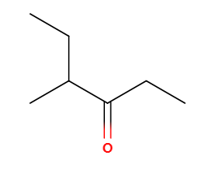
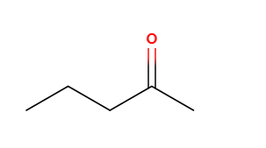
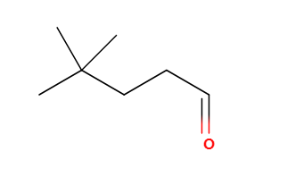
Practice

Slide 22
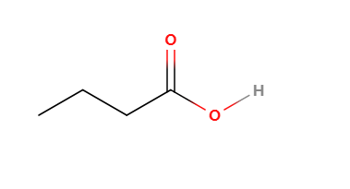
Carboxylic acid
Carboxylic acid has a –COOH group
Carboxylic acid converts the –ane to –anoic acid
Again, don’t forget the C in the C=O double bond!
Butanoic acid

Slide 23
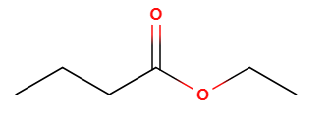
Ester
Ester has R-COO-R’ groups
Ester naming is a bit complicated
We start from the C-O single bond side, and name this part according to number of carbons, using the –yl adjective form
We then name the C=O double bond part using the number of carbons, with a suffix from –ane to –anoate.
Ethyl butanoate

Slide 24
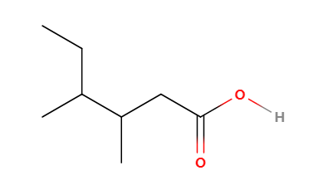
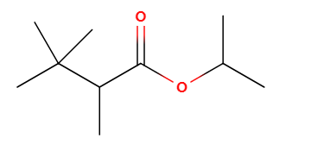
Practice

Slide 25
Plenary
Can you use either my formula, or yours, to recite the five principles in naming organic compound?
Can you recall the suffix for alkane, alkene, alcohol, aldehyde, ketone, carboxylic acid, and ester?

