Slide 1

2.2 An introduction to the glassware

Slide 2
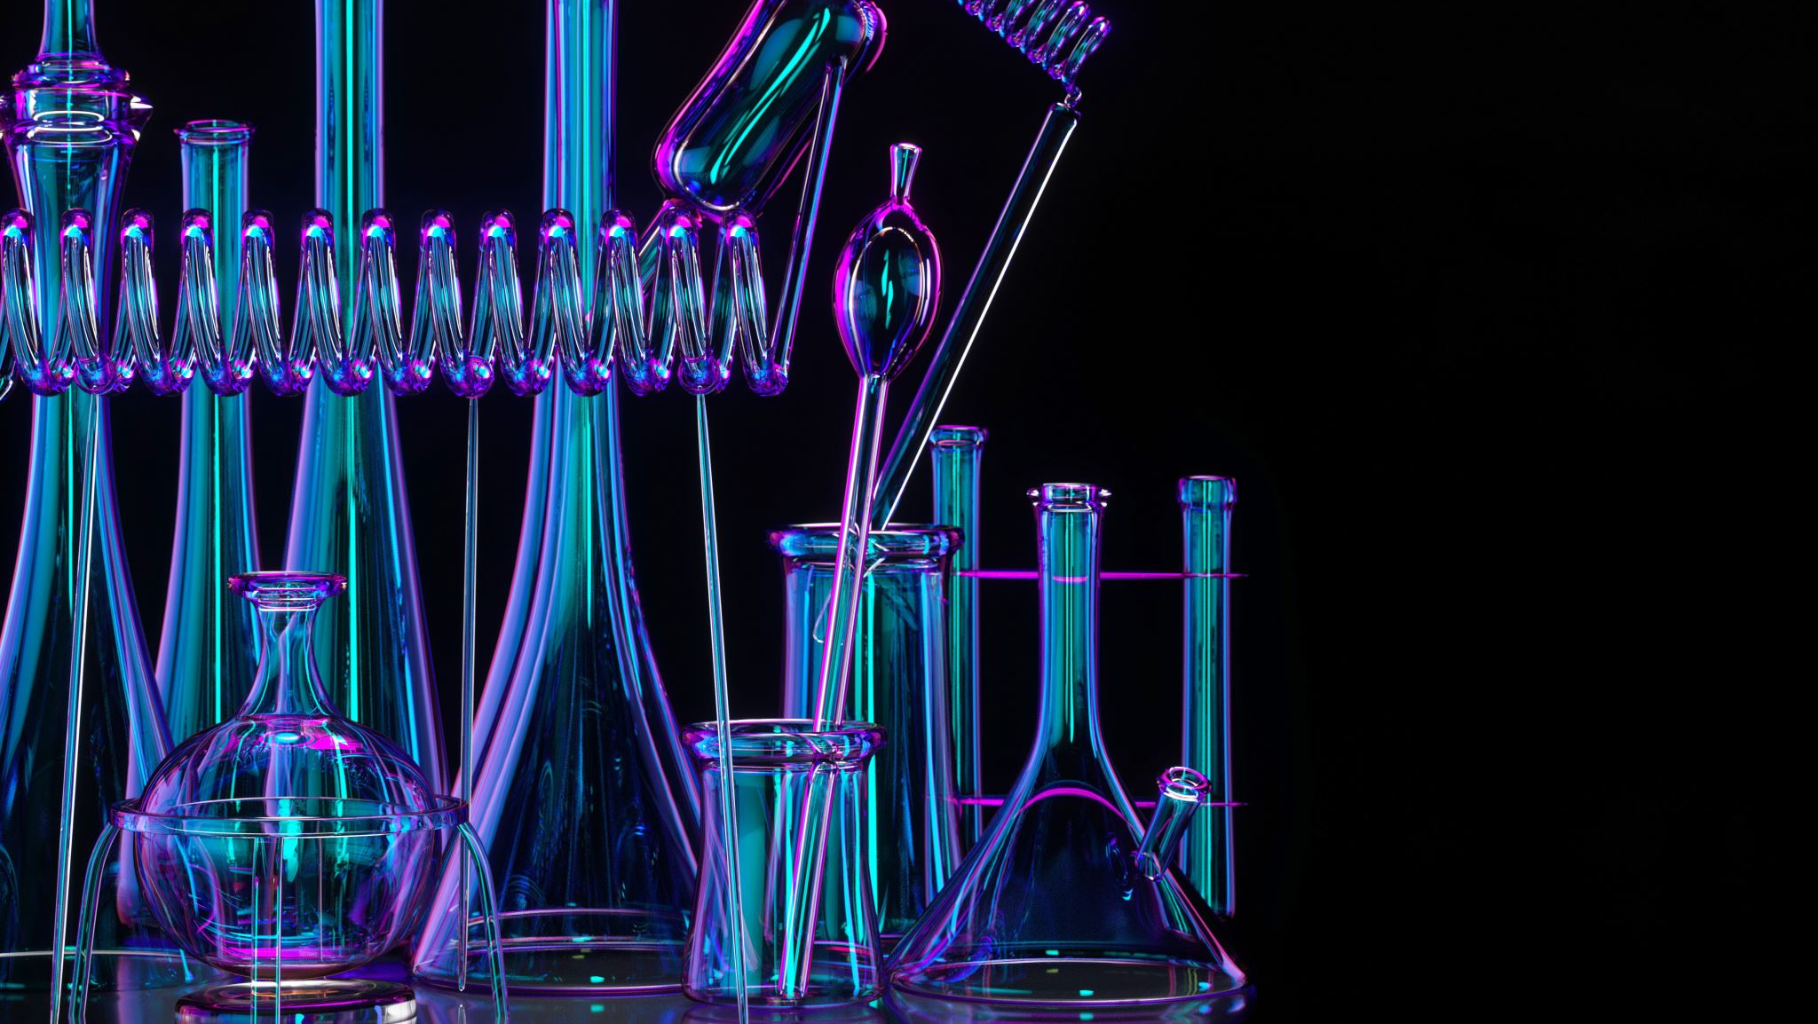
In this course, we will
learn the functions of different glassware
Understand their properties and limits
Identify the right apparatus to carry out specific experimental procedures

Slide 3
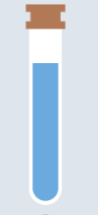

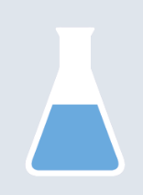
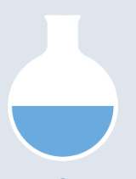
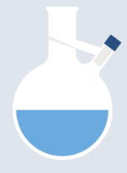
Containment and reaction
Containers are usually where reactions take place
Containers may NOT be used for volume measurement
Containers have multiple volume, choose the right volume is important!
Beakers
Erlenmeyer flasks
Test tubes
Reaction flasks

Slide 4

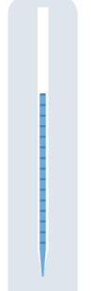
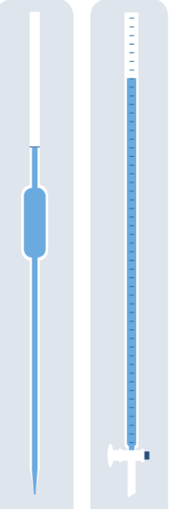
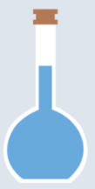
Measurement and dispensing
Measuring tools are glassware used to measure out specific number of volumes.
Their precision may vary, depend on your goals. So, choose the right glassware!
Reactions CANNOT undergo in the measuring tools. Neither heating.
Graduated cylinders
Burettes
Graduated pipettes
Volumetric flasks
Mechanical pipette

Slide 5
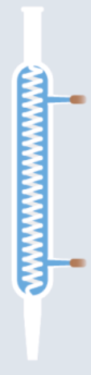

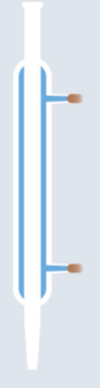
Heating and cooling
Glass beaker tongs
Crucibles and crucible tongs
Condensers
Distillation condenser
Reflux condenser
Watch glasses
Alcohol burner
Heating plate

Slide 6

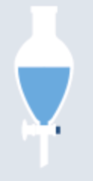
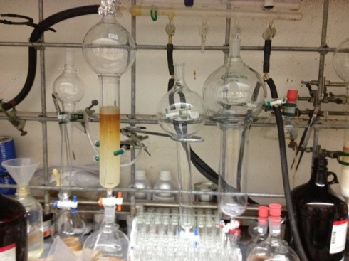
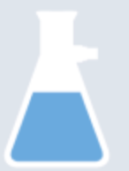
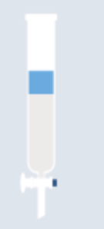
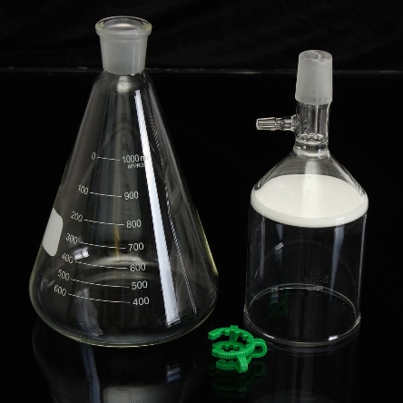
Filtration and separation
Glass funnel
Buchner funnel+flask
Separation funnel
Chromatography column

Slide 7
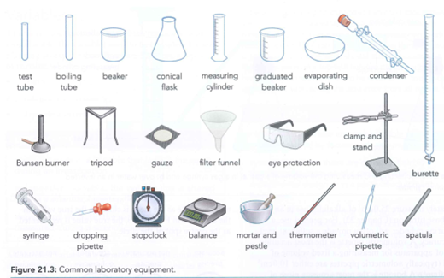
Others

Slide 8
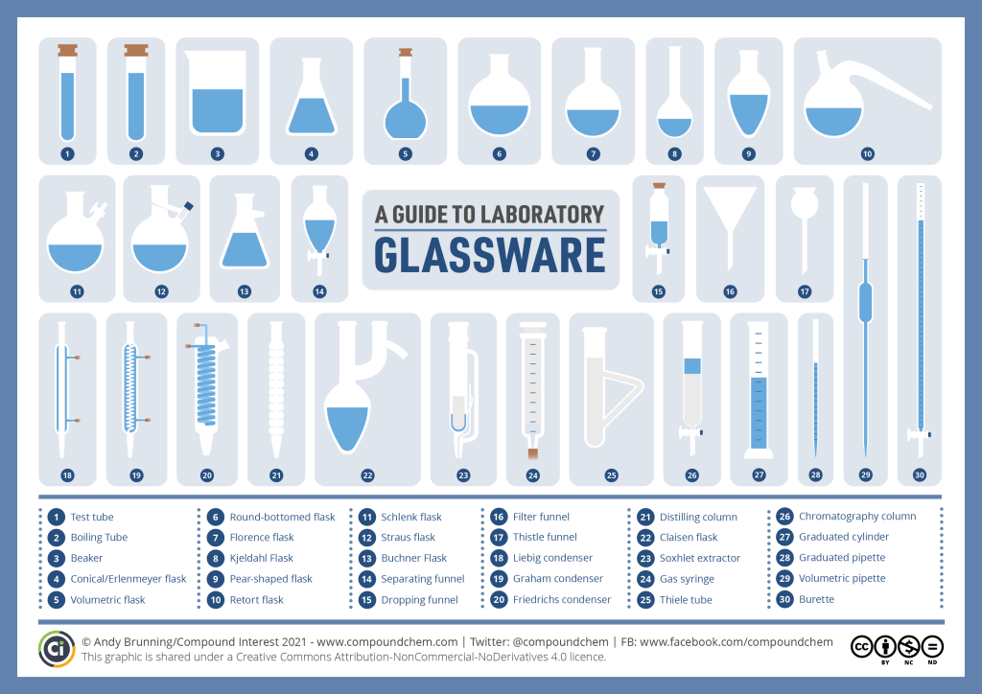

Slide 9
Homework
Remember the name of these above-mentioned common glassware and prepare for the in-class quiz next class

