Slide 1

Unit 5.2 Atomic Structure

Slide 2
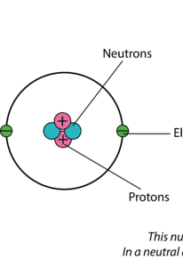
Mass and charge of subatomic particles
The mass and charge of an electron were determined by Millikan’s oil drop experiment.
Mass_{electron}= 9.1093837 × 10⁻³¹ kg Charge_{electron}= -1.602176634×10⁻¹⁹ C
The proton was observed by Goldstein’s canal ray experiment and named by Rutherford.
Mass_{proton}= 1.67262192369(51)×10⁻²⁷ kg Charge_{proton}=+1.602176634×10⁻¹⁹ C
The neutron was discovered and measured by James Chadwick
Mass_{neutron}=1.67492749804 × 10⁻²⁷ kg Charge_{neutron}=0

Slide 3
Summary of subatomic particles
Particle | Mass | Charge
Proton | 1 a.m.u | +1 e
Neutron | 1 a.m.u | 0
Electron | 1/1840 a.m.u | -1 e
a.m.u: atomic mass unit, 1 a.m.u.=1/12 ¹²C mass

Slide 4
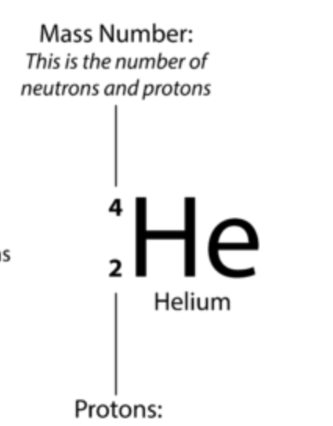
Understand of the atomic symbol
The proton number is the I.D. of an element. Same proton number, same element.
Every atom is charge neutral. Therefore, the proton number=electron number
The mass number is the sum of proton and neutron number
Remember! The mass number usually ≥ the proton number!
Proton number determines the identity of the element, electrons determine the radius and chemical properties of the element.

Slide 5
Practices
Element | # of protons | # of neutrons | # of electrons
Al |  | 14
 | 7 | 8
O²⁻ |  | 8
Fe³⁺ |  | 30
 | 9 | 10 | 12

Slide 6
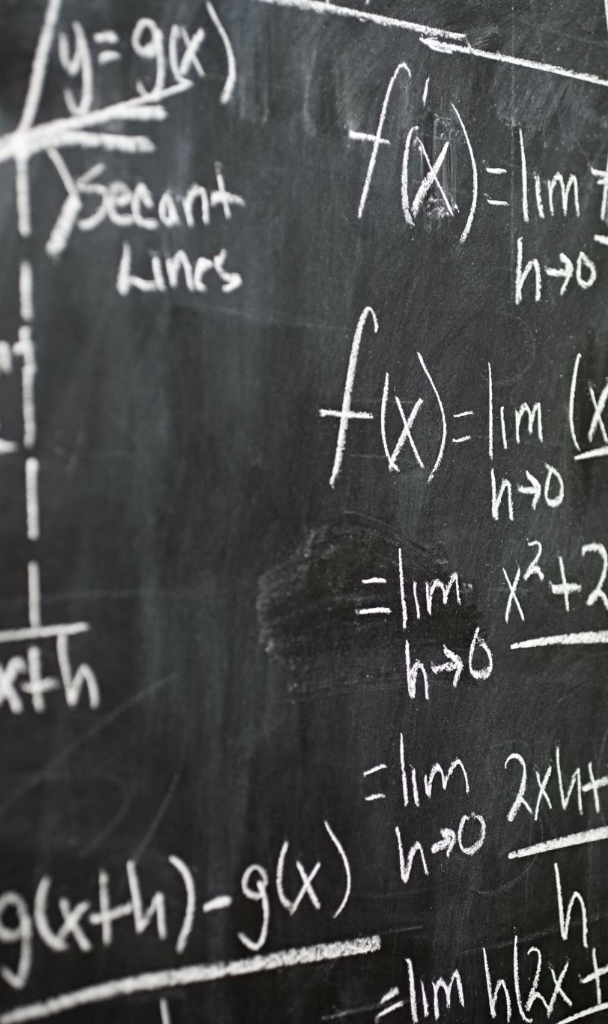
Let’s go back to a.m.u
If 1 a.m.u.= 1/12 of ¹²C mass…
Then mass of ¹² C = ?

Slide 7
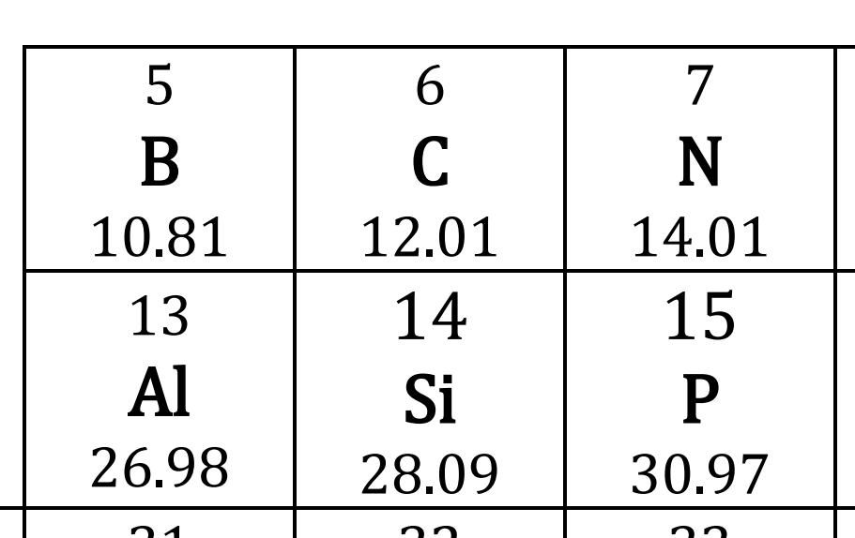
However…

Slide 8
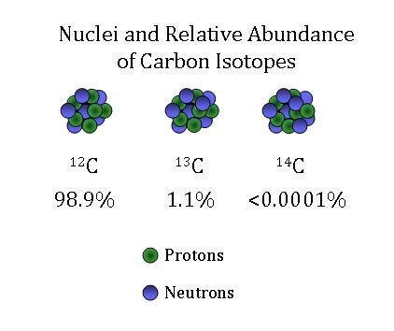
ISOTOPES
Elements with same proton number, but different numbers of neutrons and mass.
Carbon has three isotopes with different abundance.

Slide 9
Average atomic mass
Average Atomic Mass= mass_{isotope1} x abundance_{isotope1} + Mass_{isotope2} x abundance_{isotope2} + …..
Knowing chlorine has only two isotopes, ³⁵Cl and ³⁷Cl, and its average atomic mass is 35.5. Calculate the abundance of each isotope.

Slide 10
homework
Do a simple research on the mass spectroscopy, and explain how it works, and how it is used to determine the abundance of element isotopes.

