Slide 1


7.2 Ions and Ionic Bonds

Slide 2
In this Class, we will
Understand the electron configuration by using simple dot diagram and orbital diagram
Use octet rules to understand the formation of ions
Discuss the electronic configuration and the ionic bond
Understand the properties of ionic bonds, and compounds containing ionic bond

Slide 3
Electron Configuration
In the BP chemistry, we will use the circle and dot diagram to express the electron configuration, as well as the orbital diagram
Dots are drawn on circles outward, represents electrons are placed in inside orbitals first, then outside orbitals
This electron dot diagram is useful in conceptual understanding the atomic model, but it’s essentially wrong.
TOK Linkage- Can you think of a teaching model that teaches you something important but essentially wrong?

Slide 4
Draw the dot diagram
Practice draw the dot diagram for the following elements
He Be C Ne

Slide 5
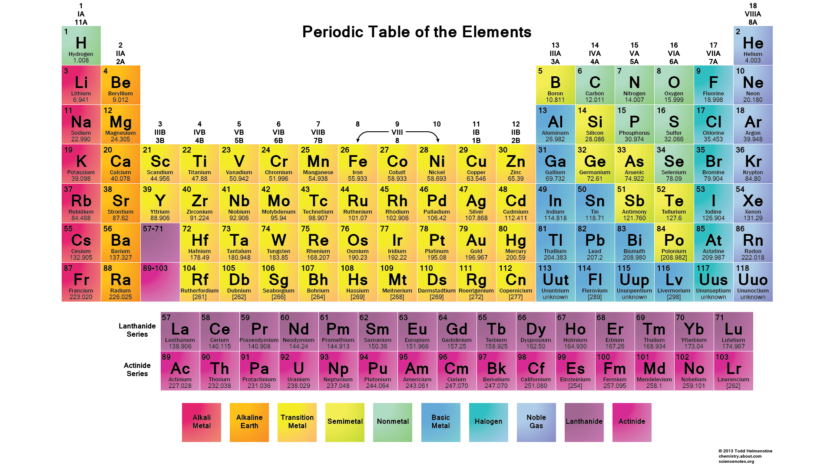
Electron Configuration and Group Number
How the electron configuration links to the group number for non-transition elements?

Slide 6
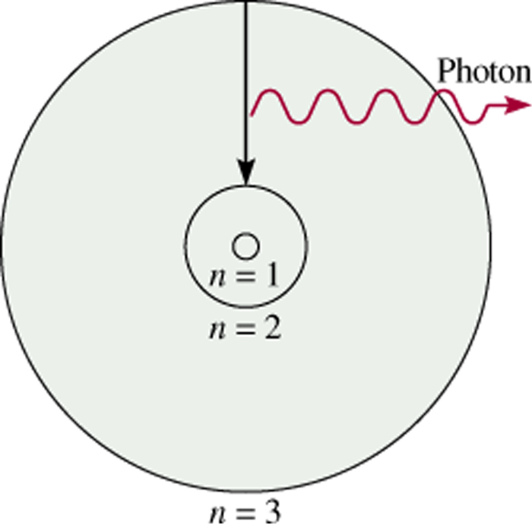
Bohr’s Model of
the Atom (1913)
e⁻ can only have specific (quantized) energy values
light is emitted as e⁻ moves from one energy level to a lower energy level
1
E_{n} = -R_{H}
( )
n²
n (principal quantum number) = 1,2,3,…
R_{H} (Rydberg constant) = 2.18 x 10⁻¹⁸J

Slide 7
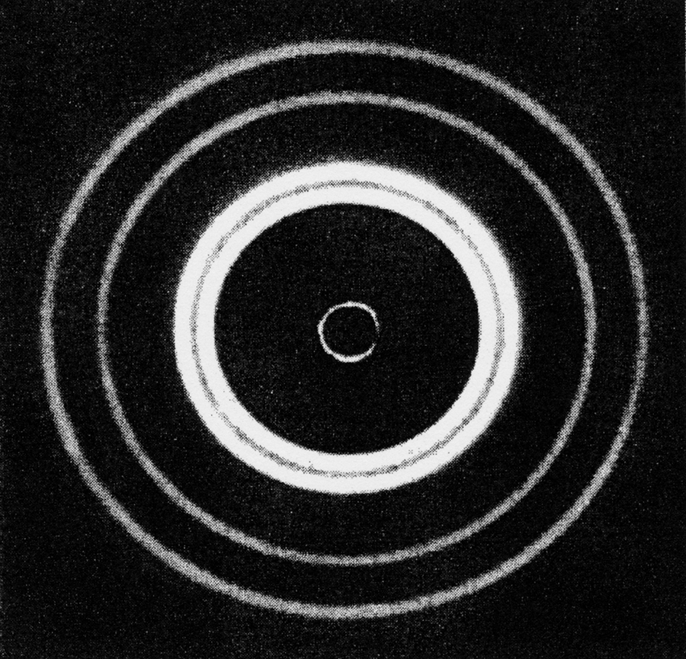
Schrodinger Wave Equation
In 1926 Schrodinger wrote an equation that described both the particle and wave nature of the e⁻
Wave function (Ψ) describes:
. energy of e⁻ with a given Ψ
. probability of finding e⁻ in a volume of space
Schrodinger’s equation can only be solved exactly for the hydrogen atom. Must approximate its solution for multi-electron systems.
7.5

Slide 8
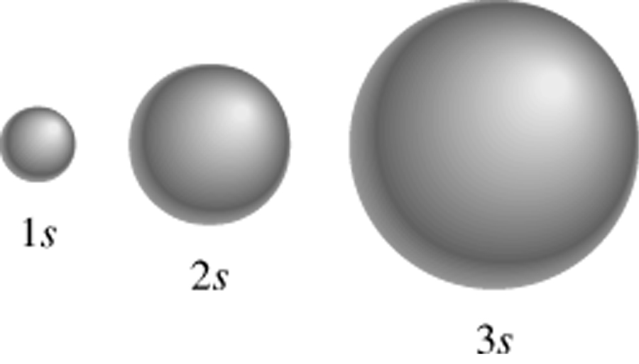
Schrodinger Wave Equation
Ψ = fn(n, l, m_{l}, m_{s})
principal quantum number n
n = 1, 2, 3, 4, ….
distance of e⁻ from the nucleus
n=1
n=2
n=3
7.6

Slide 9
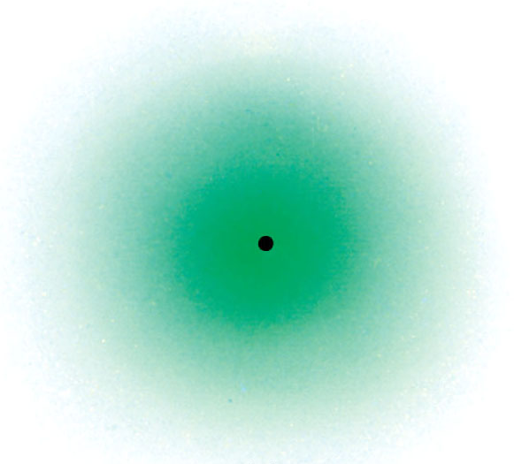
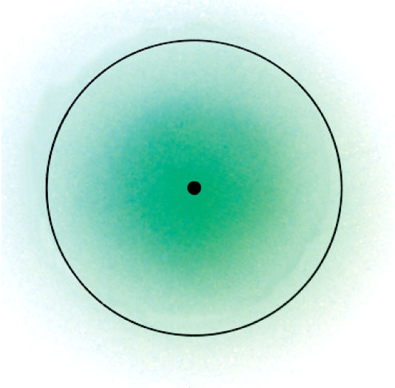
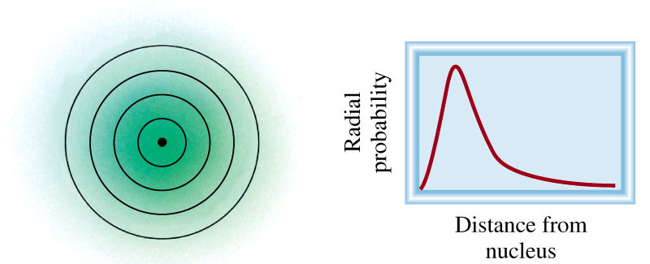
Where 90% of the
e⁻ density is found
for the 1s orbital
7.6

Slide 10
Schrodinger Wave Equation
Ψ = fn(n, l, m_{l}, m_{s})
angular momentum quantum number l
for a given value of n, l = 0, 1, 2, 3, … n-1
l = 0 s orbital
l = 1 p orbital
l = 2 d orbital
l = 3 f orbital
n = 1, l = 0
n = 2, l = 0 or 1
n = 3, l = 0, 1, or 2
Shape of the “volume” of space that the e⁻ occupies
7.6

Slide 11
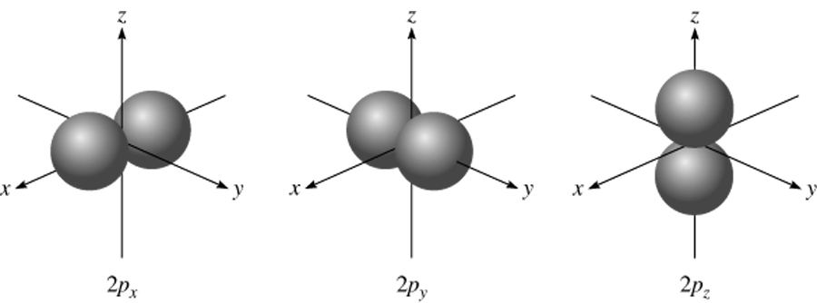
l = 0 (s orbitals)
l = 1 (p orbitals)
7.6

Slide 12
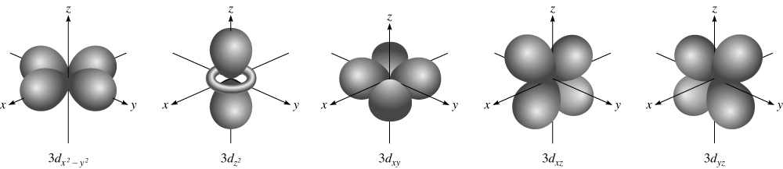
l = 2 (d orbitals)
7.6

Slide 13
Schrodinger Wave Equation
Ψ = fn(n, l, m_{l}, m_{s})
magnetic quantum number m_{l}
for a given value of l
m_{l} = -l, …., 0, …. +l
if l = 1 (p orbital), m_{l} = -1, 0, or 1
if l = 2 (d orbital), m_{l} = -2, -1, 0, 1, or 2
orientation of the orbital in space
7.6

Slide 14
m_{l} = -1
m_{l} = 0
m_{l} = 1
m_{l} = -2
m_{l} = -1
m_{l} = 0
m_{l} = 1
m_{l} = 2
7.6

Slide 15
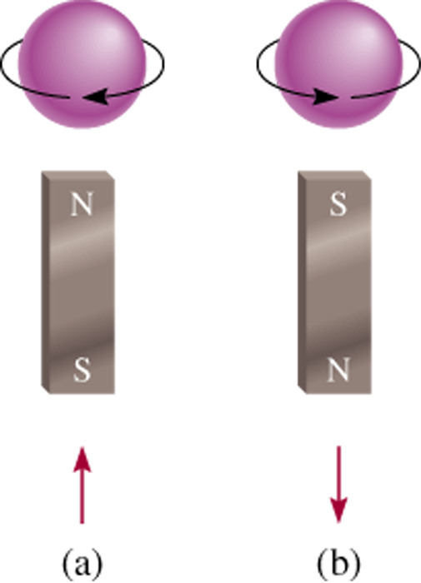
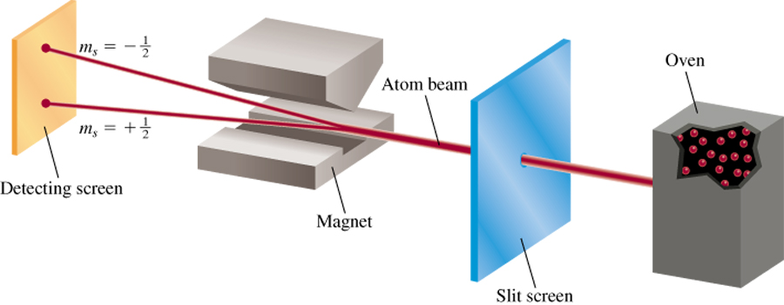
Schrodinger Wave Equation
Ψ = fn(n, l, m_{l}, m_{s})
spin quantum number m_{s}
m_{s} = +½ or -½
m_{s} = +½
m_{s} = -½
7.6

Slide 16
Schrodinger Wave Equation
Ψ = fn(n, l, m_{l}, m_{s})
Existence (and energy) of electron in atom is described
by its unique wave function Ψ.
Pauli exclusion principle - no two electrons in an atom
can have the same four quantum numbers.
Each seat is uniquely identified (E, R12, S8)
Each seat can hold only one individual at a time
7.6

Slide 17
Schrodinger Wave Equation
Ψ = fn(n, l, m_{l}, m_{s})
Shell – electrons with the same value of n
Subshell – electrons with the same values of n and l
Orbital – electrons with the same values of n, l, and m_{l}
How many electrons can an orbital hold?
If n, l, and m_{l} are fixed, then m_{s} = ½ or - ½
Ψ = (n, l, m_{l}, ½)
or Ψ = (n, l, m_{l}, -½)
An orbital can hold 2 electrons
7.6

Slide 18
How many 2p orbitals are there in an atom?
n=2
If l = 1, then m_{l} = -1, 0, or +1
2p
3 orbitals
l = 1
How many electrons can be placed in the 3d subshell?
n=3
If l = 2, then m_{l} = -2, -1, 0, +1, or +2
3d
5 orbitals which can hold a total of 10 e⁻
l = 2
7.6

Slide 19
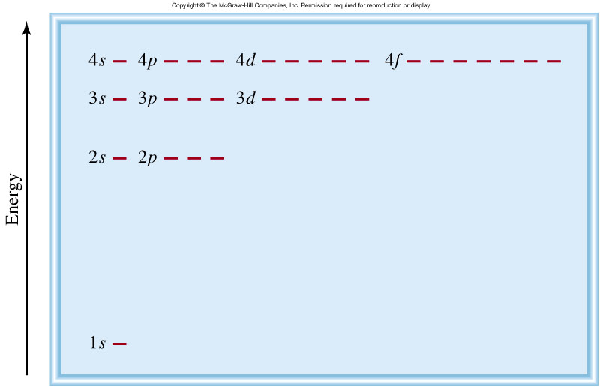
Energy of orbitals in a single electron atom
Energy only depends on principal quantum number n
n=3
n=2
1
E_{n} = -R_{H}
( )
n²
n=1
7.7

Slide 20
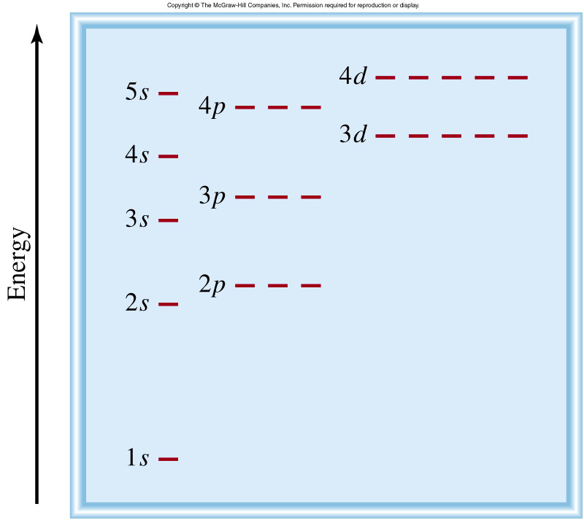
Energy of orbitals in a multi-electron atom
Energy depends on n and l
n=3 l = 2
n=3 l = 1
n=3 l = 0
n=2 l = 1
n=2 l = 0
n=1 l = 0
7.7

Slide 21
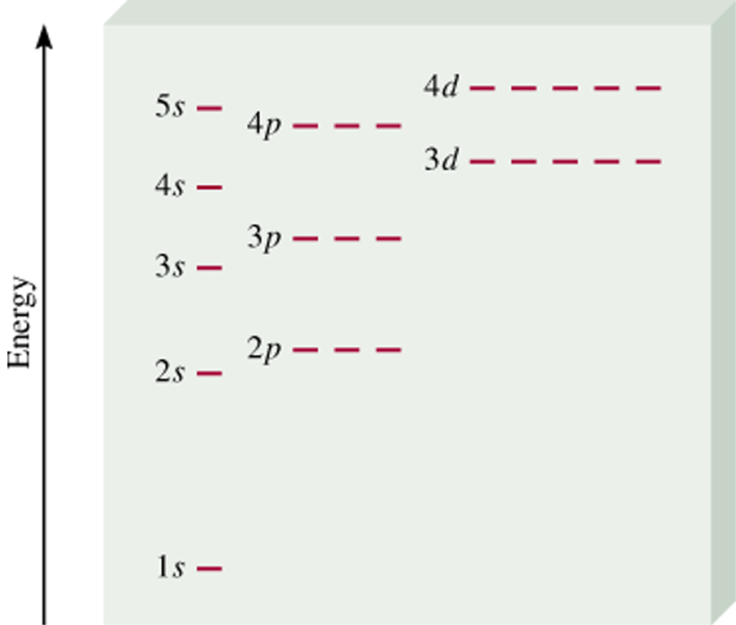
“Fill up” electrons in lowest energy orbitals (Aufbau principle)
?
?
7.9

Slide 22
The most stable arrangement of electrons in subshells is the one with the greatest number of parallel spins (Hund’s rule).
7.7

Slide 23
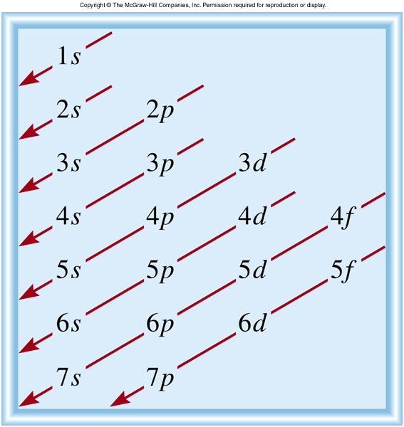
Order of orbitals (filling) in multi-electron atom
1s < 2s < 2p < 3s < 3p < 4s < 3d < 4p < 5s < 4d < 5p < 6s
7.7

Slide 24
Electron configuration is how the electrons are distributed among the various atomic orbitals in an atom.
number of electrons
in the orbital or subshell
1s¹
principal quantum
number n
angular momentum
quantum number l
Orbital diagram
H
1s¹
7.8

Slide 25
What is the electron configuration of Mg?
Mg 12 electrons
1s < 2s < 2p < 3s < 3p < 4s
1s²2s²2p⁶3s²
2 + 2 + 6 + 2 = 12 electrons
Abbreviated as [Ne]3s²
[Ne] 1s²2s²2p⁶
What are the possible quantum numbers for the last (outermost) electron in Cl?
Cl 17 electrons
1s < 2s < 2p < 3s < 3p < 4s
1s²2s²2p⁶3s²3p⁵
2 + 2 + 6 + 2 + 5 = 17 electrons
Last electron added to 3p orbital
n = 3
l = 1
m_{l} = -1, 0, or +1
m_{s} = ½ or -½
7.8

Slide 26

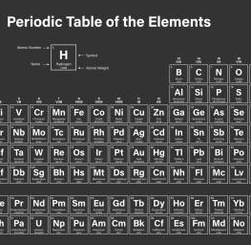
What are octet rules?
Elements have the tendency to achieve the noble gas configuration with eight (8) electrons in the valence shells.
Metals have a tendency to lose electrons to form positive ions/cations
Non-metals can either lose or gain electrons to form cations or anions.

Slide 27
Ions formation and Octet Rule
Use Octet Rule to draw ion formation of the following element
K Cl Li N

Slide 28
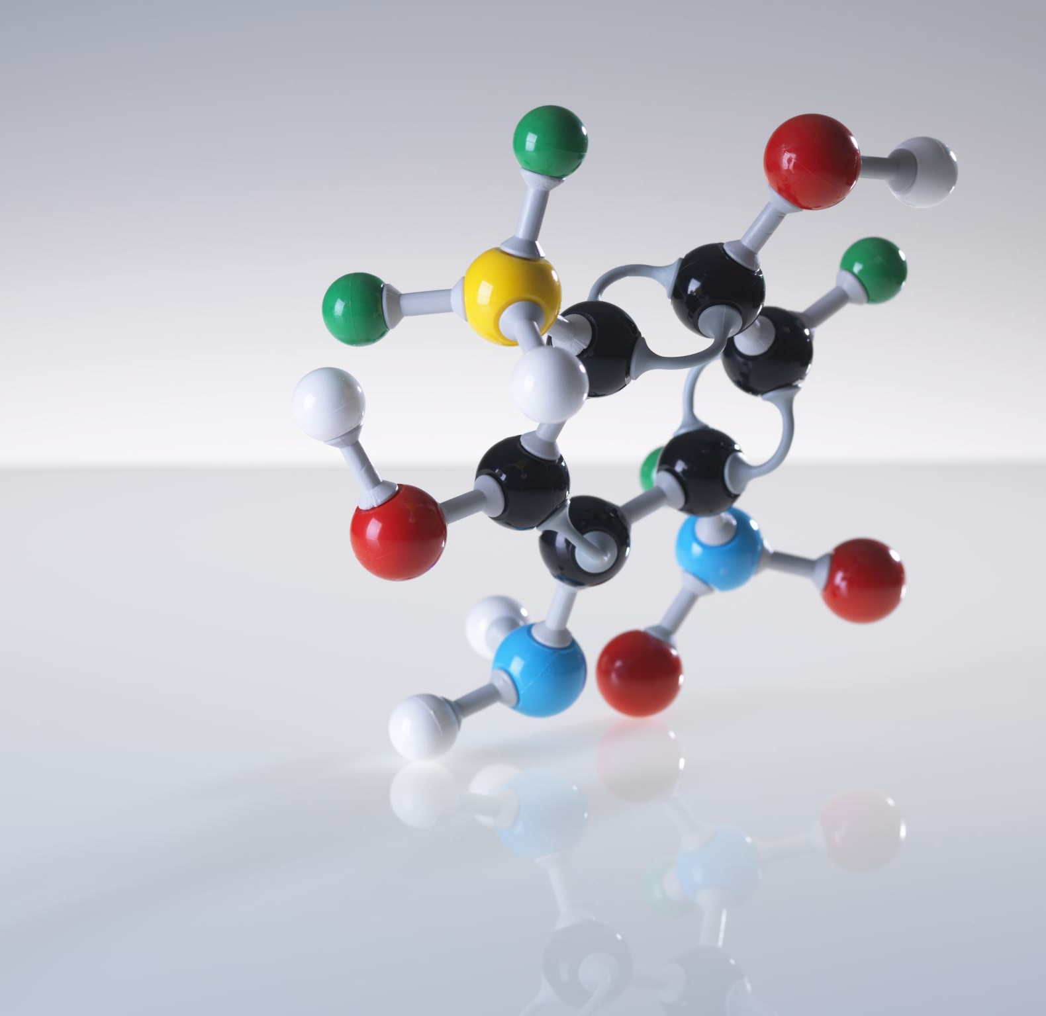
Chemical Bonds
A chemical bond is a lasting attraction between atoms or ions that enables the formation of molecules and crystals. The bond may result from the electrostatic force between oppositely charged ions as in ionic bonds, or through the sharing of electrons as in covalent bonds.

Slide 29
Now let’s take a look at the ionic bond
Ionic bonds formed between metal and non-metal elements
Ionic bonds formed between the cations and anions through electromagnetic attraction
Ionic bonds are formed through the TRANSFER of electrons

Slide 30
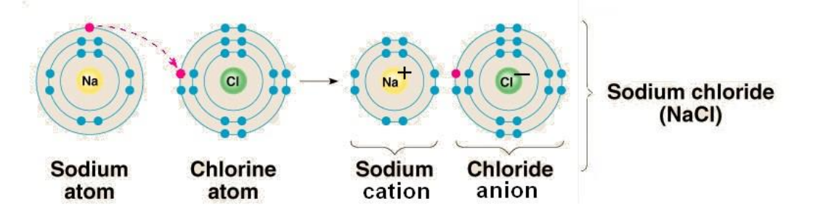
How electrons are TRANSFERRED?

Slide 31

Practice
Use sodium chloride as an example, use dot diagram of each element and explain how MgCl₂ and Al₂O₃ are formed.

Slide 32

A Conceptual Understanding
What determines the strength of the attraction between cations and anions?

Slide 33
Compounds containing ionic bond
Compounds containing ionic bonds are called ionic compound.
Ionic compounds are hard and bristle
Ionic compounds usually have high melting and boiling point
Ionic compounds do not conduct electricity in solid state but conducts electricity in aqueous or molten state.
They have different abilities to conduct electricity in aqueous state.

Slide 34
Practice
Identify which of the following compounds are ionic compounds
HCl MgSO₄ Graphite(石墨）
C₆H₁₂O₆ P₂O₅ H₂SO₄

Slide 35
Class Demo- Strong and Weak Electrolyte
Electrolyte
Chemicals able to conduct electricity in aqueous state
Electrolytes are not necessarily ionic compounds
A strong electrolyte is an electrolyte that dissolves almost completely in water. An example of a strong electrolyte is Hydrogen Chloride (HCl). A weak electrolyte is an electrolyte that doesn't dissolve completely in water.

Slide 36
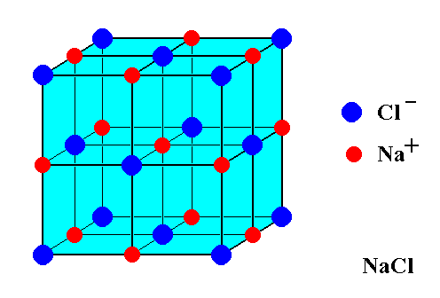
What is NaCl?
As a result of these electrostatic forces of attraction, each ion is surrounded by opposite charge ions which give rise to the formation of a three-dimensional solid ionic crystal lattice.
A crystal is a solid whose constituent particles are arranged in space following a pattern to form geometric figures.

Slide 37
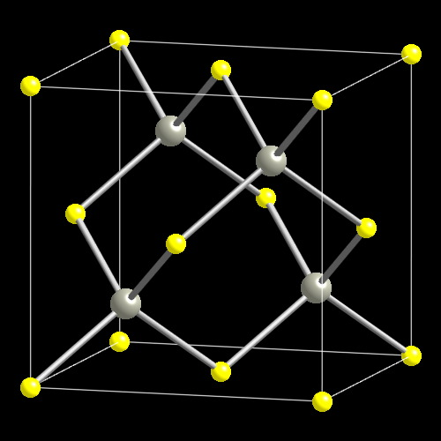
Derive the formula

Slide 38
Take Home Message
Ionic Bonds are formed between metal and non-metal through cations and anions attraction
Ionic bond represents the TRANSFER of electrons.
Compounds containing ionic bonds are ionic compounds.
Ionic compounds can conduct electricity in molten and aqueous state.
We use empirical formula and formula mass for ionic compounds.

