Slide 1

9.5 Electrolysis in Aqueous State

Slide 2

Warm-up
Write the half reactions on each electrode in the following electrolytic cell
MgI_{2(l)}
Ag₂S_{(l)}
How to extract Zn from ZnO? How to extract gold from gold ore?
Recall your junior school knowledge, what the meaning of being acidic, basic, or neutral?

Slide 3

In today’s class, we will learn
The role of water and its ionic properties
How cations and anions compete in aqueous solution
How does solution concentration affect the product of electrolysis
The details of electroplating

Slide 4
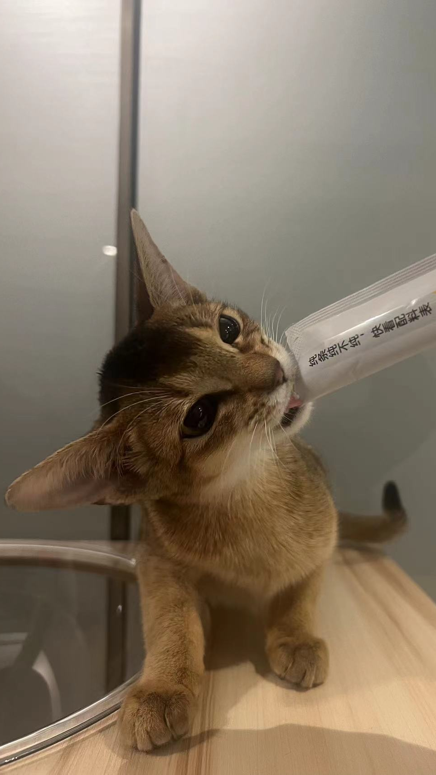
Water
Water is a molecular compound according to its type of bonds.
However, water undergoes a process called “autoionization”
H₂O_{(l)} ←→H⁺ _{(aq)} + OH⁻ _{(aq)}
This process is a spontaneous process and offers water properties such as being a neutral good solvent.
Link to our previous knowledge, how to explain this?

Slide 5
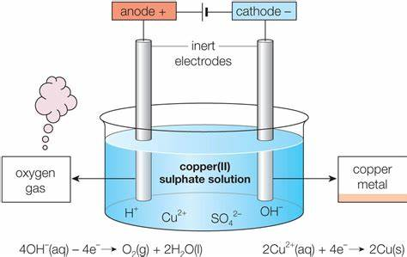
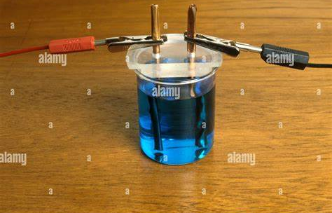
Electrolytic cell in aqueous state

Slide 6

Let’s look at the ions in the solution
Cations | Anions
Cu²⁺ | SO₄²⁻
H⁺ | OH⁻
What is the destination of each ion, and who is going to lose or gain electrons?
Standard Reduction Potential

Slide 7
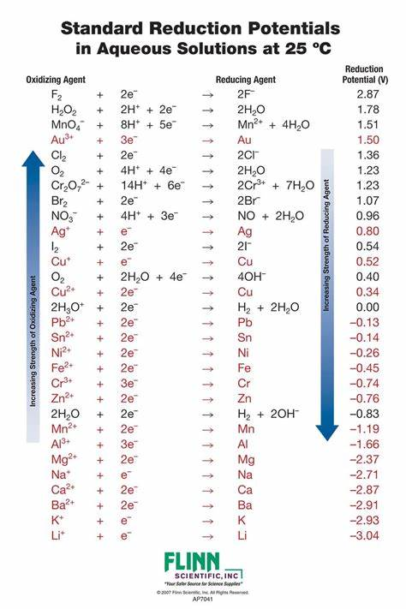
Standard Reduction Potential
In simple words, standard reduction potential indicates the preference of a substance or particle to gain electrons and being reduced.
In the BP phase, we can simply understand this as…
IF THE CATION IS LESS REACTIVE THAN HYDROGEN ION, IT WILL BE REDUCED FIRST (i.e. Cu²⁺, Ag⁺, Au⁺)
IF THE ANION IS MORE REACTIVE THAN HYDROXIDE, IT WILL BE OXIDIZED FIRST (i.e. F⁻ Cl⁻ Br⁻ I⁻)
So in CuSO₄ example,
Cu²⁺ + 2e⁻ → Cu
4OH⁻ - 4e⁻ → O₂ + 2H₂O

Slide 8
Practice
Work on the following example, and write their half reaction on the electrodes
Substance | Anode | Cathode
HCl_{(aq)}
NaOH_{(aq)}
CuCl_{2(aq)}
Na₂SO_{4(aq)}

Slide 9
A mindset in problem-solving
Molten or aqueous?
Is the cation from a non-reactive metal?
Yes
No
Is the anion from a halogen?
Yes
No

Slide 10
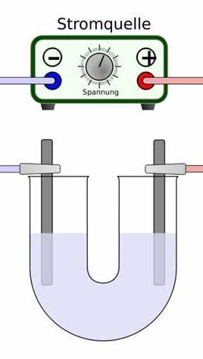
How does concentration affect the products?
What are the electrolysis products of dilute NaCl solution? Concentrated NaCl solution?
Class-demo

Slide 11
Demo observation
What’s the function of litmus?
What color change can you observe?
What does the color change indicate?
What’s the final product of electrolyzing concentrated NaCl solution?
What conclusion can you make?

Slide 12
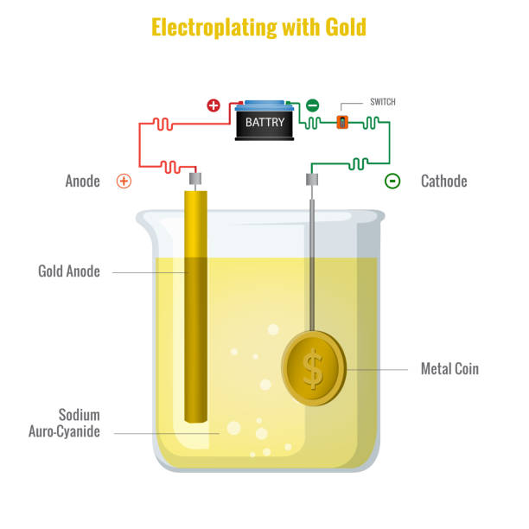
Electroplating in aqueous state
What happens on each electrode?
What can you observe on each electrode?
Let’s do the demo!

Slide 13

Plenary session
Use your own words, how to derive the products of electrolysis in aqueous state?
How to plate copper on a stainless-steel surface?

