Slide 1
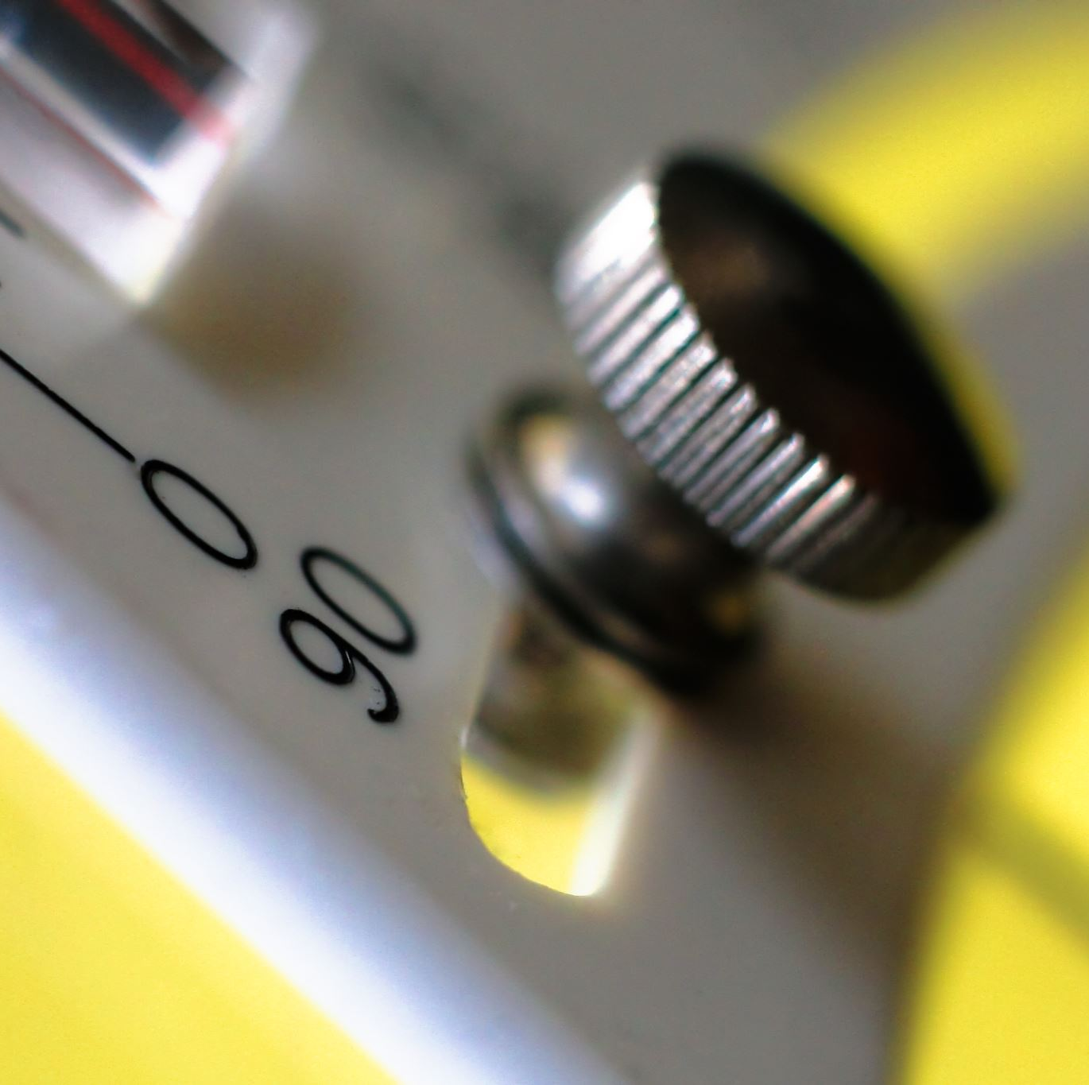
9.3 Calorimetry-An Experimental Approach to Enthalpy Change
Mar.20th 2025

Slide 2
Warm-up
What’s the enthalpy change of a chemical reaction?
What approach did we learn to calculate the enthalpy change?
As a lab science, experiment is the fundamental approach to quantitatively determine the properties of chemical reactions.

Slide 3
In this class, we will learn
How calorimeter approaches to calculate the heat change of a chemical reaction
How to chemical and physical formula to determine the enthalpy change of a reaction
What is the source of errors in calorimetry method

Slide 4
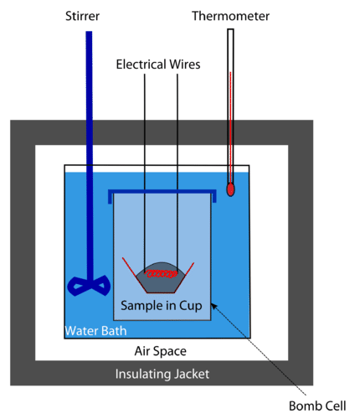
Calorimetry
Calorimetry is the measurement of the transfer of heat into or out of a system during a chemical reaction or physical process.
A calorimeter is an insulated container that is used to measure heat changes.

Slide 5
Assumptions made in calorimetry
The entire calorimeter is an isolated system, while the bomb chamber is a closed system.
The reaction is complete
The stirrer, thermometer, bomb chamber do not absorb or retain any heat.
The electrical spark does not provide any heat.

Slide 6


Physical theories behind
The temperature change of the water is measured in the experiment and the specific heat of water can be used to calculate the heat absorbed by the surroundings (q_{surr}).
The heat absorbed by the surrounding equals to the heat released by reaction with opposite sign

Slide 7
Sample question 1
In a calorimeter with 200 g of water, 0.16 g of methane (CH₄) in injected with abundant oxygen. The initial temperature is 20.0 ºC. After ignition, the temperature raised to 29.4 ºC. Determine the heat released by this reaction, and the standard enthalpy change of the methane combustion. (C_{p}=4.18 J/g K)

Slide 8
Discussion
Compared to the enthalpy change we calculated by using the bond energy (808 kJ/mol), what causes the differences?

Slide 9
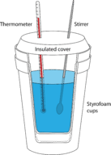
Sample question 2
In an experiment, 25.0 mL of 1.00 M HCl at 25.0°C is added to 25.0 mL of 1.00 M NaOH at 25.0°C in a foam cup calorimeter. A reaction occurs and the temperature rises to 32.0°C. Calculate the standard enthalpy change (ΔHº) in kJ for this reaction. Assume the densities of the solutions are 1.00 g/mL and that their specific heat is the same as that of water.

Slide 10
Discussion
What could be the source of error here？ How to minimize the source of errors in your operation?

Slide 11
Review
What are the physical equations that we use to calculate the heat in the calorimeter?
What’s the relationship between the heat of reaction vs. the standard enthalpy change of a reaction?

