Slide 1

Unit 6
Stoichiometry and Mole

Slide 2

Objective
In this Unit, we will
Understand the mass and atomic conservation
Be able to balance a chemical reaction
Understand the term “stoichiometry”
Understand the particle nature of chemical reactions
Understand Avogadro and Mole concept
Be able to use “mole” as a unit for conversion
Be able to link the microscopic number of particles with macroscopic mass
Be able to identify the excess, limited reagent and predict the amount of product

Slide 3
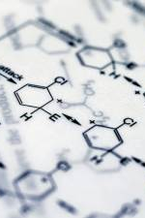
Mass and Atomic Conservation
In a chemical reaction
The mass of reagents and products remains the same
The number and type of atoms remain the same
We can use the mass and atomic conservation to BALANCE a chemical reaction

Slide 4
Balance a chemical reaction
N_{2(g)} + H_{2(g)} ←→NH_{3(g)}
Start with an element that out-numbered on the reactant and product side
Use that element as a starting point to balance the reactions
You may use half numbers but remember to scale them up to whole numbers in the end.

Slide 5




Balance the following reactions

Slide 6
Stoichiometry
the relationship between the relative quantities of substances taking part in a reaction or forming a compound, typically a ratio of whole integers.
The integers in front of every reactant and product are called “stoichiometry coefficient”
Stoichiometry is everywhere in our daily life!

Slide 7
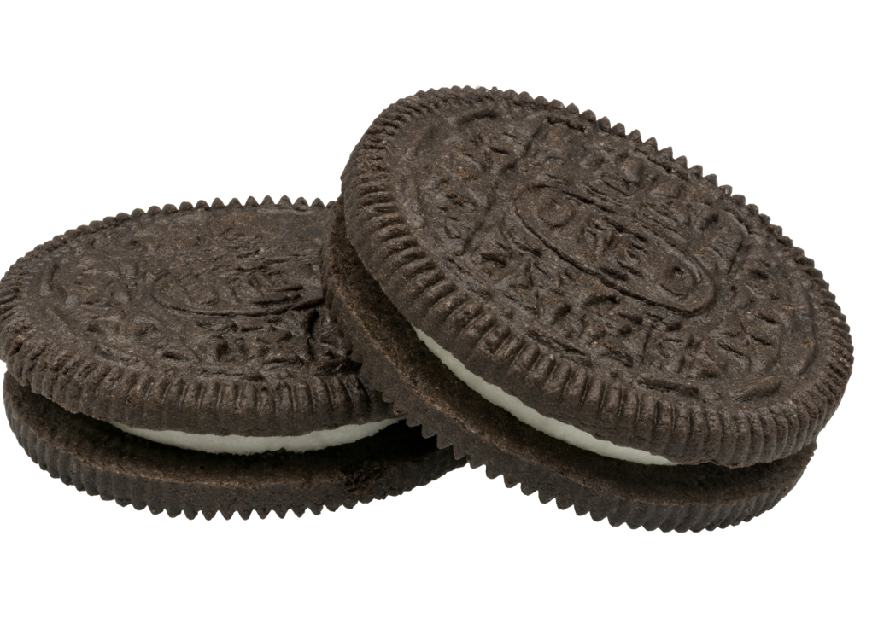
Everyday Stoichiometry
Find an example in our daily life that represents the idea of “stoichiometry.” (i.e. Oreo!)

Slide 8
Particle Nature of Chemical Reactions
Let’s start with the collision theory.
Two particles must collide with sufficient energy and right orientation to make a chemical reaction happen.
However, different chemical compounds have different mass.
So, number of particles v.s. mass of particles, which determine the amount of chemical reactions that can occur?
So, can I have two girlfriends???

Slide 9
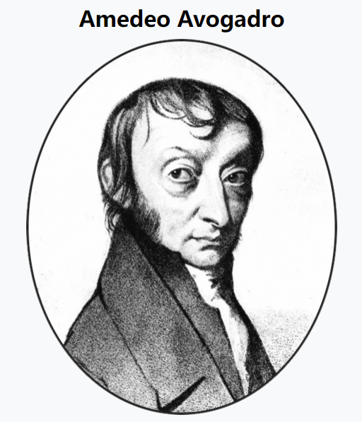
What links mass and number of particles?
Avogadro established the relationship between the mass and number of particles
He proposed the quantity N_{A}=6.02x10²³ as 1 mol
1 mol a.m.u= 1 gram
1 mol of substance contains 6.02x10²³ particles of this substance

Slide 10
Practice
1 mol of H₂O = _____________ gram
1 mol of CO₂ = ______________gram
22 g CO₂= ___________mol
contains _____ mol of C atoms
contains _____ O atoms

Slide 11
In today’s class, we will
Understand moles, molar mass, and molar volume
Understand what are limited and excess reagent
Be able to induce empirical formula and molecular formula

Slide 12
Molar Mass
Molar mass is the mass of 1 mol of substances
Molar mass has a unit of g/mol
Molar mass links the number of particles to mass of particles
n_{(mol)}= mass _{(g)} / molar mass _{(g/mol)}

Slide 13
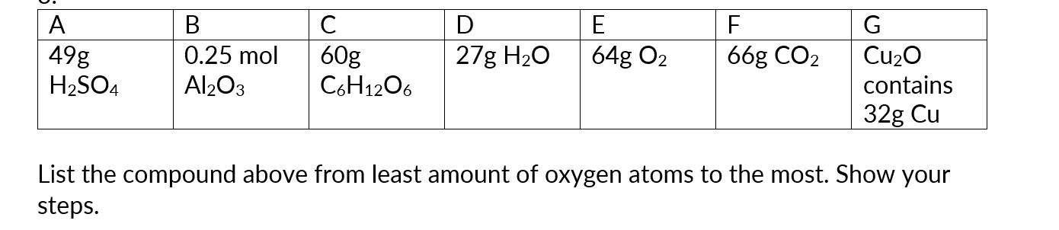
From mass to moles

Slide 14
MOLAR VOLUME
Avogadro proposed that for 1 mol of gas, the volume approximately equals to 22.4 L at 1 atm and 273 K,
or 24 L at 1 atm and 298 K
This is based on the ideal gas but can be applied to most gases.
Ex. 36 grams of carbon is combusted in ample air and the product is cooled down to room temperature at 1 atm. Determine the volume of the product.

Slide 15
Molar volume practice
Complex carbohydrates are starches that your body can convert to glucose, a type of sugar. Simple carbohydrate foods contain glucose, ready for immediate use by the human body. Breathing and burning glucose, C₆H₁₂O₆, produces energy in a jogger’s muscles, according to the following unbalanced equation:
C₆H₁₂O₆(aq) + O₂(g) → CO₂(g) + H₂O(g)
Just before going on a winter run, Myri eats two oranges. The oranges give her body 25 g of glucose to make energy. The temperature outside is 0.00˚C, and the atmospheric pressure is 101.3 kPa. Although 21% (by volume) of the air Myri breathes in is oxygen, she breathes out about 16% of this oxygen. (In other words, she only uses about 5%.)
(a) How many litres of air does Myri breathe in while running to burn up the glucose she consumed?
(b) How many litres of carbon dioxide does she produce?

Slide 16
Limited vs excess
Let’s say, you have 40 wheels, 8 car bodies, and 20 mirrors, how many cars can you build?
How many cars you can build depends on the “short string,” the car bodies here.
Car bodies are “limited,” and compared to car bodies, wheels and mirrors are in excess.

Slide 17
Determine the limited
N₂ + 3 H₂ → 2 NH₃
Given the reaction above, one have 28 grams of N₂ and 10 grams of H_{2.}
Determine the limited reagent in the above reaction
Determine the amount of products produced if the reaction goes to completion
Determine the mass of H₂ left over
Determine the volume of all gases at room temperature.

Slide 18
Practice
Determine the limited reagent, and predict the amount of each product in mole.
Fe + 2 HCl → FeCl₂ + H₂ with 28 gram of iron and 0.5 mol of HCl
4 Al + 3 O₂ → 2 Al₂O₃ with 54 gram of aluminum and 12 L of O₂

Slide 19
More practice
1.56 g of As₂S₃ , 0.140 g of H₂O, 1.23 g of HNO₃, and 3.50 g of NaNO₃ are reacted according to the equation below: 3As2S3(s) + 4H2O() + 10HNO3(aq) + 18NaNO3(aq) → 9Na2SO4(aq) + 6H3AsO4(aq) + 28NO(g) What mass of H3AsO4 is produced?

Slide 20
Empirical formula
The stoichiometry relationship can mean the ratio of each reactant and product in a chemical reaction, or it can represent the ratio of each element within a molecule.
Empirical formula represents the simplest ratio of each element in a molecule, and it DOES NOT mean the actual number of atoms.
Molecular formula means the actual number of atoms in a molecule
Compound | Molecular Formula | Empirical Formula
Benzene | C₆H₆ | CH
Glucose | C₆H₁₂O₆ | CH₂O
Ethylene | C₂H₄ | CH₂

Slide 21
Empirical formula
An inorganic salt is composed of 17.6% sodium, 39.7% chromium, and 42.8% oxygen. What is the empirical formula of this salt?

Slide 22
Practice
For compound X there is 43.7% mass percent of Phosphorous and 56.3% of Oxygen. Determine its empirical formula.
For compound Y, there are 85.7% in mass of Carbon and 14.3% of Hydrogen, with a molecular weight of 56g/mol. Find its empirical formula and determine its molecular formula.
For compound Z, it contains Carbon, Hydrogen, and may contain Oxygen. Burning 1 gram of Z yields 1.73 g of CO₂ and 0.947 g of water. Determine the presence of Oxygen in the molecule, and find its empirical formula.

