Slide 1


Unit 12 Acid and Base Chemistry
Mar. 24 2026

Slide 2

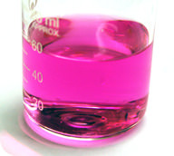


What are acid and base?
Let’s recall from your middle school chemistry, what do you know about acid and base?
Aqueous solutions of acids are electrolytes.
Acids have a sour taste. Lemons, vinegar, and sour candies all contain acids.
Acids change the color of certain acid-base indicators. Two common indicators are litmus and phenolphthalein. Blue litmus turns red in the presence of an acid, while phenolphthalein turns colorless.
Acids react with active metals to yield hydrogen gas.
5.Acids react with bases to produce a salt compound and water.
Aqueous solutions of bases are also electrolytes. Bases can be either strong or weak, just as acids can.
Bases often have a bitter taste and are found in foods less frequently than acids. Many bases, like soaps, are slippery to the touch.
Bases also change the color of indicators. Litmus turns blue in the presence of a base while phenolphthalein turns pink.
Bases do not react with metals in the way that acids do.
Bases react with acids to produce a salt and water.

Slide 3

In this class, we will
Understand the historical view of acid and base
Be able to use pH to indicate the acidity or basicity
pKa and pKb
Calculate the pH and pOH of different acids and bases

Slide 4
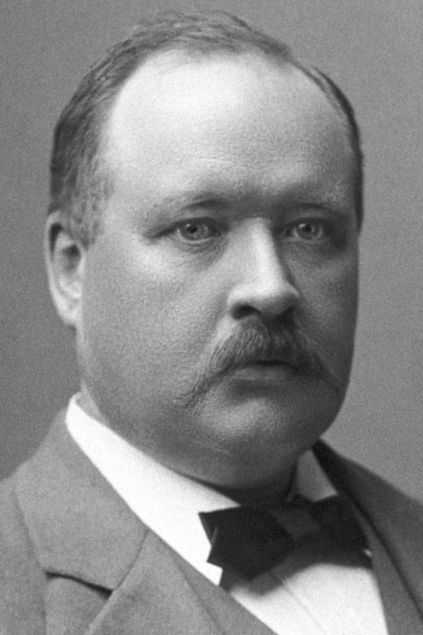
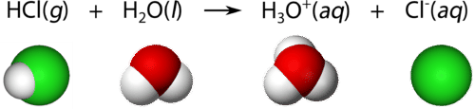

Arrhenius acid and base
An Arrhenius acid is a compound, which ionizes to yield hydrogen ions (H⁺) in aqueous solution.
An Arrhenius base is a compound, which ionizes to yield hydroxide ions (OH⁻) in aqueous solution.
Svante Arrhenius (1859-1927), Nobel Prize of Chemistry in 1903. Whistleblower of global warming

Slide 5

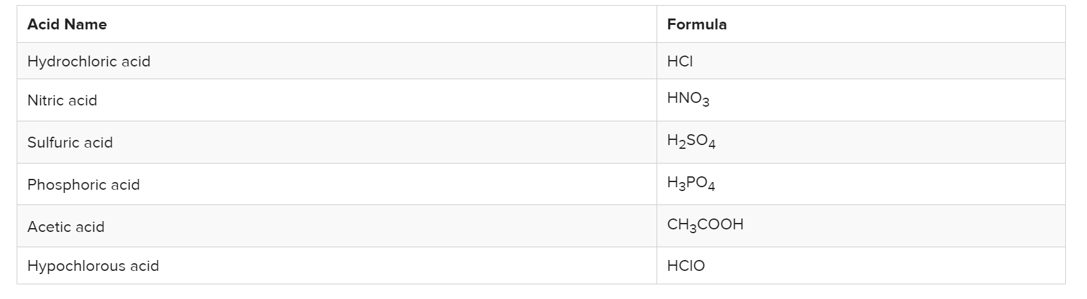
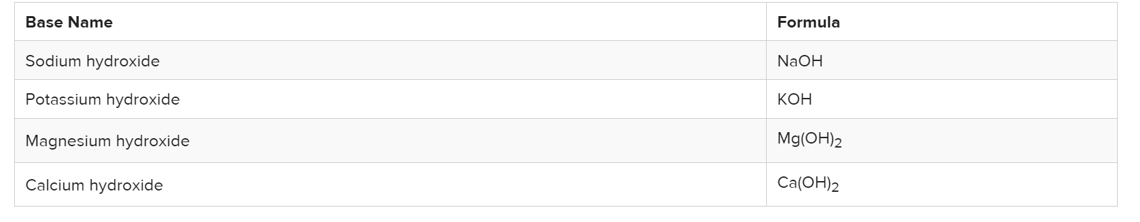
Common Arrhenius acids and bases

Slide 6
Brønsted-Lowry acids and bases
Is NH₃ an acid or base? It’s a dilemma in Arrhenius’ definition.
In 1923, a broader definition of acids and bases was independently proposed by Danish chemist Johannes Brønsted (1879-1947) and English chemist Thomas Lowry (1874-1936).
A Brønsted-Lowry acid is a molecule or ion that donates a hydrogen ion in a reaction. A Brønsted-Lowry base is a molecule or ion that accepts a hydrogen ion in a reaction.

Slide 7
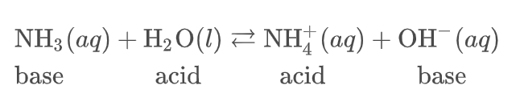
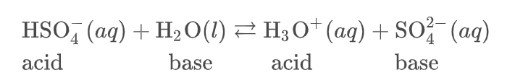
Brønsted-Lowry Acid-Base Reactions

Slide 8
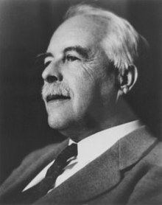
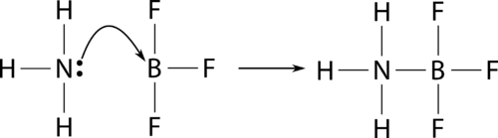
Lewis acids and bases
Gilbert Lewis (1875-1946) proposed a third theory of acids and bases that is even more general than either the Arrhenius or Brønsted-Lowry theories.
A Lewis acid is a substance that accepts a pair of electrons to form a covalent bond.
A Lewis base is a substance that donates a pair of electrons to form a covalent bond.
Gilbert Lewis (1875-1946)

Slide 9
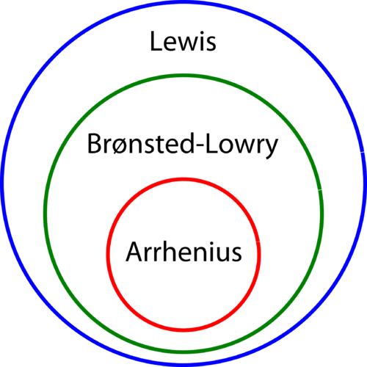
A summary of acid and base definition
Type | Acid | Base
Arrhenius
Bronsted-Lowry
Lewis

Slide 10
Acid...base...who is neutral?

Slide 11


Why water behaves neutral?
Let’s recall the autoionization of water
To what extent does water ionize? Write the Keq for this process.
What’s the concentration of H⁺ and OH⁻ in water at 25ºC?
For an aqueous solution at 25ºC, the product of hydride ion concentration and hydroxide ion concentration will remain constant at 10⁻¹⁴.

Slide 12
Sample problem
Hydrochloric acid (HCl) is a strong acid, meaning it is 100% ionized in solution. What is the [H⁺] and the [OH⁻] in a solution of 2.0 × 10³ M HCl?

Slide 13
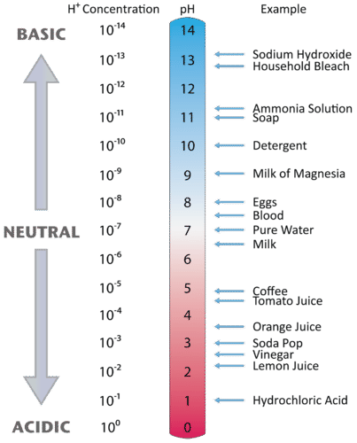
What indicates neutral?
pH scale is used to indicate the amount of hydride ion in a solution.
pH ranges from 0-14
p is a mathematical operator, means –log₁₀(X)
So pH=-log₁₀([H⁺])
What is the pH of pure water at 25ºC?

Slide 14
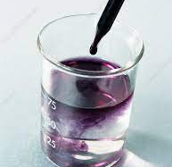
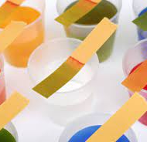
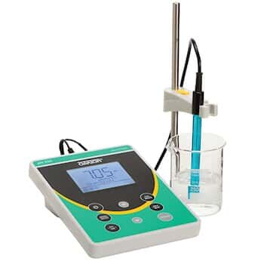
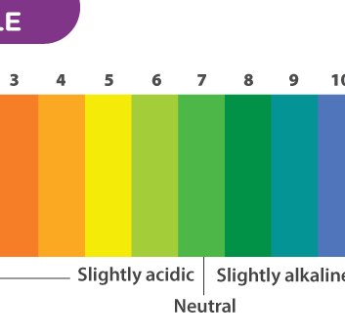
pH measuring

Slide 15
Sample problem
Calculate the pH of 1x10⁻² M HCl.
Calculate the pH of 2.3x10⁻⁵ M NaOH
Calculate the pOH and pH of 2.3x10⁻⁵ M NaOH

Slide 16

What’s the relationship between pH and pOH?

Slide 17
Strong acid vs. weak acid
Acids are classified as either strong or weak, based on their ionization in water.
A strong acid is an acid which is completely ionized in an aqueous solution. Hydrogen chloride (HCl) ionizes completely into hydrogen ions and chloride ions in water.
A weak acid is an acid that ionizes only slightly in an aqueous solution. Acetic acid (found in vinegar) is a very common weak acid. Its ionization is shown below.

Slide 18
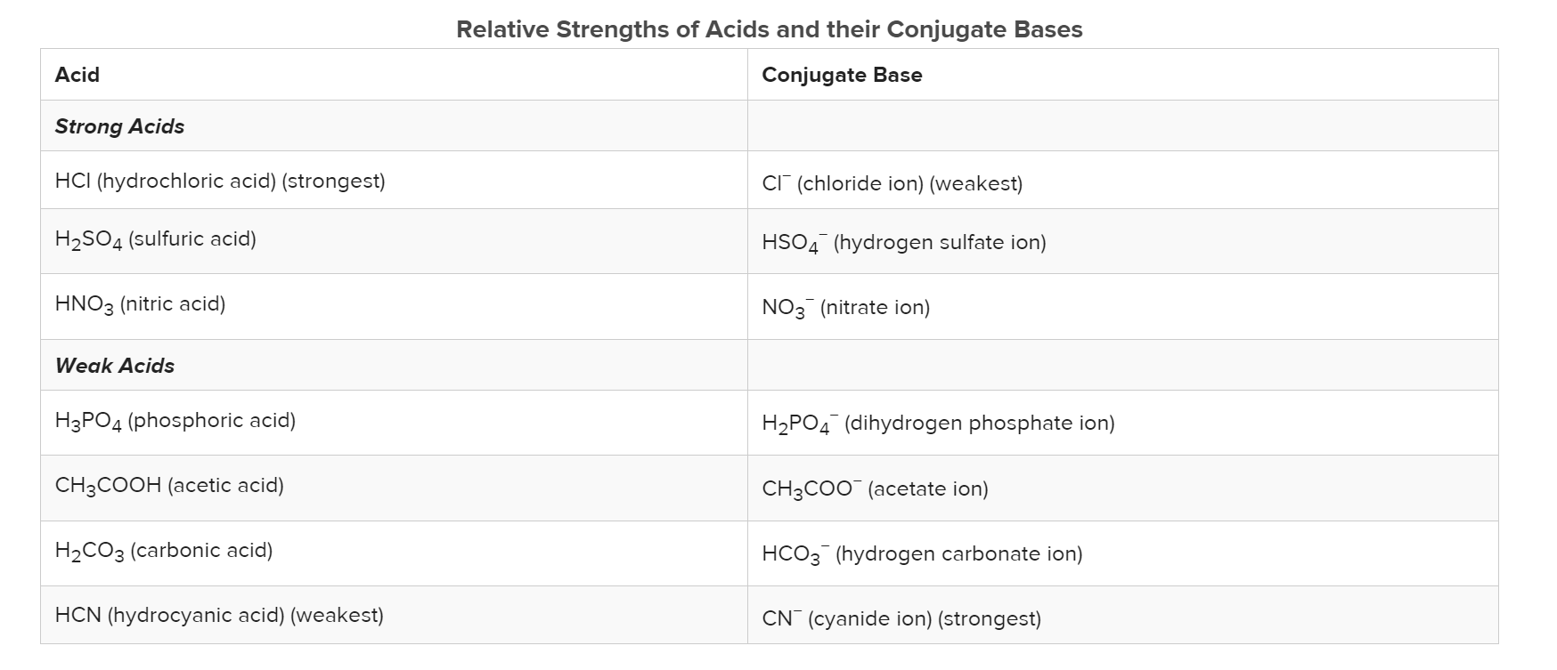
Acid strength

Slide 19
A diluted acid dilemma..
What’s the pH of a 1x10⁻⁸ mol/L HCl solution?
Does your calculation make sense?
What’s wrong with the pH system?

Slide 20
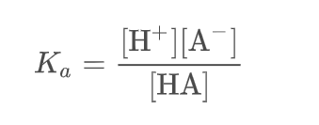
Ka and pKa
HA_{(aq)} + H₂O_{(l)} ←→ H₃O⁺_{(aq)} + A⁻_{(aq)}
How to express the degree of dissociation by using equilibrium constant?

Slide 21
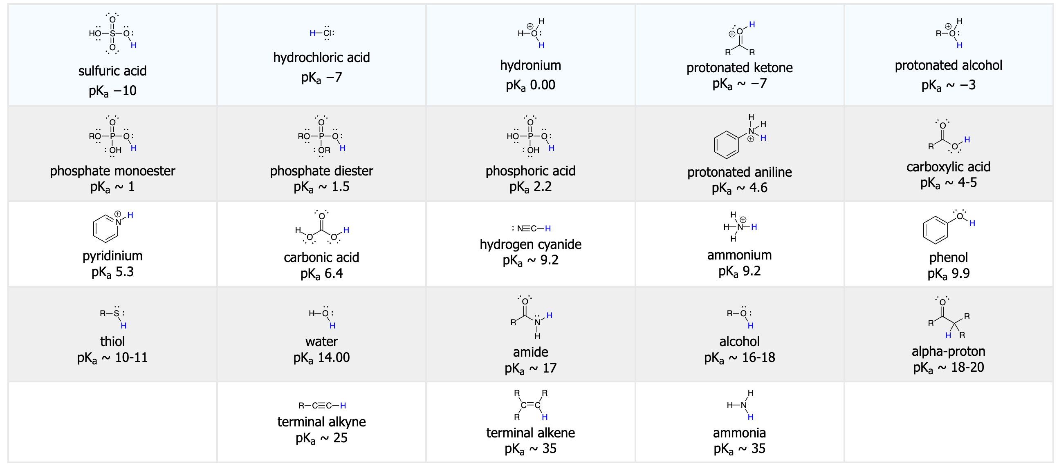

Slide 22
Typical acid and base reactions
1. Neutralization Reactions (Most Fundamental)
Acid + Base → Salt + Water
General: H⁺+OH⁻→H₂O
Example: HCl+NaOH→NaCl+H2O
2. Acid + Metal → Salt + Hydrogen Gas
General: Acid+Metal→Salt+H2(g)
Example: 2HCl+Zn→ZnCl₂+H₂

Slide 23
3. Acid + Carbonate / Bicarbonate → CO₂ + Water + Salt
General: Acid+CO₃²⁻→CO₂+H₂O+Salt
Example: 2HCl+Na₂CO₃→2NaCl+CO₂+H₂O
4. Acid + Metal Oxide → Salt + Water
General: Acid+Metal Oxide→Salt+H₂O
Example: 2HCl+CuO→CuCl₂+H₂O
5. Base + Nonmetal Oxide (Acidic Oxide) → Salt + Water
General: Base+Nonmetal Oxide→Salt+H₂O
Example: 2NaOH+CO₂→Na₂CO₃+H₂O
6. Base+ ammonium salt →Salt+ammonia+water
Example: NaOH + NH₄Cl → NaCl + NH₃ + H₂O

Slide 24
Review
What’s the definition of acid and base in Arrehenius, Bronsted-Lowry, and Lewis definition?
What indicates the acidity in solution?
What is strong acid? What is weak acid?

