Slide 1
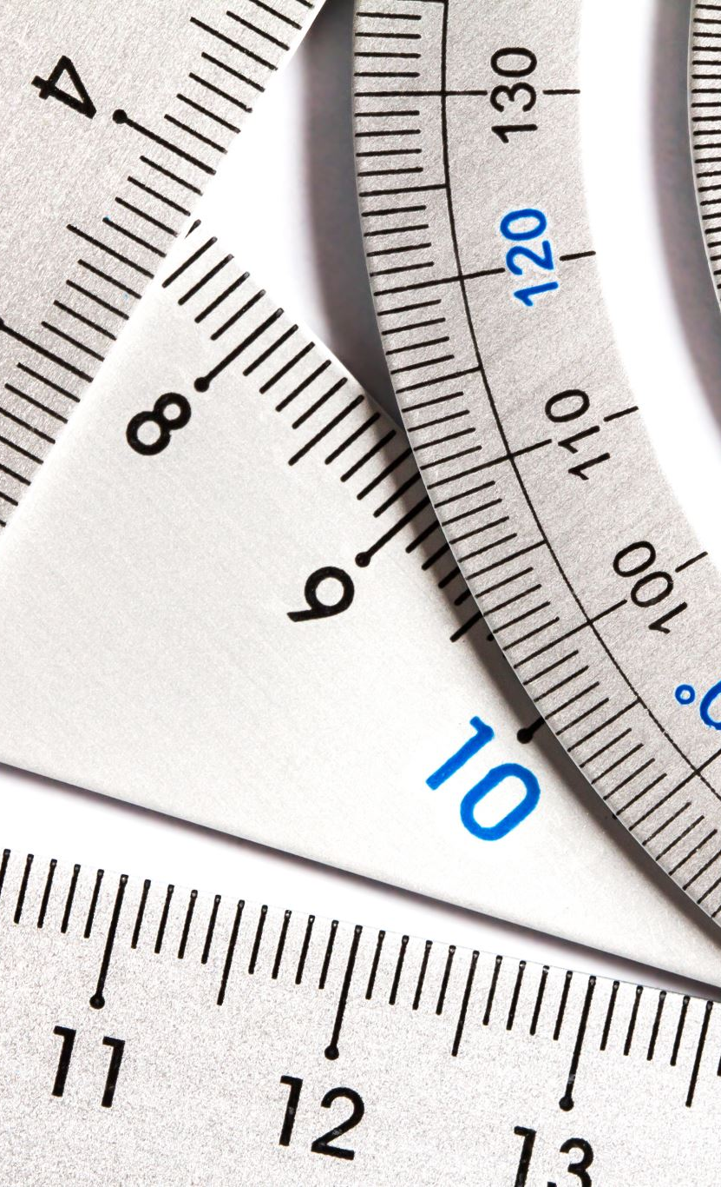
Unit 2 Measuring and Glassware
2.1 Measuring and uncertainties

Slide 2

Recap
What is a qualitative analysis and what is a quantitative analysis?
How to acquire and express the quantitative analysis results?

Slide 3

In this class, we will
Understand the different physical quantities and the proper scientific prefix and expression
Understand the different source of errors (systematic vs. random) and how they affect the results (precision vs. accuracy)

Slide 4

Physical Quantity
What physical quantities do you know?

Slide 5
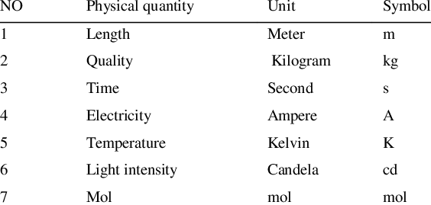
Physical Quantity
There are seven fundamental physical quantities

Slide 6
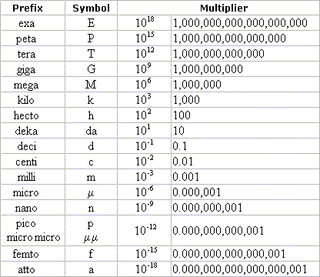
Scientific Prefix

Slide 7
Practice
Work individually, and compare the answers with your mate
Calculate the volume of a cube with side length=15 nm and convert the unit into cm³.
Determine the density of a cube with side length=3 cm, mass=9 g, in the unit of kg/m³

Slide 8
How certain is my measurement?
Let’s think about this scenario-
“the side length of a cube is 3 cm, 3.0 cm, 3.00 cm, and 3.000 cm. ”
Do they tell you the equal amount of information?
There are differences in the precision(精度）of each measurement.
And this difference is reflected in their different significant figures.

Slide 9
Significant figures (sig. fig.)
Sig. fig. tells you the precision and certainty of the data. The more sig. figs, the more precise and certain.
Non-zero digits are always significant. (i.e. 3289)
Any zeros between two significant digits are significant. (i.e. 8009)
Any tailing zeros after decimal points are significant. (i.e. 0.8000)
Any heading zeros AFTER the decimal points are not significant. (i.e. 0.000098)
The tailing zeros of an integer are unspecified. (i.e. 1000)

Slide 10
Practice
Identify the sig. figs. of each data
2.0098
1.000
0.00045000
1.000x10⁵

Slide 11
Precision and accuracy
Just now we mentioned the term precision.
Precision is frequently associated with the term accuracy
precision is how close the measurements are to each other
Accuracy is how close a given set of measurements (observations or readings) are to their true value.

Slide 12
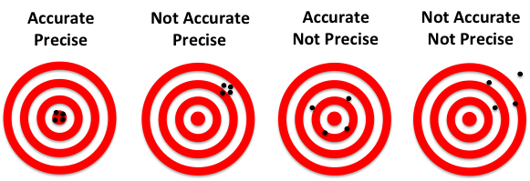
Precision vs accuracy

Slide 13

Practice
Use your own words to describe a scenario that a serial of measurements are
Accurate but not precise
Precise but not accurate
E.g. Mr. Chen put a 25 lbs barbell weight on a body weight scale for five times, and the scale reads 24.8 lbs, 24.9 lbs, 25.3 lbs, 25.0 lbs, 24.7 lbs

Slide 14

Errors and uncertainties
In the previous descriptions, we can observe that there are variations of measurements.
We call these variations the uncertainty of our measurements.
When we are objectively analyzing these uncertainties, we used the term errors to describe these variations.
There are two types of errors
Random Error
Systematic Error

Slide 15
Systematic error
Systematic errors in experimental observations usually come from the measuring instruments. They may occur because:
there is something wrong with the instrument or its data handling system, or
because the instrument is wrongly used by the experimenter.
i.e. The balance reads 2.89 g when nothing is placed on it.

Slide 16
Random error
Random errors in experimental measurements are caused by unknown and unpredictable changes in the experiment. These changes may occur in the measuring instruments or in the environmental conditions.
For example, I am shooting at a target 100 m away and suddenly a side wind blows in.

Slide 17
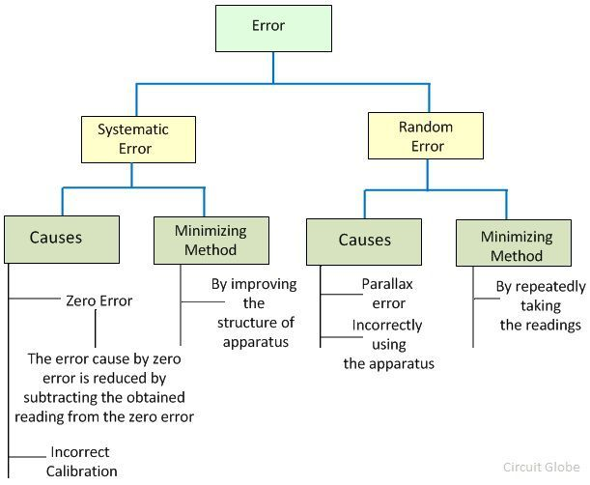
Systematic or random?
Can you give me some examples of systematic and random errors?

Slide 18
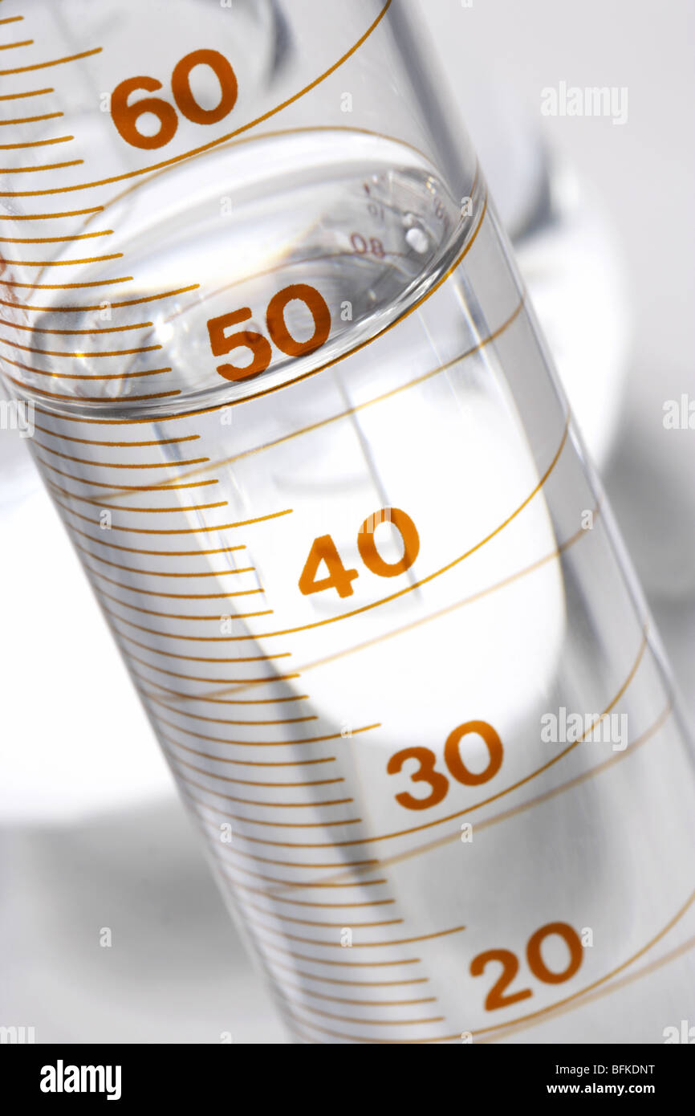

Uncertainty in readings
Type 1 of reading-analogue reading (needle-type reading)
Uncertainty=1/2 of minimal division

Slide 19
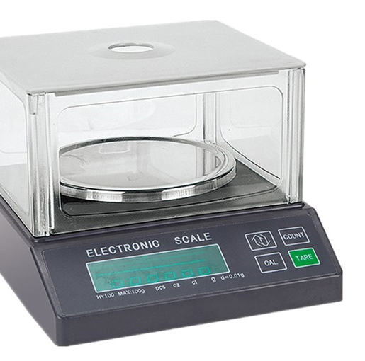
Uncertainty in reading
Type 2 reading-digital reading
Uncertainty= minimal division

Slide 20
How to express the uncertainty in measuring?
By using the balance showed in the above slide, you weigh out 2.08 g of NaCl. How do you record your measurement with uncertainty?

Slide 21
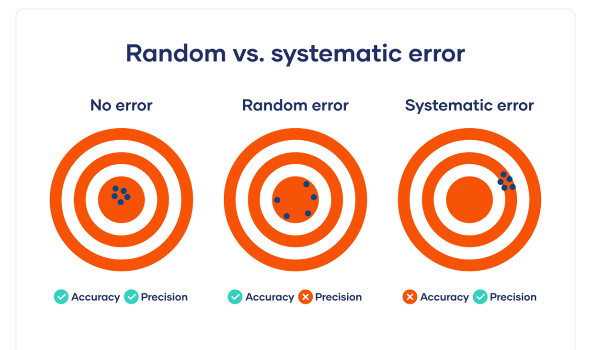
How are errors associate with precision and accuracy?

