Slide 1

Unit 6.2 Concentration, Dilution and Titration

Slide 2
In today’s lesson, we will
Understand the physical and chemical concept of concentration
Use the chemical concentration to perform dilution
Understand the concept of titration
Use concentration to perform titration

Slide 3
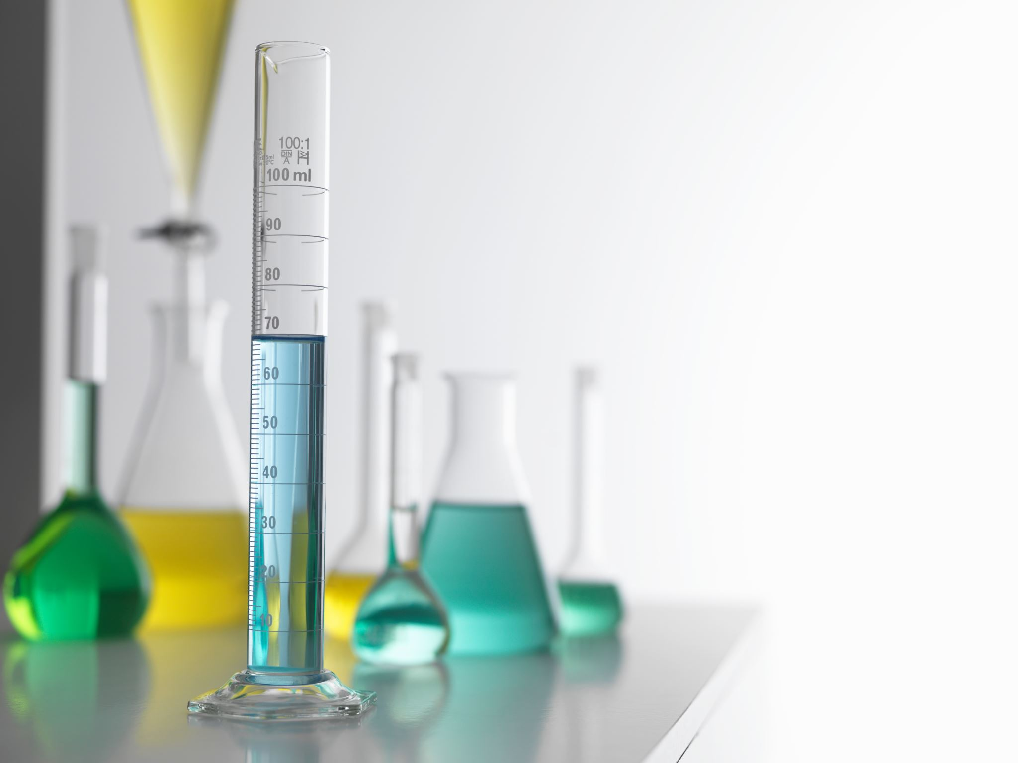
Concentration
Physical measures
• % w/w – g of solute per 100 g of solution
• % w/v – g of solute per 100 mL of solution
• % v/v – mL of solute per 100 mL of solution
ppm, parts per million, equals
mass of solute(g)/mass of solution(g) x 10⁶
2. Chemical measures
• Molarity (M) – mol of solute per L of solution Temperature dependent
• Molality (m) – mol of solute per kg of solvent Not temperature dependent
• Mole fraction (X) – 𝒎𝒐𝒍 𝒐𝒇 𝒐𝒏𝒆 𝒄𝒐𝒎𝒑𝒐𝒏𝒆𝒏𝒕/𝒕𝒐𝒕𝒂𝒍 𝒎𝒐𝒍 𝒐𝒇 𝒂𝒍𝒍 𝒄𝒐𝒎𝒑𝒐𝒏𝒆𝒏𝒕𝒔

Slide 4

Ex.1
Calculate the concentration in Molarity and PPM of 58.5 gram of NaCl dissolving in 100 mL of water, assuming the density is 1.1g/cm³

Slide 5

Ex.2
Calculate the molarity of pure water.

Slide 6
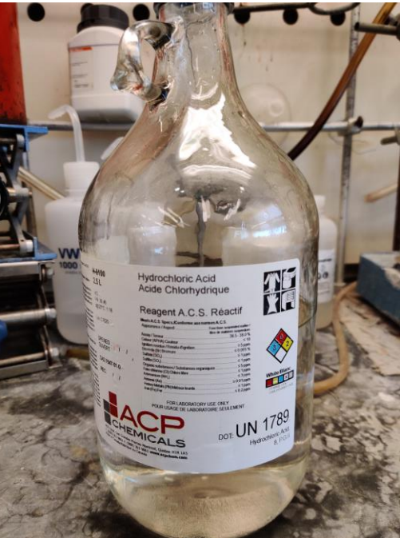
Ex.3
Commercial ‘concentrated’ hydrochloric acid has a concentration of 37.0% w/w and a density of 1.20 g/mL. Calculate the molarity and molality of this solution.

Slide 7
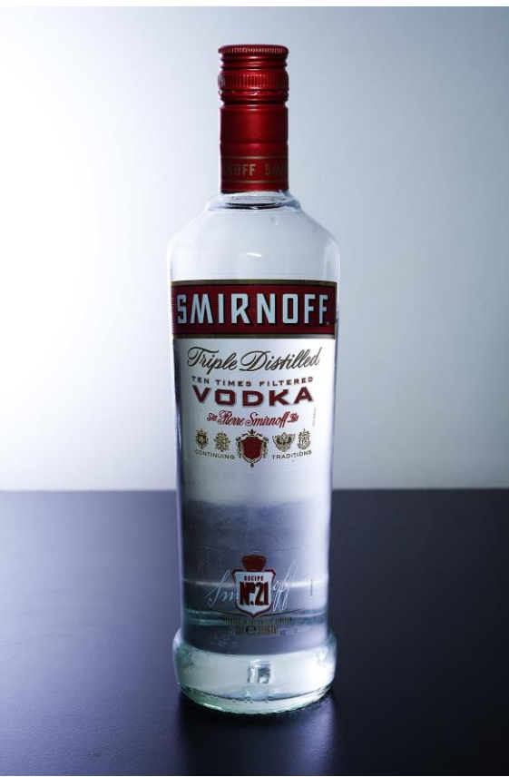
Ex.4
Vodka is an aqueous solution of ethanol in water with a mole fraction (X_{ethanol} ) of 0.150 and a density (ρ) of 0.970 g/mL. Calculate the molarity and molality of this solution.

Slide 8

In this class, we will
Review the concepts of molarity and molality
Understand the basic steps to prepare a solution according to the given concentration
Understand the steps to dilute a solution and conduct quantitative analysis
Understand the concept of titration

Slide 9

Warm-up
1.A solution prepared from 95.94 g of H₂O and 10.66 g of pure H₂SO₄ had a volume of 100.0 mL. Find ρ, m, M and X_{water}.
2.Given H₂SO₄ 98% w/w, p=1.842g/mL, find M, m, and X_{acid.}

Slide 10

Molarity vs. Molality
Molarity and molality Why is molarity typically less than molality? Can M and m ever be equal? If so, when?

Slide 11
Molarity(M) is the most frequently used concentration unit
C=n/v, c is the concentration in M, n is the mole of solute, v is the volume of solution
M usually has the unit of mol/dm³ or mol/L
Q: How to make 150 mL 2 mol/dm³ KCl solution?

Slide 12
How to prepare a solution?
https://www.bilibili.com/video/BV1K54y1y7am/?vd_source=2b14d6efae5269f1dc91bb0df501d75a

Slide 13

Dilution
The solution to pollution is dilution.

Slide 14
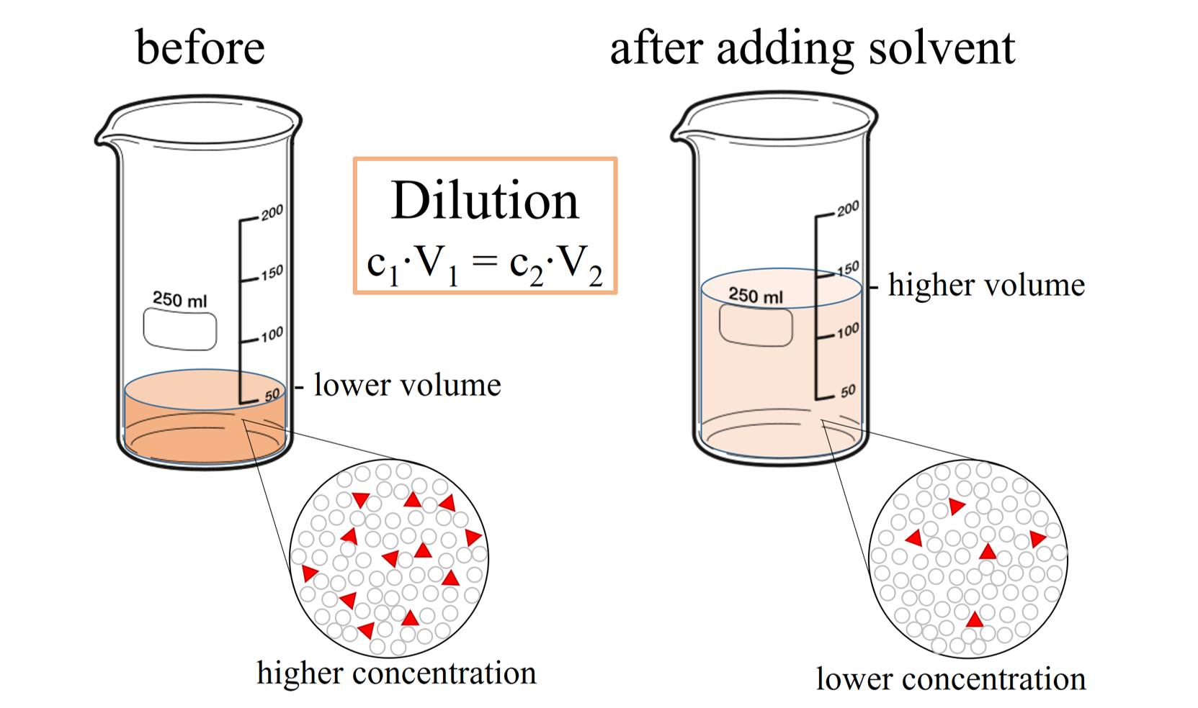
Dilution

Slide 15
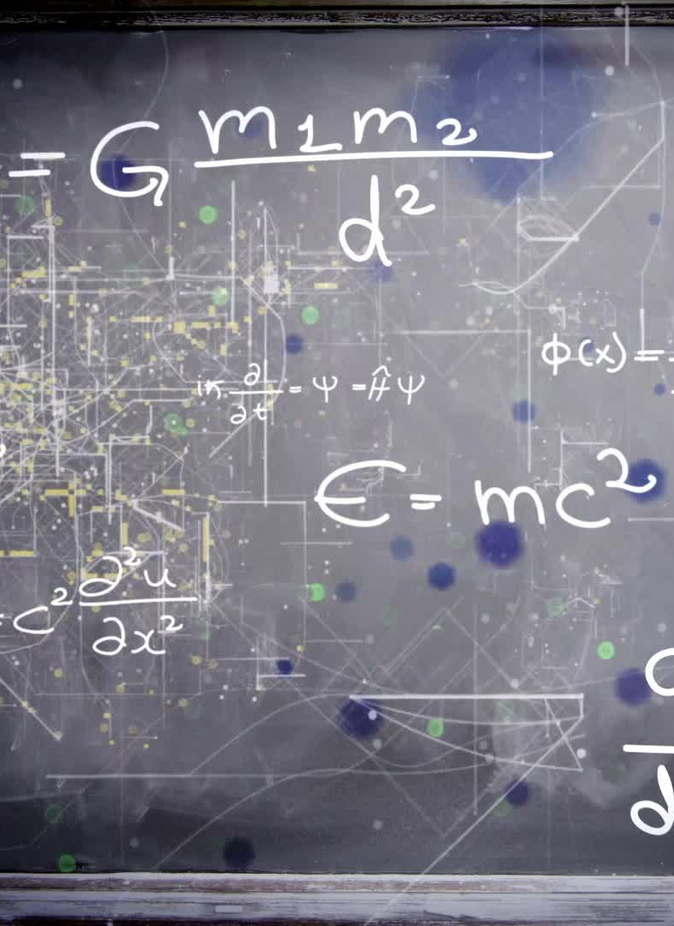
Dilution
c𝟏 × 𝑽𝟏 = c𝟐 × 𝑽𝟐
Ridiculously important note: this equation is for dilutions (i.e. taking a solution and adding more solvent). If the quantity of solute changes, this equation does not apply.

Slide 16
EX.5
450 mL of distilled water is added to 150 mL of a 2M HCl solution. Calculate the molarity of the resulting solution.

Slide 17
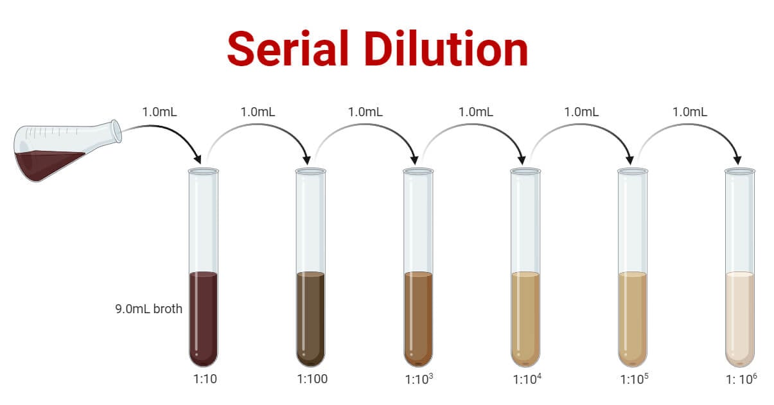
Serial dilution

Slide 18
EX.6
Prepare 100 mL of 1M NaCl solution and dilute to 0.1 mM NaCl solution. Choose the proper glassware and describe the steps.

Slide 19
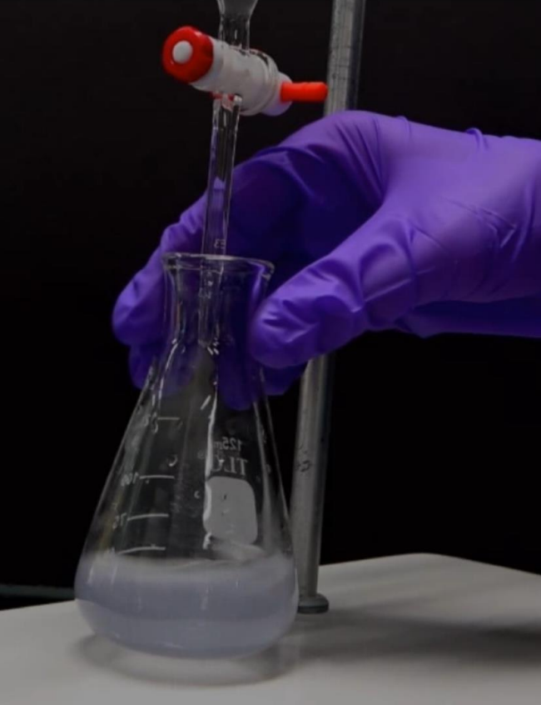
Titration
Titration is a quantitative analytical technique through which a solution of known composition and concentration (titrant) is slowly added to another solution with a known volume but unknown concentration.
This technique is commonly used to investigate acid-base or redox reactions and is often accompanied by the use of a colorimetric indicator.

Slide 20
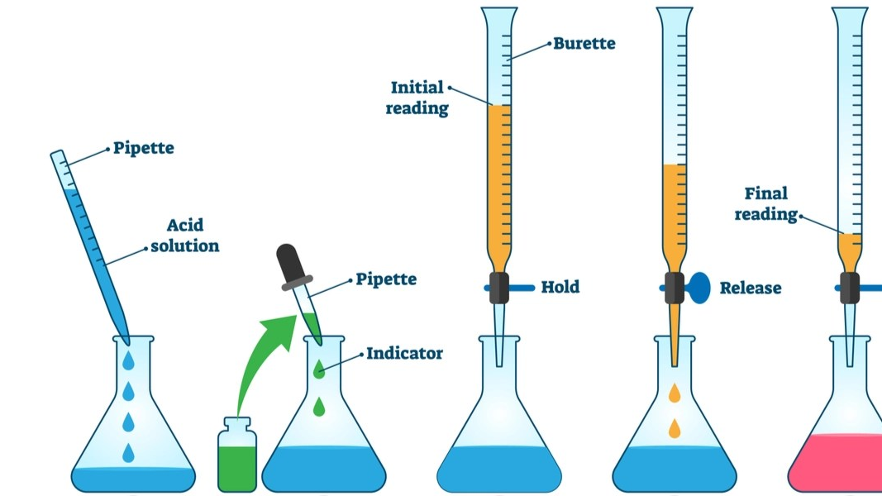
Titration

Slide 21
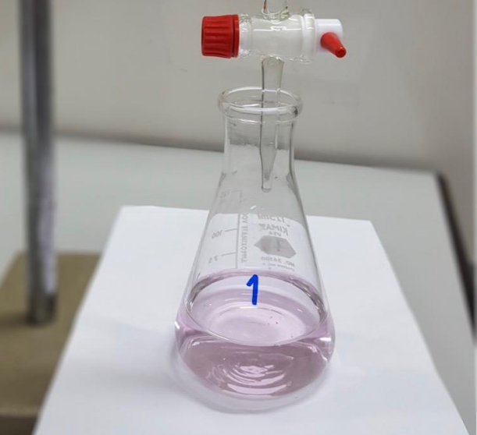
Titration
The end point of a titration is the point at which the indicator changes color.
The equivalence point of an acid-base titration is the point in the experiment when the number of moles of OH⁻ (aq) added from the burette is equal to the number of moles of H⁺ (aq) originally present in the flask.
End point of an acid-base titration with phenolphthalein as an indicator.

Slide 22
EX.7
What volume of 0.1292 M Ba(OH)2 is required to neutralize 50.00 mL of 0.1016 M HCl ?

Slide 23
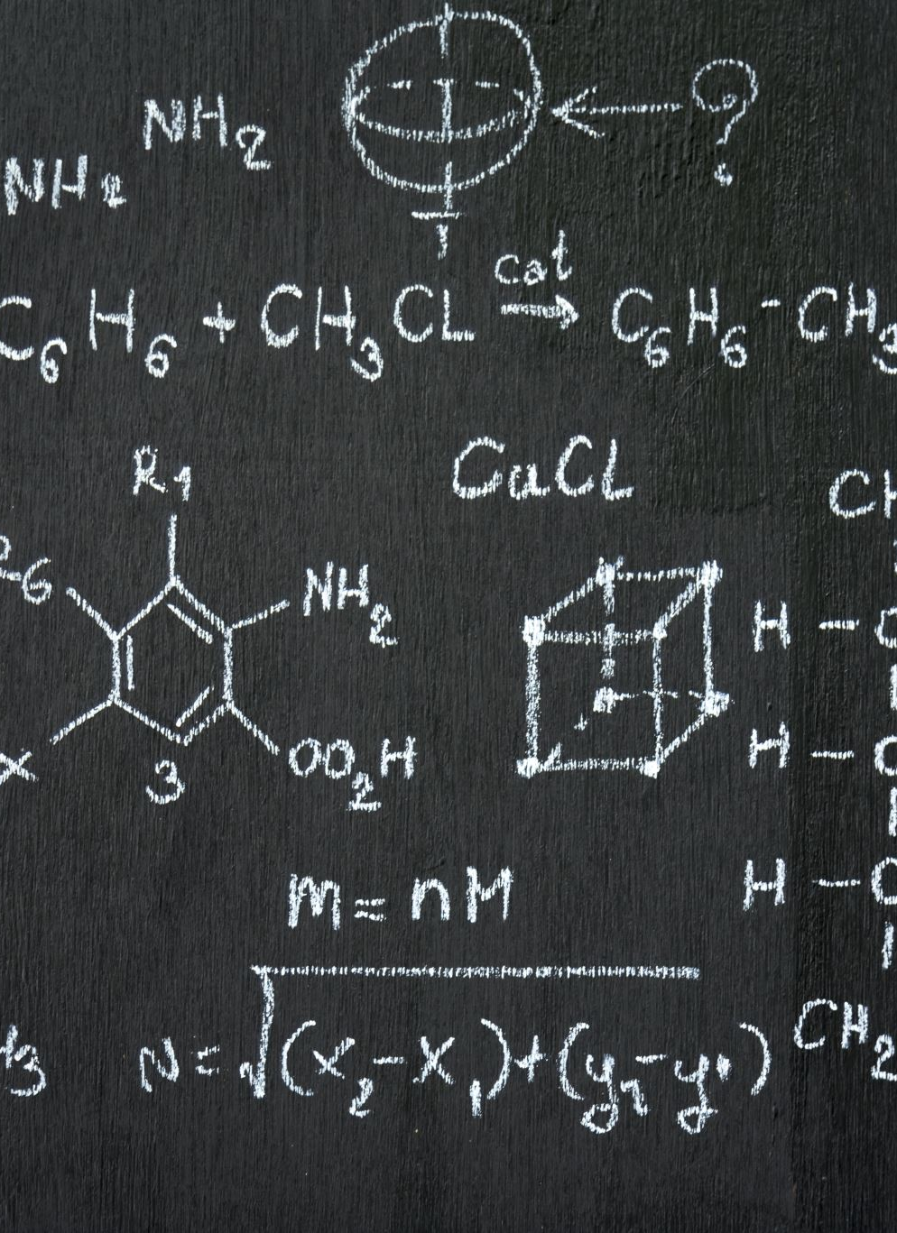
EX.8
You use 13.26 mM of HCl to neutralize 50 mL of unknown KOH. The initial reading is 3.20 mL, and the final reading is 17.80 mL. Determine the concentration of the KOH.

