Slide 1

Unit 8 Chemical Nomenclature

Slide 2
Warm-up
Define chemical bond
Define ionic compound and its properties
Define covalent bond
Define metallic bond

Slide 3
In this lesson, we will
Understand the essence of speaking a unified scientific language
Be able to identify whether an element is metal of nonmetal
Be able to name simple inorganic compounds of metals and nonmetals
Be able to name polyatomic ions

Slide 4
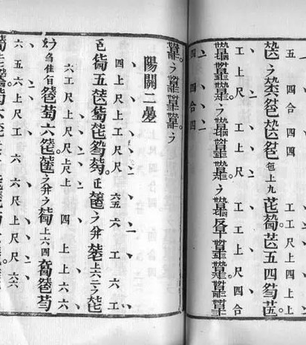
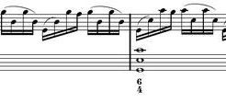
The unified language

Slide 5
The unified language
ذهب золото ရွှေ 금 ouro स्वर्णं
金
Gold
Au

Slide 6


IUPAC
IUPAC's Inter-divisional Committee on Nomenclature and Symbols (IUPAC nomenclature) is the recognized world authority in developing standards for the naming of the chemical elements and compounds.

Slide 7
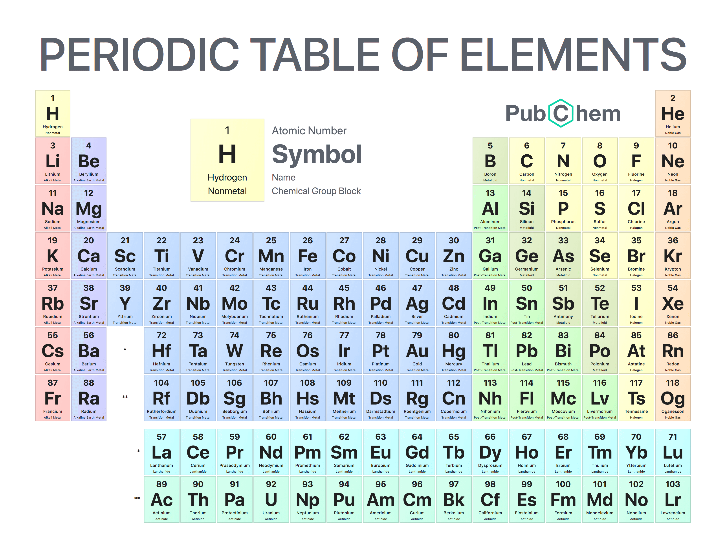

Slide 8
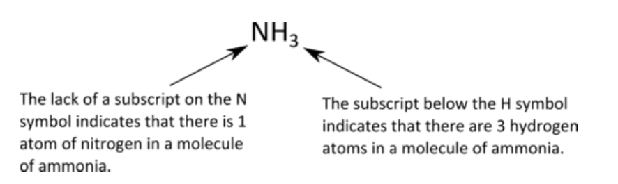
UNDERSTAND MOLECULAR FORMULA

Slide 9
NOMENCLATURE FLOWCHART
Molecular Formula
Metal+Non-Metal?
The Metal is not a transition metal
The Metal is a transitional metal
Non-metal Only?

Slide 10
The metal is not a transition metal
We name in the order of metal+non-metal
Metals remain in its original elemental name
Nonmetal changes its name to –ide
You don’t have to identify the number of atoms
Sodium Chloride
NaCl

Slide 11
-ide transformation
C: Carbon-Carbide
N: Nitrogen-Nitride
O: Oxygen-Oxide
Cl: Chlorine-Chloride
S:
F:
P:
Br:

Slide 12
practice
NaI
MgCl₂
Al₂O₃

Slide 13
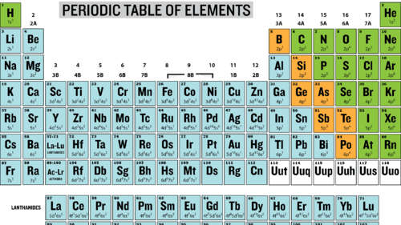
Let’s reverse it-from name to formula

Slide 14
From name to formula
Calcium Chloride
Magnesium Sulfide
Lithium Oxide

Slide 15
Bellringer
Take out a piece of paper and write your name on the top

Slide 16
In today’s class, we will
Learn the name of polyatomic ions
Learn the name of transition metal compounds
Learn the name of nonmetal compounds

Slide 17
Polyatomic ions
We need to memorize both their names, charge, and naming rule regarding the number of oxygens.
NH₄⁺ Ammonium
CO₃²⁻ Carbonate HCO₃⁻ Bicarbonate
SO₄²⁻ Sulfate SO₃²⁻ Sulfite
NO₃⁻ Nitrate NO₂⁻ Nitrite
ClO₃⁻ chlorate ClO₄⁻ Perchlorate
PO₄³⁻ Phosphate PO₃³⁻ Phosphite
CN⁻ cyanide OH⁻ Hydroxide

Slide 18
Rules of oxygen
-ate or –ite means a polyatomic ions containing one nonmetal element and oxygen
-ite means one less Oxygen than –ate
Per- means one more Oxygen than –ate
Hypo- means one less Oxygen than –ite

Slide 19
Activity 1
Name or write the following compound
NaBrO
NH₄ClO₄
Aluminum Nitrite
Calcium Periodate

Slide 20
Naming flowchart
Molecular Formula
Metal+Non-Metal?
The Metal is not a transition metal
The Metal is a transitional metal
Non-metal Only?

Slide 21
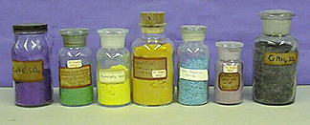
PROPERTIES OF TRANSITION METAL
Transition metals are:
Colorful
Hard and high in density
Multiple oxidation numbers (charge)

Slide 22
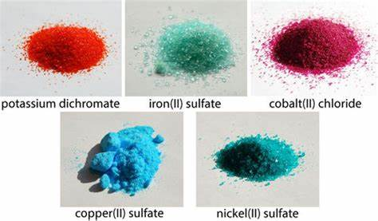
Naming rules of transition metal compound
We follow the rules of naming metal+non metal compounds that we above-mentioned.
We put the charge of the metal in Roman Numerical in ( ) after the metal

Slide 23
Activity 2
Name the following compound
Fe₂(SO₄)₃ Cu₂O
Co(ClO₄)₃ V₂O₅
MnO₂ Cr₂(CO₃)₃

Slide 24
Naming flowchart
Molecular Formula
Metal+Non-Metal?
The Metal is not a transition metal
The Metal is a transitional metal
Non-metal Only?

Slide 25
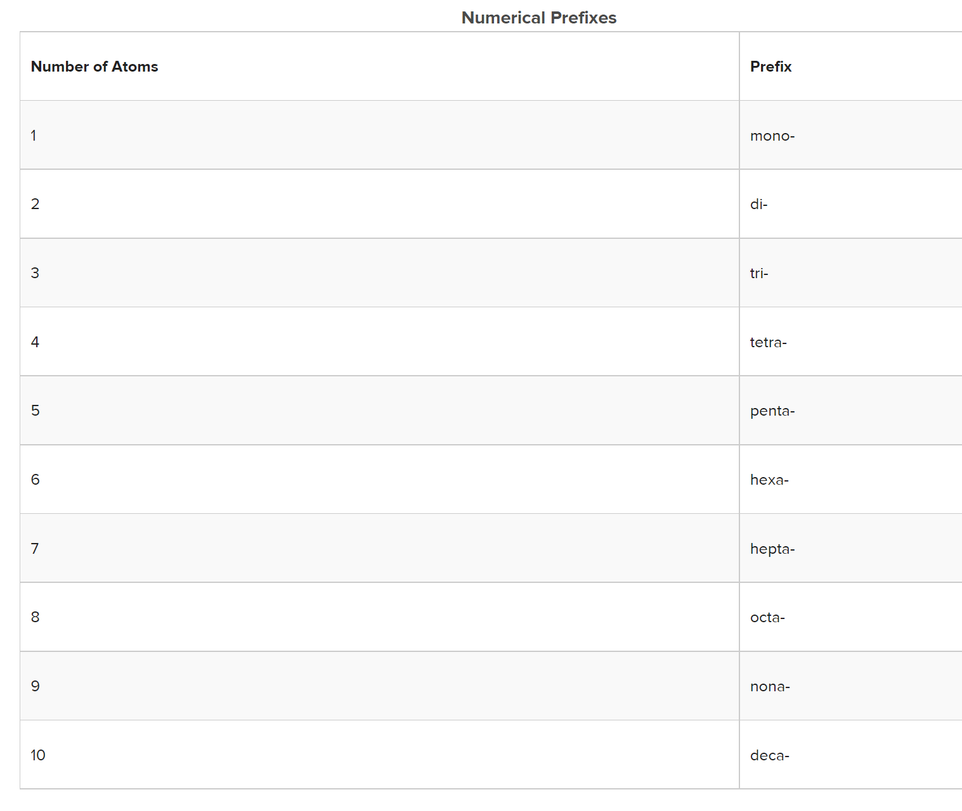
Numerical prefix

Slide 26
NONMETAL COMPOUND
We name it from left to right
The left element remain in its original name
The right element changes to –ide form
Numerical prefix is added before each element
You can omit the “mono” before the first element.
N₂O₅
Dinitrogen Pentoxide

Slide 27
Activity 3
N₂H₄
ClF₃
NO
CS₂
Cl₂O₇

Slide 28
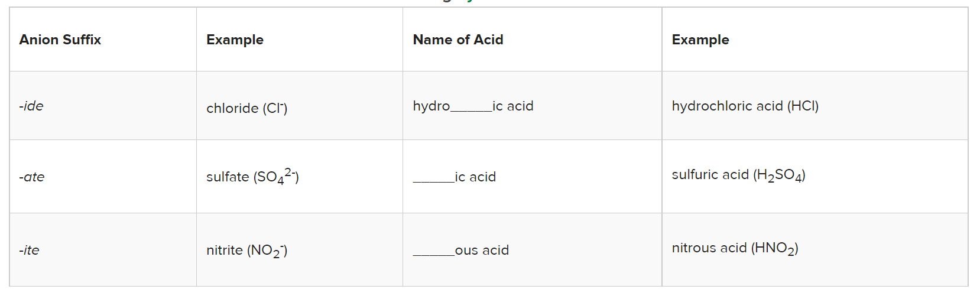
Naming of acid
Acid is a compound of Hydrogen and a non-metal part
i.e. HCl, H₂SO₄ HNO₃

Slide 29
Activity 4
Name the following acid
H₂CO₃
H₃PO₄
HCN
HClO₃

Slide 30
COMMON NAMES
H₂O
NH₃

