Slide 1
Sri Manikanda Aaditan M
Madras Institute of Technology campus, Anna University
Final Project
Car Price Prediction using Machine Learning

Slide 2

PROJECT TITLE
Car Price Prediction using Machine Learning.

Slide 3


AGENDA
The project aims to develop a Car Price Prediction system leveraging advanced deep learning algorithms trained on comprehensive historical seismic data.
This encompasses data preprocessing, the development and training of a sophisticated deep learning model, evaluating its predictive accuracy, and deploying it for real-time forecasting and proactive disaster management.
3/21/2024 Annual Review

Slide 4

PROBLEM STATEMENT
The objective of this project is to develop a machine learning model that can accurately predict the selling price of used cars based on various features such as make, model, year of manufacture, mileage, engine size, fuel type, transmission type, and other relevant attributes.
By leveraging historical car data and advanced machine learning algorithms, this project aims to provide an effective solution to this problem. The developed model will assist users in estimating the market value of used cars, facilitating informed decision-making for buyers and sellers in the automotive market.

Slide 5

PROJECT OVERVIEW
The primary objective is to assist both buyers and sellers in the automotive market by providing a reliable tool for estimating the market value of used cars, facilitating informed and fair decision-making.
The outcome of the project will be a deployed machine learning model accessible through a user-friendly interface, enabling users to input car features and receive accurate price predictions.
This tool will enhance the transparency and efficiency of the used car market, enabling buyers and sellers to negotiate fair and competitive prices based on data-driven insights.

Slide 6
WHO ARE THE END USERS?
Individual Car Buyers: People looking to purchase a used car can use the machine learning model to estimate the fair market value of a specific vehicle based on its features.
Individual Car Sellers: Individuals selling their used cars can utilize the machine learning model to determine an appropriate selling price for their vehicle.
Automotive Dealerships: Car dealerships can benefit from the machine learning model by accurately pricing used cars in their inventory.
General Public: Anyone interested in understanding the factors influencing used car prices and the overall dynamics of the automotive market can access the prediction tool to gain valuable insights and knowledge.

Slide 7
YOUR SOLUTION AND ITS VALUE PROPOSITION
Accurate Price Estimation: The machine learning model provides accurate and data-driven price predictions based on the specific features of each car, reducing uncertainty and facilitating fair pricing in the used car market.
Informed Decision-Making: Both buyers and sellers can make informed decisions by using the prediction tool to understand the market value of a used car, leading to more transparent and equitable transactions.
Versatility and Accessibility: The solution caters to a wide range of end users, including individual car buyers and sellers, automotive dealerships, and market analysts. Its versatility and accessibility make it a valuable tool for various stakeholders in the automotive market, enhancing its overall impact and value proposition.

Slide 8
THE WOW IN YOUR SOLUTION
Precision and Accuracy: The machine learning model is optimized to provide highly accurate price predictions for used cars based on a comprehensive dataset and advanced regression algorithms.
User-Friendly Interface: The deployment of the machine learning model through an intuitive and easy-to-use interface enhances the user experience, making it accessible and straightforward for individual buyers.
Time and Cost Efficiency: The automated price prediction process saves significant time and effort for users by eliminating the need for manual research and appraisal.
Enhanced Market Transparency: By offering a reliable and standardized pricing tool, the solution contributes to increasing transparency and trust in the used car market.

Slide 9

MODELLING
Data Preprocessing
Data Splitting
Feature Selection and Engineering
Model Selection and Training
Hyperparameter Tuning
Model Evaluation and Deployment

Slide 10
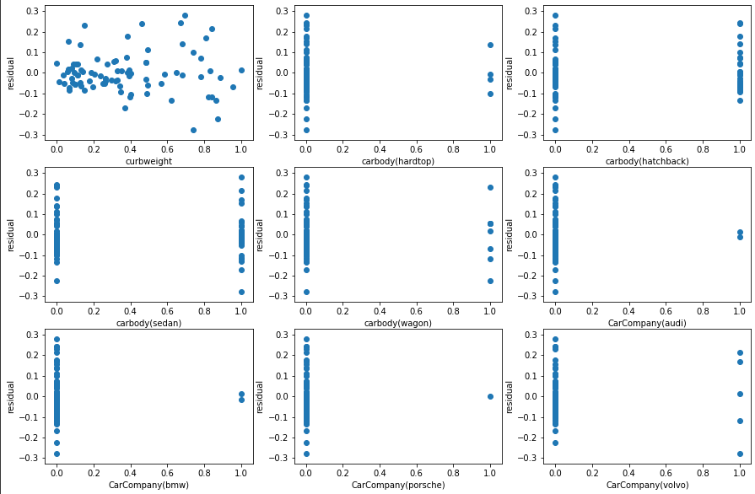
RESULTS
DRIVE LINK:
https://colab.research.google.com/drive/17t008bhhXtLX5ioJ1cp9mS7PuZvu0WAL?usp=sharing

