Slide 1
Project on JukeBox
Guided by
Mythreye R.
Shilpi j.
By
Shradha mali

Slide 2
Contents
INTRODUCTION
OBJECTIVE
DATABASE
CREATION OF CLASSES
Main Menu
OPERATIONS
CONSOLE LAYOUT

Slide 3
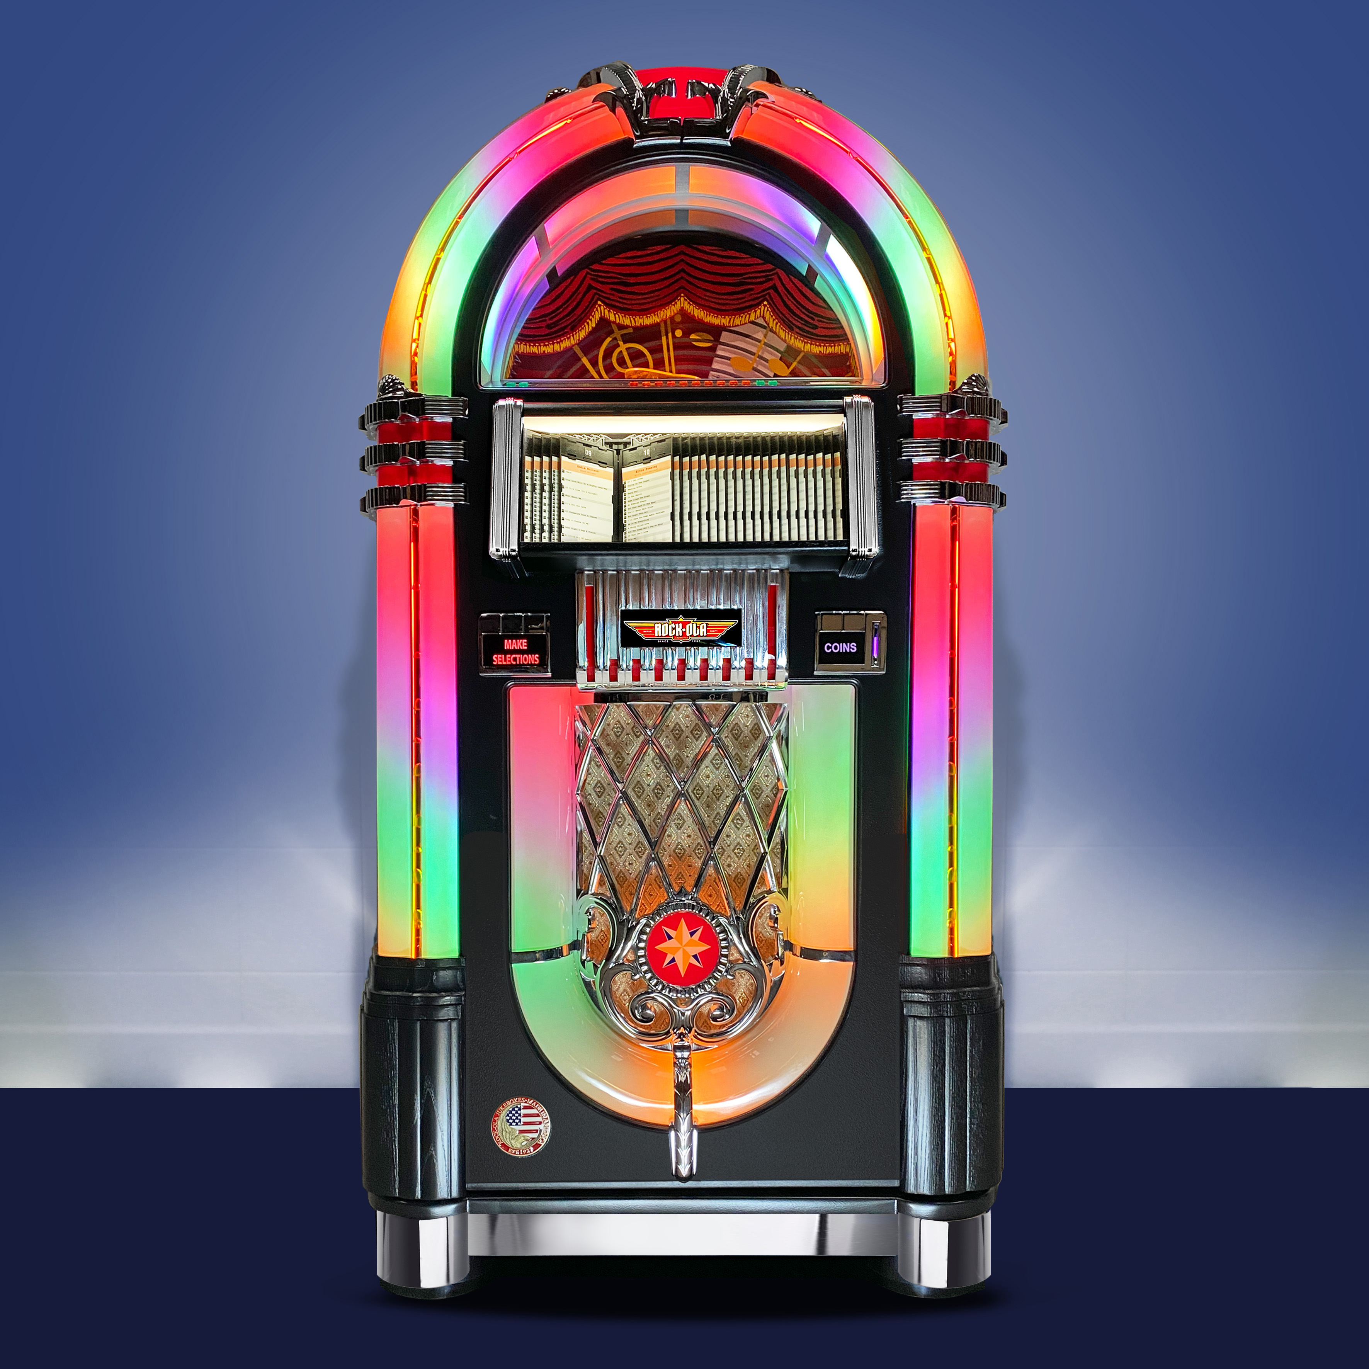
JukeBox
Jukeboxes were invented even before digital music existed - and well before streaming music became available
Jukeboxes were commonly used in restaurants
and bars to enable customers to choose what
music they wanted to listen to
Electronic and digital jukeboxes became prevalent in the 1970s and 1980s Modern jukeboxes are fully computerized and stream music from the internet directly

Slide 4
OBJECTIVE
User should Should play song according to their requirement
User can listen any song by Titles, Genre, Album Name , Artist Name.
User can do operations like Play , Pause, Resume , Forward , Stop, insert song
User can also add a song to playlist ,creat playlist ,

Slide 5
DATABASE
Tables In MySQL Workbench
1. Songs
2. Playlist
3. Playlist Content

Slide 6
CREATION OF CLASSES
Creation of Model classes
1. Songs
Creation of DAO classes
1.Song Connection
2.SongDAO
3.PlaylistDao
4.PlaylistContentDao
Creation of Service classes
1.Song Service
2. Playlist Service
3.Playlist Content Service
4. Players Service
5.JukeboxException
Main Implemention jukebox

Slide 7
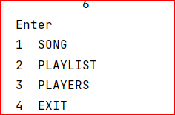
Main Menu

Slide 8
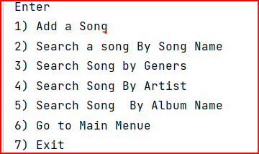
OPTIONS IN SONG
OPERATIONS

Slide 9
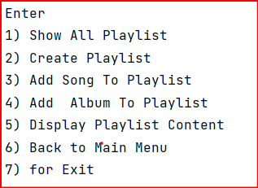
OPTIONS IN PLAYLIST

Slide 10
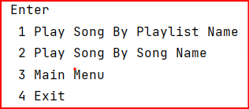
OPTIONS IN PLAYES

Slide 11
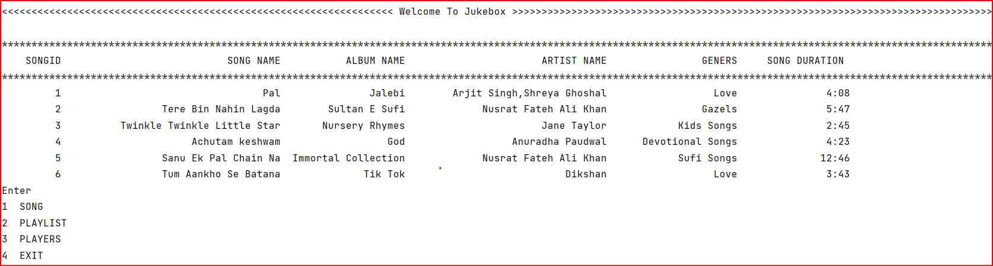
LAYOUT OF CONSOLE

Slide 12
THANK YOU

