Slide 1


RESUME CLASSIFICATION
Project members
Miss. Daneti Devi Chandini Mothukuru amruth mario Mrs. S M Aanantha Priya Mrs. R. Samatha Mr. Shantanukumar Shankar rana Mr. Shubham Dattatray Chougale Mr. Voonna Gowri Shankar

Slide 2


BUSINESS OBJECTIVE
The business objective of NLP (Natural Language Processing) resume classification is to enhance the efficiency, accuracy, and effectiveness of the hiring process, leading to better candidate selection, reduced bias, and improved talent acquisition outcomes.

Slide 3
FLOW OF PROJECT
Data Extracting and Preparation
Extracting skills
Model Training and Evaluation
Prediction
Iterative Improvements
Deployment

Slide 4
DATA EXTRACTION AND PREPARATION
Converting the raw data
Reading the data
Extracted Experience
Text Preprocessing
Creating labels

Slide 5
Converting the raw data
Dataset contains .doc/.docx/.pdf files.
Manually change .doc into .docx files.
The directory path is defined.
List of all .docx are extracted.
Column names are defined.
Iterate through each Word document file.
(i) Open the Word document
(ii) Extract file name without extension
(iii) Extract the entire content of the document
(iv) Write file name and content as a row in the CSV file
The raw data is converted into .csv and the file is saved.

Slide 6
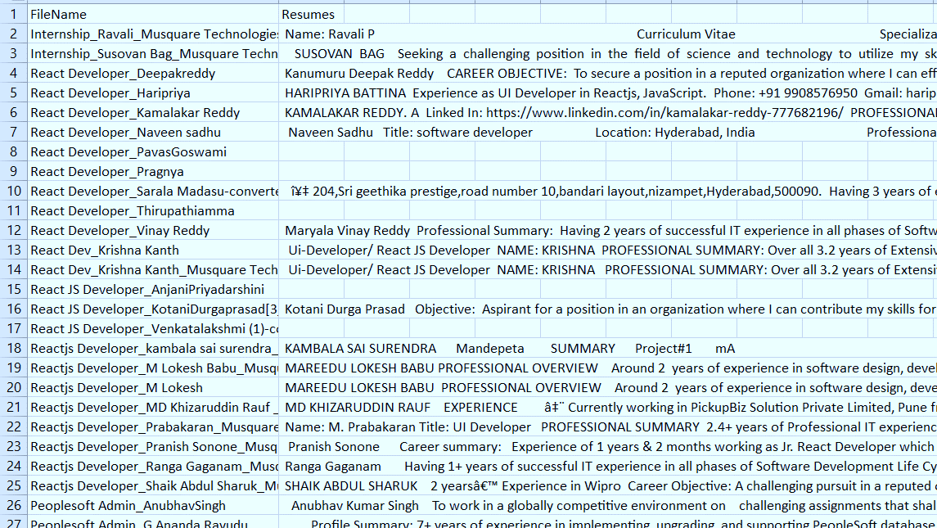
Reading the data

Slide 7
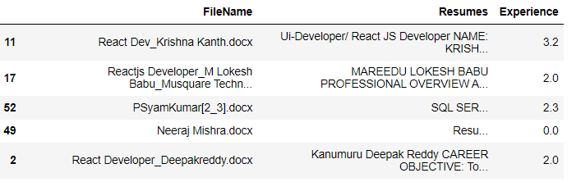
Extracted Experience
Extracting experience from resumes enables recruiters and hiring managers to assess job fit, predict performance, rank candidates, and make informed decisions in the candidate selection process.

Slide 8
Text Preprocessing
Preprocess the resumé data, which may include removing unnecessary information normalizing text and handling special characters or symbols.
We processed:
Lowercase the text
Replace parentheses with spaces
Replace special characters with spaces
Remove punctuations
Remove single quotations using regular expressions
Tokenize the text
Removed stop words
Lemmatize the tokens
Join the tokens back into a single string

Slide 9
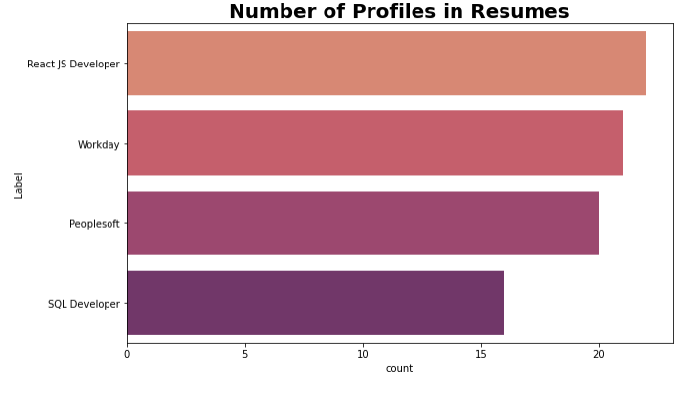
Creating labels
This virtualization created for labels in order to understand, extract, and process resume data. Among four types of profiles – we have high React js developer resumes.

Slide 10
EXTRACTING SKILLS

Slide 11
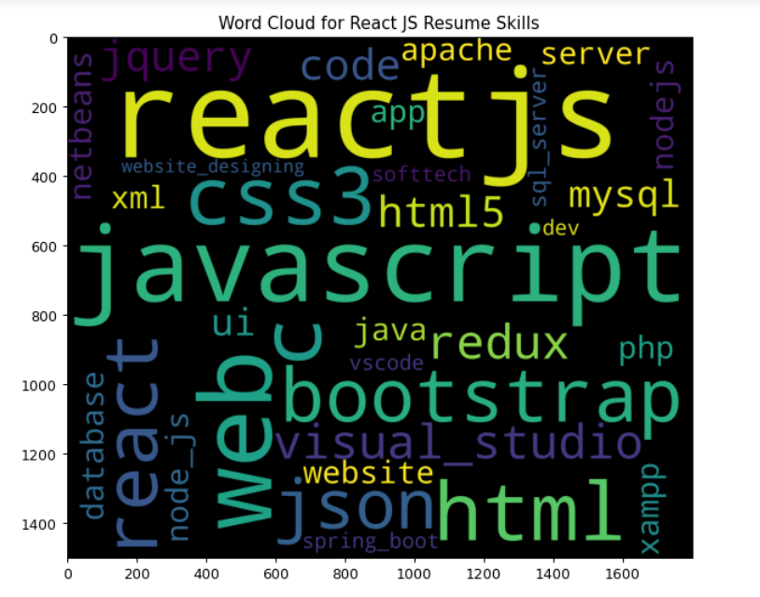
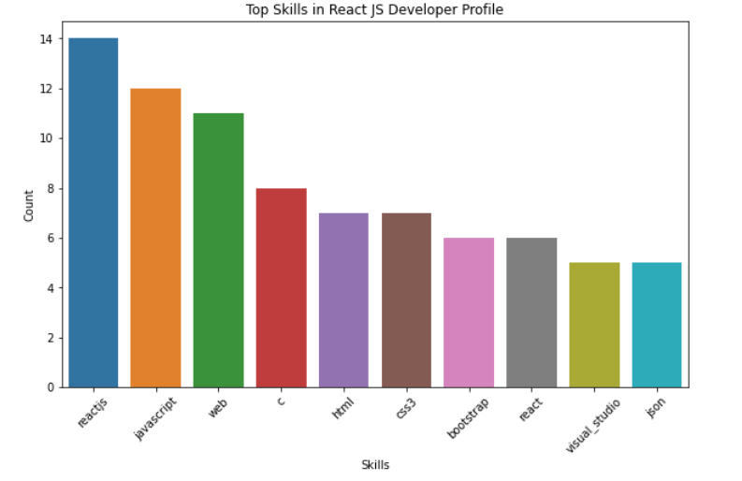
Extracting skills from React JS Resumes

Slide 12
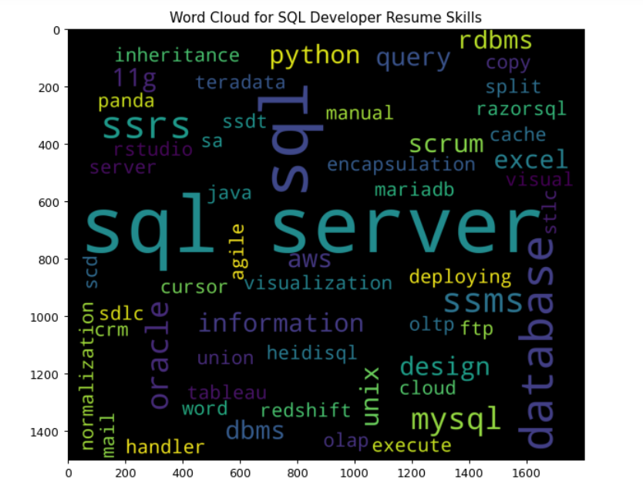
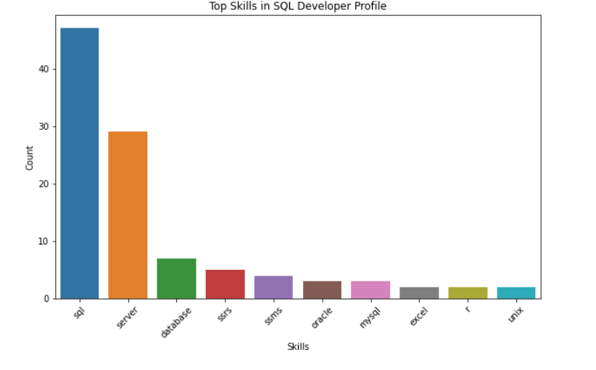
Extracting skills from SQL Developer Resumes

Slide 13
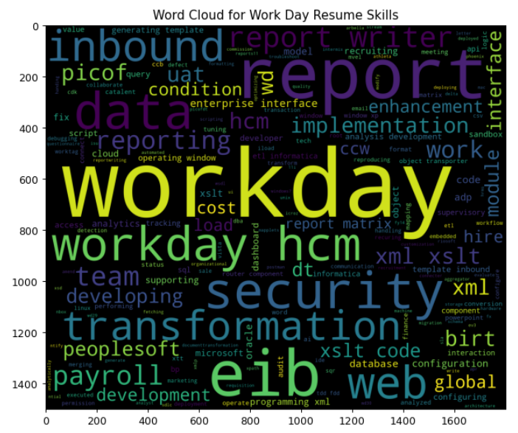
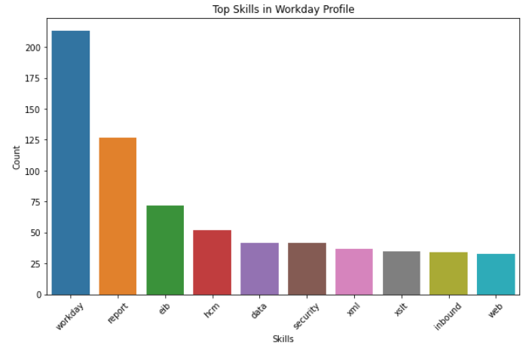
Extracting skills from Workday Resumes

Slide 14
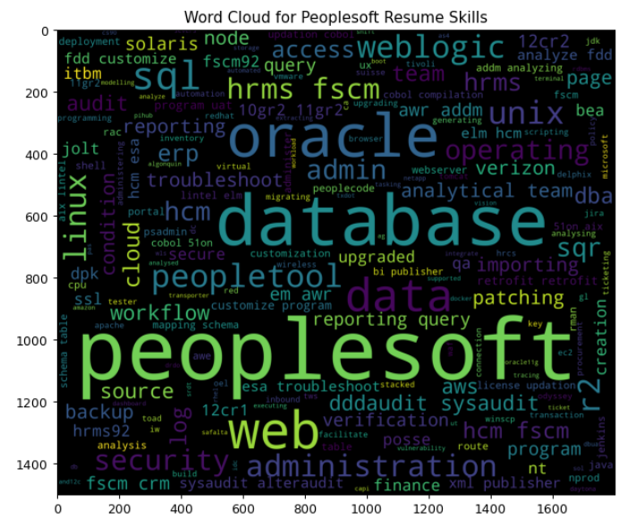
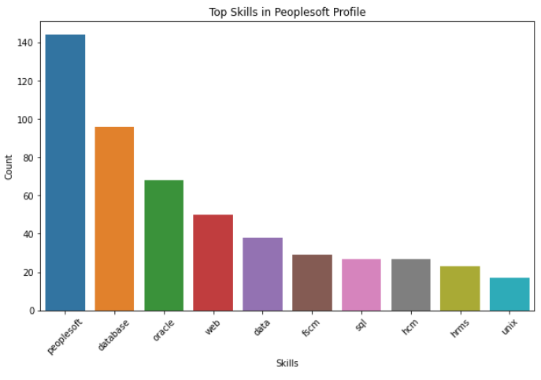
Extracting skills from Peoplesoft Resumes

Slide 15
Model Training and Evaluation
Model after TF-IDF(Term Frequency-Inverse Document Frequency )

Slide 16
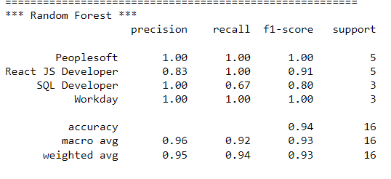
Model after TF-IDF
Convert the preprocessed text data into a numerical representation that machine learning algorithms can understand and model building is done using
K-Nearest Neighbors
LGBoost Classifier
Logistic Regression
Support Vector Machine
Decision Tree Classifier
Random Forest
Navie Bayes

Slide 17
Random Forest
Training accuracy:
0.984
Test accuracy:
0.875
Why we choose:
1. It solves the problem of overfitting as output is based on majority voting or averaging.
2. It performs well even if the data contains null/missing values.
3. Each decision tree created is independent of the other thus it shows the property of parallelization.
4. It maintains diversity as all the attributes are not considered while making each decision tree though it is not true in all cases.
5. It is immune to the curse of dimensionality. Since each tree does not consider all the attributes, feature space is reduced.

Slide 18
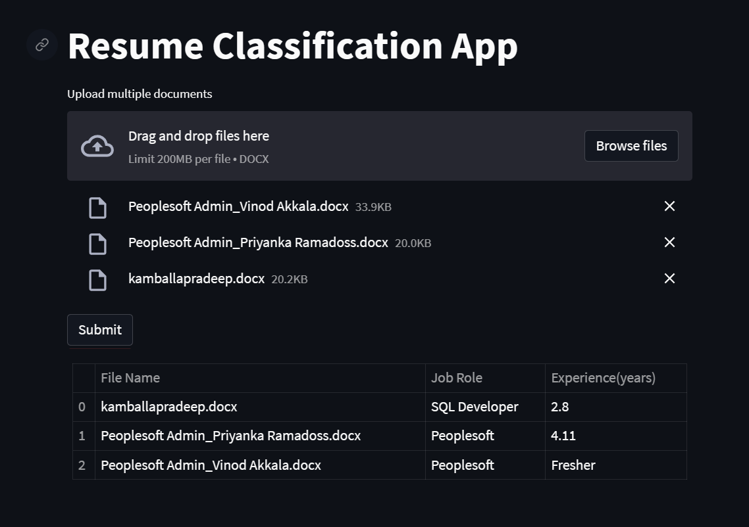
DEPLOYMENT using streamlit

Slide 19
THANK YOU

