Slide 1
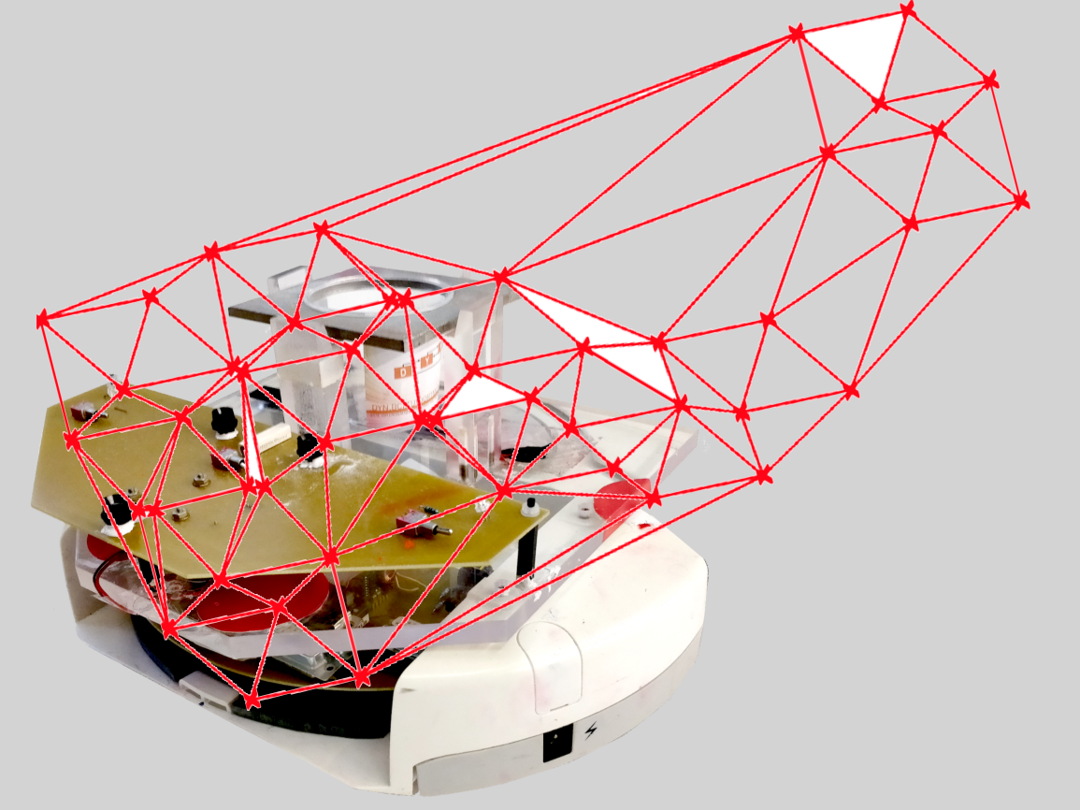
Project group SS18
Development of local positioning system for a pipe-less plant

Slide 2
Tasks for last week
RFID Tag ID
Creating a pseudo RFID Tag in the software
Sending data µController <> Computer
RFID
Order components
Emulator no. 1
Emulator no. 2
Robot Scenarios
Check the LiveStream
Create Log file for camera module

Slide 3
RFID Tag ID
64 Bit Binary ID
101010101010100011101010100100101101010101…

Slide 4
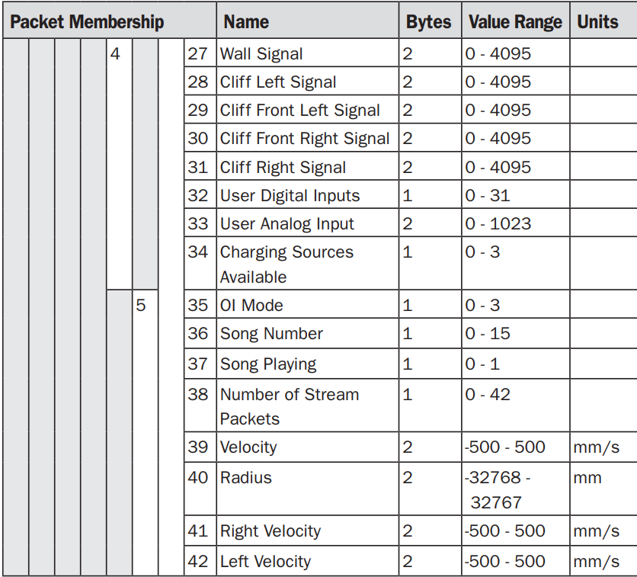
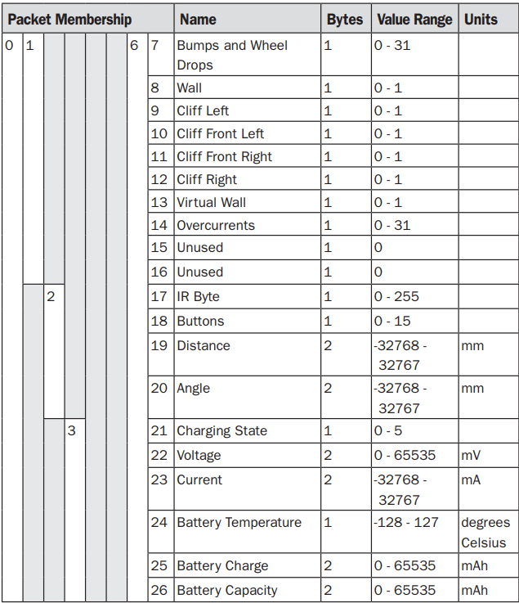
Pseudo RFID Tag
Adding to SensorData not possible
Predefined Protocoll from iRobot
Software disconnects AGV
New Protocoll for RFID Data has to be defined

Slide 5
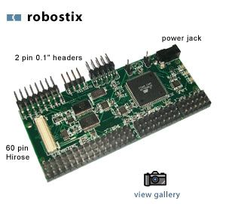
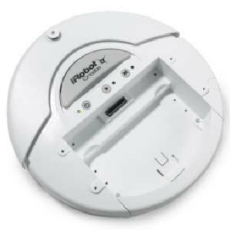

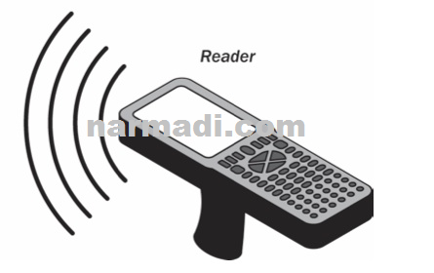
Communication to RFID Reader
UART0
UART1
I²C / SPI

Slide 6
Project group SS18
Development of local positioning system for a pipe-less plant

Slide 7
Tasks
RFID
Order components
Emulator no. 1
Emulator no. 2
CAD model of the map + drawing

Slide 8
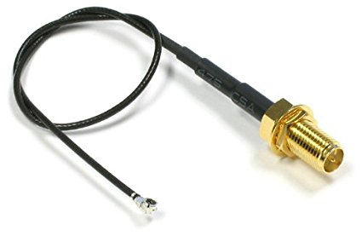
Order
RFID-Modul with
Evaluationboard RFIDM1356 PEB
Antenna
Size: 80 x 80 mm
Additional stuff:
Adapter cable, SMA cable, power adapter, connection cable
Samples of the RFID tags (PET and paper[0,18€/each])

Slide 9
Emulator no. 1
Matlab data in Github
Emulator
Cycle time [ms]
Rob speed [m/s]
Rob start and end position [x,y]
Radius reading range [10 cm]
Distance last tag <-> boarder [cm]
Distance between tags [cm]
Length or width of plant [cm]
RSSI [0...7]
Time stamp [ms]

Slide 10
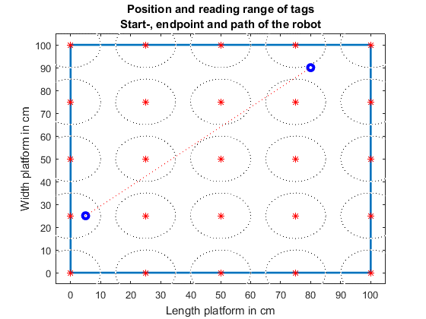
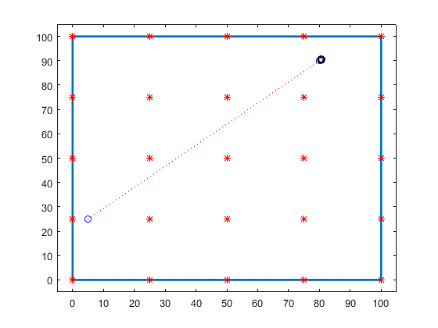
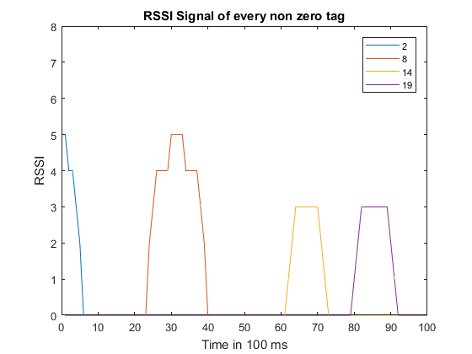
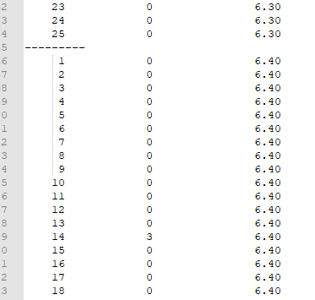
Emulator no. 1
Txt file

Slide 11
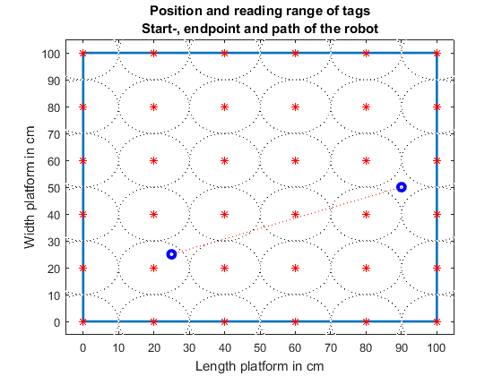
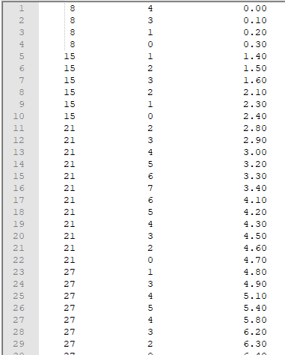
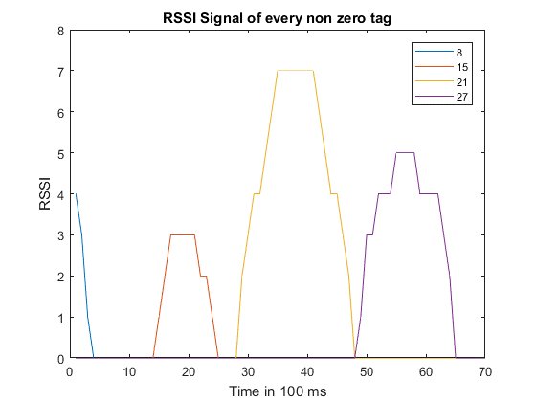
Emulator no. 2
Txt file

Slide 12
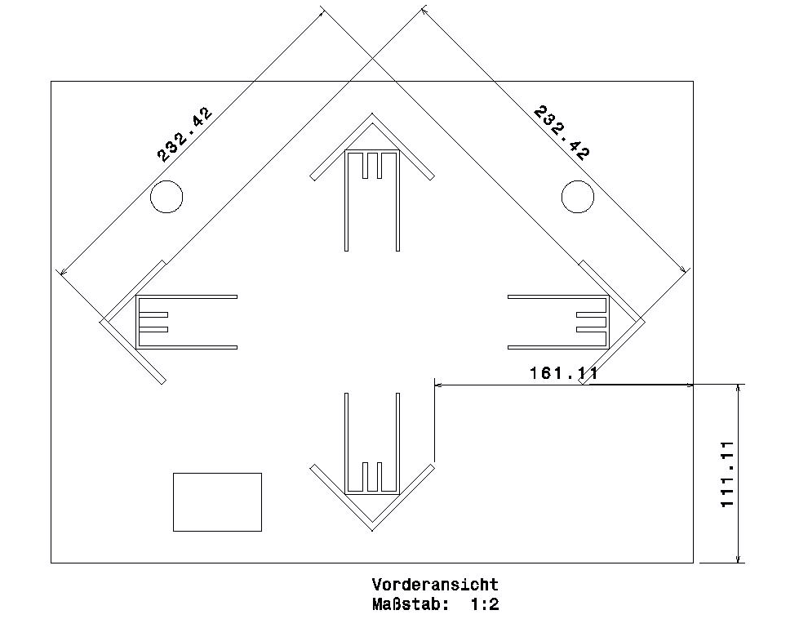
CAD model of the map + drawing
Main area
2,3 m x 2,3 m
Additional space
1,6 m x 1,1 m
Around 7 m²

Slide 13
Project group SS18
Development of local positioning system for a pipe-less plant

Slide 14
Robot Scenarios
Robot diameter= 33 cm
Tag range= 10.5 cm
Scenarios
Robot Initialization (Position & Orientation)
Blind Spots
Robot Lost
Conclusion Scenarios
RSSI | 0 | 1 | 2 | 3 | 4 | 5 | 6 | 7
Radius in mm | 105 | 100 | 95 | 90 | 80 | 60 | 50 | 40

Slide 15
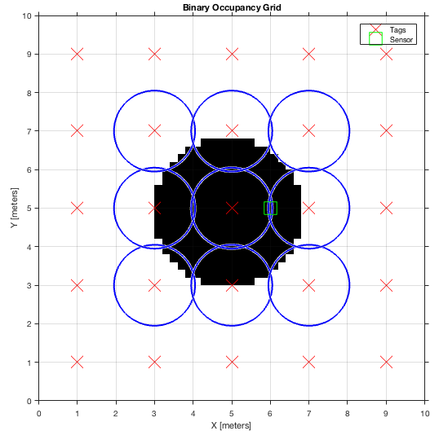
Tags Layout (1) $[1{ m}^{2}]$
Blue: Tag reading Radius 10.5 cm
X: Tags
Black: Robot
Green: Reader with distance 10 cm from robot center
RSSI= 0 tag1 & 0 tag2
Tags are 20 cm far from each other
$1{ m}^{2}$= 25 Tags
Risk of: 0.5 cm

Slide 16
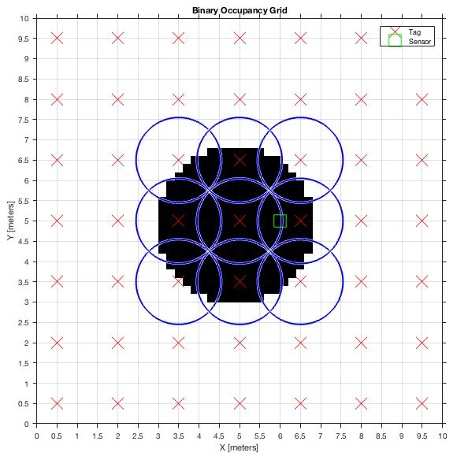
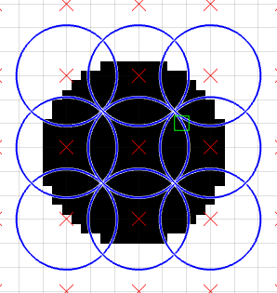
Tags Layout (2) $[1{ m}^{2}]$
RSSI= 0 tag1 & 6 tag2
Tags are 15 cm far from each other
$1{ m}^{2}$= 45 Tags
Risk of: no blind spots

Slide 17
Possible Scenarios
Blind Spot: use the encoder to calculate the distance
Robot Lost.
Move a distance not more than 20 cm to identify the nearest Tag, if tag not found Halt the robot, and reset the encoder once tag detected.
Initiating
Use a tag as Station
Center of the Robot should start and end standing at middle of Tag
Rotate around it self to approx. initial the orientation
Calculate the actual angle once the robot moves

Slide 18
Project group SS18
Development of local positioning system for a pipe-less plant

Slide 19
Tasks for last week
Check the LiveStream
Create Log file for camera module

Slide 20
Arslan’s suggestions
POSITION UPDATE IN GUI
Reading the position is consumed by capturing pictures (around 100 ms).
Updating the position in GUI would introduce more delays.
LIVE STREAM
Live Stream not possible with USB 2.0
It is only possible to either get the current position or live stream due to the camera
Updating the position in GUI would introduce more delays.

Slide 21
Tracking the robot
The positions of robots was saved from python to mat files but without time stamps and can be plotted in matlab.

Slide 22
Next steps
New code- UPDATES
Connection to robot failed, while running PUTTY
Further step
Work on the connection.

