Slide 1
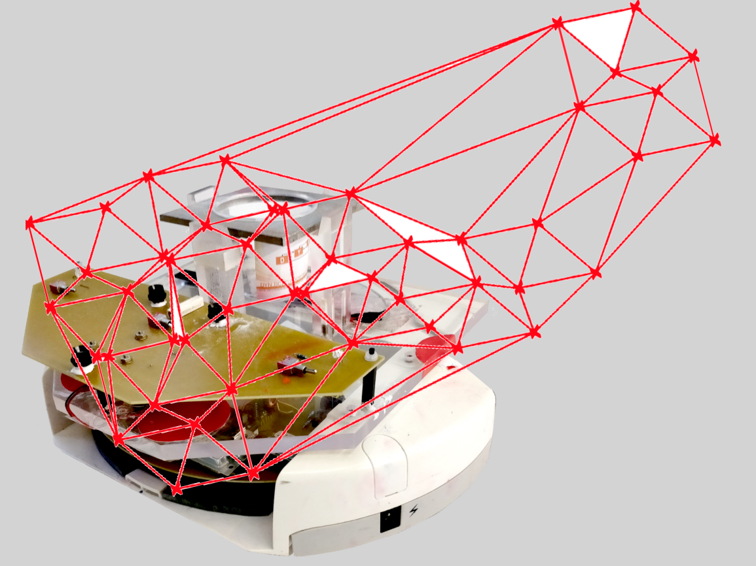
Project group SS18
Development of local positioning system for a pipe-less plant

Slide 2
Tasks
Camera
Wifi
RFID
Microcontroller
Worst Case

Slide 3
Camera Updates
Control Modules | Arslan Code | Feb 5 Code
Camera Module | Direct access of the camera | Interface between uEye software and C#
Robot Module | Velocity – double GoToPoint – pos,rot,max_velocity | Velocity – double[ ] GoToPoint - NotImplementedException
Connection Module(batterystatus Publisher Subscriber) | same | same
Controller Module | same | same
Docking Module | same | same
Feedforward Module | same | same
MPC Module | same | same
Routing Module | Still working------------------------------------
Scheduling Module | same except for TAOPTModel where few steps are commented | same
Simulation Module | same | same
Station Module | same | same

Slide 4
Wifi
Code changed: send RFID info from AGV to PC
Not verified

Slide 5
RFID
Tags
Sticker
Liner and general material: PET
Size: around 50x50 mm
Hight: Around 0.2-0.4 mm
Special feature: Every tag can have store additional information (e.g. position of the tag w.r.t. global frame)
No offer yet
Price: ???

Slide 6
RFID
Reader
RFID OEM Modul
KTS-Systeme
Communication:
Serial (UART possible)
Antenna: Pins or U.FL (Adapter to SMA available)
Size: 36 x 17 mm
RSSI: also displayed with SW
Price: 130,90 €

Slide 7
RFID
RFID-Modul with
Evaluationboard RFIDM1356 PEB
Communication:
RS232
Price: 149,94 €

Slide 8
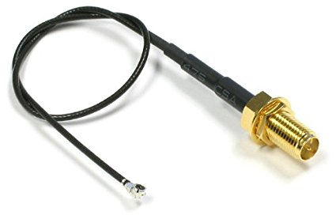
RFID
Antenna
Size: 80 x 80 mm
Communication: SMA
Price: 86,87 €
SMA -> U.FL adapter
20 cm
Price: around 6 € (Amazon)

Slide 9
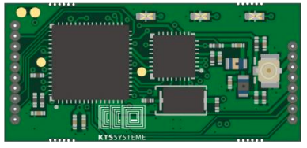
Microcontroller
RFID communication with the microcontroller

Slide 10
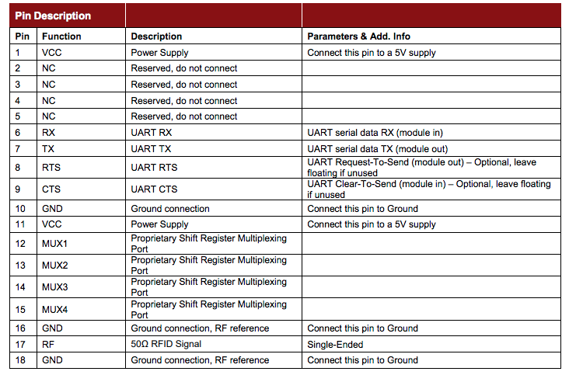
KTS Module

Slide 11
KTS Module
Receiving only data can use only TX or RX
Coding:
USART_Init(9600);
“initialize USART with 9600 baud rate”
RFID[i]=USART_RxChar();
“Read RFID Tag number”

Slide 12
Worst Case
No space for calibration tour
Special ID at the boarder: Check if signal strength of special IDs increase

