Slide 1
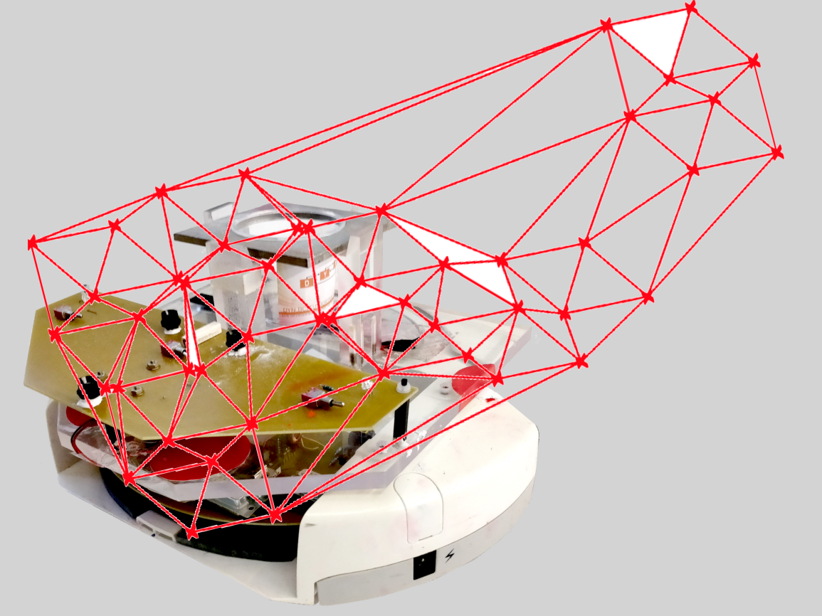
Project group SS18
Development of local positioning system for a pipe-less plant

Slide 2
Task for the week
Select formal project leader -> Stephan Vette
Think through the necessary subtasks
Write a project plan
Schedule the next meetings

Slide 3
Tasks and subtasks
Get familiar to the plant
Read all documentations
Search and read literature about tracking systems
Measurement of plant performance
Decide on quantities (Possible or not)
Perform measurements
Determine the weak points
Determine the effort needed to improve performance
Find and compare different alternatives
Vision (passive and active components)
Ideas beyond

Slide 4
Tasks and subtasks
Verify
Plausibility of made decisions
Order
Prototyping
Recheck of performance improvement
Conclusion
Description of overall improvement
Description of the limit of the new setup

Slide 5
Project Plan

Slide 6
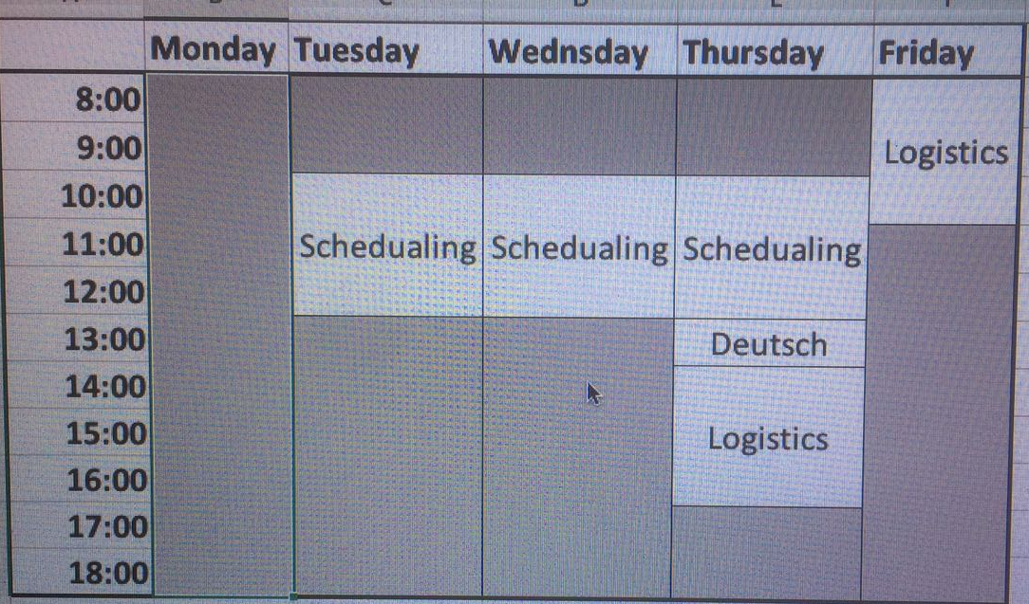
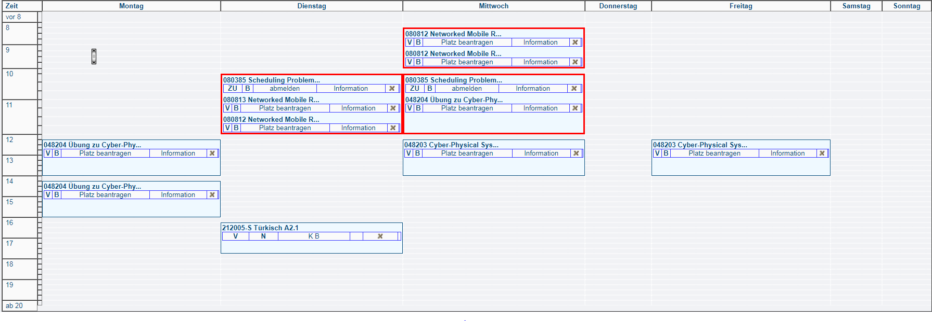
Schedule the next meetings
Abdulrahman, Medhini
Swedish
Stefan, Stephan

Slide 7
Until next time
Find good literature (+ short explanation)
Read the literature
Start to work with the plant (understanding of code)
Document knowledge and explain it to the others)
For measurements: Think about quantities

