Slide 1
A Practical Hybrid Diffusion--GAN Approach to Image Super-Resolution on CPU
By: Saad Almolled G202415440
Supervisor: Dr. Muzammil Behzad

Slide 2
Agenda
INTRODUCTION
METHOD OF STATEMENT
RESULTS AND DISCUSSION
CONCLUSION

Slide 3
INTRODUCTION
Super resolution (SR) aims to create high-resolution images from low-resolution inputs while keeping important details, but recovering meaningful texture and sharpness becomes difficult when the LR image lacks structural information.
GAN-based models such as ESRGAN and Real-ESRGAN improve visual quality by learning realistic textures and producing clearer, more appealing results.
Traditional interpolation in GAN is fast but fails to recover authentic details, while diffusion-based SR generates realistic outputs through multiple denoising steps that help reduce artifacts.
Diffusion models offer stable reconstruction, but their sequential denoising process increases computational cost compared to simpler SR methods
The logical solution to bridge the gap between them is to explore hybrid model combining their advantages

Slide 4
PROBLEM STATEMENT
Diffusion-GAN Hybrid approach has been explored in previous studies as a possible way to bridge the gap between both models
The proposed hybrid models achieves major advancements but need GPU hardware as they use too much computing power to run on CPUs with longer processing time.
Further optimization is required to run hybrid SR models on lower computational hardware including mobile/local AI hardware and cloud apps.
The benefit of such low demand model will help integrating hybrid SR in automated surveillance records upscaling for face recognition, mobile applications and so on.

Slide 5
OBJECTIVES AND SCOPE
Objectives:
The research project consists of three fundamental objectives:
The development of a lightweight SR architecture which unites core elements from GAN and diffusion models.
The approach of adding edge information for its fundamental structural reference point during its refinement process.
The research evaluates our final hybrid design against previous versions and examines their design choices.
Project Scope:
The system performs ×4 super-resolution tasks with small refinement network.
Basic SR (GAN based) + diffusion refiner + up sampler+ discriminator
The system operates exclusively on CPUs to see how light weight it is
The focus will assess the possibility for real-world field usage instead of performing complete benchmark evaluation.
The model will be revisited based on the its performance.

Slide 6
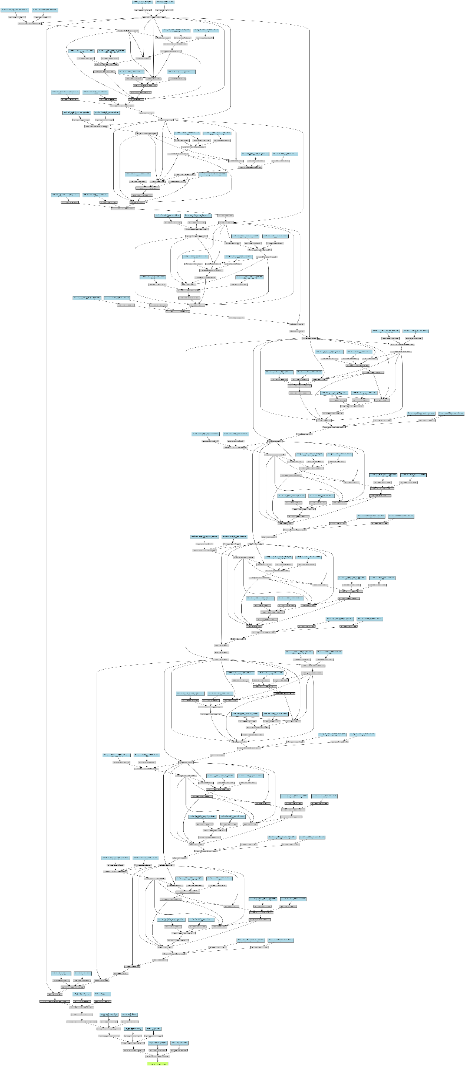
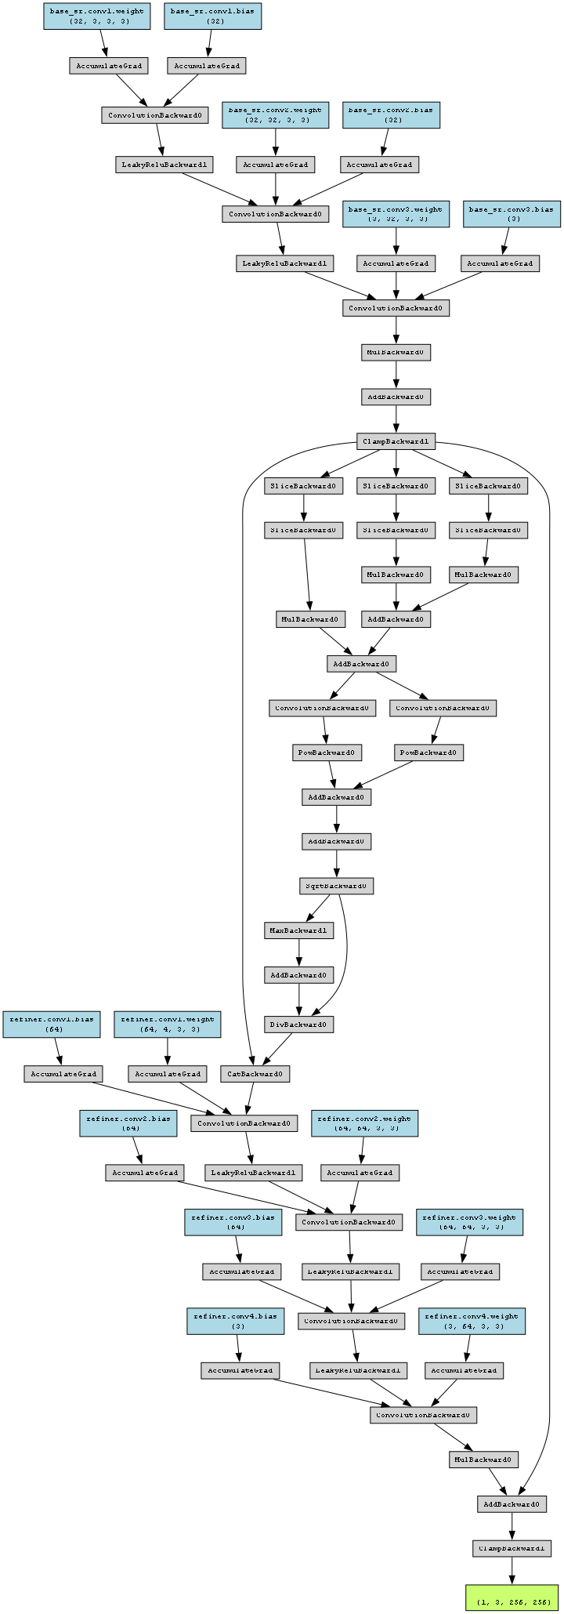
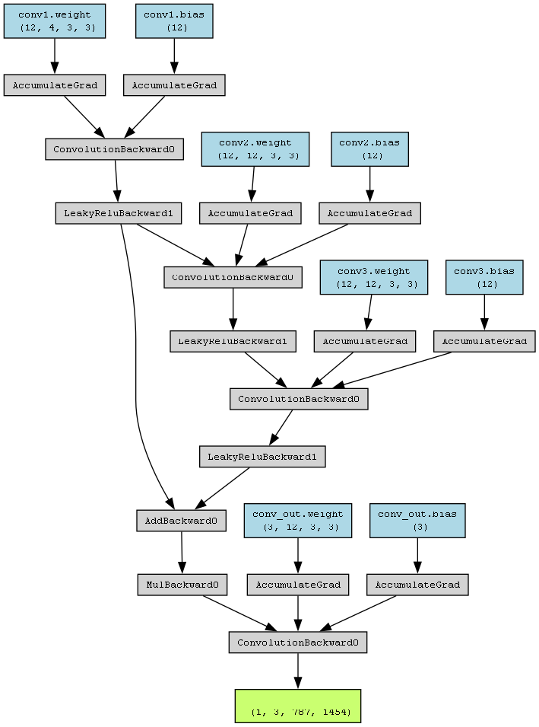
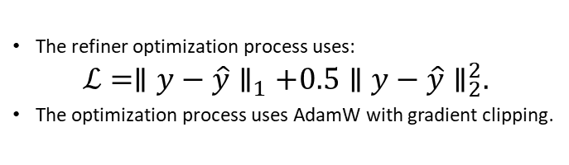
OBJECTIVES AND SCOPE
Roadmap of the Methodology
The first attempt employed RRDBNet with TinyDiffusionRefiner to produce excellent results, yet it did not fulfill the required CPU performance standards.
The FastHybridSRModel using basic SR instead of RRDBNet achieved fast operation, but its perceptual quality remained insufficient.
The ImprovedSRModel with BalancedRefiner achieved a balanced solution which delivered good quality results and acceptable CPU performance.
The refiner optimization process uses:
$$ℒ=∥y−\hat{y}∥_{1}+0.5∥y−\hat{y}∥_{2}^{2}.$$
The optimization process uses AdamW with gradient clipping.
Structure of FastHybridSRModel
Structure of HighQualityHybridModel
structure of the RRDBNet from Real-ESRGAN model
(GAN-based)

Slide 7
RESULTS AND DISCUSSION
The model benefits from edge conditioning. Generates more detailed structures than the fast prototype. Operates within the expected CPU timing range with no extensive memory usage or crashes.
The difference in image colors is due to loss in feature capture during down sampling during refinement (more training is required)

Slide 8
CONCLUSION
The research developed an efficient hybrid SR system optimized for CPU hardware. The model combines a small SR backbone with an edge-conditioned refiner and latency-aware execution. Future work explores perceptual losses, short multi-step refinement, and embedded platform testing.
The model needs to be trained on more data to capture the coloring deviations. Addition of a denoising step in the refiner will help increasing the feature capturing and edge recognition better.

Slide 9
Thank you

