Slide 1
Preserving Research Data: where are we now?
ACCOLEDS 2007

Slide 2
Outline
Today’s drivers to preserve research data
Threads traceable to earlier studies and how they have shaped today’s dialogue on data archiving
  To establish a national data management strategy
  To determine how big the problem of research data loss really is
  To distribute data archiving functions
  To provide access to publicly funded data
The “open” movements and how they are shaping data environments
Partnerships in the evolving distributed repository model

Slide 3
Drivers to preserve research data
New concerns raised about the stewardship of publicly funded resources, including research data.
  For example, new policies in health (NIH and CIHR)
A confluence of “open” movements bringing together software, research outputs and data.
The emergence of e-Science and its emphasis on access to scientific data.
  Short-term access does not require preservation but long-term access will not be possible without preservation.
The transformation of the Digital Library movement from digitizing content to accessing content.

Slide 4
Threads from earlier studies
A National Data Management Strategy
Data Policy and Barriers to Data Access in Canada: Issues for Global Change Research by the Data and Information Systems Panel of the Canadian Global Change Program, 1996
  “Current Canadian data collection and management strategies can be characterized as localized and confused… No national data management strategy exists to ensure a rational data collection scheme, standards of data management, equitable data access, nor the long-term preservation of those data that are collected.” (p. 14)

Slide 5
Threads from earlier studies
A National Data Management Strategy
In 1998, the John English consultation on the future role of the National Archives and the National Library.
  CAPDU submission recognized in the final report
    “RECOMMENDATION: WE ENDORSE THE CANADIAN ASSOCIATION OF PUBLIC DATA USERS PROPOSAL FOR A NATIONAL DATA MANAGEMENT STRATEGY IN WHICH THE NATIONAL ARCHIVES AND THE NATIONAL LIBRARY PLAY A FACILITATIVE ROLE. THE TWO INSTITUTIONS SHOULD PLAY A PARTNERSHIP ROLE WITH SUCH A DATA ARCHIVE AND COORDINATE THE FEDERAL GOVERNMENT'S RELATIONSHIP WITH SUCH AN ARCHIVE.” (p. 18-19)

Slide 6
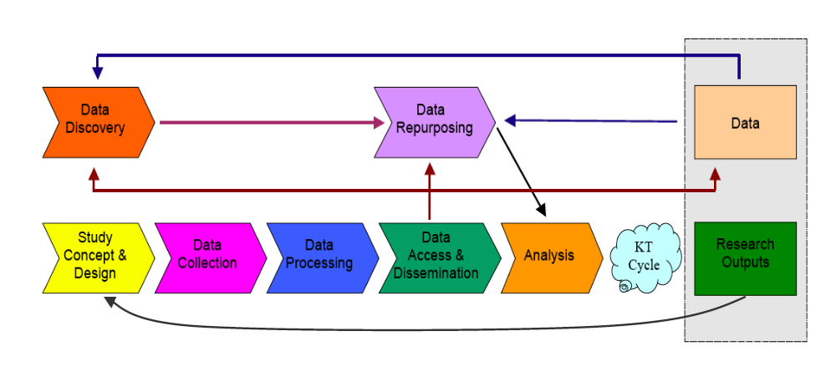
Research Life Cycle Model
The thread calling for a data management strategy has evolved into the research life cycle model for thinking about the stages needed to represent a comprehensive management strategy.
One example of a research life cycle model. Source: To Stand the Test of Time http://www.arl.org/bm~doc/digdatarpt.pdf

Slide 7
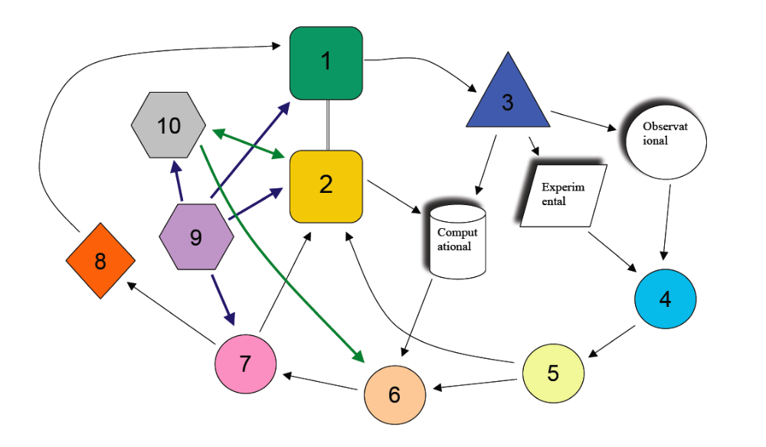
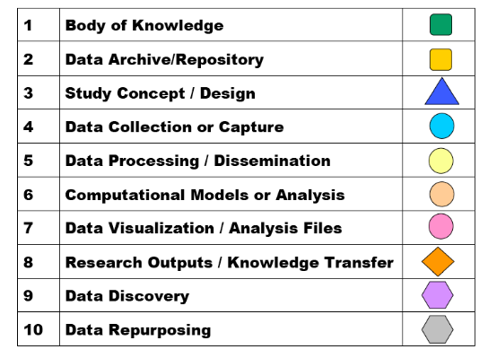
Representation of the Research Life Cycle
Observational
Experimental
Computational
Source: Humphrey, Metadata-driven Solutions, Open Data Foundation Meeting, September 13-15, 2007 at http://opendatafoundation.org/
Notes:
The components in this framework include both a collection of published knowledge and a body of research data (1 & 2) that exist as repositories. The generation of research and data consist of stages 3 through 6. Stages 7 & 8 represent the preparation and communication of research outputs, and the discovery and repurposing of data is shown in stages 6, 7, 9 & 10.

Slide 8
Where we are today
A National Data Management Strategy
While Canada is still without a national data management strategy, attention to this issue has surfaced in the following events.
  Janet Halliwell’s introductory remarks at the National Consultation on Access to Scientific Research Data (NCASRD) quoted from the report of the Data and Information Systems Panel of the Canadian Global Change Program and challenged the assembly to put this shortcoming in Canada to rest. Sections in the NCASRD final report mention both data management plans as a best practice and international leadership in data management.
  The Canadian Digital Information Strategy contains an action item (1.3.2) that also addresses data management plans as part of Canadian funding programs.

Slide 9
Where we are today
A National Data Management Strategy
The recent focus on data management strategies has been at the individual research project level around data production, dissemination and preservation. The national infrastructure to support individual research plans has not been clearly identified yet, although discussions have suggested that the solution should be at the university or discipline level.
Work continues in articulating the life cycle model as it applies to managing and preserving research data.

Slide 10
Threads from earlier studies
Determining the severity level of lost research data
The SSHRC and the National Archives joint consultation (NDAC) consisted of two phases. Phase 1, which lasted from October 2000 to June 2001, was asked to demonstrate a need for data archiving in Canada. Prior to Phase 1’s report, only anecdotal evidence existed about the risk level facing research data in Canada. Determining actual numbers of files at risk is a difficult task, as noted in Data Policy and Barriers to Data Access in Canada.
    “Understandably, the published literature is remarkably silent on the subject of lost data collections, and as no comprehensive inventory of datasets exists in Canada, the identification of lost data is a matter of inside knowledge and luck.” (p. 15)

Slide 11

The data risk level in Canada
Three studies were conducted in conjunction with Phase 1 of the NDAC that provided evidence about the level to which Canadian research data are at risk.
Source: Humphrey, Preserving Research Data: A Time for Action, Preservation of Electronic Records: New Knowledge and Decision-making, Ottawa: The Canadian Conservation Institute (2004), pp. 83-90.
Notes:
What about the level of risk facing research data? I’d like to share briefly the findings from three studies that help answer this question.

Slide 12
The data risk level in Canada
Study 1: a gap-analysis of existing mandates and practices of national institutions.
Findings:
  The vast majority of academic and non-academic research data fall outside the current [ca. 2001] interpretation and execution of the mandates of the National Library and National Archives.
  No other Canadian institutions have a national mandate or the resources to address the current level of need for preserving research data.
Notes:
These three studies examined the following. First, an institutional gap analysis was performed to evaluate where data fits into existing mandates and practices of national heritage institutions.
The second study used a sampling frame based on a 20 year old administrative survey to see how many data files from the older study could still be located.
Finally, a survey of SSHRC-funded researchers was conducted to discover their understanding an conventions in archiving research data.

Slide 13
The data risk level in Canada
Study 2: a follow-up study to an investigation first conducted twenty years ago by the now defunct Machine-Readable Archives.
Findings:
  Data from 3 out of 110 studies could be found without contacting the original principal investigators directly for further details.
  The 3 studies for which data were found all were deposited in the United States with the Inter-university Consortium for Political and Social Research (ICPSR).
Conclusion:
  The risk of data loss is very high without an institution with the specific mandate to preserve research data.
Notes:
These three studies examined the following. First, an institutional gap analysis was performed to evaluate where data fits into existing mandates and practices of national heritage institutions.
The second study used a sampling frame based on a 20 year old administrative survey to see how many data files from the older study could still be located.
Finally, a survey of SSHRC-funded researchers was conducted to discover their understanding an conventions in archiving research data.

Slide 14
The data risk level in Canada
Study 3: a survey of researchers receiving a standard research grant from the SSHRC between 1998 and 2000.
Findings:
  Without a recognized institution responsible for preserving research data, researchers do not know where or how to archive the data from their research, even if they would like to see the data preserved.
  For the vast majority of researchers in this study, archiving data is an unknown activity in conducting research.
  The survey of researchers who received a standard research grant from the SSHRC provides evidence that around 550 out of every 1,000 projects results in the creation or use of data files and/or databases.
Notes:
These three studies examined the following. First, an institutional gap analysis was performed to evaluate where data fits into existing mandates and practices of national heritage institutions.
The second study used a sampling frame based on a 20 year old administrative survey to see how many data files from the older study could still be located.
Finally, a survey of SSHRC-funded researchers was conducted to discover their understanding an conventions in archiving research data.

Slide 15
Where we are today
Determining the severity level of lost research data
No national accounting system has been developed to establish an on-going record of the number of data files with research value that are at risk. The facts gathered in the 2000-01 NDAC remain our best indicators on data loss.
A recent study by Carol Perry does corroborate evidence from the 2000-01 NDAC findings that preserving data is not part of the research culture in the social sciences and humanities.

Slide 16
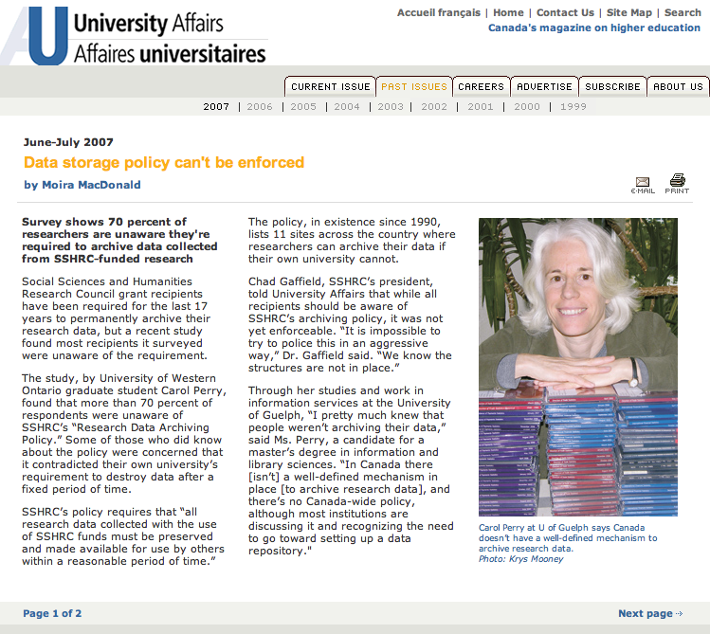

Slide 17
Threads from earlier studies
A distributed model of data archiving functions
Phase 1 of the National Data Archive Consultation made reference to a “research data archiving function” rather than an institution.
    “For the purpose of this report, a research data archiving function is defined as preserving, managing and making publicly accessible digital information structured through methodology for the purpose of producing new knowledge.” (p. 4)
    NDAC: Phase One Needs Assessment Report http://www.sshrc.ca/web/about/publications/da_phase1_e.pdf

Slide 18
Threads from earlier studies
A distributed model of data archiving functions
Phase 2 of the NDAC, which was given the green light to proceed in June 2001, examined existing international models for providing data archiving services and recommended three possible models for Canada.
A tension exists in the report between an institutional solution and a network of partnerships. Pages 10-13 provide a potential list of partners in a “National Research Data Archive network.” They include: university data services, Canadian archival institutions, international connections, CANARIE, management frameworks (e.g., REB’s), partner institutions (e.g., LAC), preservation services for other agencies.

Slide 19
Threads from earlier studies
A distributed model of data archiving functions
The three models recommended in the final report:
  Through federal legislation, create a National Research Data Archive Network as a modified version of a Separate Statutory Agency.
  Create a National Research Data Archive Network under the auspices of the SSHRC.
  Create a Special Agency within LAC to preserve research data.

Slide 20
Where we are today
A distributed model of data archiving functions
Recent discussion tends to support a distributed model that takes advantage of institutional repositories on local campuses. While universities have been identified as only one group among the partnerships needed for a national data archiving service, no dialogue has been initiated to bring all possible partners to the table. The proposal in the NCASRD report was to create an entity, called Data Force, to create such a forum.

Slide 21
Threads from earlier studies
Data as a Public Investment
OECD Ministerial Declaration on Access to Research Data from Public Funding
  dated January 30, 2004
  Canada is one of 33 co-signers
Premise of the declaration: publicly funded research data should be openly available to the maximum extent possible.
Subsequent selective implementations in the U.S. and the U.K.
In Canada, this contributed to forming the National Consultation on Access to Scientific Research Data.

Slide 22
Threads from earlier studies
Data as a Public Investment
NCASRD was an NRC, NSERC, CFI and CIHR sponsored consultation in 2004-05 “to help Canada maximize the value received from its publicly funded natural and medical sciences research by recommending an appropriate framework and guidelines, which will facilitate open and long-term access to data coming from that research.” http://ncasrd-cnadrs.scitech.gc.ca/home_e.shtml
In the NCASRD final report, a proposal is made to establish a dedicated national infrastructure, known as Data Canada, to oversee the implementation of the report’s recommendations. Data Canada would support other institutions involved in archiving data by providing national leadership. http://ncasrd-cnadrs.scitech.gc.ca/NCASRDReport_e.pdf

Slide 23
Where we are today
Data as a Public Investment
CIHR introduced a new policy regarding open access. The policy is fairly specific about research outputs, but is vague about preserving data and only addresses access to publication-related data.
  “CIHR has decided to limit this policy to peer-reviewed journal publications and publication-related biomedical research data, which is typically deposited into public databases as a condition of publication. CIHR … will explore broadening the policy to include research materials and other research data in the future. ”
  http://www.cihr-irsc.gc.ca/e/34846.html

Slide 24
Threads from more recent studies
It takes a research community to preserve its data
An ARL-NSF Consultation was held in the fall of 2006 to provide direction to NSF’s Cyber-infrastructure program, which is known as e-Science in Europe.
The final report, “To Stand the Test of Time: Long-term stewardship of digital data sets in science and engineering,” argues for new partnerships among domain scientists, librarians, and data scientists to manage digital data collections better.
A new NSF program arising from this report is NSF 07-601, “Sustainable Digital Data Preservation and Access Network Partners.”

Slide 25
Threads from more recent studies
It takes a research community to preserve its data
The Canadian Digital Information Strategy was released for public review in October of this year. This document contains a set of principles to guide digital information policies in the cultural, government and scientific sectors. The preservation of scientific data is included in this report. (see: http://www.collectionscanada.gc.ca/cdis/index-e.html)

Slide 26
Where we are today
It takes a research community to preserve its data
We are creating preservation-quality metadata in Canada. The Research Data Centre Network received a CFI award to develop metadata and supporting tools for the confidential data it houses.
  This project is based on a life-cycle model of research and examines the capture and preservation of metadata throughout the stages of research.
Statistics Canada has two internal DDI projects: one in DLI and another with a group of author divisions.
OCUL’s Data group (DINO) received funding from OntarioBuys to produce DDI metadata for data holdings in Ontario universities. This project is known as ODESI.

Slide 27
Open movements shaping research environments
Investments in e-Science or cyber-infrastructure underlie the environments being developed for researchers. This infrastructure consists of layers.
Virtual
Community
Virtual
Community
Virtual
Community
Meetings,
experiments, etc.
Meetings,
experiments, etc.
Meetings,
experiments, etc.
Workspace
Workspace
Workspace
Virtual
Laboratories
Virtual
Laboratories
Virtual
Laboratories
Scientific Data
Scientific Data
Scientific Data
Scientific Data
Economies
of Scale
Grid
Efficiency
Gains
Grid
Grid
Grid
Network
Network
Network
Network
Source:Ulf Dahlsten, “Building a global virtual research community,” http://internationaldataforum.org

Slide 28
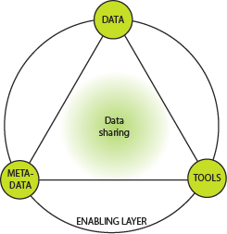
An infrastructure framework
Another framework is represented in the proposal for the European Research Observatory for the Humanities and Social Sciences (EROHS).
Data
Preservation
Bjørn Henrichsen
Chair, ESFRI Social Science and Humanities Roadmap Working Group
IASSIST May 24 2006

Slide 29
Open movements
Open Access
OUTPUTS
Open Data
Data
Environment
Open Source

Slide 30
Implementation strategies
There will be a mix of strategies to implement large, complex cyber-infrastructure frameworks, such as the one articulated by the ESFRI Social Sciences and Humanities Roadmap Working Group.
Among the mix of strategies will be national and international initiatives from research councils and agencies funding infrastructure development.
Open data environments also have a role to play in these implementation strategies.
Notes:
ESFRI : The European Strategy Forum on Research Infrastructures

Slide 31
Data Environments
 | Are the metadata open?
Are the data open? | No | Yes
No | Closed Environment | Discovery Environment
Yes | File Retrieval Environment | Repurposing Environment

Slide 32
Life Cycle Model of Research Knowledge Creation

Slide 33
No Open Metadata : No Open Data
Closed Data Environment

Slide 34
No Open Metadata : Open Data
File Retrieval Environment

Slide 35
Open Metadata : No Open Data
Discovery Environment

Slide 36
Open Metadata : Open Data
Repurposing Environment

Slide 37
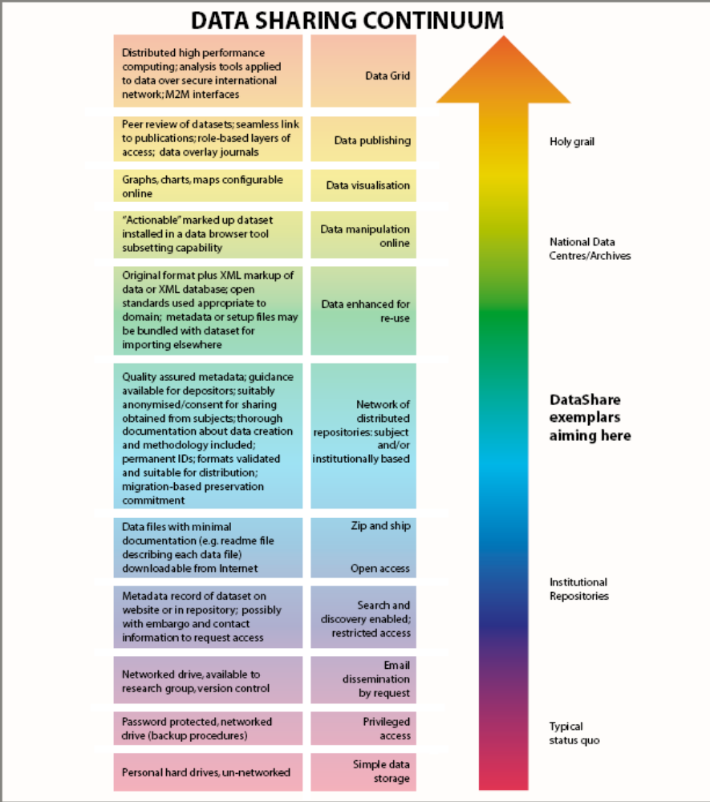
These four data environments can also be mapped onto Robin Rice’s data sharing continuum. The closed data environment is at the bottom of the scale; the file retrieval envi-ronment is in the light blue section; the discovery environment is the mid-blue section without data access and repurposing is the top half of the chart.
http://www.disc-uk.org/docs/ECDLposter.pdf

Slide 38
The “open” digital library agenda
The agenda of the international digital library movement in the 1990’s was to create digital content.
Ten years later, the agenda has shifted to capturing digital content on campuses and to providing access through institutional repositories.
  This movement was also driven by the open access and open publishing movements to offset the cost of expensive scientific journal subscriptions.
  Research data were a casual part of the initial repository agenda and tended to be rolled in with other “digital objects,” but not given serious attention.

Slide 39
Where we are today
Open movements and cyber-infrastructure
Funding councils are beginning to invest in cyber-infrastructure for the social sciences.
  CESSDA just received 2.7M euros for research infrastructure development under the European Commission Seventh Framework Programme (FP7).
  In the U.S., Data-PASS is a data preservation alliance funded by the Library of Congress National Digital Information Infrastructure Preservation Program (NDIIPP). Data-PASS partners consist of the ICPSR, Odum Institute, Roper Center, Henry A. Murray Research Archive, Harvard-MIT Data Center and NARA.
  In Canada, CFI funded the Research Data Centre project to create DDI 3.0 metadata and tools; and OntarioBuys has invested in the OCUL ODESI DDI project.

Slide 40
Where are we headed?
In Canada, we lack a collective direction and a coordi-nation of efforts. As Kevin Schurer (UKDA) said at the 2007 ICPSR OR meeting, “They [Canada] can’t get their act together.”
I wrote a letter to Chad Gaffield (SSHRC) on August 30, 2007, which I subsequently sent to the Chair of the SSHRC Standing Committee on Research Support, asking him to initiate a process to build a national social sciences data strategy that stands on the principles articulated in the CDIS report. The intent would be to bring together stakeholders who would develop a larger plan for social science infrastructure and would identify roles for the various stakeholders. This could be modeled after the UK Data Forum and the International Data Forum.

Slide 41
Where are we headed?
Developments in establishing institutional repositories are happening at the institutional and regional levels across Canada. The ACCOLEDS submission to the recent COPPUL strategic plan proposed a regional project around open journal publishing, tables in articles and linkages to data sources.
Ann Green proposed a model of weaving these various developments into a safety net (not her words but mine) for research data, which involves local data services on campuses.

Slide 42

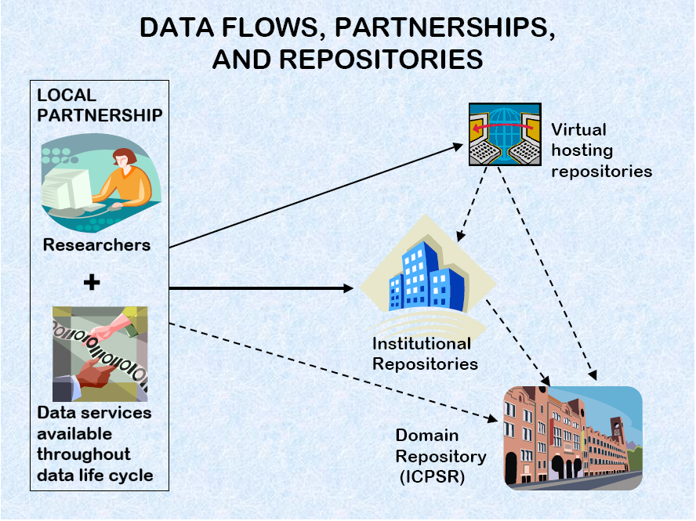
Source: Ann Green, Connecting the Dots among digital repositories, data services and social science researchers, ICPSR OR Meeting, October 2007

Slide 43
Where are we headed?
This approach is largely pragmatic and builds on related but not necessarily connected infrastructure and services emerging at the local institution level.
Canada will still need a national data archiving service to facilitate research data preservation but the distributed nature of data preservation may be very dependent on local support.
The results in Canada may be similar to the model envisioned in Europe (see the next slide), where institutions instead of nations form the hubs in the network.

Slide 44
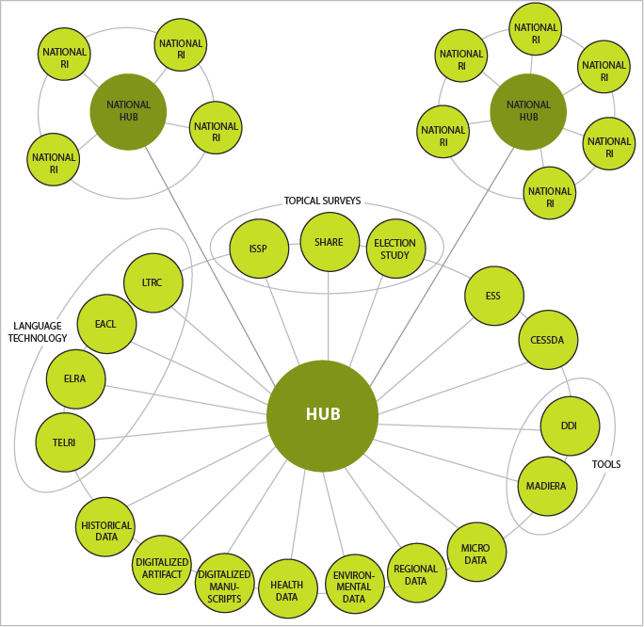
Future European SSH infrastructure
Bjørn Henrichsen
IASSIST - Ann Arbor
May 24 2006

