Slide 1
Health Trends (2017–2025) – Compiled Plots

Slide 2
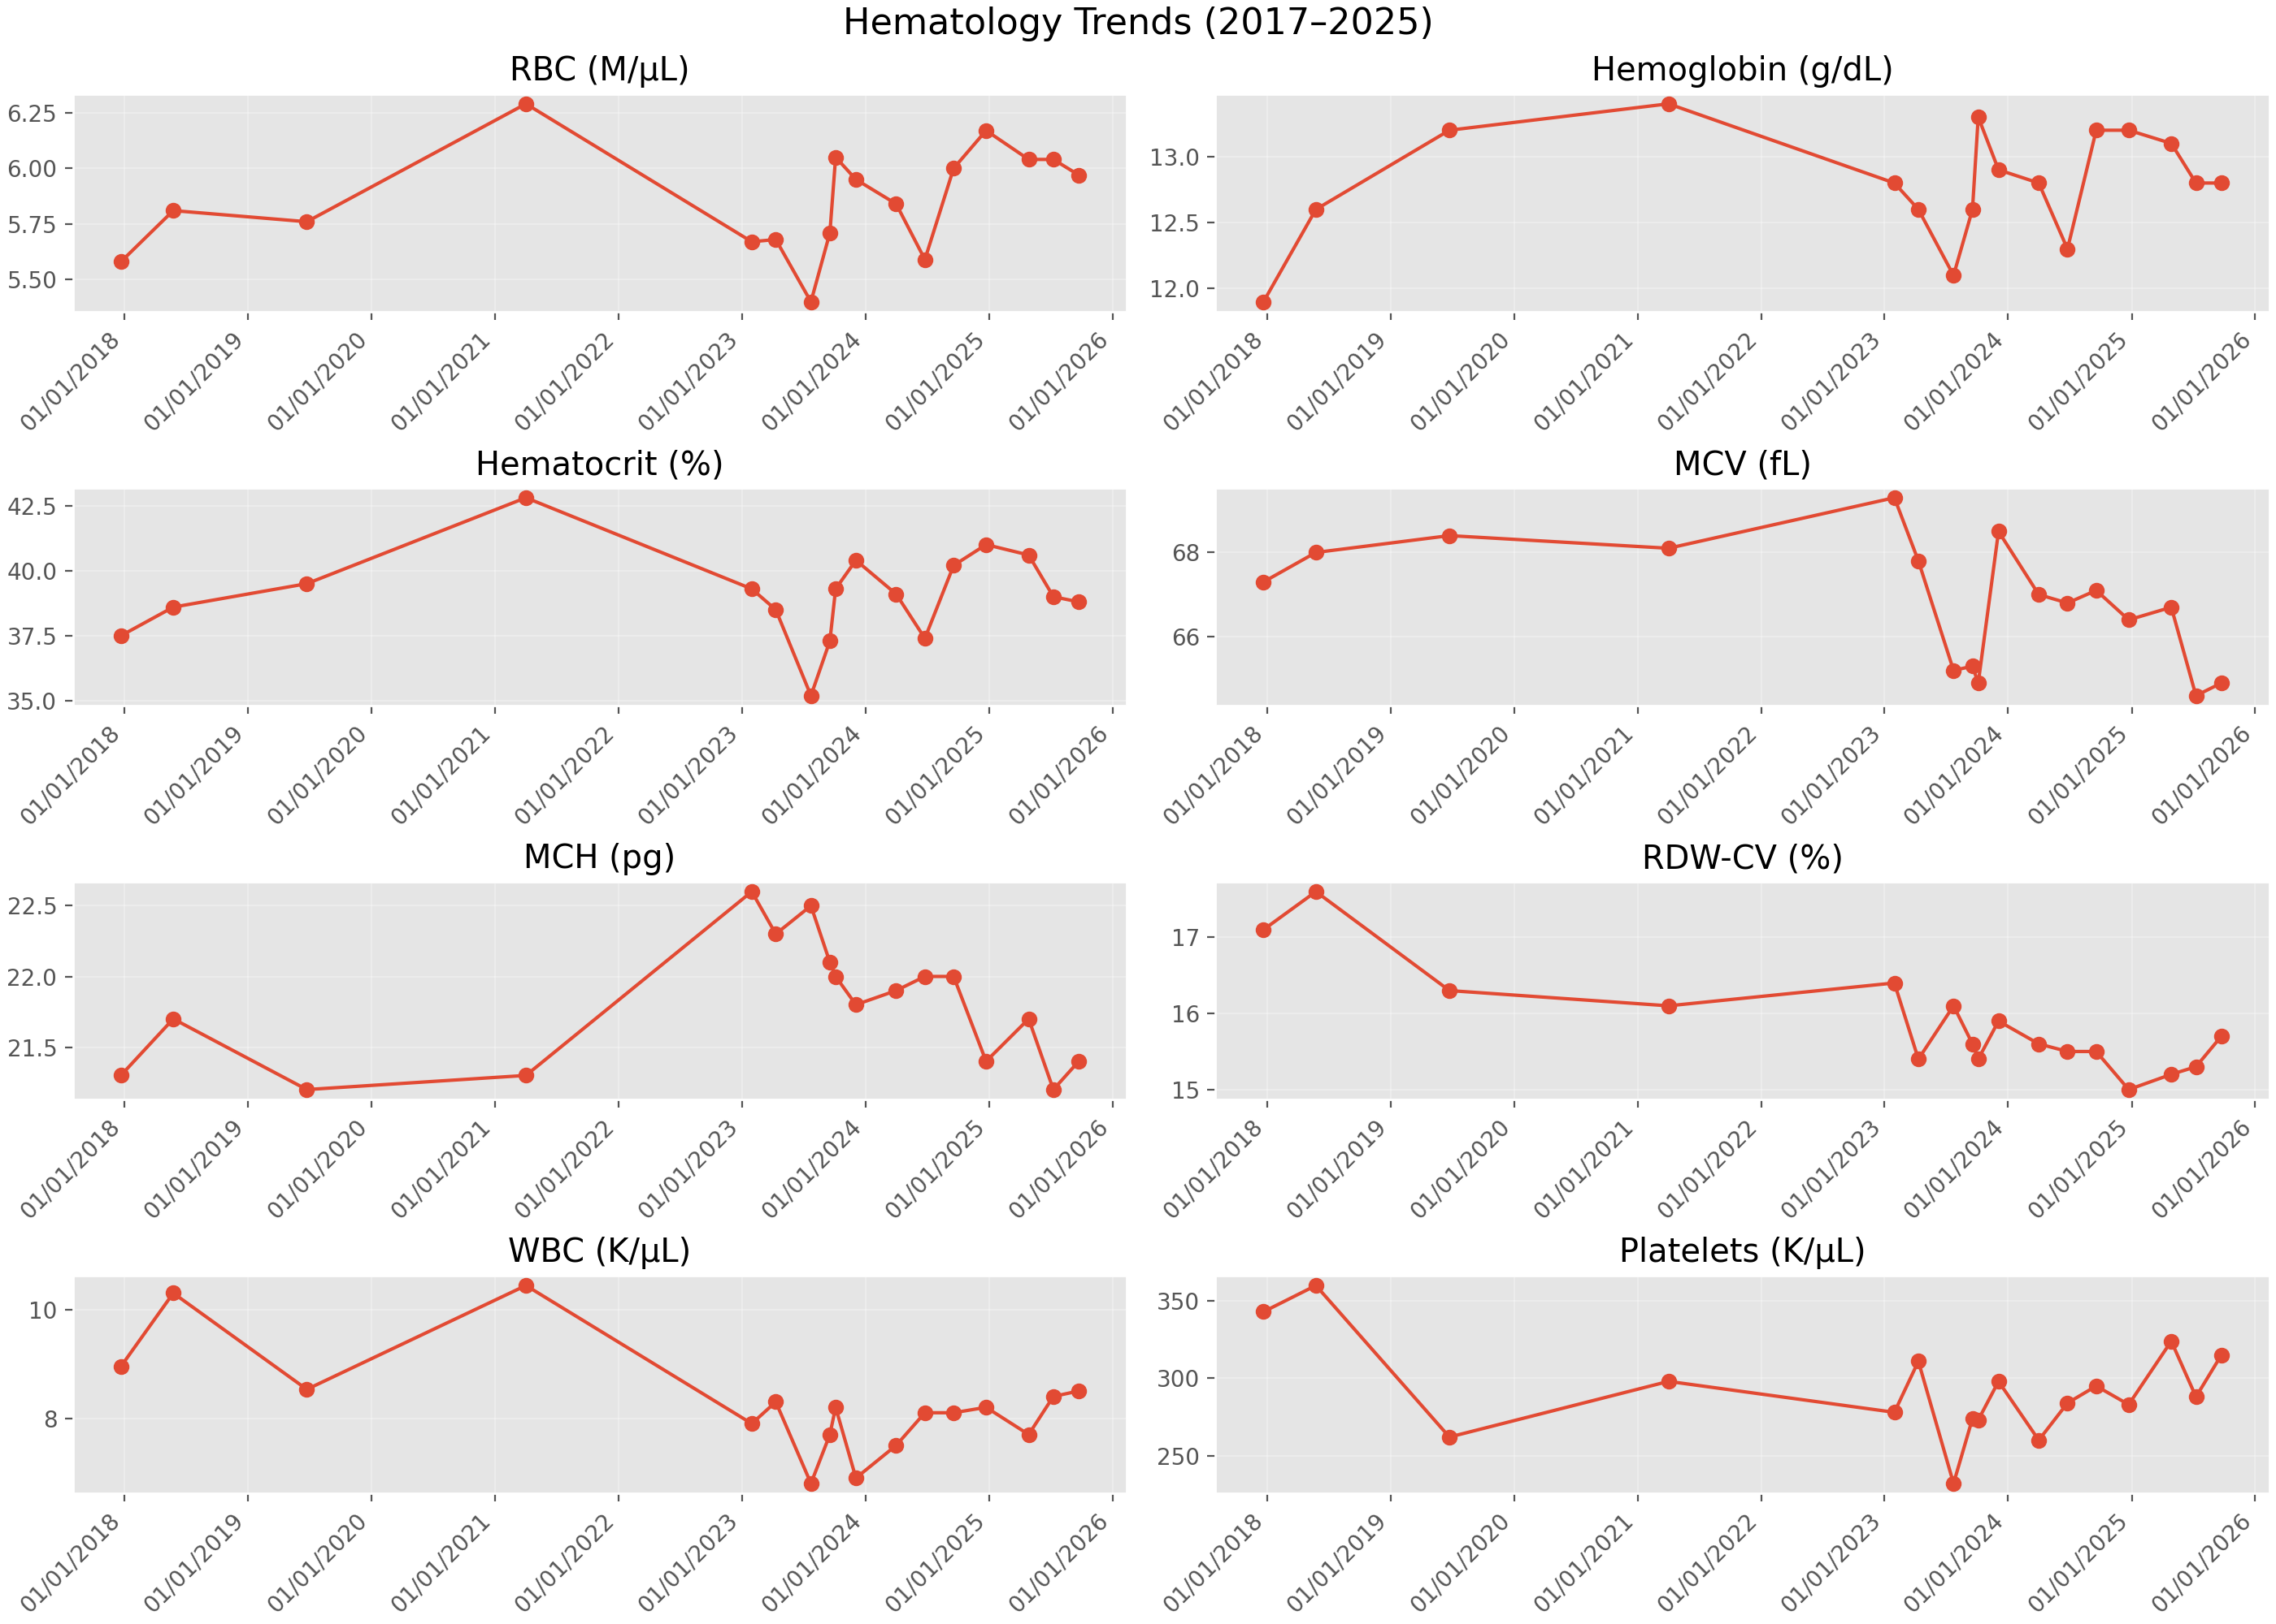
Hematology Trends

Slide 3
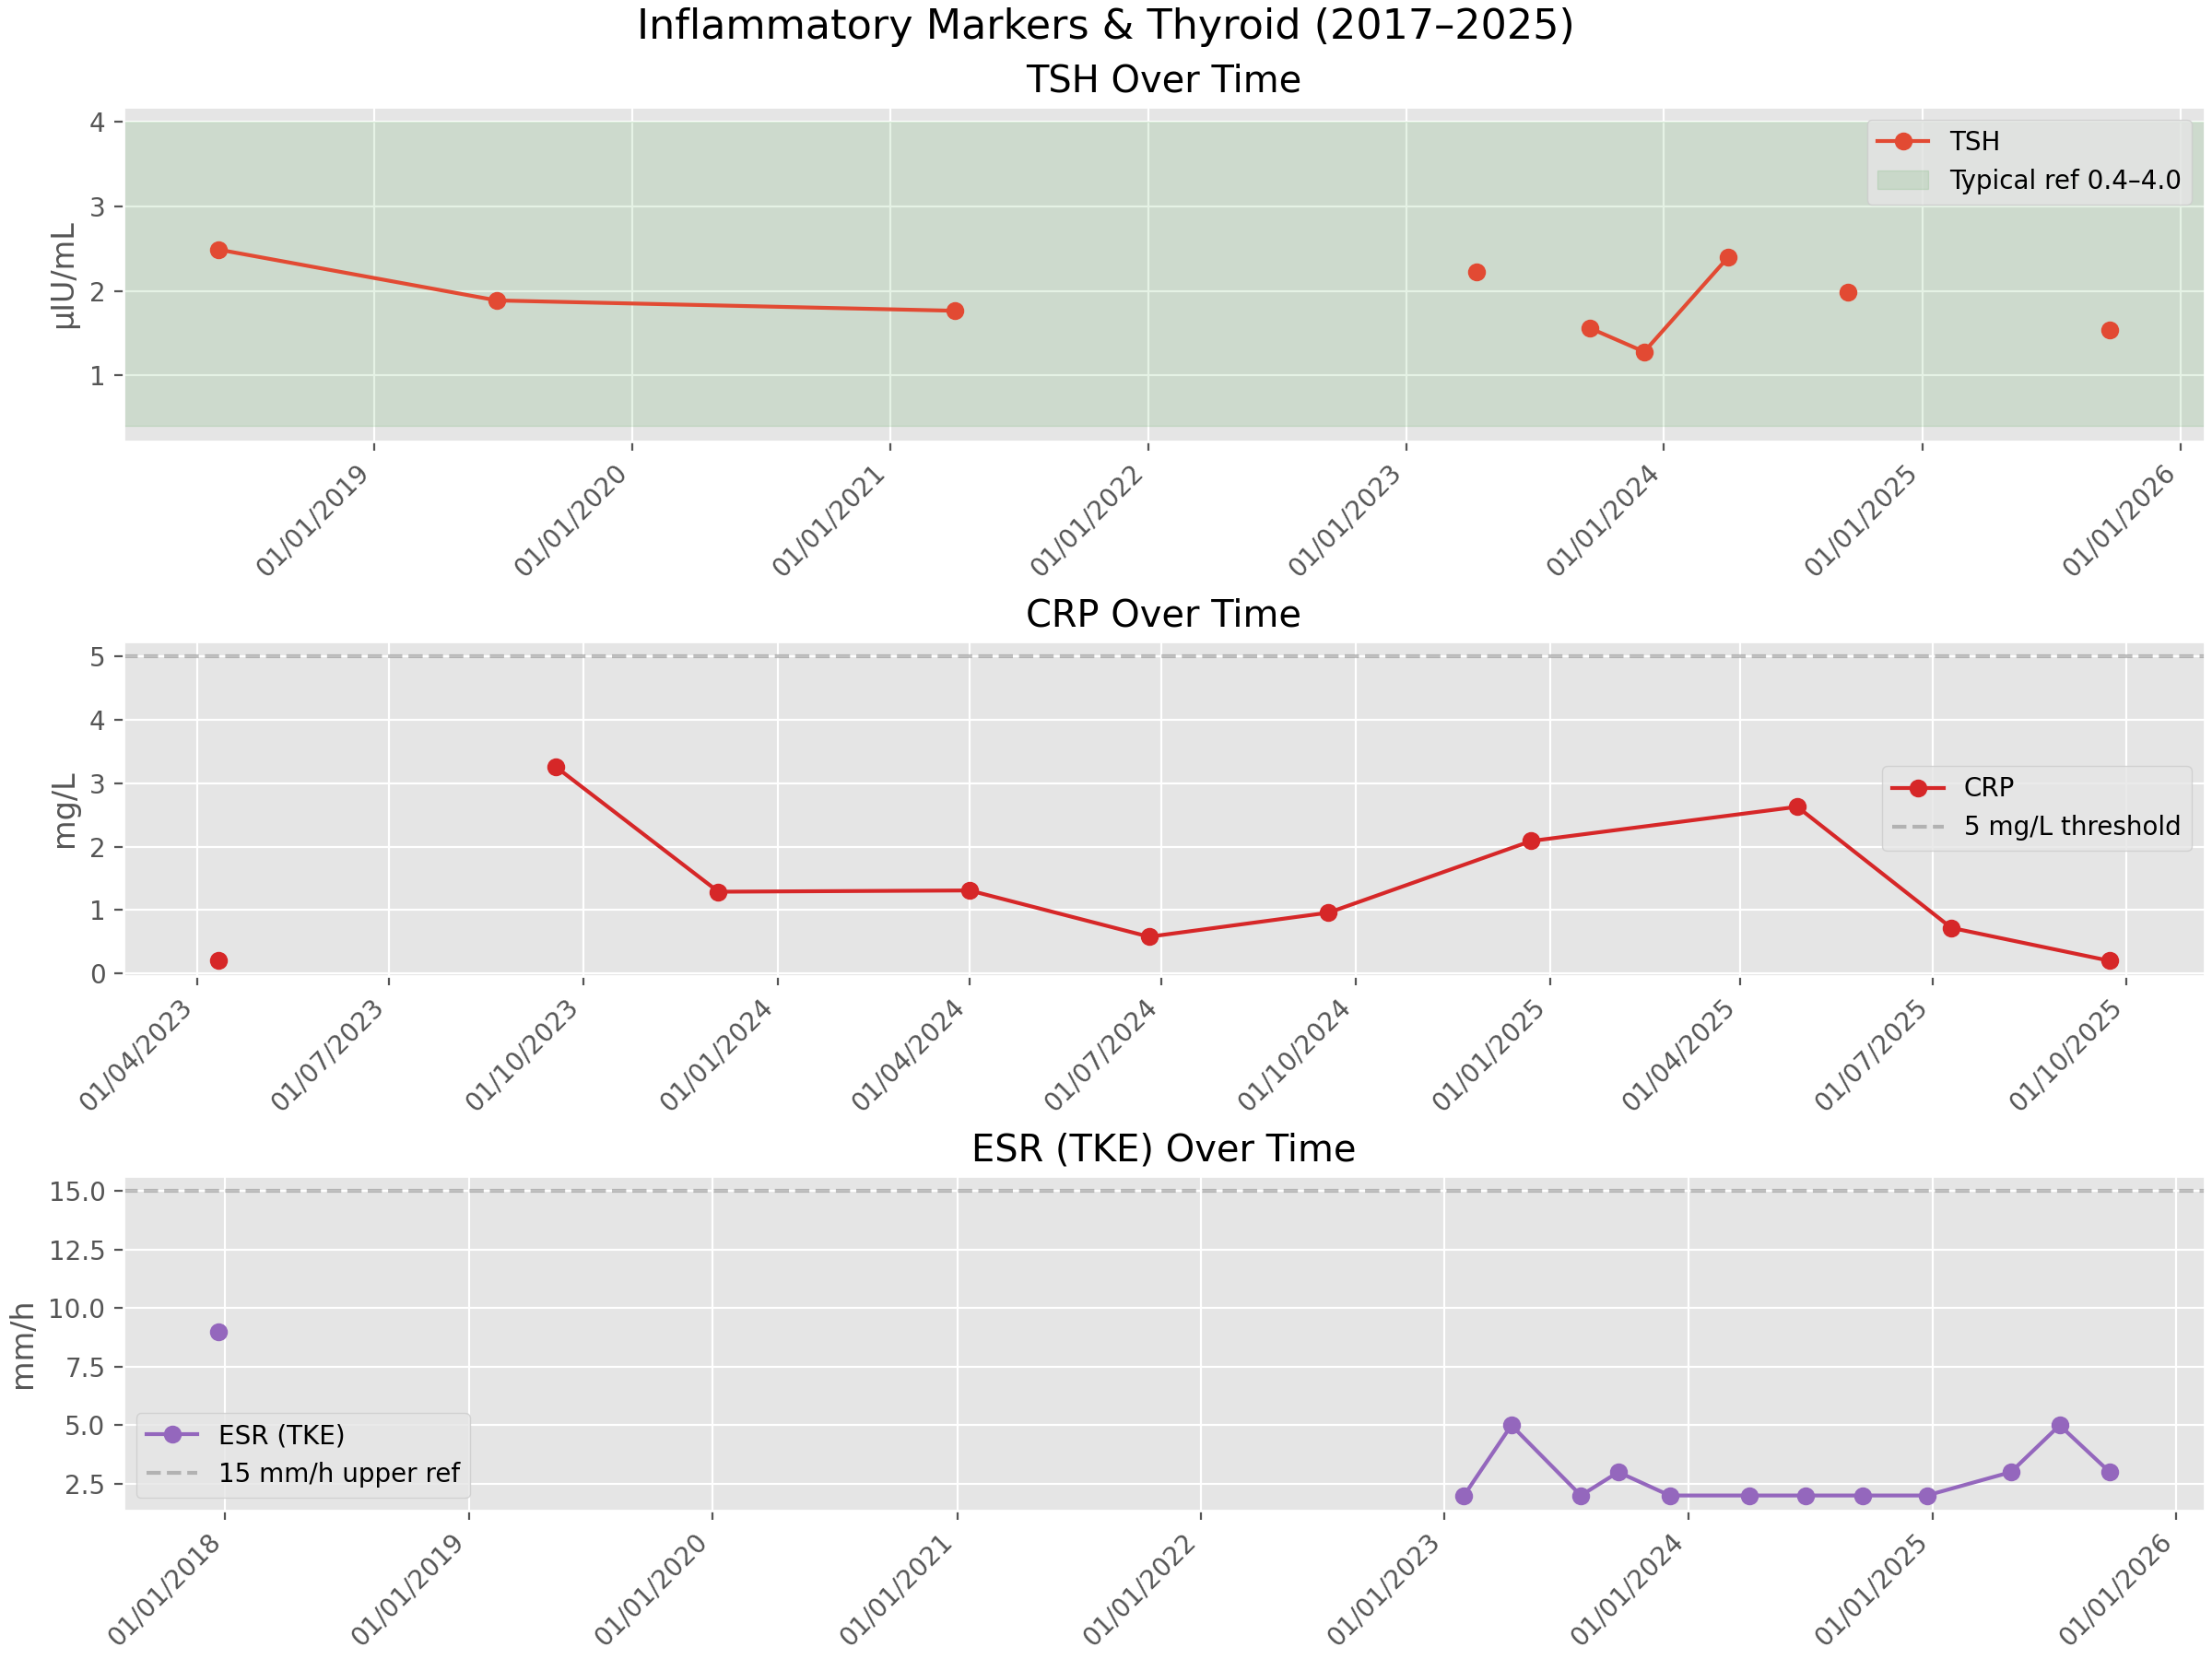
Inflammation & Thyroid

Slide 4
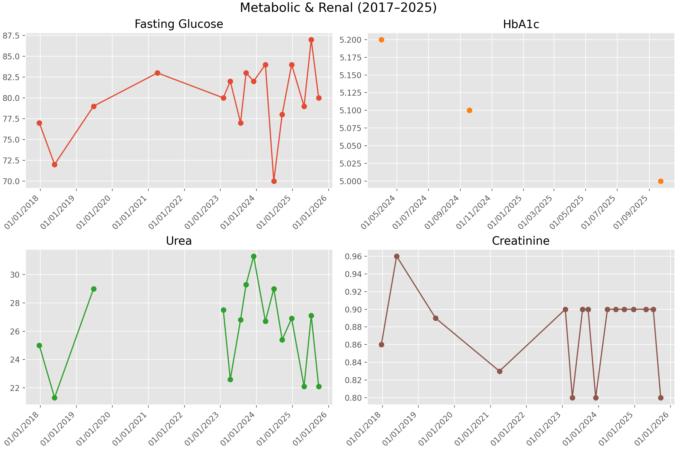
Metabolic & Renal

Slide 5
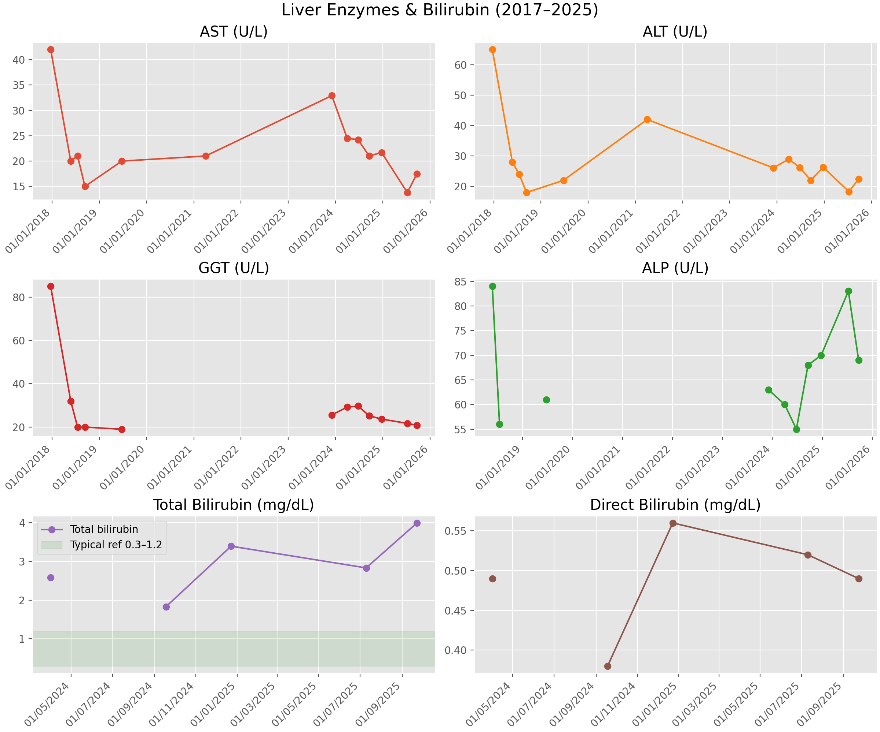
Liver & Bilirubin

Slide 6
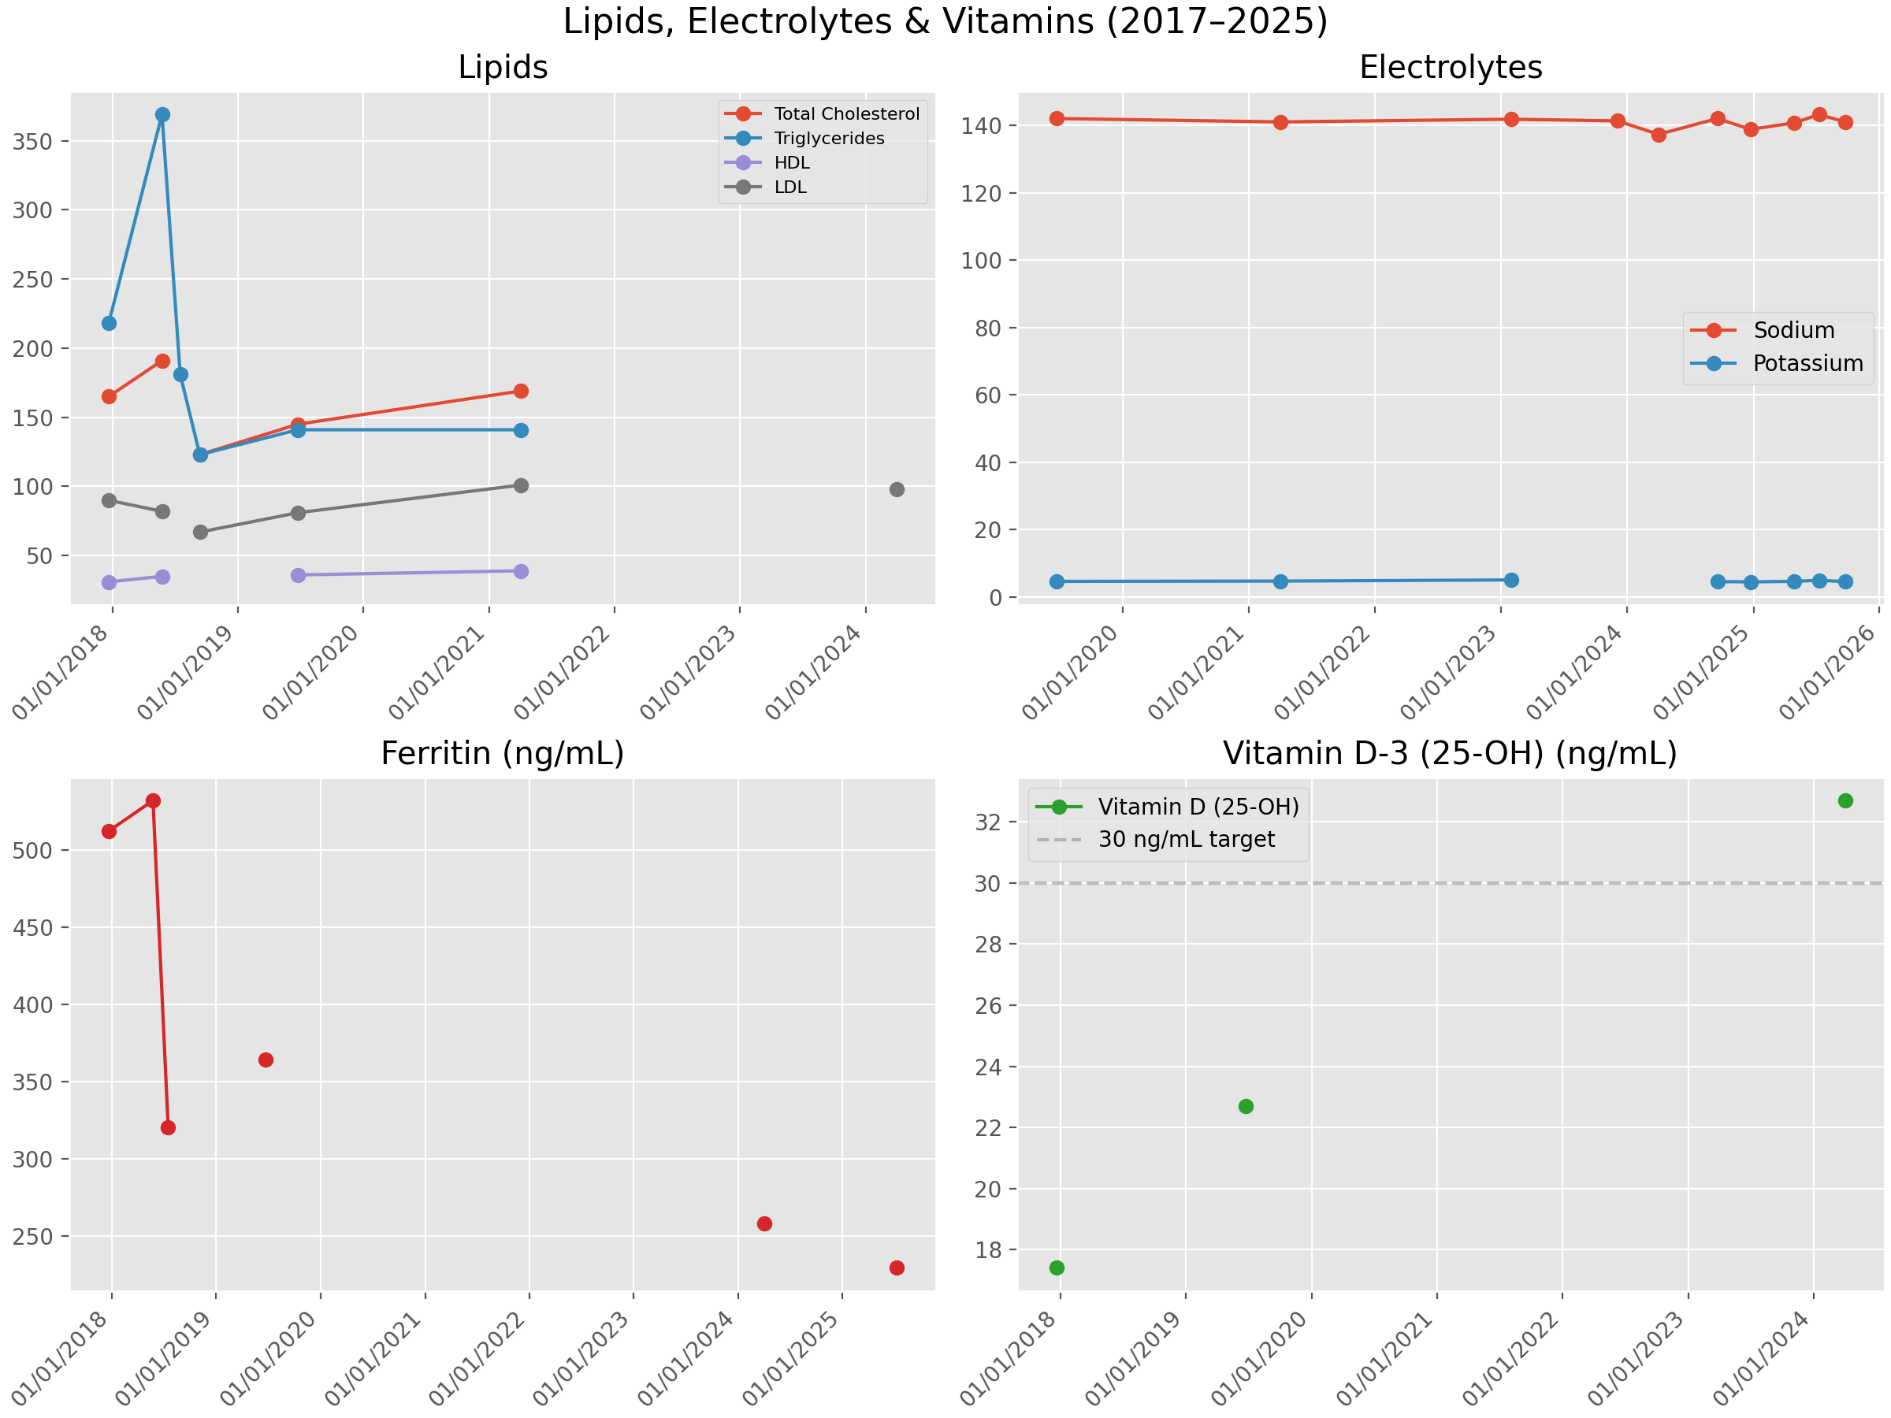
Lipids, Electrolytes & Vitamins

Slide 7
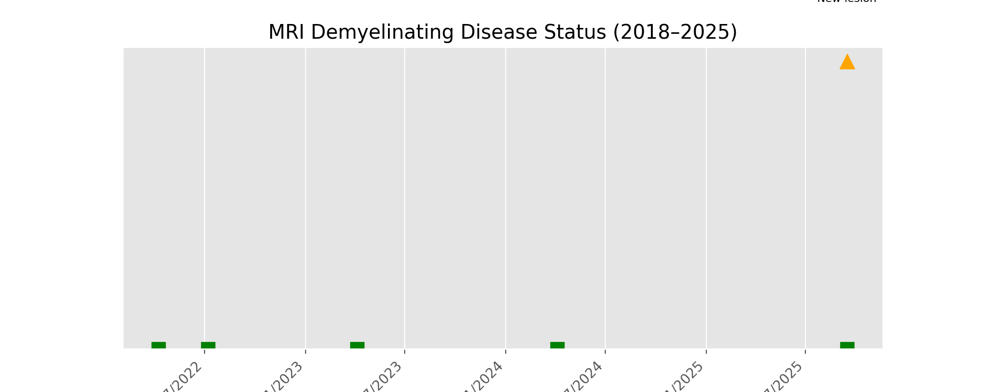
MRI Status Timeline

Slide 8
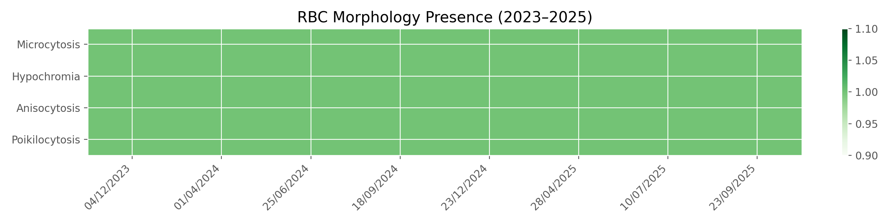
RBC Morphology Heatmap

