Slide 1
Neuron Morphology using pyMoose
http://moose.sourceforge.net/pymoose/moose_cookbook.html#single-neuron-models
Best documentation is online for classes: https://moose.ncbs.res.in/builtins_classes/moose_classes.html
Or from examples in the installation directory:
moose/moose-examples/snippets

Slide 2
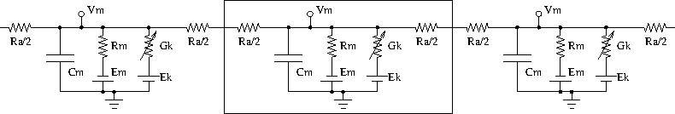
Subdivide dendrite into multiple segments
The morphology of a neuron can be broken into isopotential compartments connected by axial resistances R_{a} denoting the cytoplasmic resistance.
In each compartment, the neuronal membrane is represented as a capacitance C_{m} with a shunt leak resistance R_{m}. Electrochemical gradient (due to ion pumps) across the leaky membrane causes a voltage drive E_{m}, that hyperpolarizes the inside of the cell membrane compared to the outside.

Slide 3
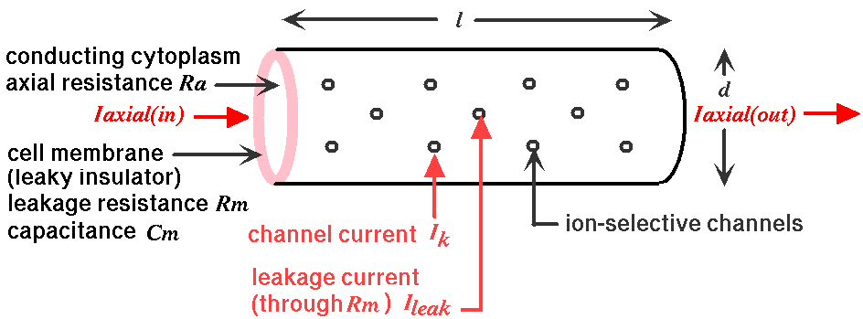
Passive Properties
The cylindrical compartments have membrane surfaces and cytoplasm, through which current can flow. The amount of current flow depends on the intrinsic resistance of the membrane and the intrinsic resistance of the cytoplasm.

Slide 4

Passive Properties
The larger the surface area for current flow, the lower resistance. The longer the distance (axial), the higher the resistance. These qualitative relationships have the following quantitative equations:
Surface area:
>>>SA = np.pi * diameter * length
Cross sectional area:
>>>x_area = np.pi * diameter * diameter / 4.0
>>>Rm= RM / SA
>>>Ra=RA*length/x_area
Also Cm:
>>>Cm=CM * SA

Slide 5
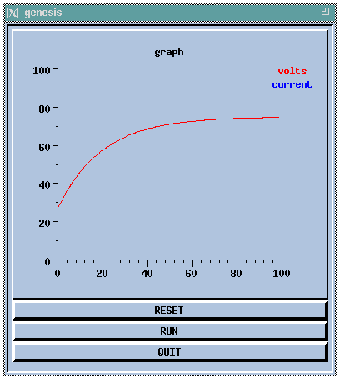
Measuring Time constant and input resistance
Input resistance (definition):
Rn = ΔVm(ss)/ Δ Inj
For single compartment model, all current flows across membrane resistance (Rm) and Ra is irrelevant:
Δ Vm(ss)=Rm* Δ Inj, so Rm=Rn.
How fast does Vm reach steady state? Notice exponential rise. Define time constant, τ, as time required to reach 0.63 (1/e) of state state value
τ = Rm*Cm
From measurements of Rn and τ can determine Rm and Cm

Slide 6
Create compartments
create and connect two compartments
>>> neuron=moose.Neutral('/neuron')
>>> soma=moose.Compartment(‘/neuron/soma’)
>>> dend=moose.Compartment(‘/neuron/dend’)
Calculate Rm, Ra, Cm for each compartment from the compartment dimensions and the intrinsic values (constants).
>>> soma.Rm=RM / soma_area
>>> dend.Rm=RM/ dend_area
>>> soma.Cm=CM * soma_area
>>> dend.Cm=CM* dend_area

Slide 7
Examine and Connect Compartments
>>> moose.le(‘/neuron’)
>>> moose.showfield(‘/neuron/soma’)
>>> moose.showfield(‘/neuron/dend’)
>>> m=moose.connect(soma,’axialOut‘, dend,’handleAxial‘)
This is a bidirectional message for connecting asymmetric compartments (all axial resistance is on one side), soma sends Vm to dend, dend sends Vm and its Ra back to soma. This is generalized as
>>>m=moose.connect(largercomp,’axial’,smallercomp,’raxial’)
For symmetric compartment
m=moose.connect(soma,’axialOut‘, dend,’handleRAxial‘)

Slide 8

Length constant
How many dendrite compartments are needed to accurately modeling a long dendrite?
We assumed that each compartment was isopotential, i.e., the voltage at the left side was similar to the voltage of the right side.
Cable theory tells us that this assumption is true if the compartment is <=5% of length constant. The latter is number indicating the rate of voltage decay along a dendrite.
The attenuation of voltage with distance x along an infinitely long uniform section of dendrite:

Slide 9
Cell Reader
For 100 micron dendrite, λ=200, need to create 10 compartments.
Do not implement the equation calculating Rm, Cm 10 times, etc. This is the ideal place for a function that:
Takes the compartment name and dimensions
Creates the compartment
Calculates Rm, Cm, Ra and makes the compartment assignment
Connects to previous compartment (assuming there is one)
We do not need to create this function ourselves, it has been implemented with the cellreader

Slide 10
Cell reader
Simplifies specification of realistic cells with complicated morphology
cell.p is sequence of cylindrical compartments
each compartment has a length and diameter (in microns), and the compartment it connects to (parent)
optionally can specify the x, y, z (or r, theta, phi) coordinates where the compartment ends ( compartment begins at end of parent compartment)
in cartesian mode, each line looks like:
name parent x y z d
if y and z are zero, x is treated as length, if y and z are non-zero, then x,y,z are end coordinates:
soma none 30 0 0 30
dend soma 100 0 0 2

Slide 11
Cell reader
The cell reader will
1. create compartments. The following creates 1 soma and 4 attached dendrites:
*start_cell
soma none 16.000 0 0 16.000
primdend1 soma 9 4.5 0 2.5
primdend2 soma 9 -4.5 0 2.5
primdend3 soma 4.5 9 0 2.5
primdend4 soma 4.5 -9 0 2.5

Slide 12
P file compnents
The cell reader will
2. calculate the geometry specific membrane and axial resistance given the intrinsic resistances (calculates surface areas, cross-sectional areas, multiplies by appropriate RA, RM and CM). These are parameters specified at the top of the file with one of two commands:
*set_global RA 4.0
*set_compt_param CM 0.03
*set_global RM 2.8
*set_compt_param EREST_ACT -80e-3
*set_global ELEAK -50e-3
Note that EREST_ACT is the initial voltage (initVm)

Slide 13
P file components
Other commands:
*relative
The specified x, y, z are relative to parent compartment
*cartesian
Versus polar
*asymmetric
All axial resistance is on one side of the node.
Versus symmetric, in which total axial resistance is split, with half on either side

Slide 14
Realistic neuron models
Three main steps to build a realistic model neuron
Obtain a morphological reconstruction of the cell to be modeled.
Neurons are stained, and a specialized microscope and software are used to trace the dendritic structure and create a data file with segment coordinates, lengths, diameters, and branch points.
Or, can download a reconstruction from neuromorpho.org
Browse by brain region
Select cell
Download swc file
Convert to genesis format using
http://neuronland.org/NLMorphologyConverter/NLMorphologyConverter.html
https://github.com/pgleeson/Cvapp-NeuroMorpho.org
http://neuron.duke.edu/cells/usage.html
Possibly simplify the morphology if there are too many short compartments. How long should a compartment be?
Utility to combine adjacent compartments if same diameter and < 0.1 lambda
What values of R_{m}, C_{m}, and R_{a} should be used for each compartment?
Parameter optimization or hand tuning to response to current injection

Slide 15
Practice
Create a model using cell reader, inject current, plot output
create the simple.p file (modify cell.p as follows: delete the chan stuff):
http://www.genesis-sim.org/UGTD/Tutorials/genprog/simplecell-tut.html
Slightly more complicated cell: http://www.genesis-sim.org/UGTD/Tutorials/genprog/textScripts/cells/corticalcells/layer5.p.txt
download and convert to .p something from neuromorpho; create complicated model
1. Current injection function (in file called, e.g. “util.py”):
def current_step_test(comp):
stim = moose.PulseGen('/model/stimulus')
stim.delay[0] = 20e-3
stim.level[0] = 1e-9
stim.width[0] = 40e-3
stim.delay[1] = 1e9
moose.connect(stim, 'output', comp, 'injectMsg')
return stim

Slide 16
Practice
2. Output function
def Vmoutput(comp,stim)
data = moose.Neutral('/data')
current_tab = moose.Table('/data/current')
moose.connect(current_tab, 'requestOut', stim, 'getOutputValue')
vm_tab = moose.Table('/data/Vm')
moose.connect(vm_tab, 'requestOut', comp, 'getVm')
return ts, current_tab, vm_tab

Slide 17
Practice
3. Main
Note that by changing the name of simplecell.p, you can change the entire model in one line
Import moose
Import numpy as np
Import util
pfile=simplecell.p
Other parameters
simtime = 0.1
simdt = 25e-6
plotdt = 0.25e-3
Create the model
Container=“cell”
cell=moose.loadModel(p_file, container)
Moose.le(‘/’)
Select the soma compartment:
Comp=‘soma’

Slide 18
Practice
Main (continued)
Connect stimulation and create output
Stim = util.current_step_test( comp)
Currenttab,vmtab=util.vmoutput(comp,stim)
Adjust simulation time step
print “stim”,stim.tick, stim.dt,”vm”, vm.tick,vm.dt
moose.setClock( stim.tick, simdt)
moose.setClock( vmtab.tick, plotdt)
moose.setClock(currenttab.tick, plotdt)
Run simulations
moose.reinit()
moose.start(simtime)

Slide 19
Practice
Pure python to plot the results
ts = np.linspace(0, simtime, len(vm))
plt.plot(ts, vmtab.vec * 1e3, label='Vm (mV)')
plt.plot(ts, currenttab.vec * 1e9, label='current (nA)')
plt.legend()
plt.show()
Repeat simulations using different number of dendritic segments while keeping total dendritic length the same (edit cell.p)
Plot Soma Vm AND middle dendrite Vm (need to edit Vmoutput)

Slide 20
Other compartment connections
Best to use SymCompartment,
Allows accurate compensation of Rm, Cm for lack of spines.
Allows spines to connect to middle of compartment
Requires connections between daughter branches
Moose.connect(soma,’distal’,dend1,’proximal’)
Moose.connect(soma,’distal’,dend2,’proximal’)
Moose.connect(dend1,’sibling’,dend2,’sibling’)
Moose.showmsg(‘dend1’)
sumRaxialOut: Sends Ra, proximalOut: sends Vm
Connecting Spines: srcF=‘cylinder’, destF=‘raxialCylinder’
sends Vm and ~0 Ra to spine
Multiple dendrites to large soma: srcF=‘sphere’, destF=‘raxialSphere’
no need for sibiling msg
dend1
soma
dend2

Slide 21
http://www.anc.ed.ac.uk/school/neuron/tutorial/tutB.html

