Slide 1
MOOSE : Multiscale Object-Oriented Simulation Environment.
Overview and Installation
(two lectures)

Slide 2
Installation instructions
Moose.ncbs.res.in
Click “Downloads”
Click “installing pre-built packages”
Click “Open Build Service”
Click on your OS
Follow instructions
Must have super user privileges, or
Cd /etc/yum.repos.d/
Sudo wget http://download.opensuse.org/repositories/home:moose/Fedora_22/home:moose.repo
Sudo dnf install moose

Slide 3
Alternative installation instructions (for Macs)
Install, using dnf install <name>
a. gsl-devel: (GNU Scientific Library (GSL) development packages) b. python-devel: Python development headers and libraries c. numpy development libraries - these already include the develoment headers d. g++ - already have this e. gnu make - I already had this f. hdf5-devel: HDF5 development library\
git clone https://github.com/BhallaLab/moose.git
Cd moose/moose-core
Make USE_SBML=0
export PYTHONPATH="/homedir/moose-core/python"

Slide 4
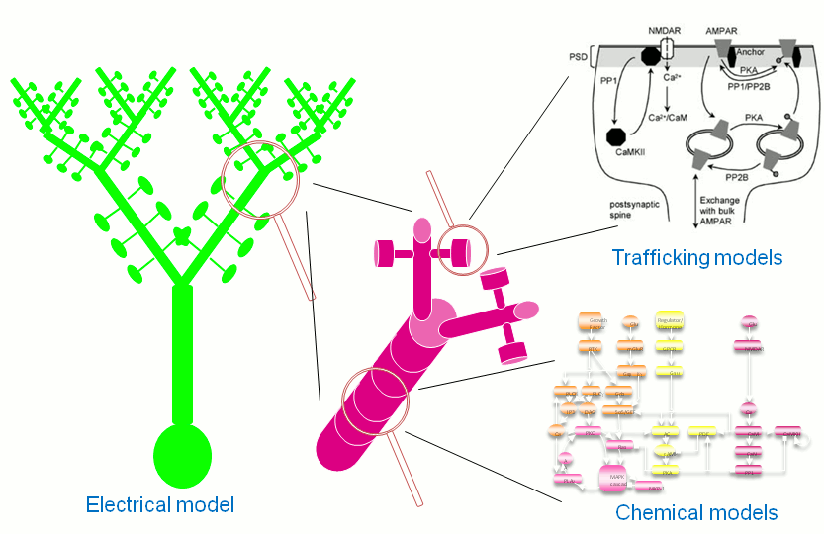
Designed to simulate neural systems ranging from subcellular components and biochemical reactions to complex models of single neurons, circuits, and large networks.
MOOSE can operate at many levels of detail, from stochastic chemical computations, to multicompartment single-neuron models, to spiking neuron network models.

Slide 5
Objects similar to GENESIS
The moose simulator essentially is a completely rewritten and improved version of the genesis simulator. This means that the objects, such as compartments, from genesis are implemented with same equations and names as in genesis. However, the interface and numerics are completely different. One of the most important and significant improvements from the perspective of model creation is the python interface. This tutorial assumes some familiarity with python, and there are online resources for learning python. This information is modified from
https://moose.ncbs.res.in/quickstart/index.html
http://moose.sourceforge.net/pymoose/moose_quickstart.html

Slide 6
Object oriented, simulation environment
Biological concepts are mapped into classes, and a model is built by creating instances of these classes and connecting them by messages. MOOSE also has numerical classes whose job is to take over difficult computations in a certain domain, and do them fast.
MOOSE is a simulation environment, not just a numerical engine: It provides data representations and solvers (of course!), but also a scripting interface with Python, graphical displays with Matplotlib, PyQt, and OpenGL, and support for many model formats. These include SBML, NeuroML, GENESIS kkit and cell.p formats, HDF5 and NSDF for data writing.

Slide 7
Python interface
https://moose.ncbs.res.in/quickstart/index.html
The PyMoose interface provides both a language for creating the model, while providing all the numeric and graphics capabilities of Python. After installing Moose (either installing the rpm or compiling it from the source) get into python and type
python
>>> import moose
>>> help(moose)
provides information on moose
>>> dir(moose)
Provides a list of available functions and classes

Slide 8
Getting help
To list the classes only, use moose.le('/classes')
this is equivalent to the genesis listobjects command
THIS DOESN’T WORK: To obtain more information on the object, type moose.doc(objectname), e.g.
>>> moose.doc(moose.Compartment)
this is equivalent to the genesis showobject compartment command
THIS WORKS:
>>>help(moose.Compartment)
The next lecture will explain how to construct a model from these pieces. In this lecture I will introduce some basic commands and building blocks.

Slide 9
Creating objects and traversing the object hierarchy
Different types of biological entities like synapses, channels, etc are represented by classes and individual instances of those types are objects of those classes. Objects are the building-blocks of models in MOOSE.
Instantiations of MOOSE objects are elements. Elements are conceptually laid out in a tree-like hierarchical structure. If you are familiar with file system hierarchies in common operating systems, this should be simple.
The objects (C++ classes) implement a set of equations describing that aspect of the neuron, e.g. compartment or channel.
Developing the model entails creating numerous elements, e.g. one compartment element for each dendritic segment, one channel element for each ion channel in each dendritic compartment, and connecting them.

Slide 10
Element hierarchy
At the top of the element hierarchy sits the Shell, equivalent to the root directory in UNIX-based systems and represented by the path /. You can list the existing objects under / using the le function.
>>> moose.le()
Elements under /
/Msgs
/clock
/classes
/postmaster
Msgs, clock and classes are predefined objects in MOOSE. And each object can contain other objects inside them.
We will discuss them later.

Slide 11
Creating elements
Invoke MOOSE class constructors (just like regular Python classes):
>>> moose.Compartment(‘soma’)
This creates a compartment with the name soma. To make it easier to refer to the object without having to use quotes and to facilitate passing the object into functions, you can instead type
>>> soma=moose.Compartment(‘soma’)

Slide 12
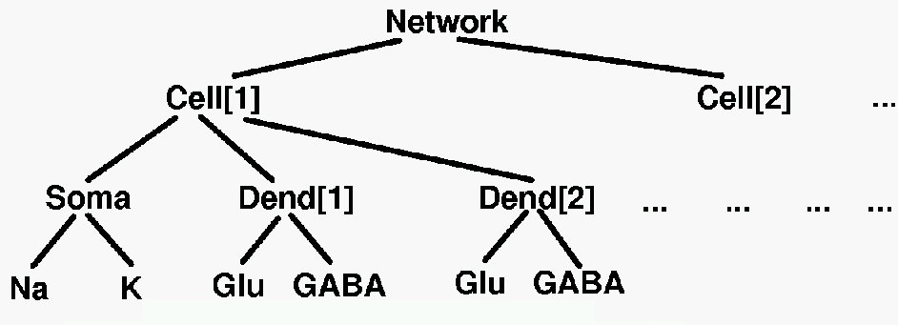
Organize elements into hierarchy
Realistic models typically have many objects, such as 10-100 compartments, each of which has 2-10 ion channels, plus synaptic channels. Element hierarchy (tree) is similar to how you organize your files on your computers into directories or folders.

Slide 13
Creating Moose elements
Elements are referenced with a notation similar to that used in UNIX directory trees.
There are multiple ways to organize the element tree, choose the one that makes the most sense to you. For example, you could place all the ion channels in the soma under the soma element, etc.
To help with this organization, there is an object called neutral. Thus, we can place all our compartments under a neutral object called neuron:
>>> cell=moose.Neutral('/neuron')
>>> soma=moose.Compartment(‘/neuron/soma’)
>>> dend=moose.Compartment(‘/neuron/dend’)
then place output elements under a different neutral element, e.g.
>>>data=moose.Neutral(‘/data’)

Slide 14
How do we examine these objects?
Every element has a unique path. This is a concatenation of the names of all the objects one has to traverse starting with the root to reach that element.
>>> print soma.path
/model/soma
The name of the element can be printed, too.
>>> print soma.name
soma
To list the elements under the cell, we use the “le” for list elements commands
>>> moose.le('/neuron')
Elements under /neuron
/neuron/soma
/neuron/dend

Slide 15
How do we examine these objects?
We can use regular python commands or Moose commands
to list the fields/parameters/variables in the compartment, we use the showfield command:
>>> moose.showfield(‘/neuron/soma’)
>>> soma.getFieldNames('valueFinfo')
The first command lists the fields and their associated values, whereas the second comand just lists the fields with out values. You can also use the python print statement to examine the values, thus:
print soma.Rm, soma.Vm, soma.Cm, soma.Ra will provide those values.
It is possible to traverse the element hierarchy, which is useful to minimize typing with a deep hierarchy.
>>> moose.ce(‘/neuron’) allows you to shorten the showfield command to
>>> moose.showfield(‘soma’)

Slide 16
Creating and accessing Moose elements
What if you created an element without giving it a python variable name:
>>> moose.Compartment(‘/model/soma’)
and now you want to access it with a name like soma? Or, you created a bunch of elements in a function, and in the main program you’re not even sure what object class they are, but you want to access it. You can use the following command:
>>>soma = moose.element('/model/soma')
Or, you don’t know the name of your elements, so you type
>>>moose.le(‘/model’)
select the element you want to access, and then
>>>x = moose.element(‘elementname’)

Slide 17
Setting the properties of elements: accessing fields
Elements have several kinds of fields. The simplest ones are the value fields. These can be accessed like ordinary Python members. You can list the available value fields using getFieldNames function
>>> soma.getFieldNames('valueFinfo')
Here valueFinfo is the type name for value fields. Finfo is short form of field information. For each type of field there is a name ending with -Finfo. The above will display the following list
Notes:
Here valueFinfo is the type name for value fields. Finfo is short form of field information. For each type of field there is a name ending with -Finfo. The above will display the following list

Slide 18
Names of value fields (valueFinfo)
('this', 'name', 'me', 'parent', 'children', 'path', 'class', 'linearSize', 'objectDimensions', 'lastDimension', 'localNumField', 'pathIndices', 'msgOut', 'msgIn', 'Vm', 'Cm', 'Em', 'Im', 'inject', 'initVm', 'Rm', 'Ra', 'diameter', 'length', 'x0', 'y0', 'z0', 'x', 'y', 'z')
Some of these fields are for internal or advanced use, some give access to the physical properties of the biological entity we are trying to model.
Notes:
Some of these fields are for internal or advanced use, some give access to the physical properties of the biological entity we are trying to model.

Slide 19
Modifying elements
The fields are populated with some default values.
>>> print soma.Cm, soma.Rm, soma.Vm, soma.Em, soma.initVm
1.0 1.0 -0.06 -0.06 -0.06
Modifying elements
To assign values to the elements, use typical python assignment statement:
>>> soma.Cm=1e-9
>>> soma.Rm=10e6
>>> soma.initVm=-0.075
Note that there are no units associated with these values. It is critical to use a consistent set of units.

Slide 20
Examing elements
[ /soma[0] ]
diameter = 0.0
Ra = 1.0
y0 = 0.0
Rm = 10000000.0
numData = 1
inject = 0.0
initVm = -0.075
Em = -0.06
y = 0.0
numField = 1
path = /soma[0]
dt = 5e-05
tick = 4
z0 = 0.0
name = soma
Cm = 1e-09
x0 = 0.0
Vm = -0.06
className = Compartment
length = 0.0
Im = 0.0
x = 0.0
z = 0.0
Instead of writing print statements for each field, you could use the utility function showfield to see that the changes took effect
>>> moose.showfield(‘soma’)

Slide 21
Units digression
Use consistent units. Your options are (1) use SI units, or (2) use physiological units. The latter often make more sense, i.e., have far fewer decimals, but sometimes lead to problems without extreme vigilance.
Physiological units, e.g. nanoAmps, Megaohms, nanoFarads, msec
current * resistance = volts
nA (10^-9) * Mohms (10^6) = mV (10^-3)
capacitance * resistance = time
nF(10^-9) * Mohms(10^6) = msec
uF (10^-6) * Mohms (10^6) = sec

Slide 22
Consistent Units
SI units
A method for working in SI units that appear physiological is to specify values with e3, e-6, etc. In other words, specify values using Xe6 for megaohms, Ye-6 for microSiemans, Ze-9 for nanoAmps, etc. Then, you use SI units, but X, Y and Z are the physiological values
Length units and concentration units
Meters for SI, but 1 Meter^3 doesn't produce 1 Liter! It produces 1000 Liters
Thus, 1 mole in 1 meter cubed = 1 mM, so mM is an SI unit.
Also, microns are often used for morphology.

Slide 23
How to connect elements together
As we build up the neuron model from multiple pieces (elements) we need to connect them together, so that the voltage or current from one element causes the appropriate change to the voltage or current in another element. This is done with the moose.connect command. This is the most complicated command, because you need to send the value/field from the source to the correct field of the destination, and in some cases messages are passed in both directions.

Slide 24
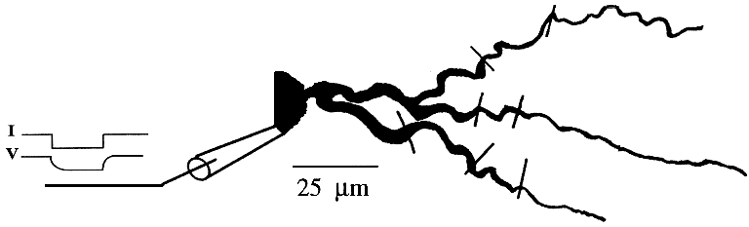
Pulsegen
We will first give an example by connecting the soma to a current injection source, called PulseGen
Specify onset time (called delay), amplitude (called level), duration (called width)
Unlike the example on the moose website, I do not put this under the model hierarchy, because I consider the current injection part of the experiment, not part of the model itself. I could have created a separate IO neutral object and put the PulseGen underneath it.

Slide 25
Pulsegen
help(moose.PulseGen),
>>> pulse = moose.PulseGen('pulse')
>>> moose.showfield(‘pulse’)
>>> pulse.delay[0] = 50e-3
>>> pulse.width[0] = 100e-3
>>> pulse.level[0] = 1e-9
>>> pulse.delay[1] = 1e9
Notice that delay[0] = firstdelay
This tells the pulse generator to create a 100 ms long pulse 50 ms after the start of the simulation. The amplitude of the pulse is set to 1 nA.
The pulse generator can produce trains of pulses; thus, the pulse will be repeated every 50 ms, unless there is an additional delay term (delay[1]) saying that the pulse should not be repeated until a long time later.
Create trains of bursts using two delays – change field “count” to 3, then pulse.delay[2]=x

Slide 26
How to connect elements together
First, identify all the fields that can be sent as messages.
Do this with the command:
>>>moose.getFieldNames(objectname, 'srcFinfo')
for the pulsegenerator, that would be
>>> moose.getFieldNames('PulseGen', 'srcFinfo').
The result is:
('childOut', 'output')
Verify that output is the output value of the pulsegen:
>>> moose.doc('PulseGen.output'), which doesn’t work, but
>>>help(moose.PulseGen)
tells us:
PulseGen.output: double - source field
Current output level.

Slide 27
How connect elements together
Now, we need to know the destination field on the soma.
>>> soma.getFieldNames('destFinfo'), is equivalent to
>>> moose.getFieldNames(‘Compartment’, 'destFinfo')
The result is a long list, with injectMsg being the most likely candidate.
>>> soma.getFieldNames('destFinfo')
('parentMsg', 'setThis', 'getThis', ... 'setZ', 'getZ', 'injectMsg', 'randInject', 'cable', 'process', 'reinit', 'initProc', 'initReinit', 'handleChannel', 'handleRaxial', 'handleAxial')
But much of it are fields for internal or special use. Anything that starts with get or set are internal destFinfo used for accessing value fields (we shall use one of those when setting up data recording).

Slide 28
connect elements together
The connection is made with this command
>>> moose.connect(pulse, 'output', soma, 'injectMsg')
Moose.connect(source, source_field, dest, dest_field) creates a message from source element’s source_field field to dest elements dest_field field and returns that message.

Slide 29
Examine connections
>>> moose.showmsg(‘soma’).
Or if we want to examine just that one connection, we need to connect using
>>> m=moose.connect(pulse, 'output', soma, 'injectMsg')
print m
<moose.SingleMsg: id=5, dataId=733, path=/Msgs/singleMsg[733]>
This is not really useful information
You can get some more information about a message
>>> print m.e1.path, m.e2.path, m.srcFieldsOnE1, m.destFieldsOnE2
/model/pulse /model/soma ('output',) ('injectMsg',)
e1 and e2 are the source and destination elements; the next two items are lists of the field names which are connected by this message.

Slide 30
Examine connections
You could also check which elements are connected to a particular field
>>> soma.neighbors['injectMsg']
[<moose.vec: class=PulseGen, id=729,path=/model/pulse>]
Notice that the list contains something called vec. We discuss this later.
Also neighbors is a new kind of field: lookupFinfo which behaves like a dictionary.

Slide 31
output elements
Moose tables store the data in a vector, allowing standard python objects to access the data after the simulation is complete. I.e., we can plot or create output files from Moose.Table.
First, create a moose table called vmtab under the neutral object called output
>>> output= moose.Neutral('/output')
>>> vmtab = moose.Table('/output/somaVm')
>>>moose.showfield(vmtab)

Slide 32
output elements
Second, connect the table to the soma
Recall the list of destFinfo fields when we examined the soma. The ones beginning with “get” are used to access that field and send the data to the output table. In other words, for each value field X, there is a destFinfo get{X} to retrieve the value at simulation time. This is the strange part about moose, because when we connect the soma Vm to the vmtab, the table is the source and the soma is the destination.
>>> moose.connect(vmtab, 'requestOut', soma, 'getVm')
<moose.SingleMsg: id=5, dataIndex=0, path=/Msgs[0]/singleMsg[0]>
We can store any value X from any object if there is a ‘getX’ destFinfo.

Slide 33
Running simulation
With the model created, we have to schedule the simulation. Different components in a model may have different rates of update. For example, the dynamics of electrical components require the update intervals to be of the order 0.01 ms whereas chemical components can be as slow as 1 s. Also, the results may depend on the sequence of the updates of different components.
These issues are addressed in MOOSE using a clock-based update scheme. Each model component is scheduled on a clock tick (think of multiple hands of a clock ticking at different intervals and the object being updated at each tick of the corresponding hand). The scheduling also guarantees the correct sequencing of operations. For example, your Table objects should always be scheduled after the computations that they are recording, otherwise they will miss the outcome of the latest calculation.

Slide 34
Simulation time step
MOOSE has a central clock element (/clock) to manage time. Clock has a set of Tick elements under it that take care of advancing the state of each element with time as the simulation progresses. Every element to be included in a simulation must be assigned a tick. Each tick can have a different ticking interval (dt) that allows different elements to be updated at different rates.
By default, every object is assigned a clock tick with reasonable default timesteps as soon it is created:

Slide 35
Simulation clocks and ticks
Class type tick dt
Electrical computations: 0-7 50 microseconds
electrical compartments,
V and ligand-gated ion channels,
Calcium conc and Nernst,
stimulus generators and tables,
HSolve.
Table (to plot elec. signals) 8 100 microseconds
Diffusion solver 10 0.01 seconds
Chemical computations: 11-17 0.1 seconds
Pool, Reac, Enz, MMEnz,
Func, Function,
Gsolve, Ksolve,
Stats (to do stats on outputs)
Table2 (to plot chem. signals) 18 1 second
HDF5DataWriter 30 1 second
Postmaster (for parallel 31 0.01 seconds
computations)

Slide 36
Three methods for obtaining fine control over the scheduling
>>>print soma.tick, soma.dt
Alter the ‘tick’ field on the object
>>>soma.tick=2
Alter the dt associated with a given tick
>>>moose.setClock(tick, newdt)
(more difficult) Go through a wildcard path of objects reassigning there clock ticks, using moose.useClock(newtick, path, function).
>>> moose.useClock(2, '/neuron/soma', 'process')
process means to do the computations associated with a single step. Some objects need to be initialized, such as compartments, so to re-assign the clock for the soma, you need an additional command
moose.useClock(2, '/neuron/soma', init’)

Slide 37
Running simulation
Once the model is all set up, we can put the model to its initial state using
>>> moose.reinit()
Finally, we run the simulation for 300 ms
>>> moose.start(300e-3)
The data will be recorded by the somaVm table, which is referenced by the variable vmtab. The Table class provides a numpy array interface to its content. The field is vector. Plot the membrane potential using matplotlib:
>>> import pylab
>>> t = pylab.linspace(0, 300e-3, len(vmtab.vector))
>>> pylab.plot(t, vmtab.vector)
>>> pylab.show()

Slide 38
Wildcards (works as argument to some moose functions)
There are many times when you will want to specify a collection of objects. I.e., assign all compartments in the model to a different tick, or assign a new initial value, etc. The wildcard character is the “#”. You can use either # or ## as follows
/model/# means all elements under model
/model/## means all elements under model, and all elements under those elements, recursively
Using the wildcard with the clock command to assign the entire model to tick 1:
>>> moose.useClock(1, '/model/##', 'process')

Slide 39
Good code design
Good code design means many things, but I want to emphasize issues such as model readability, debugging, re-use, and extendability.
1. do not mix model specification with experiment control and output
separate functions/files for output, not intermixed
separate functions/files for inputs, not intermixed
This also makes it easier to read the model

Slide 40
Good code design
2. Do not repeat code
to create ion channels, same process for each channel, only parameters are different
create function (separate file) that takes parameters as input
place parameters as separate file - allows easy conversion into different neuron type
The debugging is enhanced because when you change a piece of code in the function, it takes effect everywhere. If you repeat the code, likely you will forget to change it in all places.
The parameters in a separate file also allows someone to use just your parameters in their model

Slide 41
Good code design
3. Make your code hierarchical from perspective of neurons and networks:
Create Neuron with channels
Separate file / function to add synaptic channels to neuron
Separate file/function to create copies of that neuron, and connect them for network
This allows you to simulate the neuron under current injection separately from the network
This allows you to debug the neuron, and then know it works as you create the network

Slide 42
Compartmental modeling in Neuron
http://www.anc.ed.ac.uk/school/neuron/
http://neuron.yale.edu/neuron/static/docs/neuronpython/firststeps.html#what-is-neuron
part A: create soma, gui

