Slide 1
Chapter 1:Section 3
HTML5 Video Series
Working with Lists & Tables

Slide 2

HTML Tables
HTML5 Video Series
What Are Tables Used For?
Displaying tabular data
Compare & Contrast
Design & layout of a webpage (Bad Practice)

Slide 3
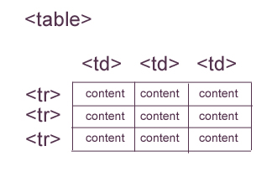
Simple Table Syntax
<table>
<tr>
<td>Content</td>
<td>Content</td>
<td>Content</td>
</tr>
<tr>
<td>Content</td>
<td>Content</td>
<td>Content</td>
</tr>
<tr>
<td>Content</td>
<td>Content</td>
<td>Content</td>
</tr>
</table>
HTML5 Video Series

Slide 4

HTML Lists
HTML5 Video Series
What Are Lists Used For?
Group together related pieces of information
Ranking Data
Design & Layout Formatting

Slide 5
List Syntax
<ul>
<li>Content</li>
<li>Content</li>
<li>Content</li>
</ul>
<ol>
<li>Content</li>
<li>Content</li>
<li>Content</li>
</ol>
Content
Content
Content
HTML5 Video Series
Unordered List
Content
Content
Content
Ordered List

