Slide 1
Chapter 1:Section 4
HTML5 Video Series
Basic HTML Forms & Input

Slide 2

Web Forms 101
HTML web forms let websites become interactive by allowing user input
Forms have front-end and back-end processing. HTML takes care of the front end and another language takes care of the back-end such as PHP or ASP
HTML can create forms but HTML alone is not enough to process forms
Forms usually include a series of html input tags and other elements
HTML5 Video Series

Slide 3
Simple Form Syntax
<form>
Name: <input type=“text>
Email: <input type=“text>
Message:<textarea></textarea>
</form>
HTML5 Video Series
Common HTML tags found in forms:
<form> <input>
<select> <option>
<textarea> <label>
<button> <fieldset>

Slide 4
<form> Tag
The <form> tag wraps around the entire form
HTML5 Video Series
Common Attributes:
action: This specifies the page or script used to
process the form on the server side
method: How the form gets processed (get, post)

Slide 5
<input> Tag
The <input> specifies an input field where a
user can enter data.
HTML5 Video Series
Common Attributes:
type: This specifies the type of input (text,
password, etc
name: Specifies a name for the element. Used in
server-side and/or client-side processing
size: Specifies the width in characters
max: The maximum amount of characters

Slide 6
<textarea> Tag
The <textarea> tag is for large blocks of text
HTML5 Video Series
Common Attributes:
name: Specifies a name for the element. Used in
server-side and/or client-side processing
rows: Specifies the visible number of lines
cols: Specifies the visible width
maxlength: Specifies the maximum number of
characters allowed in the text area

Slide 7
<select> Tag
The <select> tag is used for dropdowns (single and
multiple select
HTML5 Video Series
Common Attributes:
name: Specifies a name for the element. Used in
server-side and/or client-side processing
multiple: Specifies if the list field can contain
multiple values
size: Specifies the maximum number of
visible options

Slide 8
<label> Tag
The <label> tag is used to associate a fields heading
with the input field
HTML5 Video Series
Common Attributes:
for: Specifies which form element the label is
bound to
From w3schools:
The <label> element does not render as anything special for the user. However, it provides a usability improvement for mouse users, because if the user clicks on the text within the <label> element, it toggles the control.

Slide 9
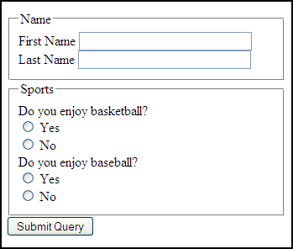
<fieldset> Tag
The <fieldset> tag is used to group together
certain fields. It draws a box around the elements
HTML5 Video Series
Common Attributes:
name
form
disabled

