Slide 1
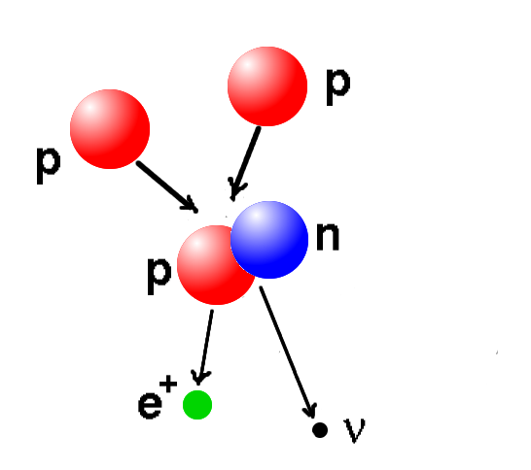
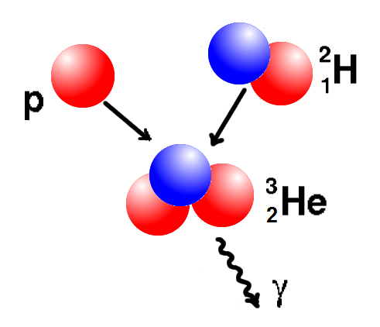
Proton-Proton Chain: Step #1 Formation of “deuteron”, slow weak interaction.
p + p → d + e⁺ + ν

Slide 2
Proton-Proton Chain: Step #2 Formation of “Helium-3” Rapid, radiative association.
p + d → ³He + γ

Slide 3
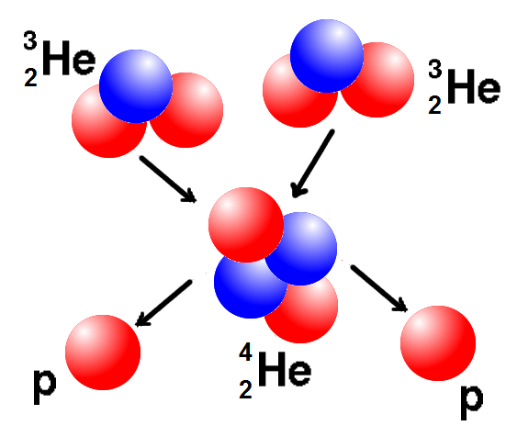
Proton-Proton Chain: Step #3 Formation of “Helium-4” Medium time scale.
³He + ³He → ⁴He + p + p

Slide 4
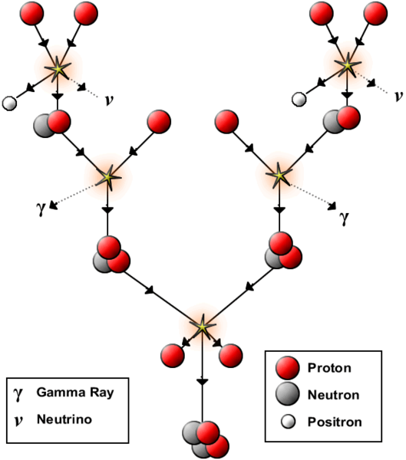
Proton-Proton Chain:
Positrons annihilate with free electrons.
Resulting gamma-rays are absorbed
locally together with gamma-rays
produced in step #2.
Neutrinos escape the Sun directly.
Prediction! Sun is a source of neutrinos.

Slide 5
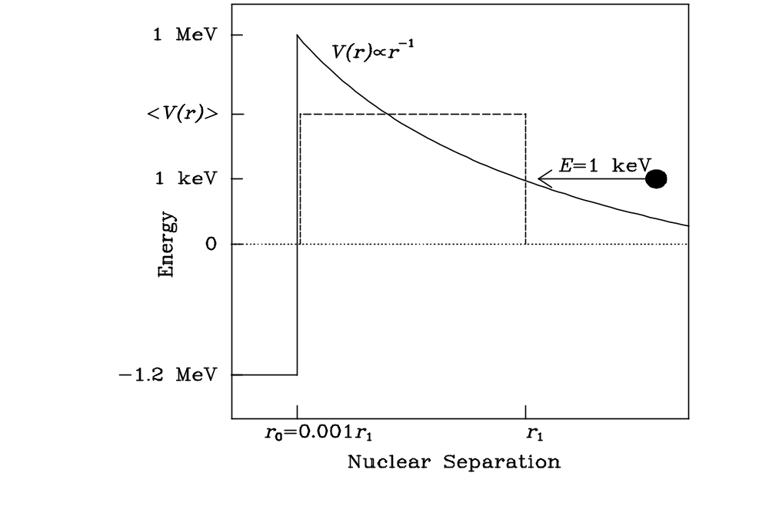
Coulomb Barrier:
-2.2
r_{N} ≈ 0.001r_{C} r_{C}

Slide 6
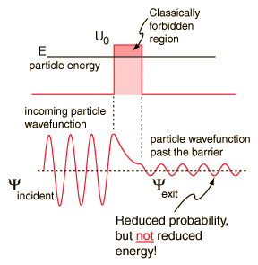
Quantum Mechanical Barrier Penetration:

Slide 7
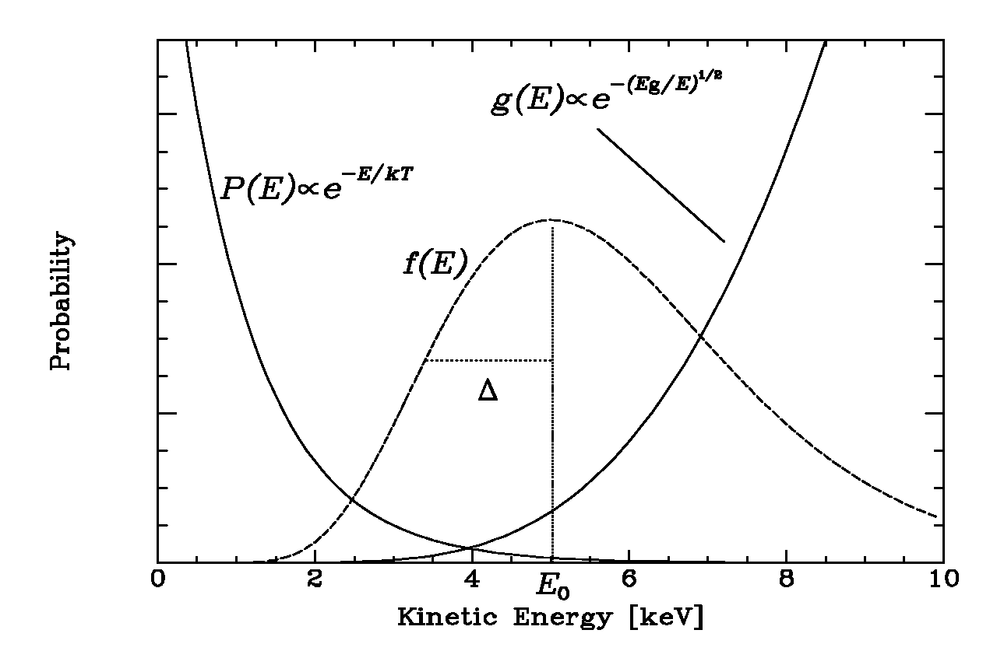
Fusion Window:

Slide 8
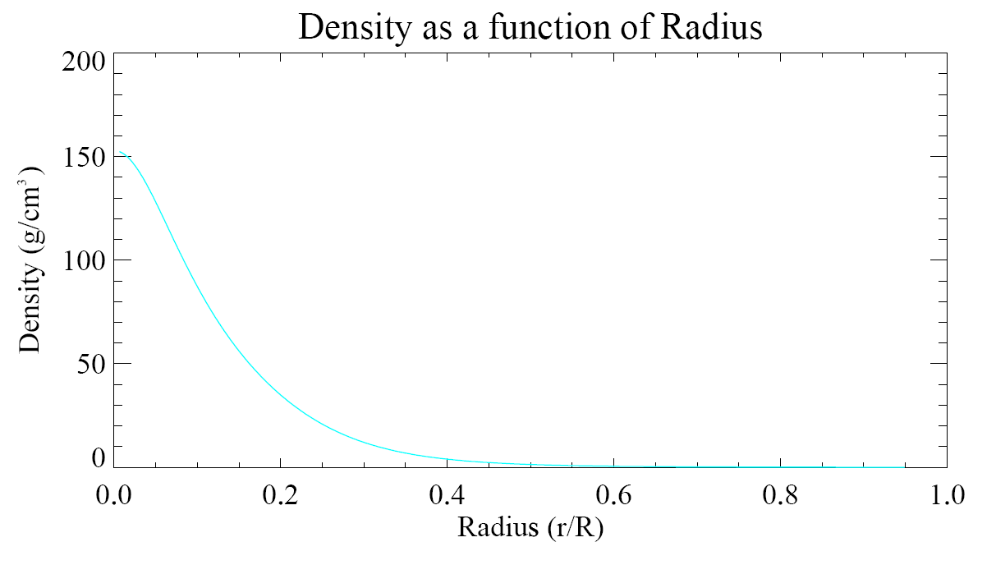
Standard Solar Model:

Slide 9
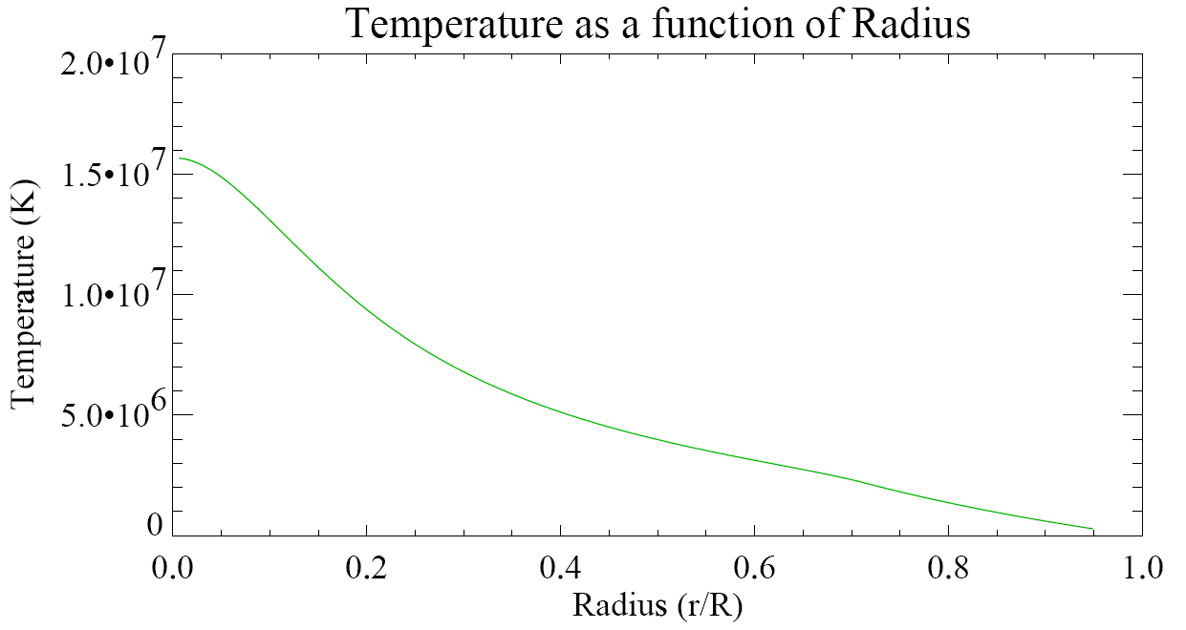
Standard Solar Model:

Slide 10
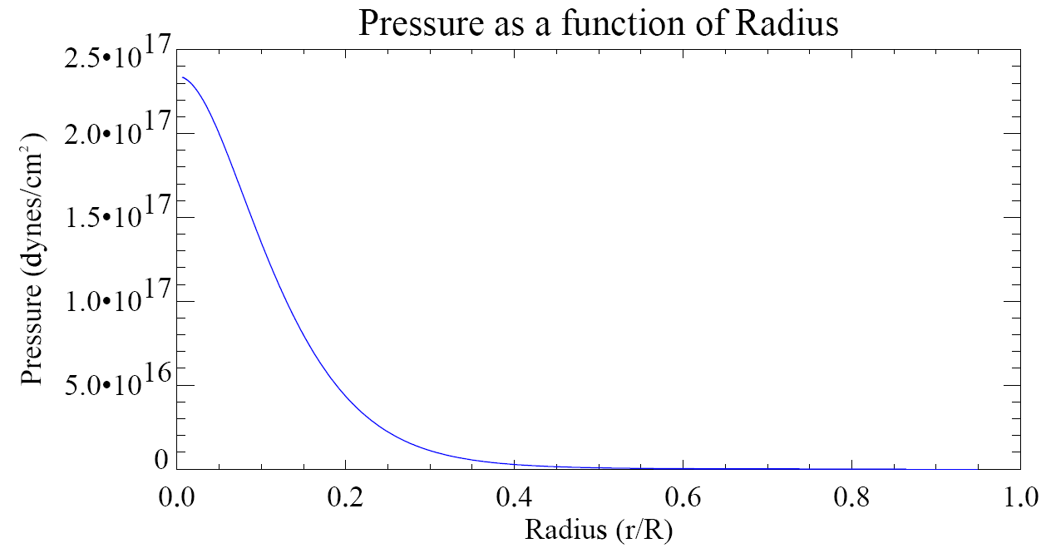
Standard Solar Model:

Slide 11
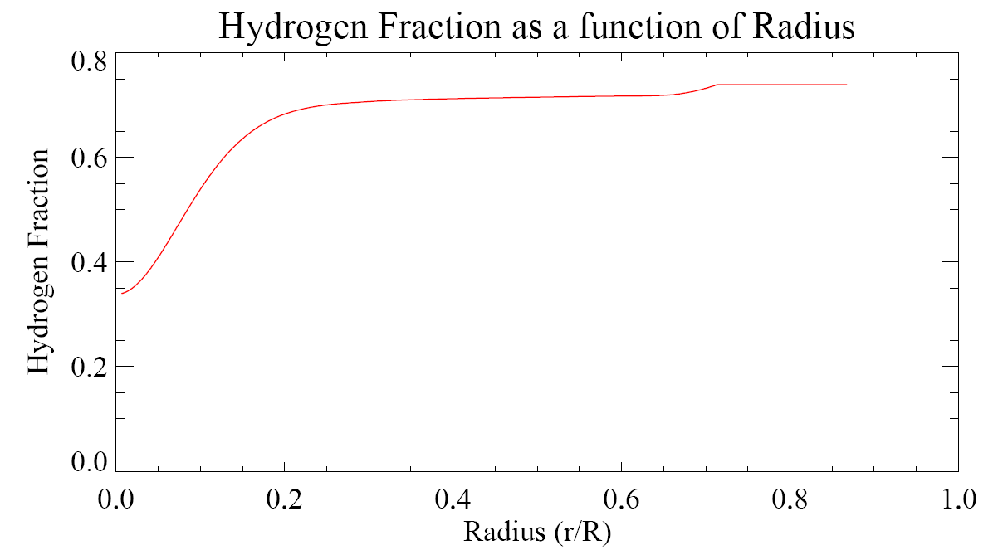
Standard Solar Model:
Half way to a helium core!

Slide 12
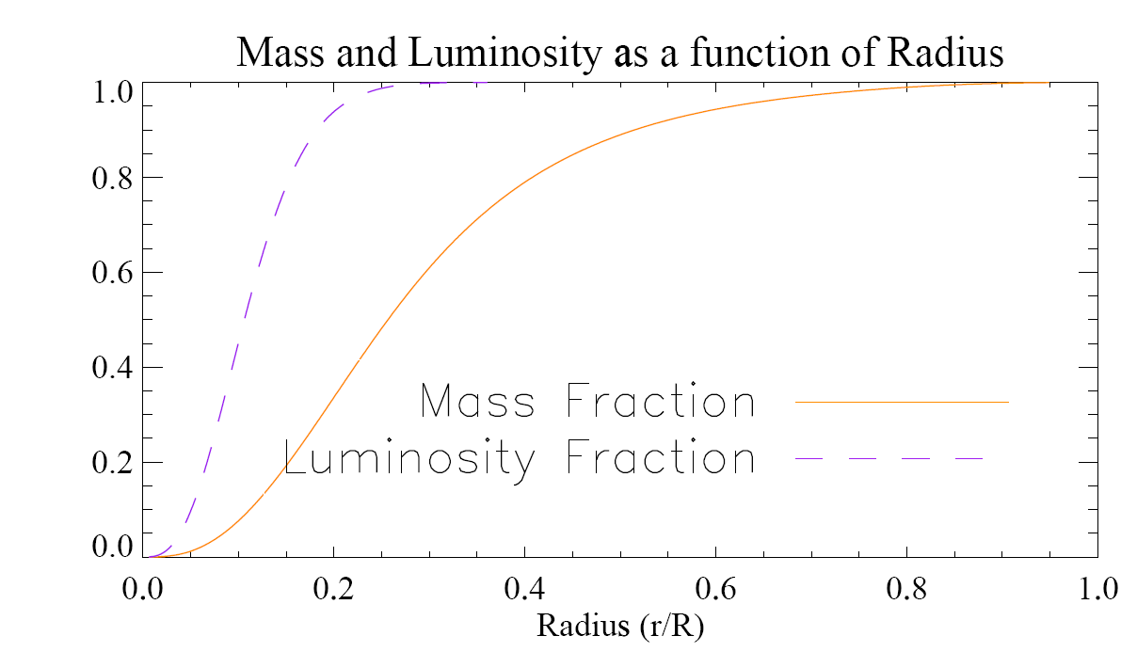
Standard Solar Model:

Slide 13
Carbon-Nitrogen-Oxygen (CNO) cycle: net effect 4p → ⁴He
“catalysis”
MeV
p + ¹²C → ¹³N + γ
¹³N → ¹³C + e⁺ + ν_{e}
p + ¹³C → ¹⁴N + γ
p + ¹⁴N → ¹⁵O + γ
¹⁵O → ¹⁵N + e⁺ + ν_{e}
p + ¹⁵N → ¹²C + ⁴He
1.99
1.71
7.55
7.29
2.22
4.97
25.7
Positrons annihilate with free electrons, so add 2 x 0.511 = 1.02
Neutrinos carry away 0.7 and 1, so subtract 1.7. TOTAL = 25 MeV per cycle

Slide 14
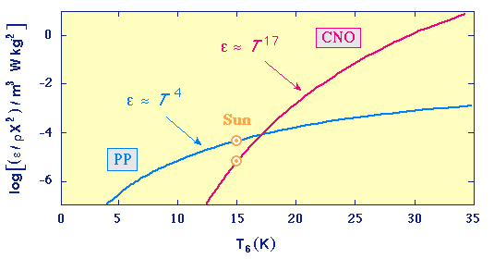
Proton-Proton versus CNO cycle:
CNO begins to dominate energy production for M > 1.3 M
The much greater temperature sensitivity of the CNO cycle enables
the much higher luminosities of massive stars (recall L ~ M³).

Slide 15
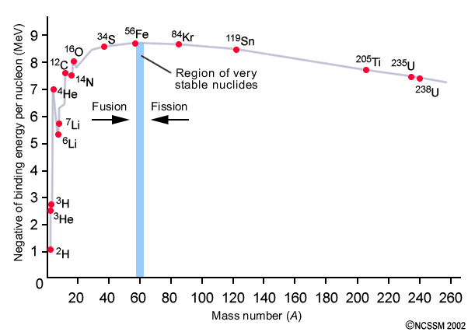
Binding Energy per Nucleon in Atomic Nuclei:
“iron peak”
⁹Be

Slide 16
Triple alpha reaction: Enables a fusion jump from helium to carbon.
⁴He + ⁴He → ⁸Be + γ
However, ⁸Be → ⁴He + ⁴He in 2.6 x 10⁻¹⁶ s
At high temperatures (T>10⁸ K) enough ⁸Be remains for an occasional
⁸Be + ⁴He → ¹²C* + γ
¹²C* → ¹²C + γ
Once carbon is produced, elements can be synthesized up to the iron peak
if the temperature is high enough to overcome the Coloumb barriers.
For example,
⁴He + ¹²C → ¹⁶O + γ
etc.

Slide 17
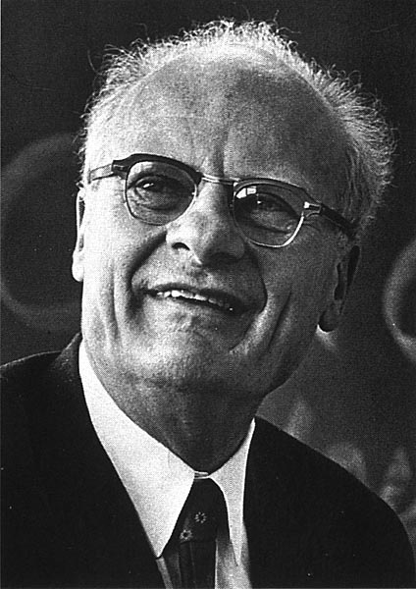
Nobel Prize in Physics 1967
For his contributions to the theory of nuclear reactions,
especially his discoveries concerning the energy
production is stars.
Hans Bethe 1906-2005

Slide 18
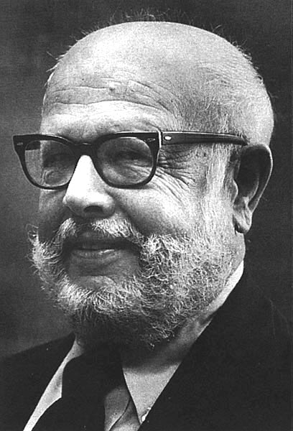
Nobel Prize in Physics 1983
For his theoretical and experimental studies of the
nuclear reactions of importance in the formation of
the chemical elements in the universe.
William A. Fowler 1911-1995

Slide 19
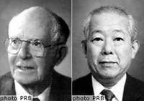
Nobel Prize in Physics 2002
For pioneering contributions to astrophysics,
in particular for the detection of cosmic neutrinos.
Raymond David 1914 -
Masatoshi Koshiba 1926 -

