Slide 1
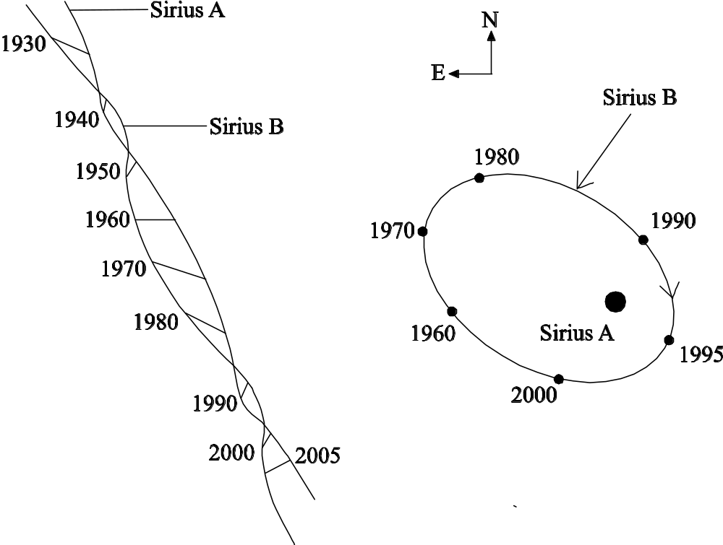
Sirius A & B:
1.5 arc-minutes
Sirius-B discovered by Clark in 1862
after predicted by Bessel in 1848.
Question: Given a distance of 2.6 pc, what is the transverse speed in km s⁻¹ ? (homework).

Slide 2
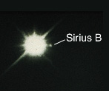
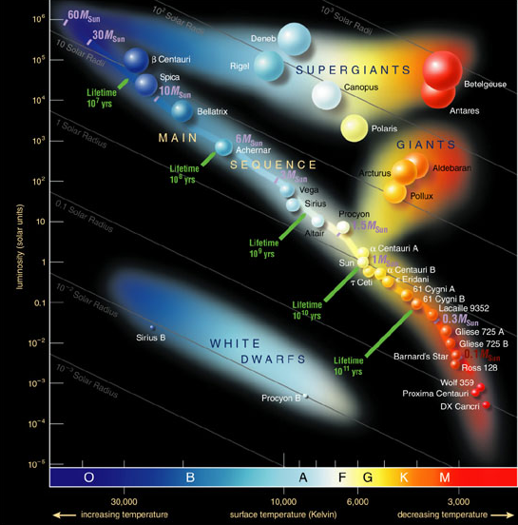
Some Famous Stars:
A binary system!
Sirius A (α Canis Majoris)
A-type main-sequence
T_{eff} = 9,900 K
M ≈ 2.1 M
L = 26.1 L
R = 1.7 R
distance = 2.6 pc
Spica
Betelgeuse
Arcturus
Sirius A
Luminosity
α Centauri
Sun
Sirius B
OB type white dwarf!
T_{eff} = 24,790 K
M ≈ 0.98 M
L = 0.00024 L
R = 0.008 R
Sirius B
30,000
Temperature
3,000

Slide 3
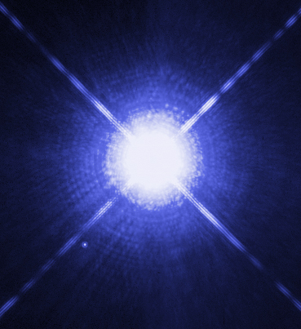
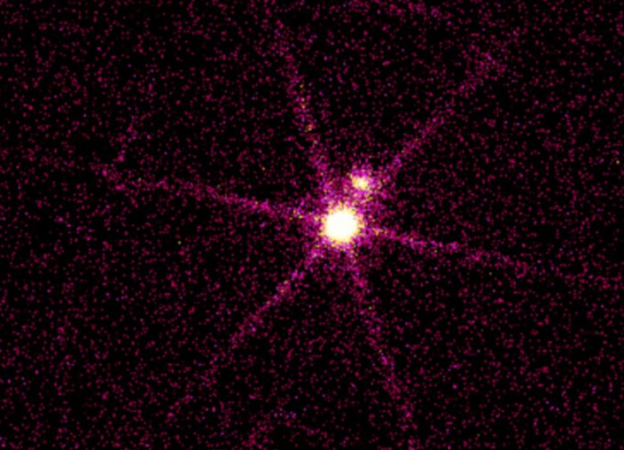
Sirius A & B:
Optical image
X-ray image

Slide 4
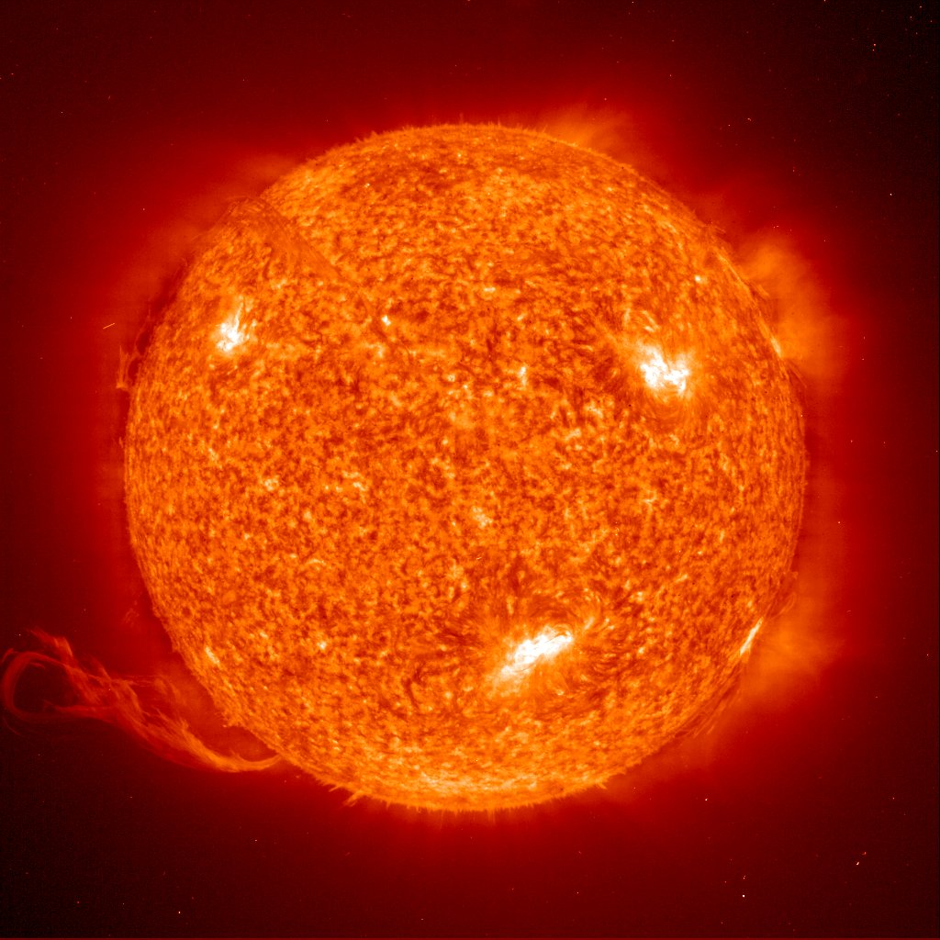

Slide 6
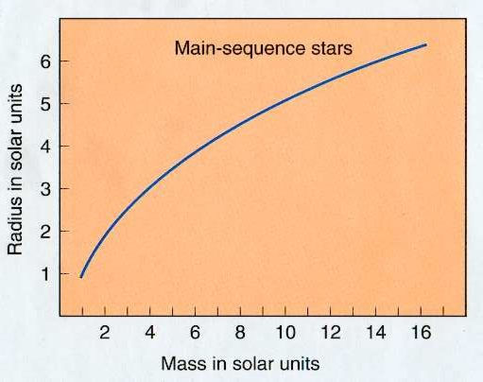
Recall, mass-radius relation for main-sequence stars.

Slide 7
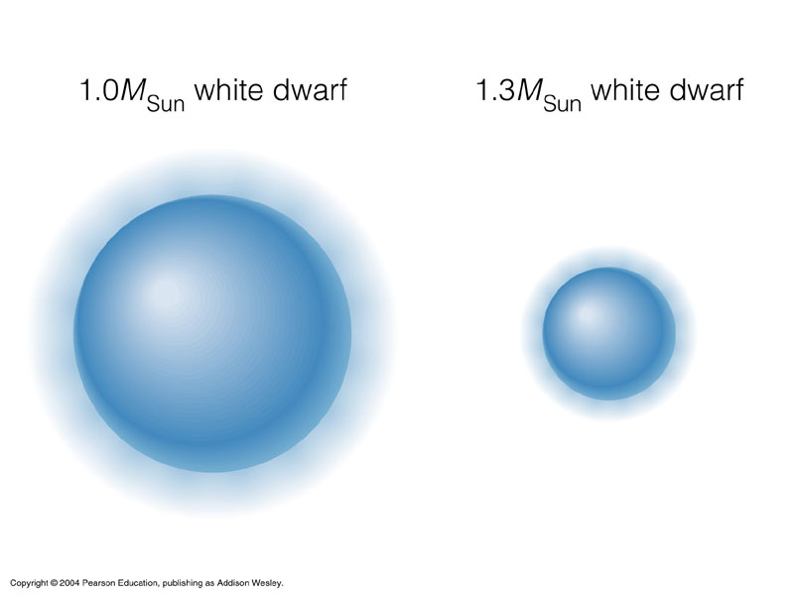
The radius of a White Dwarf decreases with mass! (strange).

Slide 8
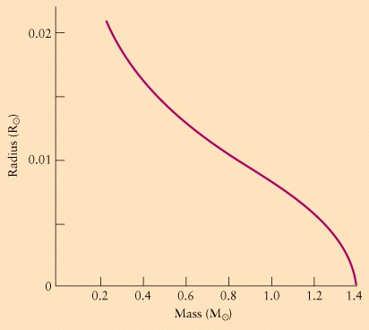
Mass-Radius Relation for White Dwarfs:
Chandrasekhar Limit: R → 0 as M → 1.4 M !

Slide 9
White dwarf properties are beautiful (and simple) consequences
of quantum mechanics, thermodynamics, and special relativity.
Goals:
1) understand “degenerate electron pressure” for
non-relativistic and ultra-relativistic gases.
2) derive an exact formula for the mass-radius relation
for a non-relativistic degenerate gas.
3) show that a mass-radius relation is impossible for
a relativistic gas, leading to the Chandrasekhar limit.

Slide 10
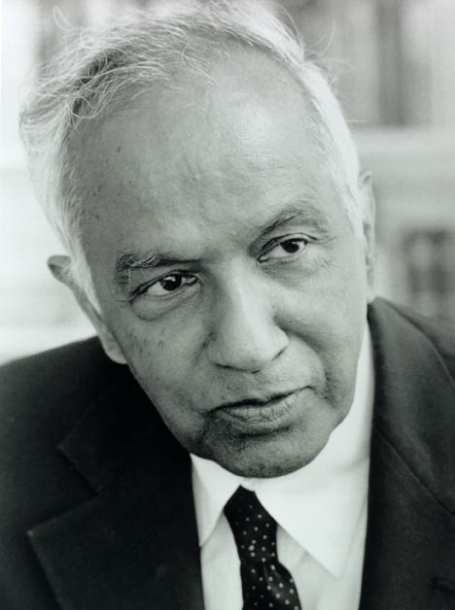
Nobel Prize in Physics 1983
For his theoretical studies of the physical processes
of importance to the structure and evolution of the stars.
Sabramanyan Chandrasekhar 1910-1995

Slide 11
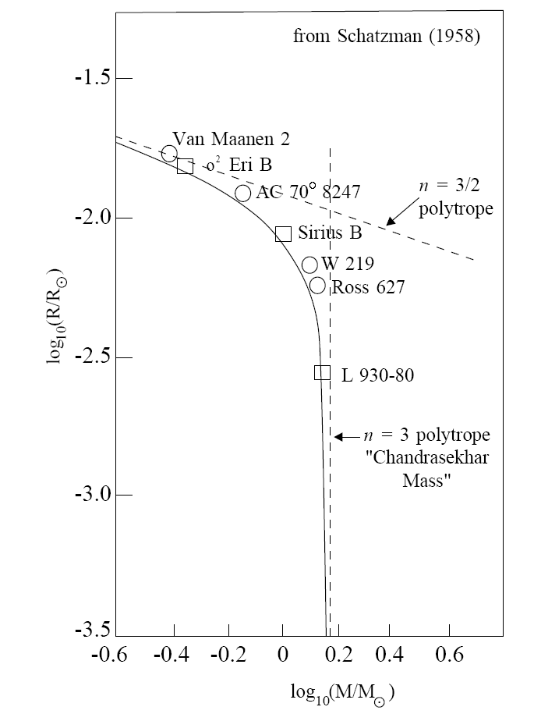
Mass-Radius Relation for White Dwarfs:

Slide 12
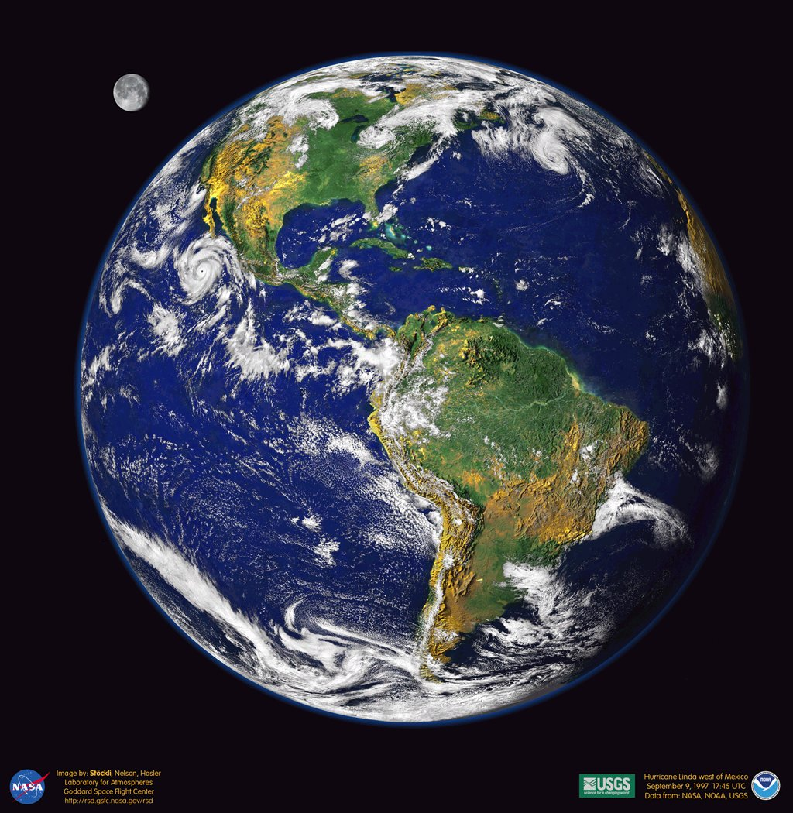
Compressing the Earth to the Density of a Neutron Star!

Slide 13
