Slide 1
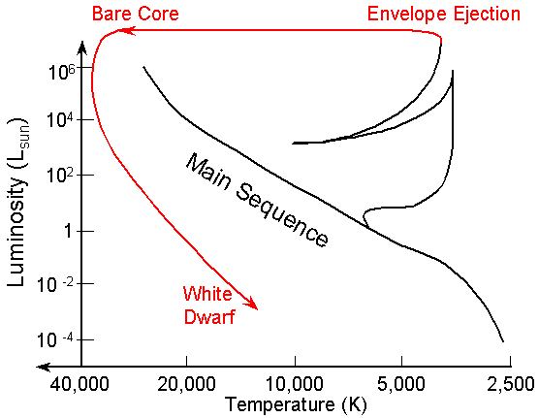
Main-Sequence Lifetimes:
100 M main-sequence lifetime ≈ 3 x 10⁶ yr
1 M main-sequence lifetime ≈ 10¹⁰ yr

Slide 2
Evolution of Sun-Like Stars:
Main-Sequence. Energy produced by core “hydrogen burning”
for 10 billion years.
4p → ⁴He via pp-chain (and CNO cycle).
1

Slide 3
2) Sub-Giant Phase. Core is fully converted to ⁴He. No fusion takes place
in the helium core, so it contracts and heats up.
Hydrogen burning (4p → ⁴He) occurs in a surrounding shell.
Energy production rate increases due to increasing temperature/density in the shell.
However, extra energy can’t get out (escape limited by radiative diffusion rate),
so the star expands at fixed luminosity, and the surface temperature drops.
2
1

Slide 4
3) Red Giant Phase. Hydrogen burning (4p → ⁴He) continues in a shell around an
inert hydrogen core.
Convective energy transport takes over, so increased energy production rate
can now lead to a dramatice increase in luminosity. Opacity behavior prevents
the surface temperature from falling below a certain limit, so an enormous
expansion occurs as the luminosity increases. The star becomes a red giant!
The inert helium core becomes degenerate as it continues to collapse and heat up.
3
2
1
1 billion years from end of main-sequence
to the end of the red-giant phase.
Hayashi Limit

Slide 5
Helium Flash. The degenerate core reaches a temperature of 10⁸ K.
This is sufficiently hot for helium fusion reactions to turn on (“triple alpha reactions”).
This occurs explosively since the pressure is dominated by degenerate electrons,
so the pressure does not respond to changes in temperature.
higher T → more nuclear energy → even higher T, etc.
Mass loss.
4
3
2
1
Done in minutes…

Slide 6
Triple alpha reaction: Enables a fusion jump from helium to carbon.
⁴He + ⁴He → ⁸Be + γ
However, ⁸Be → ⁴He + ⁴He in 2.6 x 10⁻¹⁶ s
At high temperatures (T>10⁸ K) enough ⁸Be remains for an occasional
⁸Be + ⁴He → ¹²C* + γ
¹²C* → ¹²C + γ
Once carbon is produced, elements can be synthesized up to the iron peak
if the temperature is high enough to overcome the Coloumb barriers.
For example,
⁴He + ¹²C → ¹⁶O + γ
etc.

Slide 7
Helium Core Burning (“Horizontal Branch Stars”): The helium flash injects so
much heat that the core degeneracy is finally “lifted”. Core expands and
triple-alpha helium fusion then proceeds stably in the core under non-degenerate
conditions. The helium burning core is surrounded by a hydrogen burning shell.
Due to core expansion overall energy production rate decreases.
Luminosity and radius decrease. Surface temperature increases.
4
3
5
2
1

Slide 8
6) Asymptotic Giant Branch (AGB): Core is fully converted to carbon and oxygen.
No fusion takes place in the core. A helium burning shell is surrounded by a hydrogen
burning shell. The core contracts, heats up, and becomes degenerate.
Energy production rate increases due to increased temperature/density in the shells.
An enormous expansion again occurs and the star becomes a red super giant.
6
4
3
5
2
1
100 million years from onset of helium core burning
to the tip of the AGB.

Slide 9
Mass ejection, “planetary nebulae” formation: Thermal instabilities in the
helium shell lead to pulsations and mass ejection. Inner hotter layers are exposed.
Surface temperature rises, radius shrinks.
Hydrogen and helium shells burn out. Temperature in carbon/oxygen core
too low for any further nuclear fusion…
7
6
4
3
5
2
1
~50,000 years.

Slide 10
White Dwarf: The hot (10⁹ K) degenerate core is exposed as a white dwarf.
No internal energy sources. Cools down to 10⁴ K in 10⁷ years.
Further cooling to 10³ K takes 10¹⁰ years.
The carbon oxygen ions eventually cool to form a crystal lattice.
7
6
4
3
5
2
8
1

Slide 11
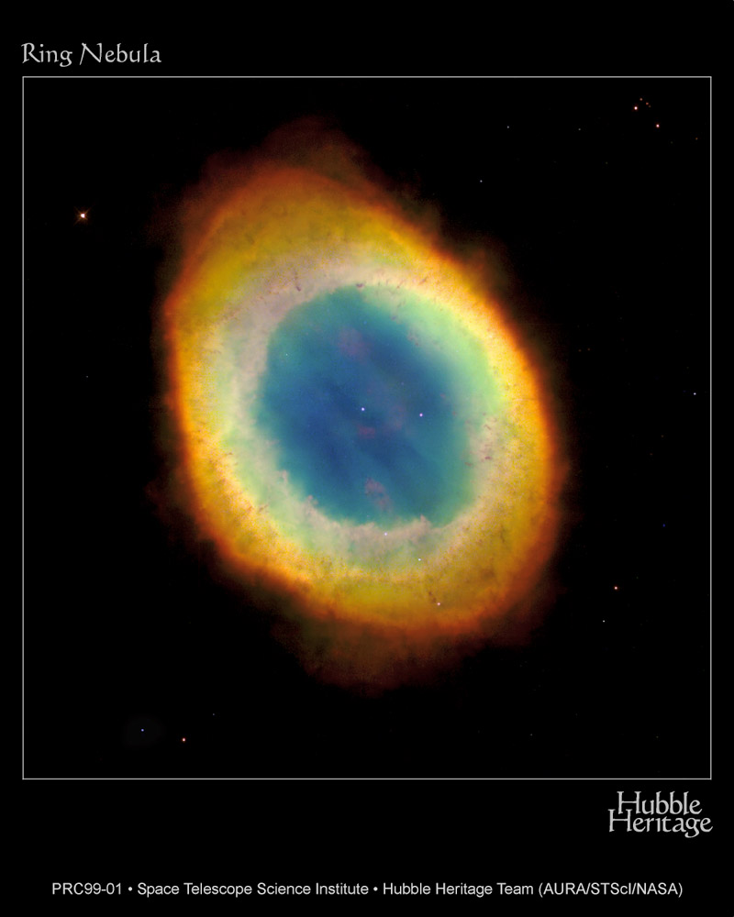
A Famous “Planetary” Nebula, The Ring:
white dwarf
distance ≈ 630 pc
diameter ≈ 0.5 pc

Slide 12
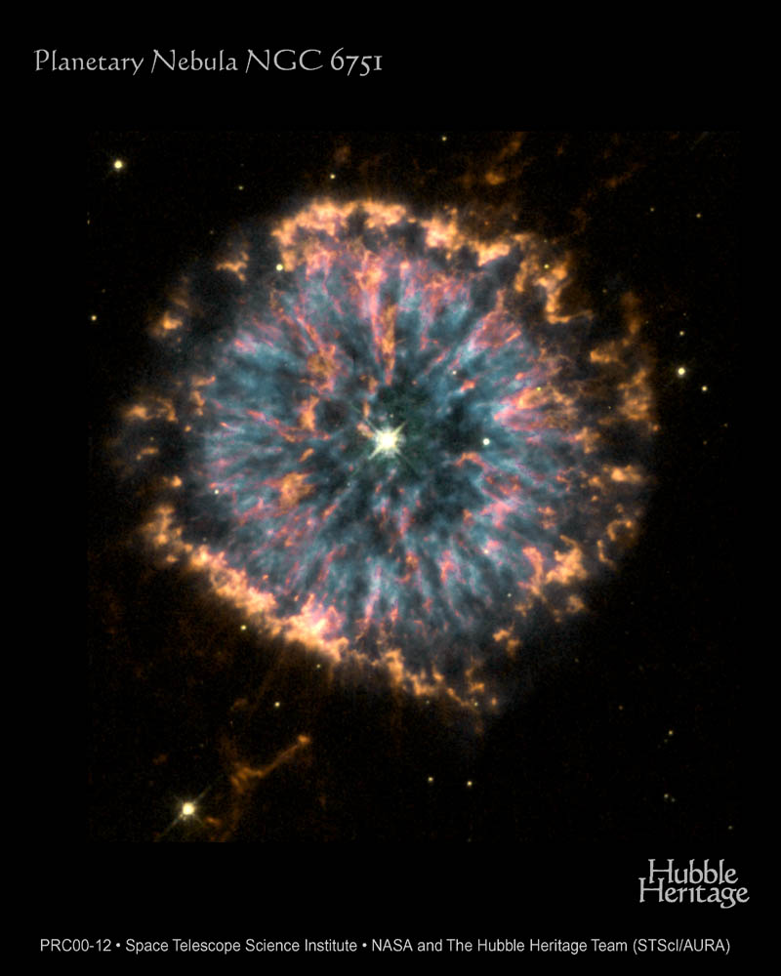

Slide 13
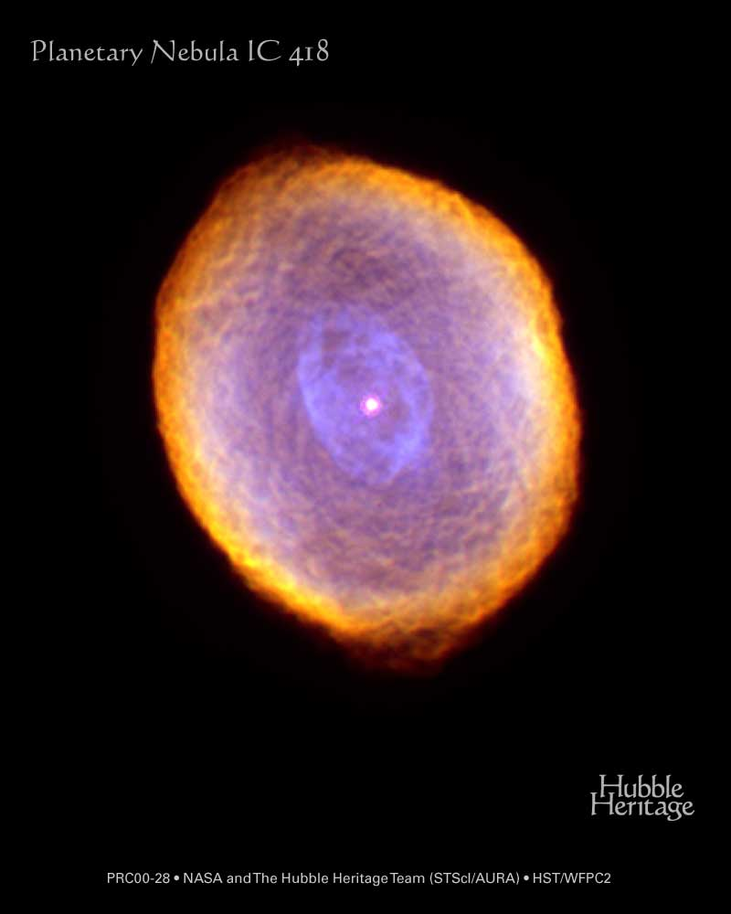

Slide 14
Evolution of Massive Stars (M > 8M):
Main-Sequence. Energy produced by core “hydrogen burning”
for less than 30 million years.
4p → ⁴He via CNO cycle.
1

Slide 15
Evolution of Massive Stars (M > 8M):
2) Core Contraction: Hydrogen shell burning.
1
2

Slide 16
Evolution of Massive Stars (M > 8M):
3) Core Helium Burning: Hydrogen shell burning around a helium burning core.
3
1
2

Slide 17
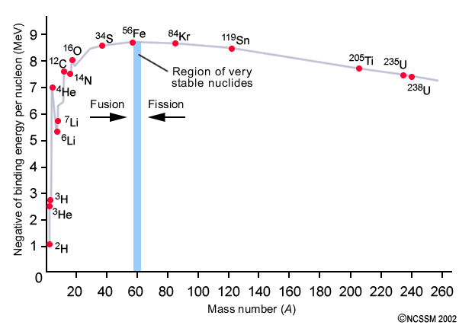
Binding Energy per Nucleon in Atomic Nuclei:
“iron peak”
⁹Be

Slide 18
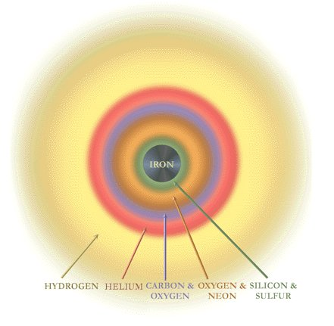
Increasingly Rapid Shell Burning to the “Iron Catastrophe”:
5x10⁶ yr 5x10⁵ yr 500 yr 1 yr 1 day … (for M=25M)

Slide 19


Slide 20

Computer Simulation of Core Collapse Supernova Explosion:

Slide 21
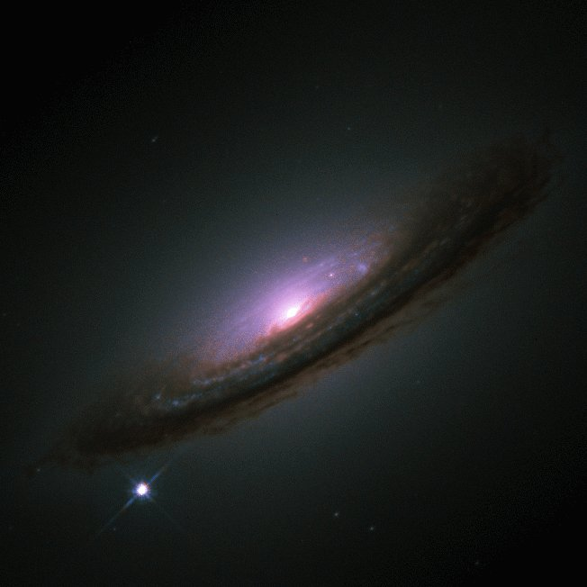
A Spiral Galaxy Containing 100 Billion Stars:
50,000 pc

Slide 22
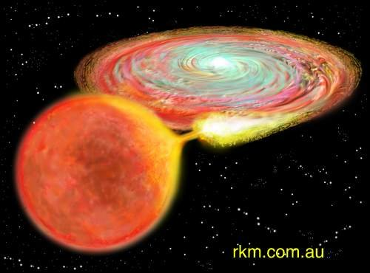
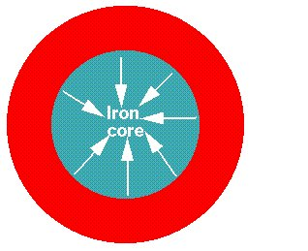
Two Types of Supernovae:
Type I low-mass stars
(around 1 M)
mass transfer onto a degenerate
white dwarf in a binary system:
explosion of entire white dwarf.
Type II high-mass stars
(greater than 8 M)
core-collapse: implosion/explosion

Slide 23
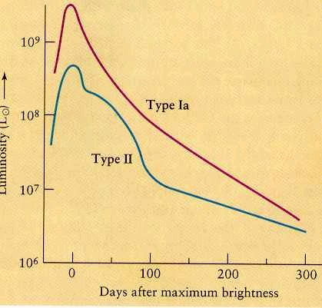
Supernovae “Light Curves”:
Energy produced
within a few seconds
equal to total Sun’s
output over
10 billion years.

Slide 24
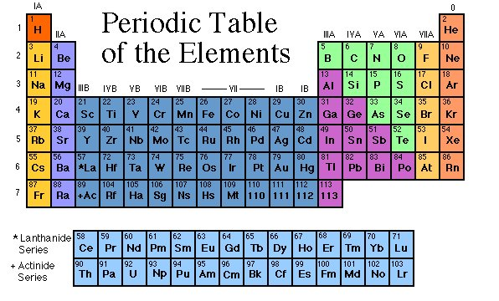
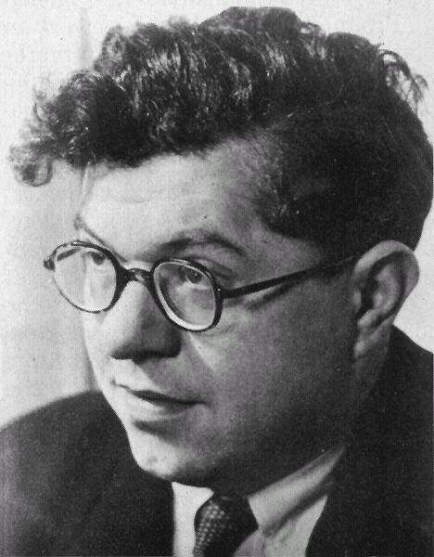
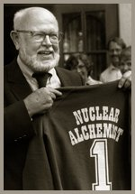
Nucleosynthesis in stars and supernovae:
William Fowler 1911 - 1995
Nobel Prize in Physics 1983
“for his theoretical and experimental
studies of the nuclear reactions of
importance in the formation of the
chemical elements in the universe”
Fred Hoyle 1915 - 2001

Slide 25
“...My major theme has been that all of the heavy elements from carbon
to uranium have been synthesized in stars. Let me remind you that your
bodies consist for the most part of these heavy elements. Apart from
hydrogen you are 65 percent oxygen and 18 percent carbon with smaller
percentages of nitrogen, magnesium, phosphorous, sulphur, chlorine,
potassium, and traces of still heavier elements.
“Thus it is possible to say that you and your neighbor and I, each one of
us and all of us, are truly and literally a little bit of stardust!...”
W. Fowler 1983
Nobel Lecture

