Slide 1
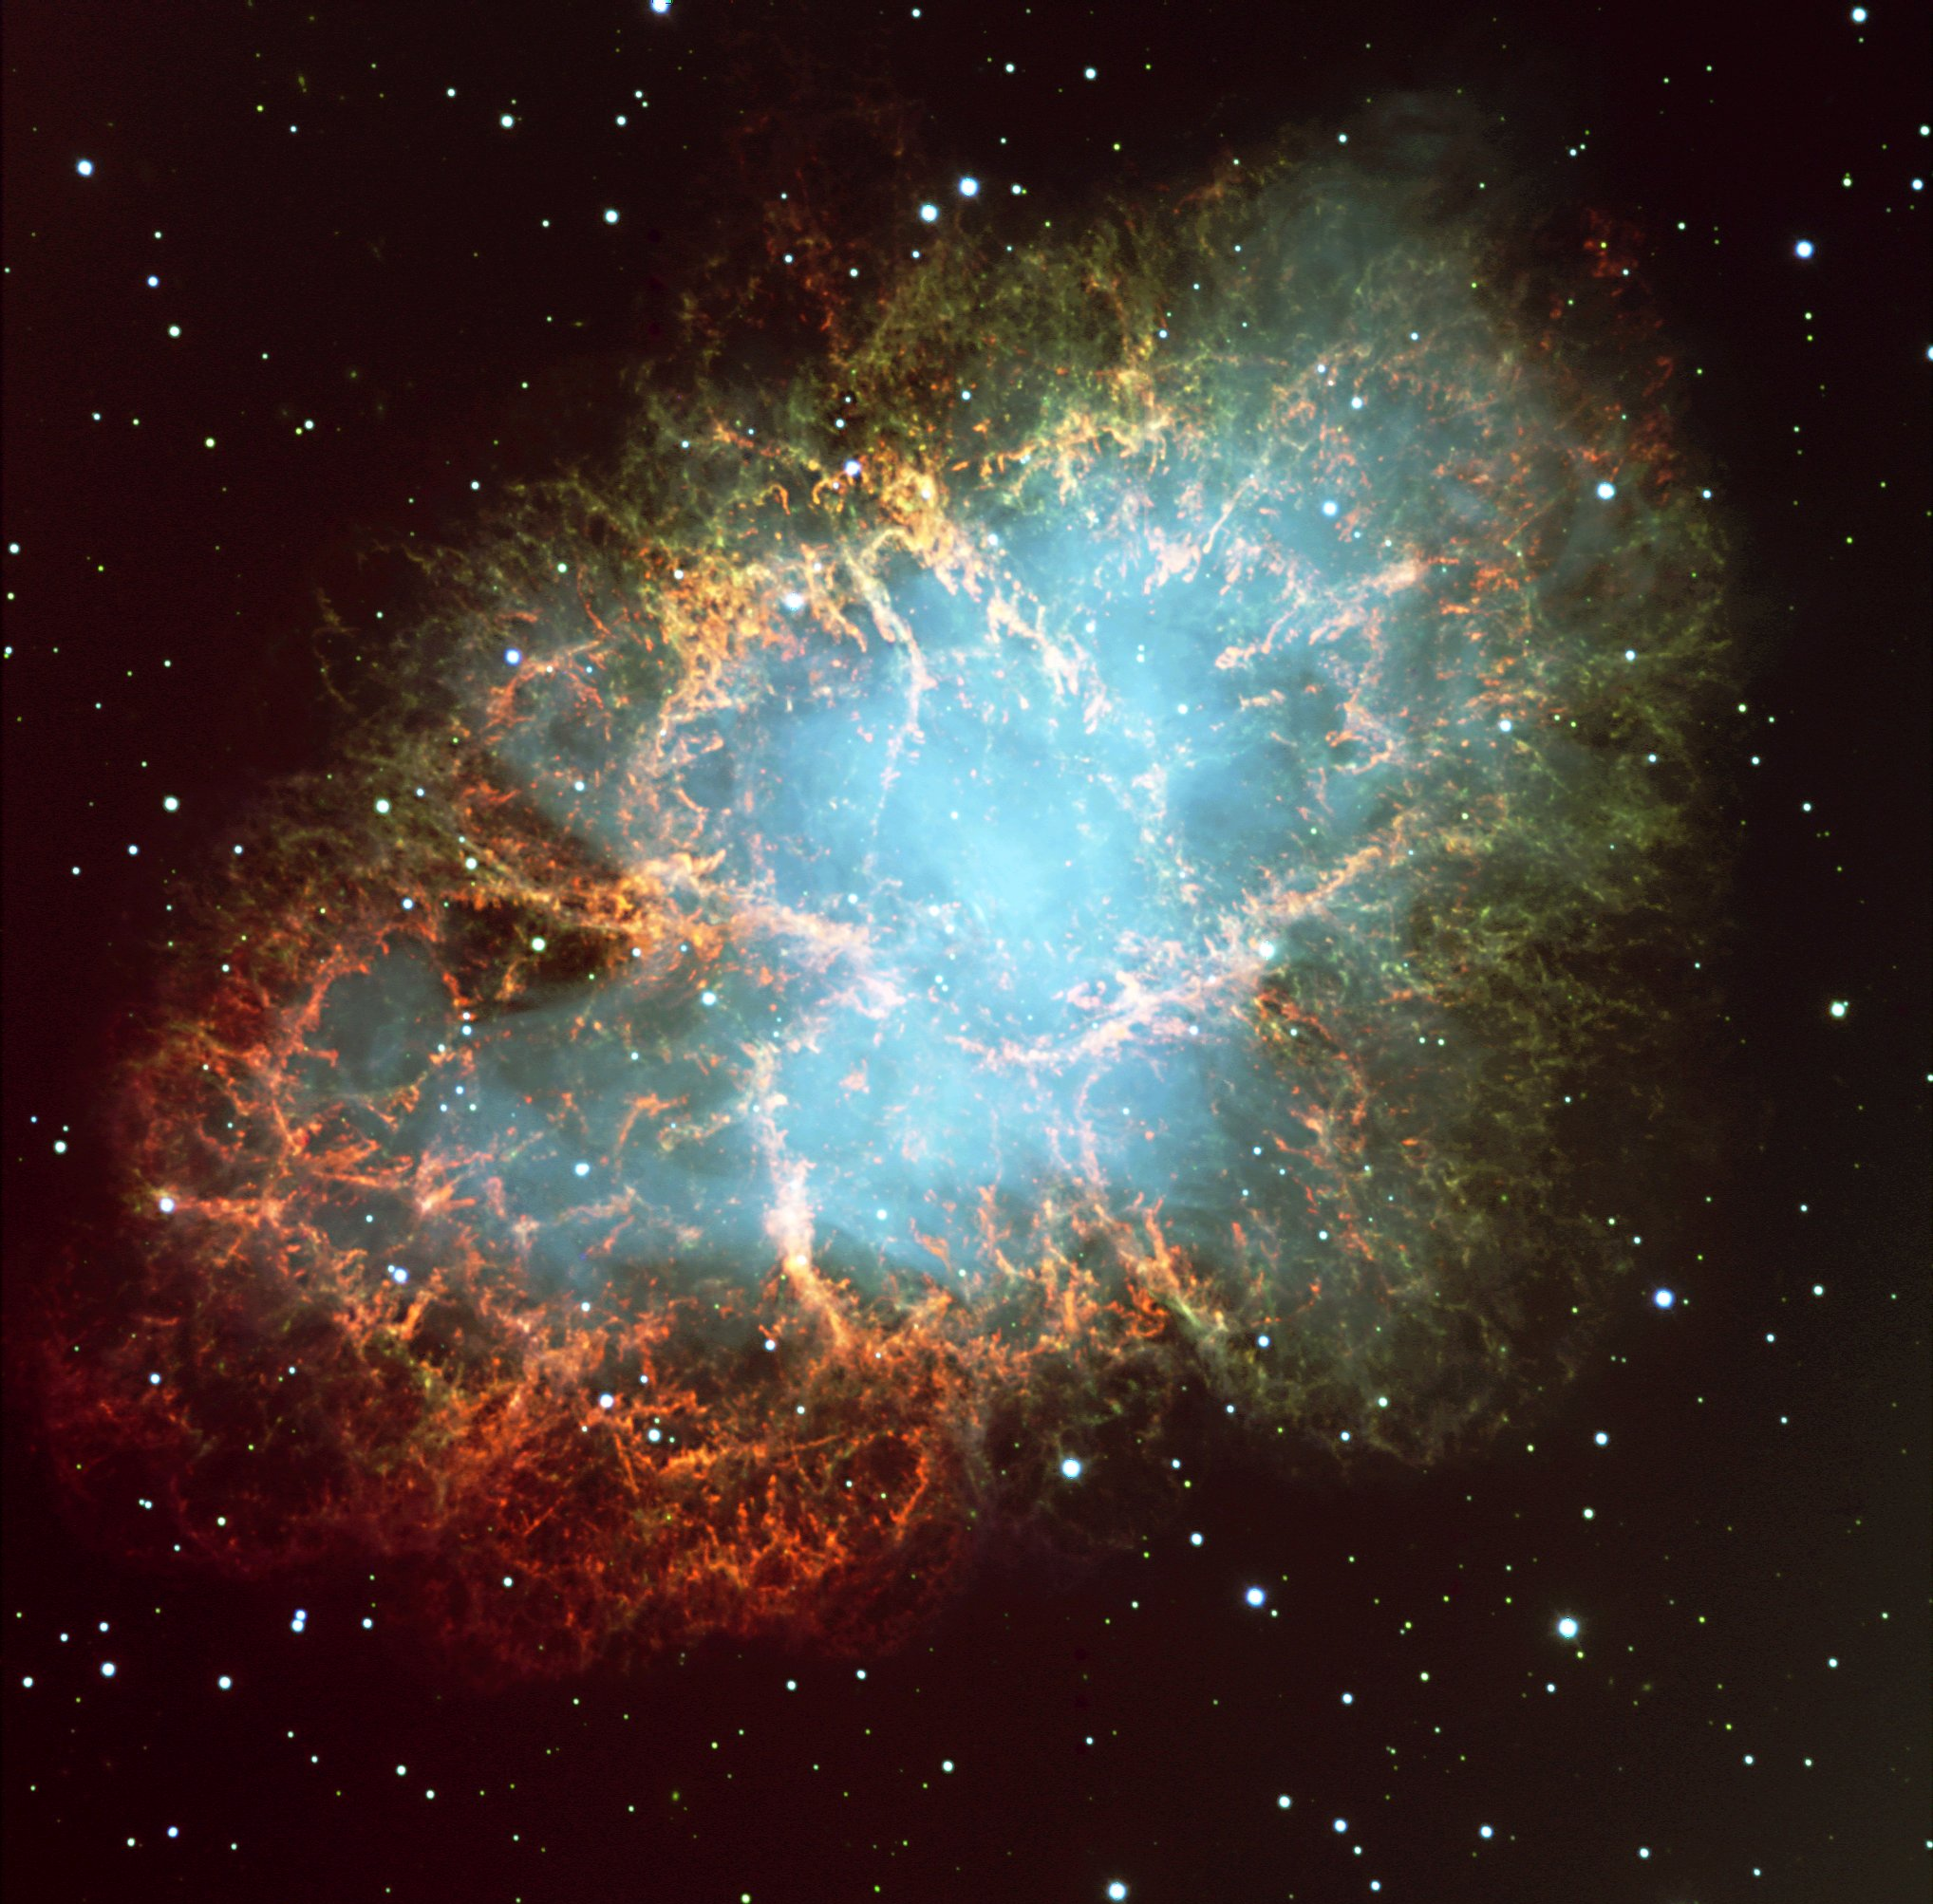
The “Crab Nebula”: the most famous supernova remnant.
distance ≈ 2000 pc
diameter ≈ 3 pc

Slide 2
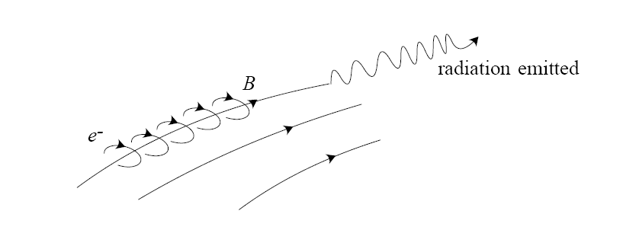
Synchrotron Emission: relativistic electrons spiralling around
magnetic field lines.
radiation
Gives rise to the “ghostly” blue light (non-thermal).

Slide 3
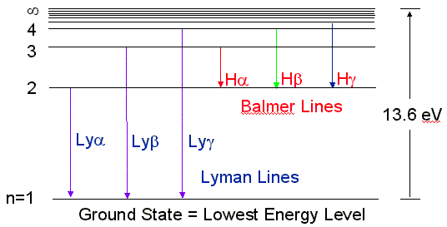
Recombination Emission Line Radiation:
Red filaments are due to Hα photons
produced when protons and electrons
recombine to form hydrogen atoms.
(optical)
(ultraviolet)

Slide 4
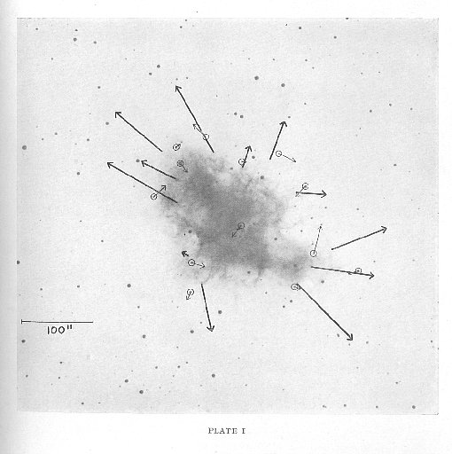
Crab Nebula is Rapidly Expanding:
Expanding at 1,800 km/s
diameter = 3 pc
implying an explosion around the
year 1054!

Slide 5
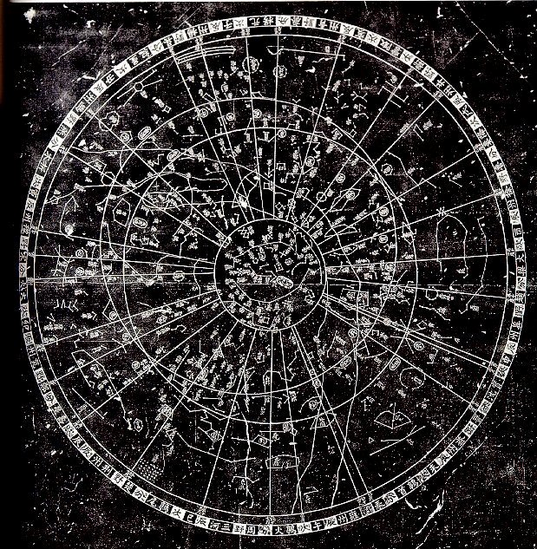
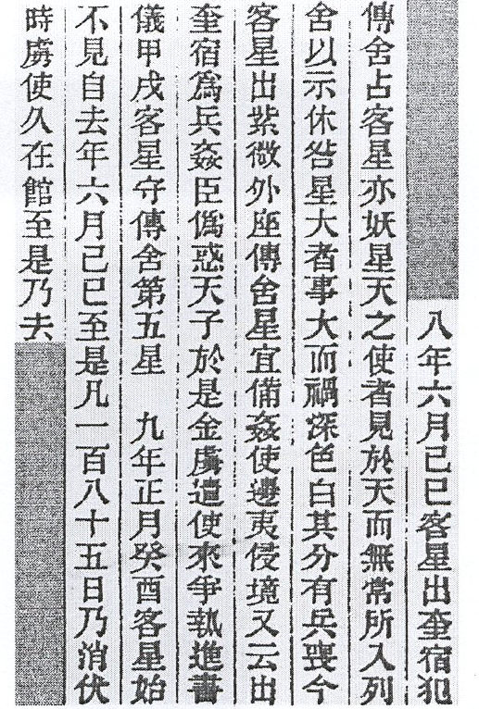
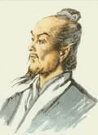
The Supernova Event as Recorded by Chinese Astronomers in 1054:

Slide 6
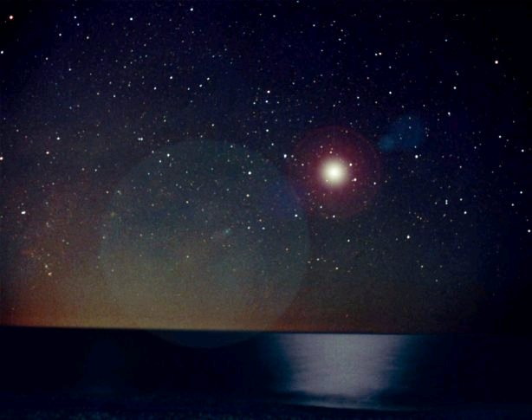
An Artist Conception:
5 July 1054

Slide 7
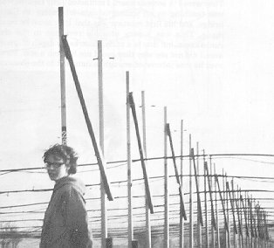
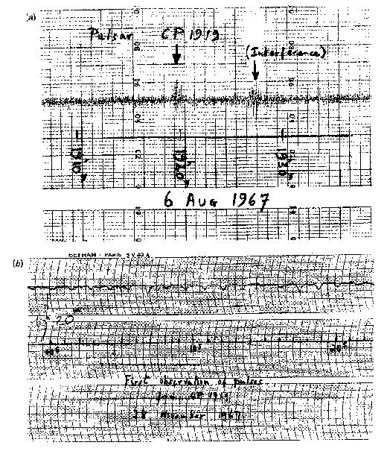
Discovery of Pulsars:
Jocelyn Bell 1943 -

Slide 8
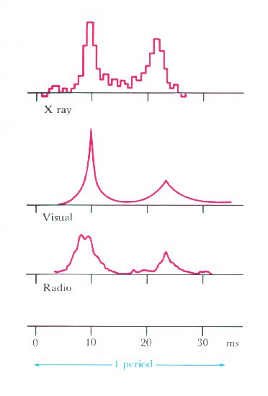
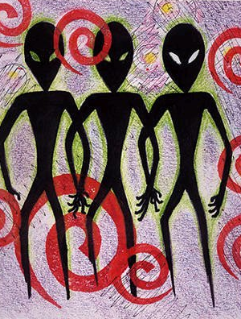


Are these alien signals???

Slide 9
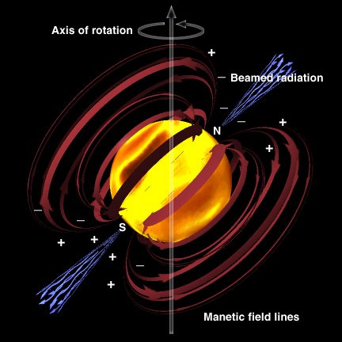
No! these are rotating neutron stars! called Pulsars.
Pulsars rotate
from 10 to 1000
times per second!

Slide 10
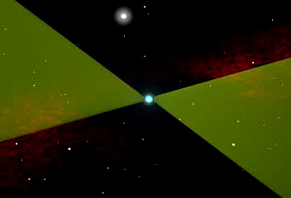

Slide 11
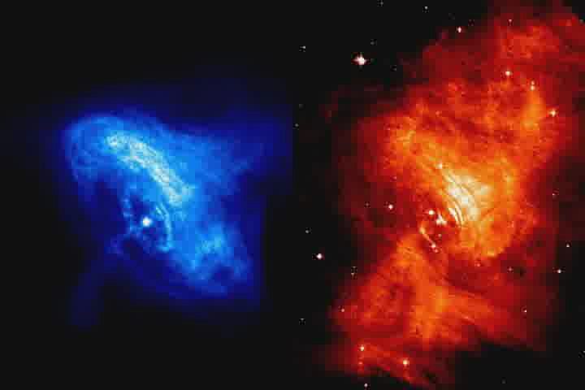
Chandra Space Telescope (X-ray)
Hubble Space Telescope (optical)
Pulsar injecting energy into the Crab nebula!

Slide 12
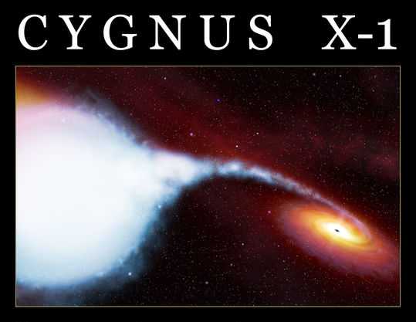
A Stellar Black Hole in a Binary System!

