Slide 1
Modèles et Outils pour la Reconception et L’Évolution des Structures d’un Document Multimédia en Fonction des Usages
État d’avancement des travaux de thèse
Madjid SADALLAH DSSM, DTISI
Directeur de thèse: Pr. Yannick PRIÉ (Université de Nantes)
1ère inscription: Décembre 2012 (4ème inscription en cours)

Slide 2
Outline
Context & goals
An approach for time –based analysis of logs
Towards Reading Session-based Indicators
CoReaDa : the Course Reading Analysis Dashboard

Slide 3



CEMaDoM
Not supported by the learning equipments
Well received, well understood
Well received, reading/understanding concerns

Slide 4


Part of the CEMaDoM project
Adaptation
Document non supporté par l’équipement
Bien reçu, bien compris
Difficulté d’assimilation.
Reconception
Usage logs

Slide 5
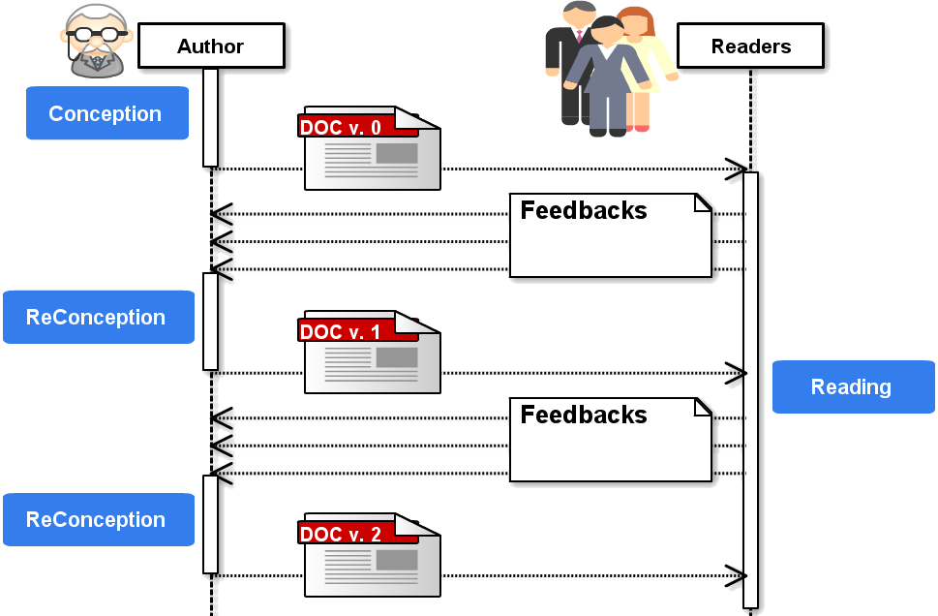
Assumptions
Digital world
Documents: complex but also easily editable/updatable/alterable
Persistent, two-ways communication between authors and readers
2-ways communication → author may use reading logs as a knowledge source for reengineering documents

Slide 6





Usage-based document reengineering
[Sadallah, 2013]
Editing
Author
Reading-session based Indicators
Indicators
Delivery
Reading
sessions
Analysis
Reading
Analysis tools
Logs
Readers
Target: User, Course, page,…
Based on the events sequence

Slide 7
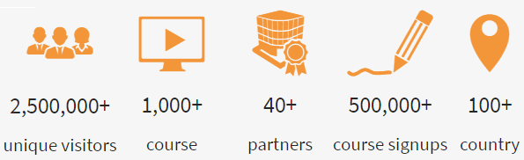

Platform & data
Representative courses over a period of 6 months
NodeJS (36 parts)
Screensaver (11 parts)
XML (107 parts)
JAVA (164 parts)
Log structure
<id, user, server_session, course, part, date>

Slide 8
Outline
Context & goals
An approach for time –based analysis of logs
Towards Reading Session-based Indicators
CoReaDa : the Course Reading Analysis Dashboard

Slide 9
Why time-based indicators?
Trace
Action1
A2
A3
A4
A5
A6
A7
A8
A9
Actual reading
More "accurate" estimate of student learning [Kovanovic, 2015]
Best reflect and predict user behavior and environment over time [Hofmann, 2006]

Slide 10
Issue in time-based analysis
Trace
Action1
A2
A3
A4
A5
A6
A7
A8
A9
Actual reading
IDLE
IDLE
IDLE
IDLE
Activity in time: active and inactive periods
Session = active periods
Not logged
No time-on-task data to reconstruct the real sessions
Web Usage Mining methods for approaching them

Slide 11
Session duration threshold method
Trace
Action1
A2
A3
A4
A5
A6
A7
A8
A9
Actual reading
Session
Session
Session
Session
Limit on the total duration of the session: 30 min
But: cuts continuous activities and merges separate short ones including potential in-between inactive periods

Slide 12
Page-stay threshold method
Trace
Action1
A2
A3
A4
A5
A6
A7
A8
A9
Actual reading
Session
Sess.
S.
S.
S.
S.
Session
Limit on the page-stay time with a predefined threshold: 10 min
But: some pages may be read faster or slower

Slide 13
Requirements & proposals
Each course/course part has its inner-complexity
Limit sessions by a threshold on page-stay
Each page has its own threshold value
Reading depends on its context (courses, pages, readers) which changes over time
Thresholds grounded from users logs and updated with new incoming data

Slide 14
An algorithm for extracting reading sessions
Pre-process
Data
Calculate
Tresholds
Delimit
Reading Sessions
Raw data
Identify users
Compute durations
User 1
User 2
User 3
t1 t2 t3 t4 t5 … tn
d1=t2 – t1 d2=t3-t2 d3= t4 – t3 d4= t5 – t4 dn = ?
User 4
…
User n
Very long Very short Unknown

Slide 15
An algorithm for extracting reading sessions
Pre-process
Data
Calculate
Tresholds
Delimit
Reading Sessions
Eliminate outliers
Compute thresholds values
Peirce criterions [Ross, 2003]
Parts | Durations
Part 1 | d11, d12, d13,……
Part 2 | d21, d22, d23,……
… | ……
Part n | dn1, dn2, dn3,……
Threshold
=MAX(d11,…)
=MAX(d21,…)
…
=MAX(dn1,…)
Duration distribution

Slide 16
An algorithm for extracting reading sessions
Pre-process
Data
Calculate
Tresholds
Delimit
Reading Sessions
Deal with unknown durations
Delimit sessions
d1 d2 d3 d4 d5 d6 … dn
P
Session
Session
Threshold(P)
Session ends on an action if:
Action duration > time threshold of the read part

Slide 17
How to evaluate the quality of reading sessions?
Build a groundtruth
not always feasible
Use quality metrics
compliance with parts complexity
quality of the reconstruction

Slide 18
1. Compliance with parts complexity
Complexity in terms of size
Important part size ➔ Important threshold value ?
Pearson correlation coefficient between part size ⇆ part threshold :
r = 0,82

Slide 19
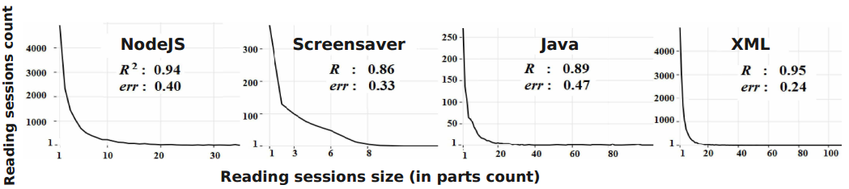
2. Quality of the reconstruction
Power Law distribution
most visits to a website are concentrated on a small number of pages
Linear regression: Log(number of distinct read parts) on Log(total number of reading sessions)
Good results → regression correlation coefficient R²~1 & std. error err~0
 | Reading session |  | 30 mn- Session-duration Threshold |  | 10 mn Page-stay Threshold
 | R ² | Err. | R ² | Err. | R ² | Err.
Nodejs | 0.94 | 0.40 | 0.92 | 0.42 | 0.87 | 0.31
Screensaver | 0.86 | 0.33 | 0.76 | 0.48 | 0.27 | 0.20
XML | 0.89 | 0.47 | 0.82 | 0.45 | 0.79 | 0.51
Java | 0.95 | 0.24 | 0.94 | 0.23 | 0.94 | 0.25

Slide 20
Outline
Context & goals
An approach for time –based analysis of logs
Towards Reading Session-based Indicators
CoReaDa : the Course Reading Analysis Dashboard

Slide 21
Reading session-based Indicators
27 basic indicators
leading to 21 reading indications (higher level)
within 4 categories
Global Facts
Reading paths and transitions
Rereading indicators
Reading session interruptions

Slide 22
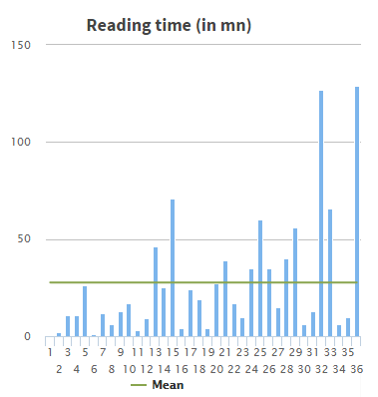
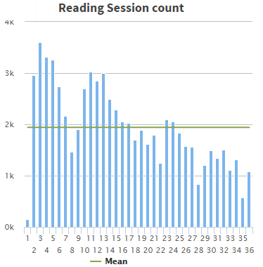
1 : Global Facts
Basic statistics and hints to characterize reading

Slide 23
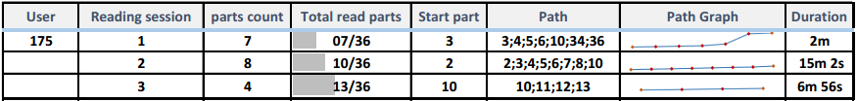
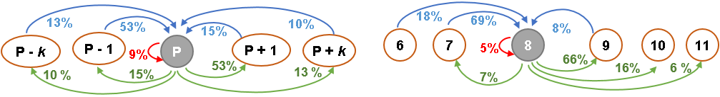
2 : Reading paths and transitions
Path : sequence of parts read in a reading session
Transition → a relation between parts

Slide 24
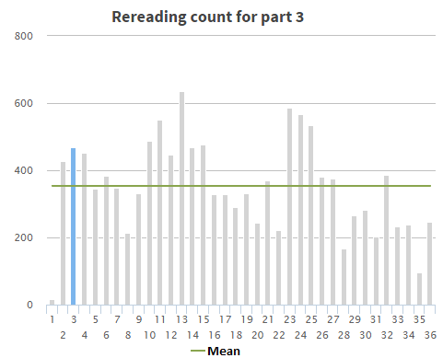
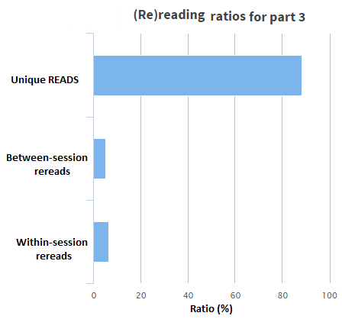
3 : Rereading indicators
Within-session rereads. Readers struggling with the part?
Between-session rereads. Reminder needed?

Slide 25
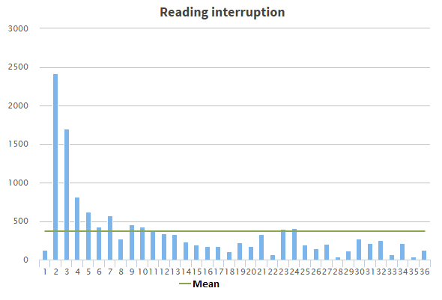
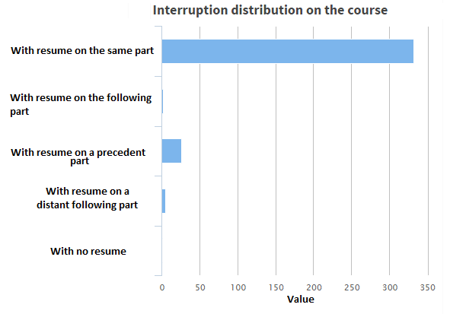
4 : Reading session interruption
Interruptions : Final or With Resume
Resume: Same part, Next or Previous part, Distant part

Slide 26
Evaluation of the suggested indicators & classes usefulness for reconception
Method
online survey
likert scales + free comments
Participants
105 OpenClassrooms course authors

Slide 27
Authors survey: indicators rating
Top indicators: #parts per session, rereaders count and definitive stops
Flop indicators: reading speed per part, session count

Slide 28
Authors survey: comments & opinions
Exchanges between authors and readers are important
“Making possible for authors and readers to communicate is essential if we want to produce more interesting and productive documents”
“Why not to include direct exchanges between authors and readers through comments and forums ?”

Slide 29
Authors survey: comments & opinions
Exchanges between authors and readers are important
Proposed indicators: relevant for reconception. Too many?
“These are important metrics and yes, they would help me understand how to rethink my course document”
“While they seem interesting, I think you would have to select the more interesting to present to authors. The other ones can serve for deeper analysis”

Slide 30
Authors survey: comments & opinions
Exchanges between authors and readers are important
Proposed indicators: relevant for reconception. Too many?
Privacy
“Be careful not to abuse the personal data of users. The reader should actually be informed that his reading is logged and analyzed”

Slide 31
Outline
Context & goals
An approach for time –based analysis of logs
Towards Reading Session-based Indicators
CoReaDa : the Course Reading Analysis Dashboard

Slide 32
Overview
Logging engine
By the OC stuff. Basically server log data enhanced with client one
Analysis engine
R (python code also available on github*)
Assistance engine
Within a dashboard
* https://github.com/smadjid/CoReaDa-dev

Slide 33



L.A. Dashboard
Dashboards
Visual display of the most important information needed to achieve one or more learning objectives, consolidated and arranged on a single screen so the information can be monitored at a glance
CoReaDa
Course Reading Dashboard
* + ** App (https://github.com/smadjid/CoReaDa)
Hosted on Amazon EC2 (http://54.154.169.214)
*MongoDB, ExpressJS, AngularJS, NodeJS. Open-source JavaScript stack for building dynamic webapps
** Data-Driven Documents. JavaScript library for producing interactive and dynamic data visualizations in web browsers (implemented using SVG, CSS & HTML5)

Slide 34
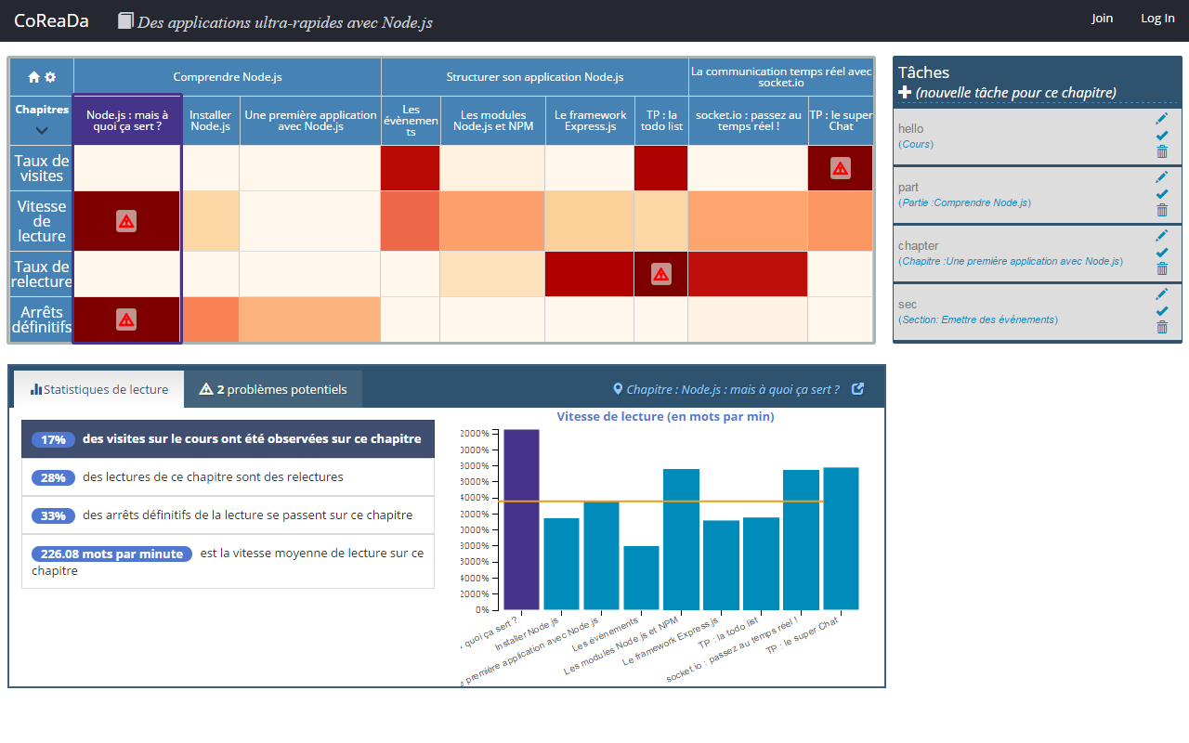
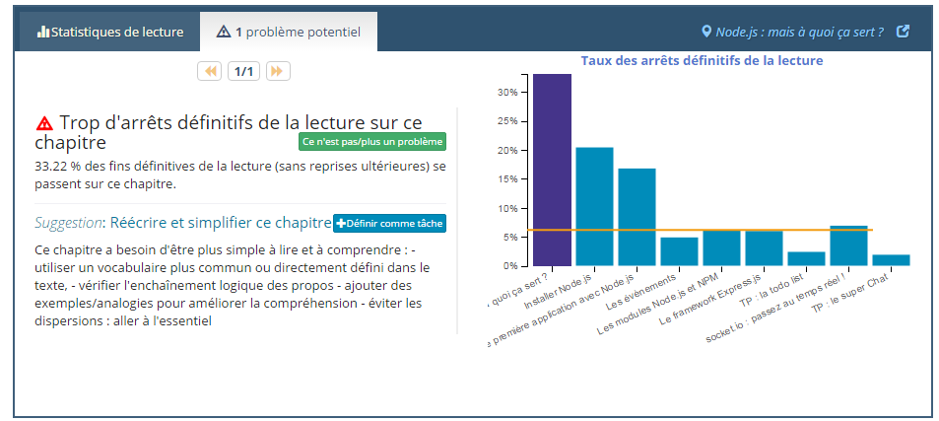
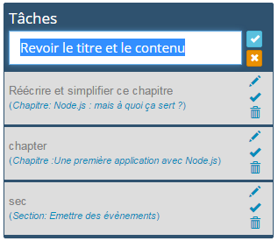
Interface
Ongoing theoretical & practical validation

Slide 35
State of completion
Theoretical (80%)
Mostly refinement of the indicators and the reading issues & suggestions
Practical (~ 85%)
Rewording and translation
auto update of logs from OC when deployed on their machines
Currently
Journal paper almost ready for submission
Ongoing dissertation writing (~ 30% )

Slide 36
Thank you!
Sadallah, M., Encelle, B., Mared, A. E., & Prié, Y. (2013). A framework for usage-based document reengineering. In Proceedings of the 2013 ACM symposium on Document engineering (pp. 99- 102).
Sadallah, M., Encelle, B., Maredj, A. E., & Prié, Y. (2015). Towards Reading Session-Based Indicators in Educational Reading Analytics. In Design for Teaching and Learning in a Networked World. Proceedings of the 10th European Conference on Technology Enhanced Learning, EC-TEL 2015, Toledo, Spain, September 15-18, 2015 (pp. 297-310). Springer International Publishing.
---------
Théorie et Ingénierie des Documents Numériques, des Usages Documentaires et des Annotations. Rapport de recherche interne. Mai 2013
De l’ingénierie des traces informatiques à la réingénierie documentaire. Rapport de recherche interne. janvier 2014
Towards Educational Reading Analytics: a Study on Course Reading Logs. Rapport de recherche interne. Juin 2015
Reading Dashboard Requirements in Learning Analytics. Rapport de recherche interne. Mars 2016

