Slide 1



Towards Reading Session-based Indicators in Educational Reading Analytics
Madjid SADALLAH CERIST, Algeria
Benoît ENCELLE University of Lyon, France
Azze-Eddine MAREDJ CERIST, Algeria
Yannick PRIÉ University of Nantes, France
EC-TEL 2015 - Toledo, Spain - 2015/09/17
Notes:
Hello everyone, I’m Madjid Sadallah, a phd student and a researchet at the cerist in algeria. I’m pleased to present you this paper….

Slide 2





Usage-based document reengineering
[Sadallah, 2013]
Editing
Author
Reading-session based Indicators
Indicators
Delivery
Reading
sessions
Analysis
Reading
Analysis tools
Logs
Readers
Target: User, Course, page,…
Based on the events sequence
Notes:
It is part of the project « usage-based document reengineering » which aims to provide authors feedback from learners to help him decide how to to revise his document
We propose an iterative process that starts when the author first composes and delivers his document to learners
All the reading actions of learners are logged and saved then analysed to compute indicators than may describe how the reading was performed and higlight possible needs and issues in reading & understanding
These indicators are sent back to the author to help him point out how and what aspects of the document need to be revised or reconceived
So, our work is situated at the analysis level.
This analysis can target for instance users, the whole course or parts of the courses.
On Web, it is in general performed using the sequence of action in the clickstream
We propose to consider this sequence by supplying it the time-on-action data to be able to analyse the activity on time
This brings us to model reading using the reading session concept that we’ll introduce later
Based on this concept, we proposed a related indicators which may help the author in the reconception process

Slide 3

Platform & data
Major French platform (850 courses , 1 million members, 3 million visitors/month )
4 representative courses over 75 days
NodeJS (36 parts)
Screensaver (11 parts)
XML (107 parts)
JAVA (164 parts)
Log structure
<id, user, server_session, course, part, date>
Notes:
To test our proposals, we use data from the OC platform, which is a major French provider of online courses.
We have selected 4 representative courses to work on, and logged them for a period of 75 days.
Each log record has data about the user and the web-session, the course and read part and a date timestamp
This is an example of a course and its structure
Each course is a nesting of parts with part being either course-part, chapter and subchapter

Slide 4

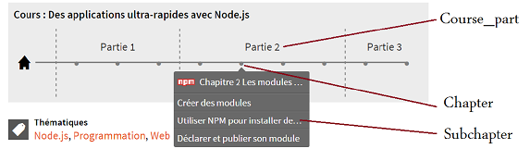
Platform & data

Slide 5
Outline
Time-based analysis of reading in eLearning
A proposal for detecting reading sessions
Towards Reading Session-based Indicators
Notes:
The reminder of this presentation will first describe our background before introducing the reading-session concept and how we calculate it and a set of related indicators

Slide 6
Why time-based indicators?
Trace
Action1
A2
A3
A4
A5
A6
A7
A8
A9
Actual reading
More "accurate" estimate of student learning [Kovanovic, 2015]
Best reflect and predict user behavior and environment over time [Hofmann, 2006]
Notes:
The time-based analysis best reflects the learning process and issues since it describes reading activity from a behavioral viewpoint
As illustrated on the figure, the learner activity is distributed in time so it is composed of active and idle periods
On the Web, an important issue come from the fact that this cutting is not recorded

Slide 7
Issue in time-based analysis
Trace
Action1
A2
A3
A4
A5
A6
A7
A8
A9
Actual reading
IDLE
IDLE
IDLE
IDLE
Activity in time: active and inactive periods
Session = active periods
Not logged
No time-on-task data to reconstruct the real sessions
Web Usage Mining methods for approaching them
Notes:
The time-based analysis best reflects the learning process and issues since it describes reading activity from a behavioral viewpoint
But learner activity is distributed over active and non active periods
To better model this, we use the concept of session to delimit the actual reading periods from the idle ones

Slide 8
Session duration threshold method
Trace
Action1
A2
A3
A4
A5
A6
A7
A8
A9
Actual reading
Session
Session
Session
Session
Limit on the total duration of the session: 30 min
But: cuts continuous activities and merges separate short ones including potential in-between inactive periods
Notes:
The first one is based on the limitation of the total session duration by a predefined threshold, generally 30 minutes.
The main drawback of this is that continuous and long activity may be cut while separate short ones may be merged including potential in-between inactive periods.

Slide 9
Page-stay threshold method
Trace
Action1
A2
A3
A4
A5
A6
A7
A8
A9
Actual reading
Session
Sess.
S.
S.
S.
S.
Session
Limit on the page-stay time with a predefined threshold: 10 min
But: some pages may be read faster or slower
Notes:
The second method defines a max value (generally 10 mn) not for the session but for each part.
This is also not realistics since parts may be in reality read faster or slower.
Again we see in this illustration that the results are from the real one
Actually, using one threshold value in not appropriate since courses and course pages differ

Slide 10
Outline
Time-based analysis of reading in eLearning
A proposal for detecting reading sessions
Towards Reading Session-based Indicators
Notes:
The study of these methods bring us to propose another algorithm for computing the reading sessions

Slide 11
Requirements & proposals
Each course/course part has its inner-complexity
Limit sessions by a threshold on page-stay
Each page has its own threshold value
Reading depends on its context (courses, pages, readers) which changes over time
Thresholds grounded from users logs and updated with new incoming data
Notes:
Actually, we identified many issues that the existing methods do not consider. Based on these, we formulate our proposals
Courses and parts within even a same course differ in content and structure.
That’s why we propose to delimit sessions suing a threshold on the page-stay time. Moreover, each page must have its own value for the threshold.

Slide 12
An algorithm for extracting reading sessions
Pre-process
Data
Calculate
Tresholds
Delimit
Reading Sessions
Raw data
Identify users
Compute durations
User 1
User 2
User 3
t1 t2 t3 t4 t5 … tn
d1=t2 – t1 d2=t3-t2 d3= t4 – t3 d4= t5 – t4 dn = ?
User 4
…
User n
Very long Very short Unknown
Notes:
The following briefly describe our method algorithm.
The first one is related to preprocessing data. We first identify the distinct users and assume anonymous websessions as distinct users.
For each user, we order his subset of data using action timestamps and then we compute action duration as the time between its occurrence and the occurrence of the next one.
After that, we still have two cases to deal with:
The last action of the user is still unknown, there’s no other action to use in order to compute the supposed duration
We have some excessive durations (up to days) and insignificant ones (some seconds).

Slide 13
An algorithm for extracting reading sessions
Pre-process
Data
Calculate
Tresholds
Delimit
Reading Sessions
Eliminate outliers
Compute thresholds values
Peirce criterions [Ross, 2003]
Parts | Durations
Part 1 | d11, d12, d13,……
Part 2 | d21, d22, d23,……
… | ……
Part n | dn1, dn2, dn3,……
Threshold
=MAX(d11,…)
=MAX(d21,…)
…
=MAX(dn1,…)
Duration distribution
Notes:
The outiers are elimanted using Peirce’s criterion, a very used method in eLearning.
Using the remaining data, we compute for each parts its time threshold as the maximum value needed for reading it.

Slide 14
An algorithm for extracting reading sessions
Pre-process
Data
Calculate
Tresholds
Delimit
Reading Sessions
Deal with unknown durations
Delimit sessions
d1 d2 d3 d4 d5 d6 … dn
P
Session
Session
Threshold(P)
Session ends on an action if:
Action duration > time threshold of the read part
Notes:
For action with unknown durations, we suppose that they are read using the maximum value allowed, corresponding to the part threshold.
Using part thresholds, we delimit sessions as follows. A session is composed of reading actions of a user till we have an action which duration is greater than the part threshold. We suppose then that the next action is the first of another reading session.

Slide 15
Overview of the constructed reading sessions
 | # reading sessions | #RS per user (median) | RS duration (median) | RS Size (median, in parts count)
Nodejs | 13 431 | 3 | 8 min | 3
Screensaver | 977 | 2 | 2 min | 2
XML | 1 223 | 3 | 10 min | 4
Java | 14 042 | 2 | 27 min | 2
First indicators of reading orchestration
But: hard to find immediately reading patterns / issues
Higher level indicators aim at that
Notes:
We have implemented this algorithm and applied it to our data corpus. This is a summary of the results

Slide 16
How to evaluate the quality of reading sessions?
Build a groundtruth
not always feasible
Use quality metrics
compliance with parts complexity
quality of the reconstruction
Notes:
The validation of the constructed sessions is not easy since there’s no formal method to estimate the compliance of the constructed sessions with the real ones, unless we observe users.
Hence, we propose to use 2 metrics. The first one supposes that a complex part needs more time to read and we verified if this is true. The 2nd allows estimating the quality of the reconstruction using a power law estimator.

Slide 17
1. Compliance with parts complexity
Complexity in terms of size
Important part size ➔ Important threshold value ?
Pearson correlation coefficient between part size ⇆ part threshold :
r = 0,82
Notes:
We estimate complexity only using part size and we want to know if for a big part, the computed thresholds are more important than those for less important parts. We are conscientious that the size is not everything for defining the complexity but already, the size is positively correlated with part threshold as shown by the Pearson correlation coefficient

Slide 18
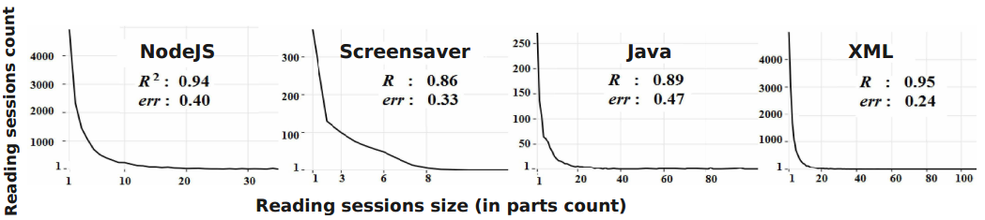
2. Quality of the reconstruction
Power Law distribution [Berendt, 2001]
most visits to a website are concentrated on a small number of pages
Linear regression: Log(number of distinct read parts) on Log(total number of reading sessions)
Good results → regression correlation coefficient R²~1 & std. error err~0
 | Reading session |  | 30 mn- Session-duration Threshold |  | 10 mn Page-stay Threshold
 | R ² | Err. | R ² | Err. | R ² | Err.
Nodejs | 0.94 | 0.40 | 0.92 | 0.42 | 0.87 | 0.31
Screensaver | 0.86 | 0.33 | 0.76 | 0.48 | 0.27 | 0.20
XML | 0.89 | 0.47 | 0.82 | 0.45 | 0.79 | 0.51
Java | 0.95 | 0.24 | 0.94 | 0.23 | 0.94 | 0.25
Notes:
The second metric estimates the quality of the reconstruction using the empirical observed Power Law distribution
This law states that most visits to a website are concentrated on a small number of pages.
Evaluating this can be performed by a linear regression on the logarithm of the number of the distinct read parts and the logarithm of the total number of reading sessions.
Good results means that R-squared is close to 1 with the standard error near to 0
Results for our method applied on the four courses are shown on this figure. And we see that it gives very acceptable results.
It gives best results compared to the 2 most used other methods: 10 min for pages and 30 min for sessions.

Slide 19
Outline
Time-based analysis of reading in eLearning
A proposal for detecting reading sessions
Towards Reading Session-based Indicators

Slide 20
Reading session-based Indicators
27 basic indicators
leading to 21 reading indications (higher level)
within 4 categories
Global Facts
Reading paths and transitions
Rereading indicators
Reading session interruptions
Notes:
We propose a set of 27 basic indicators leading to 21 reading indications, which denote important facts and possible issues related to reading.
The whole set is organized into 4 categories

Slide 21
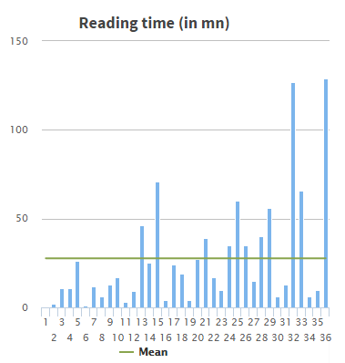
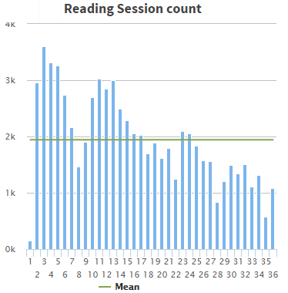
1 : Global Facts
Basic statistics and hints to characterize reading
Notes:
The 1st one gives reading general facts and basic hints for readings characterization within reading sessions.
Parts with excessive reading time
RS duration and count can serve as an indication of success and difficulty of the learning task

Slide 22
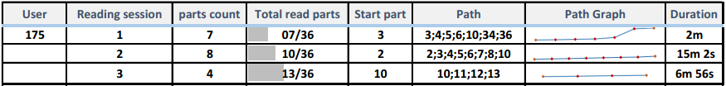
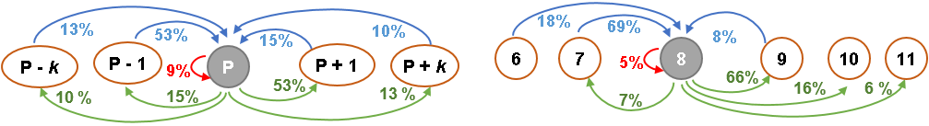
2 : Reading paths and transitions
Path : sequence of parts read in a reading session
Transition → a relation between parts
Notes:
The 2nd class is related to the navigational pace of reading within the course.
For instance, the path deviation from the author expected one can be used to predict a possible user disorientation
The transition between two parts allows reporting a relation between them. Considering a given part, they indicates what are the previous and following parts that are read with their respective proportions.
This may help to point out needed restructuration of the course.

Slide 23
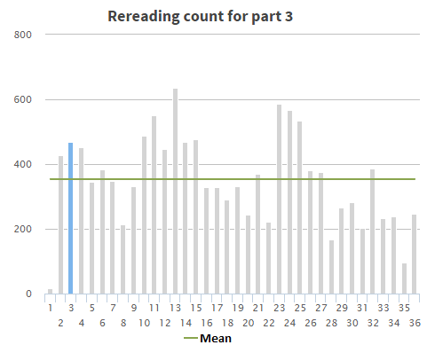
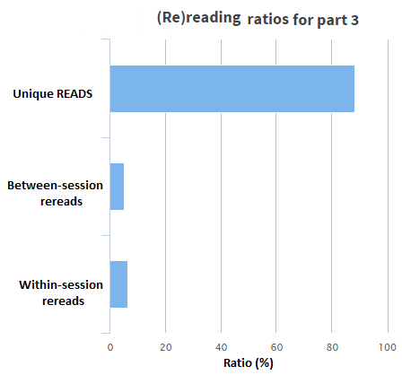
3 : Rereading indicators
Within-session rereads. Readers struggling with the part?
Between-session rereads. Reminder needed?
Notes:
The 3rd class is related is related to revisitation
We differentiate rereads that occur on the same reading session (Within-session rereads) from those that are performed on different reading sessions (Between-session rereads).
Within-session rereads is a potential indicator that readers are struggling with it.
Between-session rereads may indicate that the reader needs a reminder of the earlier read parts

Slide 24
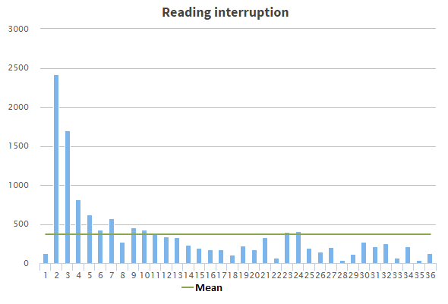
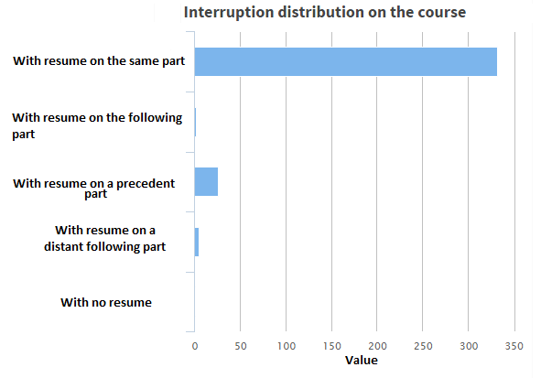
4 : Reading session interruption
Interruptions : Final or With Resume
Resume: Same part, Next or Previous part, Distant part
Notes:
The last class is related to reading interruptions with possible resumes.
Analyzing reading session interruptions allows determining the problematic parts where reading generally stops definitively
The study of resume can help to understand for instance why people stops at specific parts and why they continue on different ones. Maybe structural problem!

Slide 25
Evaluation of the suggested indicators & classes usefulness for reconception
Method
online survey
likert scales + free comments
Participants
105 OpenClassrooms course authors
Notes:
To evaluate the relevance of the proposed indicators for course rewriting, we have conducted an exploratory study to gather OpenClassrooms course authors’ opinions regarding our proposals.
An online survey was set up that both contains Likert scales for rating indicators usefulness (very useful, useful, no opinion, somewhat useful or not useful) and free comment sections. At the time of writing,
105 out of hundreds authors had filled the online survey

Slide 26
Authors survey: indicators rating
Top indicators: #parts per session, rereaders count and definitive stops
Flop indicators: reading speed per part, session count
Notes:
Figure presents results of authors’ ratings aggregated by category.
All the proposed indicators were highly rated (useful), with the more contrasted results on the indicators related to parts distribution within sessions (average number of parts per session), rereading (rereaders count and rereading – within and between-session – distribution on the parts and interruption points (definitive stops parts).
Indicators related to the average reading speed per part and session count on the course are the least rated ones

Slide 27
Authors survey: comments & opinions
Exchanges between authors and readers are important
“Making possible for authors and readers to communicate is essential if we want to produce more interesting and productive documents”
“Why not to include direct exchanges between authors and readers through comments and forums ?”

Slide 28
Authors survey: comments & opinions
Exchanges between authors and readers are important
Proposed indicators: relevant for reconception. Too many?
“These are important metrics and yes, they would help me understand how to rethink my course document”
“While they seem interesting, I think you would have to select the more interesting to present to authors. The other ones can serve for deeper analysis”

Slide 29
Authors survey: comments & opinions
Exchanges between authors and readers are important
Proposed indicators: relevant for reconception. Too many?
Privacy
“Be careful not to abuse the personal data of users. The reader should actually be informed that his reading is logged and analyzed”

Slide 30
Main Contributions & Future Work
Contribution 1: Reading Sessions
grounded on data: real interaction + part characteristics
threshold values dynamic: become more precise with course, reading and learners’ evolution
ongoing
further verification. Which metrics?
Notes:
The concept of reading session allows us to model course reading.
The proposed approach for session identification is grounded on data that represent learners’ interactions with the course and take into account each part characteristics.
The computed threshold values for part reading-times are dynamic since they may be updated when new reading actions are logged.
Hence their values can be adjusted with incoming reading data, taking into account any evolution of the courses like pages restructuring and content update.
This approach seems a very plausible way to simulate learners reading and to fit the expected statistical behavior of real reading sessions.
We plan to further verify this method capability by using/ defining appropriate metrics to characterize parts complexity and to compare the deduced sessions compliance with the real ones.

Slide 31
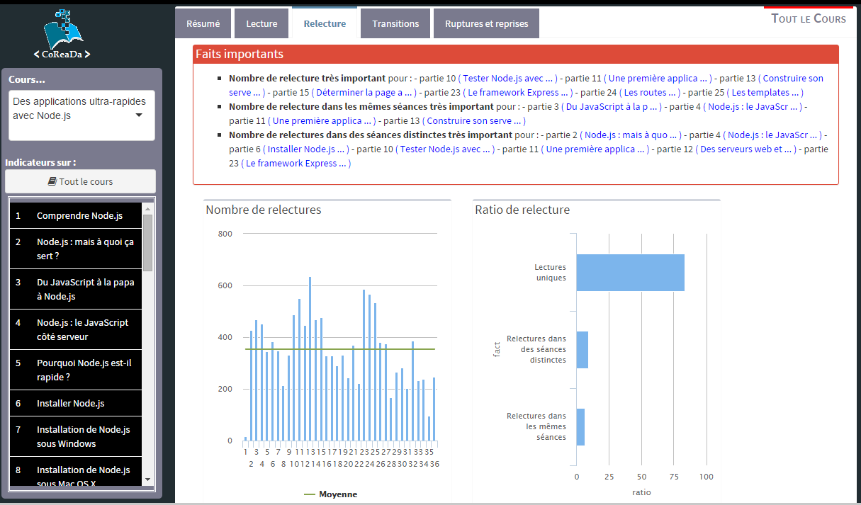
Main Contributions & Future Work
Contribution 2: Reading session-based indicators
reading considered from a behavioral perspective
→ potential readers’ needs + reading issues
acknowledged by authors
ongoing
further refine indicators
design & evaluate a dashboard for authors
Notes:
Several indicators based on reading sessions have been proposed and illustrated on courses from a major French eLearning provider.
They intend to analyze reading from a behavioral perspective to reflect potential readers’ needs and reading issues.
This is acknowledged by authors
Currently we are refining these and implementing a dashboard for authors….

Slide 32
Thank you!
[Berendt, 2001] B. Berendt, B. Mobasher, M. Spiliopoulou, and J. Wiltshire. Measuring the accuracy of sessionizers for web usage analysis. Workshop on Web Mining, 2001.
[Hofmann, 2006] K. Hofmann, C. Reed, and H. Holz. Unobtrusive data collection for web-based social navigation. In Workshop on the Social Navigation and Community based Adaptation Technologies. 2006.
[Kovanovic, 2015] V. Kovanović, D. Gašević, S. Dawson, S. Joksimović, R. S. Baker, and M. Hatala. Penetrating the black box of time-on-task estimation. In Proceedings of the 5th International Conference on Learning Analytics And Knowledge, pp. 184–193. ACM, 2015.
[Ross, 2003] S. M. Ross. Peirce’s criterion for the elimination of suspect experimental data. Journal of Engineering Technology, 20(2):38–41, 2003
[Sadallah, 2013] M. Sadallah, B. Encelle, A.-E. Maredj, and Y. Prié. A framework for usage-based document reengineering. In Proceedings of the 2013 ACM Symposium on Document Engineering, DocEng ’13, pp. 99–102, New York, NY, USA, 2013. ACM.

