Slide 1
Front-End Match
Overview

Slide 2





UNIFIED CUSTOMER VIEW VISION
For the Allstate Enterprise, UCV is the platform that provides a 360 degree view of customer centric data to enable our strategic objectives.
Call Center View
UCV SUPPORTS
SHIFTING
CONSUMER
DEMAND
EXTERNAL
DATA
QUOTES
Allstate
Company
View
Agency
View
BEING A
TRUSTED
ADVISOR
SERVICE
OFFERINGS
POLICIES
CLAIMS
INTERACTIONS
RELATIONSHIPS
SERVE ME
MAINTAIN ME
PROTECT ME
IDENTIFY ME
KNOW ME
Customer View
UCV integrates new and existing customer and household centric data from internal and external disparate sources. It provides actionable insights specifically tailored to meet each customer’s unique needs. The UCV model is extensible; it can be leveraged for anything that is customer-centric.
CHANGING CONSUMER EXPECTATIONS

Slide 3



FRONT-END MATCH IS FOUNDATIONAL TO UCV
Front End Match is the fundamental change required in customer facing systems to move us towards a Customer-Centric Data Platform
IDENTIFY
QUALITY
RELATE
INSIGHTS
Who am I talking to? What relationships do they have with Allstate?
Improve the accuracy of customer information. Where do they live, what is their phone number?
Relate information about this transaction for enterprise visibility and consumption.
What is important to know about this customer?
FEM enables Allstate to move from a transaction-based, product-focused provider to a relationship-driven, data-informed, household solutions advisor
Policy-Centric Systems
Customer-Centric Data Platform
Asset
Policy
Activities
Quotes
External Data
Billing
Claims
Claims
Service Offerings
Relationships
Analytics
Policyholder
Spouse
Customers only understood in the context of their policy relationships
UCV provides a multi-dimensional view of the customer shared across all channels

Slide 4

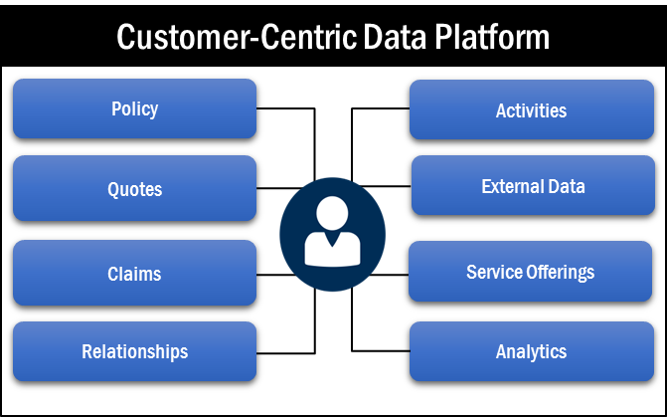
FEM MAKES UCV POSSIBLE
FRONT-END MATCH
`
Front-End Match (FEM) is the process by which our applications ‘identify’ an individual. This requires changes in our applications and business process to ensure an accurate understanding of our customers.
FEM supports moving from a transaction-based, product-focused provider to a relationship-driven, data-informed, household solution provider.
FEM is the fundamental change required in customer facing systems to move us towards a Customer-Centric Data Platform.
POLICY
ADMIN
CRM
CLAIMS
Party ID
Party ID
Party ID
CUSTOMER
MDM
FRONT-END MATCH BENEFITS
Enables a comprehensive view of a customer and their household by linking all known data to an individual party through the Party ID from across the enterprise
Creates a consistent experience with all channels viewing and sharing the same information
Enhances party and household matching to facilitate application of discounts
Reduces complaints and tickets required to correct erroneous party records
Limit Allstate exposure to potential law suits due to lacking data integrity
UNIFIED CUSTOMER VIEW

Slide 5


WHAT IS FEM?
Front-End Match (FEM) is an enterprise-wide initiative that sets the foundation to enable agents and support channels to identify a customer at the point of service.
Establish a single view of a customer by linking all known data to an individual party through the Party ID from across the enterprise. A Single Customer View is an aggregated, consistent and holistic representation of the data known by Allstate about our customers.
Deliver metrics to provide timely insights and highlight what’s most important.
Perform Comprehensive Search
Validate Party
Updates
Provide
Metrics
Store PartyID in Front-End Application
FRONT-END MATCH COMPONENTS
Performing a comprehensive search before attempting to add a new party.
Validating significant updates made to party.
Providing metrics/tokens when adding or updating data in the customer MDM.
Storing unique identifier in front-end system and staying in sync with the customer MDM.

Slide 6
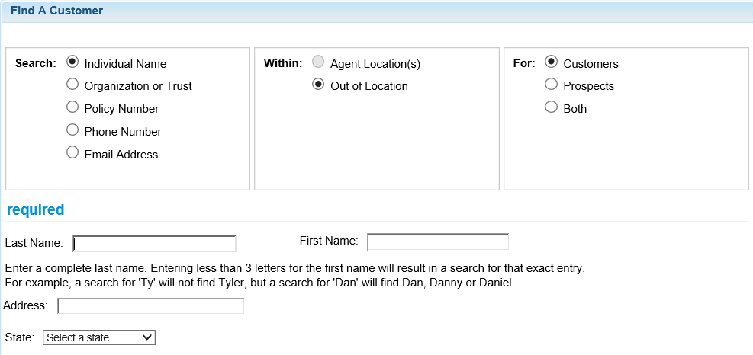
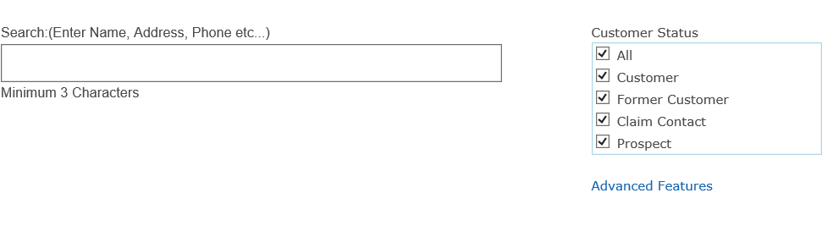
COMPREHENSIVE SEARCH
All applications performing FEM will be required to perform a SEARCH to determine if the person they are working with already exists in UCV.
UCV offers multiple options for search:
A Submitted Search allows for searching by specific, pre-defined criteria and submits all search terms in one request
A One Box Search allows for type-ahead searching capabilities, with the search criteria submitted with each character typed.
A Search For Match is a specific type of submitted search that applies a specific match algorithm and will only return matches that score above the defined match threshold. Search For Match requires full name and address, with birth date and Social Security Number recommended, if available.

Slide 7



SIGNIFICANT UPDATES
Any application performing Frond End Match (FEM) and attempting to update an existing party record in UCV will be required to call the CheckPartyUpdate (CPU) service.
The CPU service ensures applications are planning to update the correct party record. Applications will pass the data they plan to update and the service will compare the updated data to the existing data for that party.
The service will return a response indicating whether or not UCV thinks the proposed update is for the same person provided.
If not, the service will return a significant change warning. This means the application may have the wrong PartyID on record for the person they want to update.
Applications are expected to act upon this warning by prompting the agent/user to confirm if they want to proceed prior to completing the update.
?
CPU DATA ELEMENTS
PartyID Birth Date Claim Number (when applicable) Social Security Number/Tax Identification Number Policy Number (when applicable) Address (Street, City, State, Zip) Name (Prefix, First, Middle, Last, Suffix) Phone Number Gender Email Address Marital Status

Slide 8
TOKENS
When adding/updating party data in UCV, tokens can be passed to inform UCV of the FEM/standardization steps the application performed prior to sending the add/update request.
The SNA token is passed if the application standardized the name and address prior to calling UCV. The token is returned by the standardization service and should be passed as is.
The FETOKEN is required when adding a new party to UCV (if backend matching needs to be suppressed). The token is returned by the Search service when existing parties are found in UCV.
The SFM token is required on every add/update service call to UCV as part of any FEM flow.
The CPU token is passed to indicate what action the calling application took with regards to the call to the CheckPartyUpdate service.
SFM TOKENS
Calling Application identified the PartyID using UCV search services
Calling Application did not call the SFM service
Calling Application found no party when calling SFM
Calling Application selected the single party returned in the SFM service call
Calling Application chose not to select the single party returned in the SFM service call
Calling Application selected a party from the multiple parties returned in the SFM service call
Calling Application chose not to select any of the multiple parties returned in the SFM service call
Calling Application identified a potential overmatch after reviewing the response from Search

Slide 9
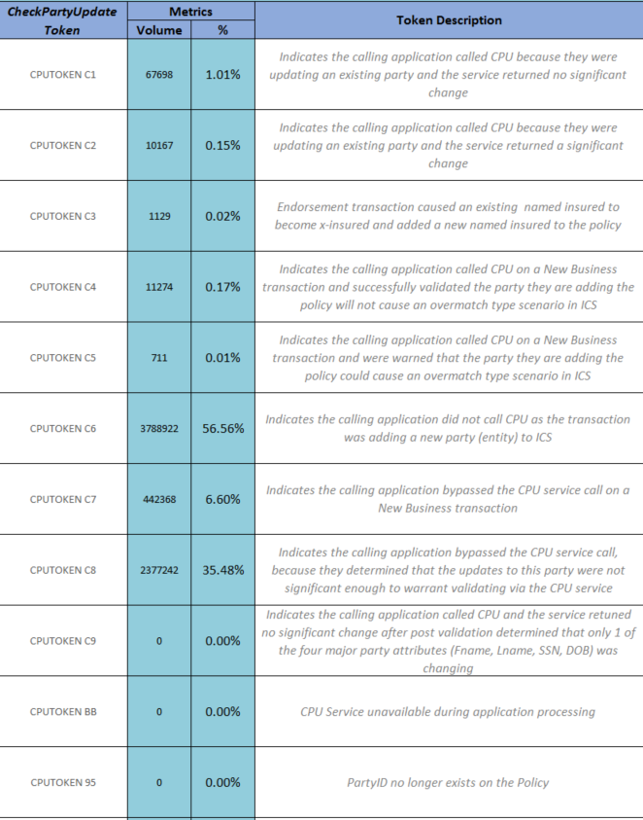
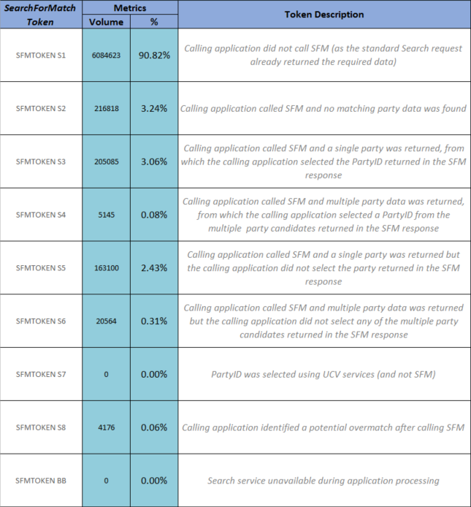
METRICS
Metrics are generated based off of the tokens that are generated during the FEM flow and are broken out by application.

Slide 10
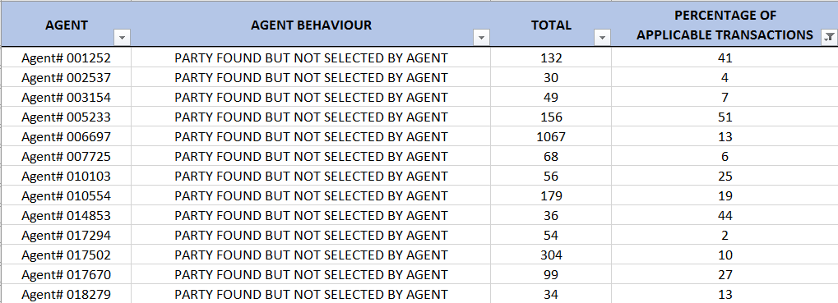
METRICS
Metrics are also used to identify potential inappropriate agent behavior when compared to matching algorithm.

Slide 11
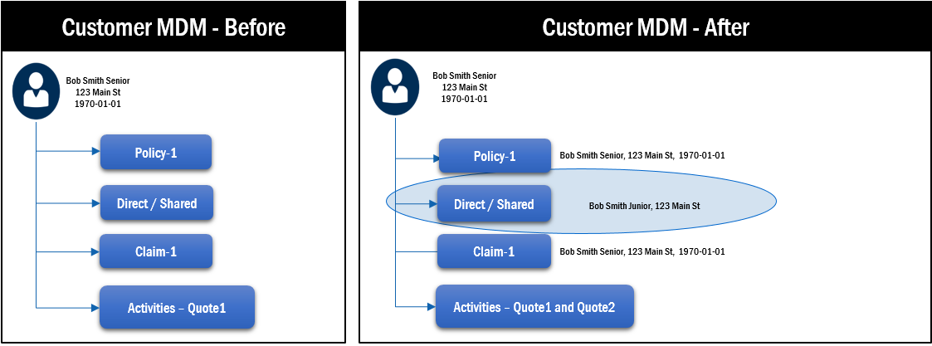
WHY DO FEM?
Person contacts Allstate for the first time for a quote – backend match
Application
e.g. Alliance, Claims, etc
No Search
Demographic data + Quote sent to UCV
UCV performs backend matching to systematically determine if person already exists
Bob Smith Junior
123 Main St
(no DOB provided)
Existing person updated in Customer MDM

Slide 12

WHY DO FEM?
Person contacts Allstate for the first time for a quote – non-FEM with Search (Bad)
Application
e.g. Alliance, Claims, etc
Search
Matching candidates found in Customer MDM
Match Found and
SELECTED
Bob Smith Junior
123 Main St
1990-01-01
Existing person updated in Customer MDM
Customer MDM - Before
Customer MDM - After
Bob Smith Senior
123 Main St
1970-01-01
Bob Smith Senior
123 Main St
1970-01-01
Policy-1
Policy-1
Bob Smith Senior, 123 Main St, 1970-01-01
Direct / Shared
Direct / Shared
Bob Smith Junior, 123 Main St, 1990-01-01
Claim-1
Claim-1
Bob Smith Senior, 123 Main St, 1970-01-01
Activities – Quote1
Activities – Quote1 and Quote2

Slide 13
WHY DO FEM?
Person contacts Allstate for the first time for a quote – non-FEM with Search (Good)
Application
e.g. Alliance, Claims, etc
Search
Matching candidates found in Customer MDM
Match found but
NOT SELECTED
Bob Smith Junior
123 Main St
1990-01-01
New person created in Customer MDM
Customer MDM - Before
Customer MDM - After
Bob Smith Senior
123 Main St
1970-01-01
Bob Smith Senior
123 Main St
1970-01-01
Bob Smith Junior
123 Main St
1990-01-01
Policy-1
Policy-1
Direct / Shared
Direct / Shared
Direct / Shared
Activities – Quote2
Claim-1
Claim-1
Activities – Quote1
Activities – Quote1

Slide 14
WHY DO FEM?
Person contacts Allstate for the first time for a quote – FEM Scenario (SFM search only)
No matching candidates found in Customer MDM
Search For Match
(SFM)
Matching candidates found in Customer MDM
No match found
Update not possible
Application
e.g. Alliance, Claims, etc
Search
Bob Smith Junior
123 Main St
1990-01-01
New person created in Customer MDM
Customer MDM - Before
Customer MDM - After
Bob Smith Senior
123 Main St
1970-01-01
Bob Smith Senior
123 Main St
1970-01-01
Bob Smith Junior
123 Main St
1990-01-01
Policy-1
Policy-1
Direct / Shared
Direct / Shared
Direct / Shared
Activities – Quote2
Claim-1
Claim-1
Activities – Quote1
Activities – Quote1

Slide 15
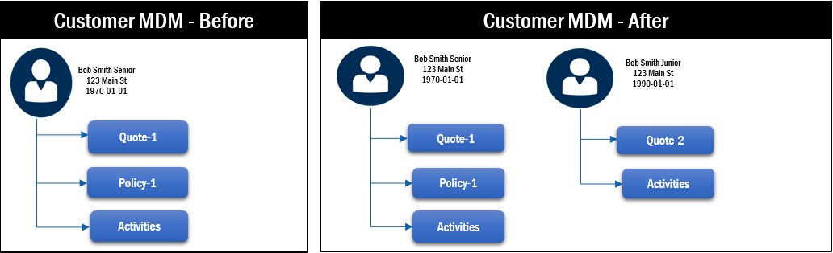
WHY DO FEM?
Person contacts Allstate for the first time for a quote – FEM Scenario (including non-SFM searches) - Good
Application
e.g. Alliance, Claims, etc
SFM Search
No Match Found
New person created in Customer MDM
Bob Smith Junior
123 Main St
1990-01-01
Search
(not SFM)
Match found but
NOT SELECTED
Application decides not to proceed with update
Significant Change warning returned to application
Matching candidates found in Customer MDM
Match Found and
SELECTED
Information to be updated is sent for validation
CheckPartyUpdate
(CPU)

Slide 16
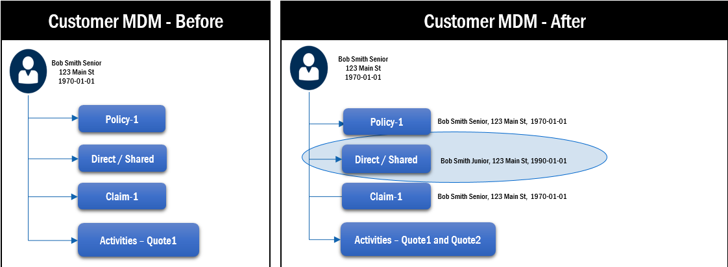
WHY DO FEM?
Person contacts Allstate for the first time for a quote – FEM Scenario (including non-SFM searches) - Bad
Application
e.g. Alliance, Claims, etc
SFM Search
No Match Found
Existing person updated in Customer MDM
Bob Smith Junior
123 Main St
1990-01-01
Search
(not SFM)
Match found but
NOT SELECTED
Application decides to proceed with update
Significant Change warning returned to application
Matching candidates found in Customer MDM
Match Found and
SELECTED
Information to be updated is sent for validation
CheckPartyUpdate
(CPU)

Slide 17

WHY DO FEM?
Person contacts Allstate for a quote (already has history with Allstate) – FEM Scenario (Good)
Application
e.g. Alliance, Claims, etc
Application decides to proceed with update
Existing person updated in Customer MDM
Robert Smith
123 Main St
Search
(not SFM)
Significant Change warning returned to application
Matching candidates found in Customer MDM
Match Found and
SELECTED
Information to be updated is sent for validation
CheckPartyUpdate
(CPU)
CPU validates pending update

Slide 18

QUESTIONS
Business Owner: Stuti Mehta
Project Manager: Bhavani Prabakaran
FEM Lead: John McArdle
UCV Adoption Delivery Leads: Elina Genadiynik, Cary Wenstrand, Karen Ammentorp, Dyuti Patankar, Beth Pastere

