Slide 1
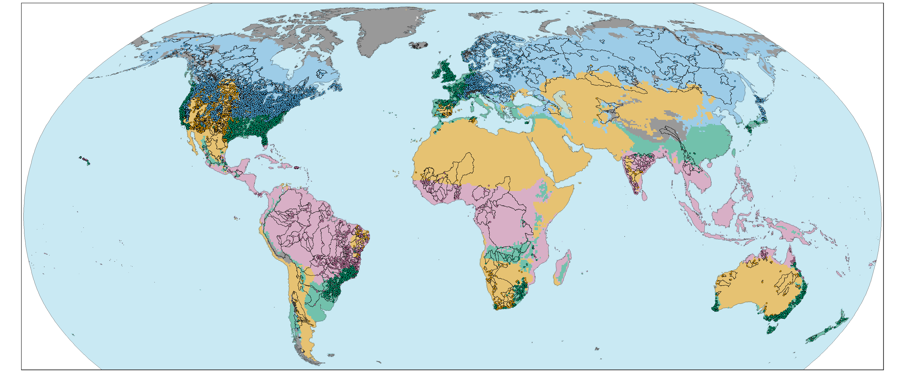
II. Modeling procedure
FloodMagnitude_v1.4/01_Covariate_selection/
We consider 9,023 streamgauges with at least 30 years of observations available.
Streamflow database
USGS (CONUS): 4,596 basins
ADHI (Africa): 362 basins
HRS (Australia): 467 basins
GSIM (Others): 3,598 basins
Climate type
Tropical Temperate Polar
Arid Cold

Slide 2
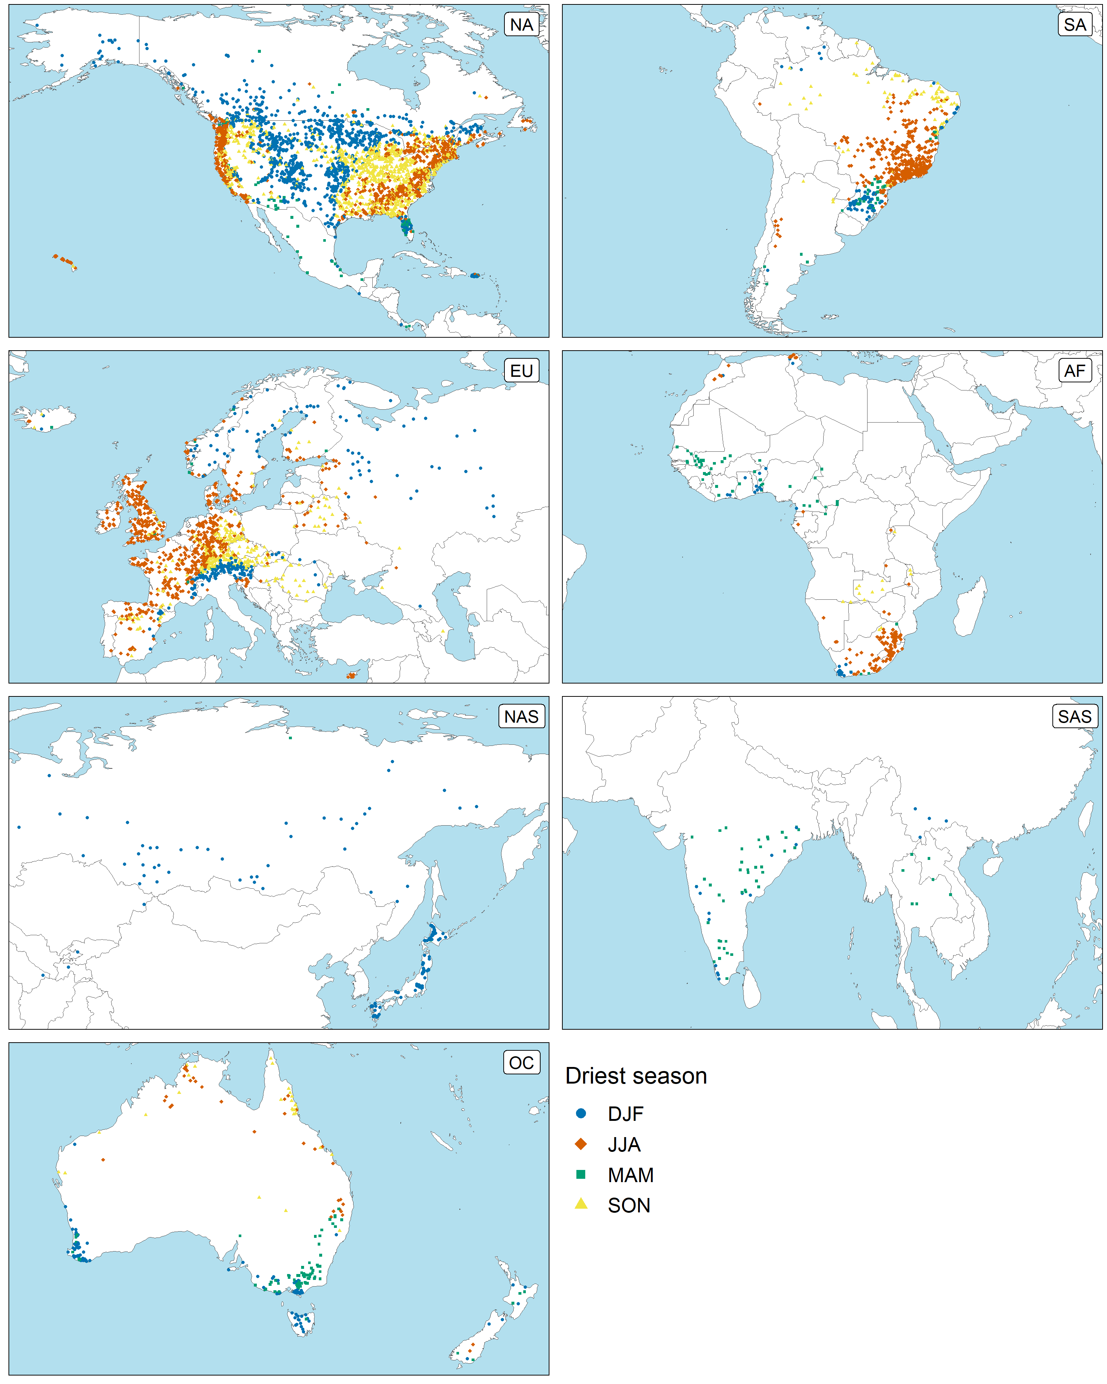
II. Modeling procedure
We consider a local water year that starts in the season with the lowest median of seasonal maxima among the four seasons.
e.g.) Driest season: Jun-Aug (JJA)
Calander year: 2000
J | J | A | S | O | N | D | J | F | M | A | M | J | J | A | S | O | N | D | J | F
Water year: 2000
e.g.) Driest season: Sep-Nov (SON)
Calander year: 2000
J | J | A | S | O | N | D | J | F | M | A | M | J | J | A | S | O | N | D | J | F
Water year: 2000
…
e.g.) Driest season: Mar-May (MAM)
Calander year: 2000
J | J | A | S | O | N | D | J | F | M | A | M | J | J | A | S | O | N | D | J | F
Water year: 2000

Slide 3
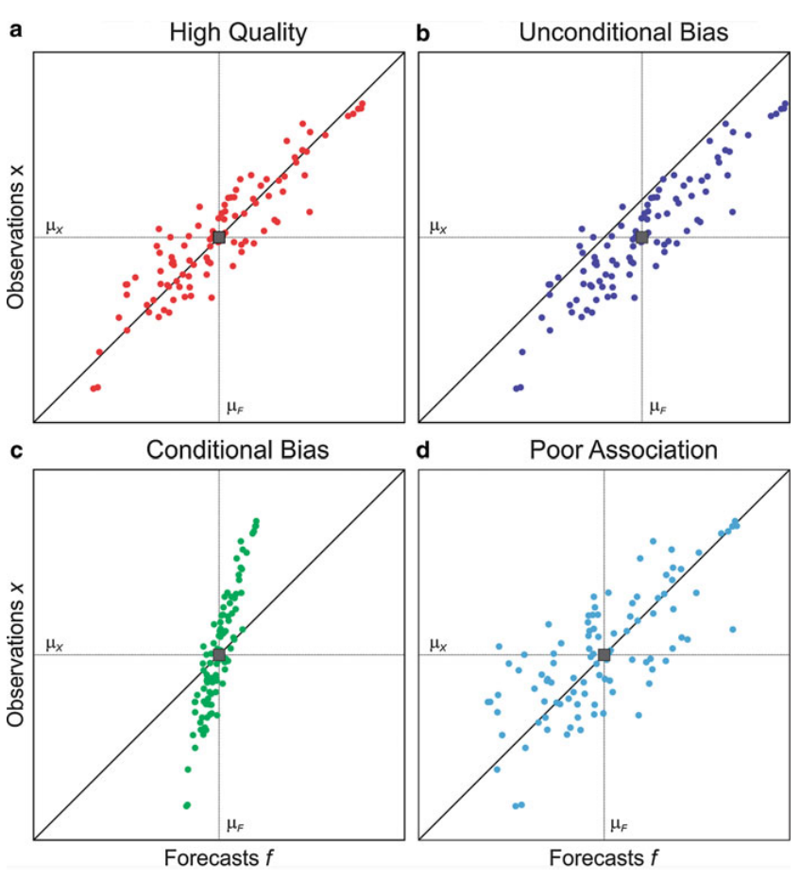
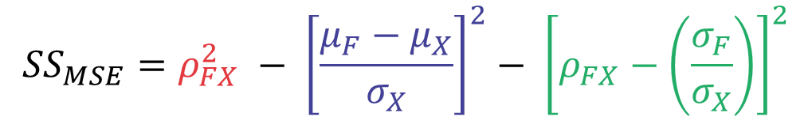
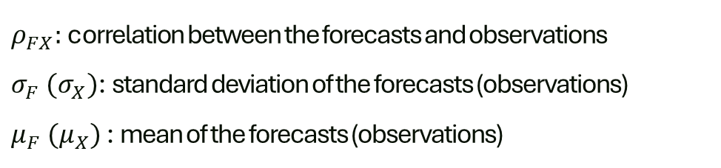
II. Modeling procedure
We employ the skill score (SS) decomposing it into potential skill and bias to evaluate the model performance.
$${SS}_{MSE}=ρ_{FX}^{2} − {\left[\frac{μ_{F}−μ_{X}}{σ_{X}}\right]}^{2}− {\left[ρ_{FX}−\left(\frac{σ_{F}}{σ_{X}}\right)\right]}^{2}$$
Potential Skill
Unconditional Bias
Conditional Bias
$ρ_{FX}:$ correlation between the forecasts and observations
$σ_{F} (σ_{X})$: standard deviation of the forecasts (observations)
$μ_{F} (μ_{X})$ : mean of the forecasts (observations)
Bradley A.A. et al. (eds), Handbook of Hydrometeorological Ensemble Forecasting, Springer, Berlin, Heidelberg, 2016

Slide 4

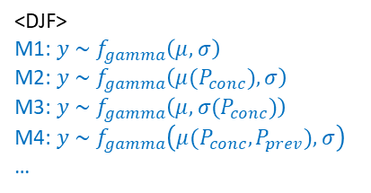
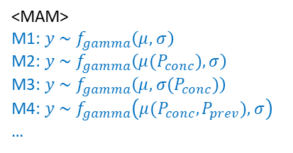

II. Modeling procedure — (1) Climate driver selection
Instead of using all observations, we apply a training – validation approach to identify primary climate drivers, enabling more robust peak discharge predictions, especially for extrapolation.
(1) Randomly split the entire years into training (80%) and validation (20%) years.
Training years (80%)
Validation years (20%)
(2) For each season, fit all possible statistical models based on training years and select the best model based on the SBC.
P_{conc} (P_{prev}): basin-averaged seasonal precipitation for the
concurrent (previous) season of interest.
T_{conc} (T_{prev}): basin-averaged seasonal temperature for the
concurrent (previous) season of interest.
Training years (80%)
<DJF>
M1: $y \sim f_{gamma}\left(μ, σ\right)$
M2: $y \sim f_{gamma}\left(μ(P_{conc}), σ\right)$
M3: $y \sim f_{gamma}\left(μ, σ(P_{conc})\right)$
M4: $y \sim f_{gamma}\left(μ(P_{conc},P_{prev}), σ\right)$
…
<MAM>
M1: $y \sim f_{gamma}\left(μ, σ\right)$
M2: $y \sim f_{gamma}\left(μ(P_{conc}), σ\right)$
M3: $y \sim f_{gamma}\left(μ, σ(P_{conc})\right)$
M4: $y \sim f_{gamma}\left(μ(P_{conc},P_{prev}), σ\right)$
…
<JJA> <SON>
…
…
M2 (Smallest SBC)
M1 (Smallest SBC)
(3) Once we have four seasonal models, simulate annual maximum values for the validation years through Monte Carlo simulation (5,000 times).
Monte Carlo simulation
Validation years (20%)
DJF: M2
MAM: M1
JJA: M4
SON: M4
Annual maxima
${SS}_{AM}^{}$
(4) Calculate skill score between simulated and observed annual maxima for the validation years
(5) Iterate (1)–(4) 1,000 times.
${SS}_{AM}^{1}$, ${SS}_{AM}^{2}$, ${SS}_{AM}^{3}$, …, ${SS}_{AM}^{1000}$

Slide 5
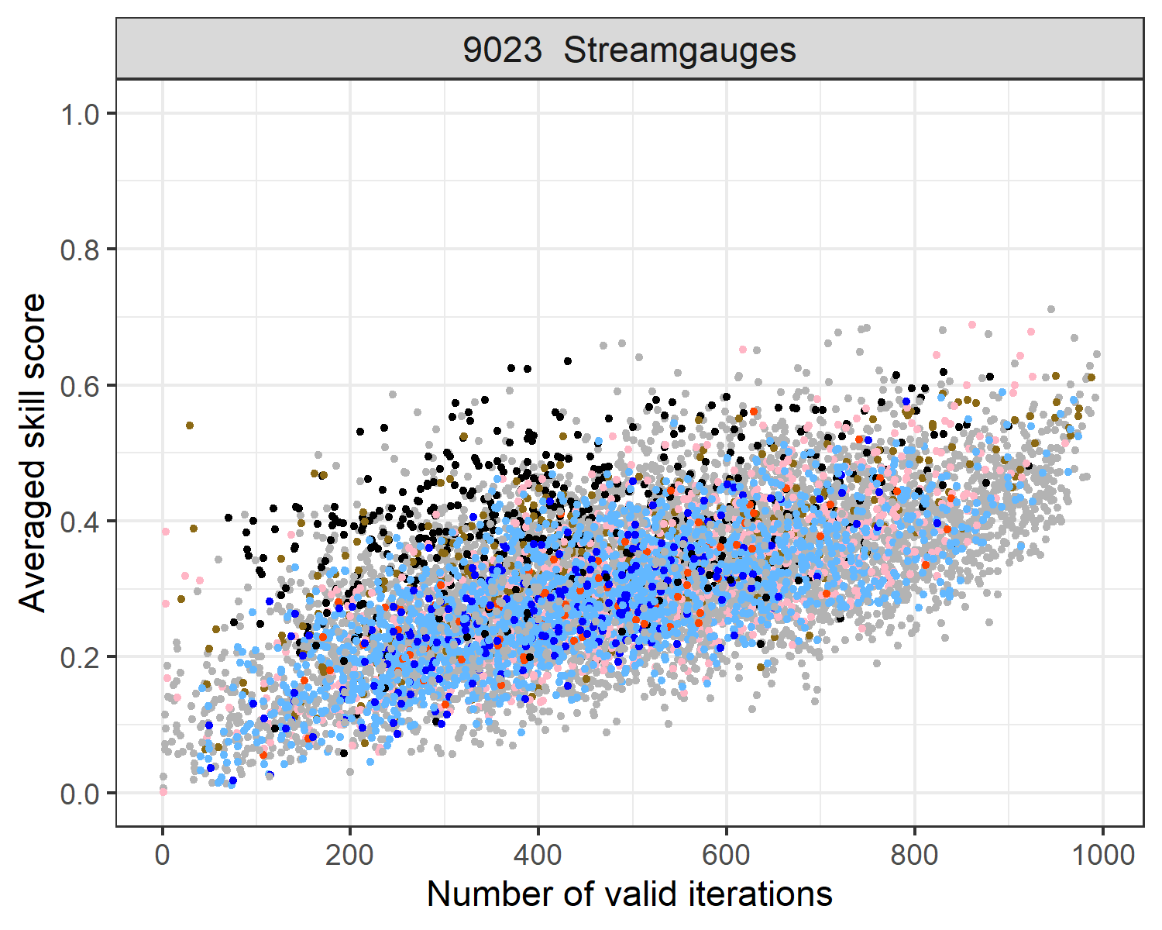
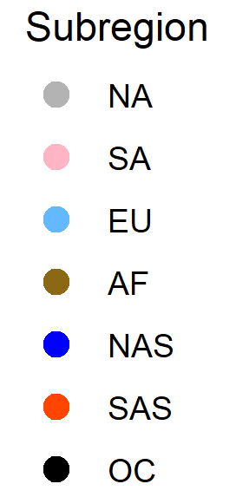
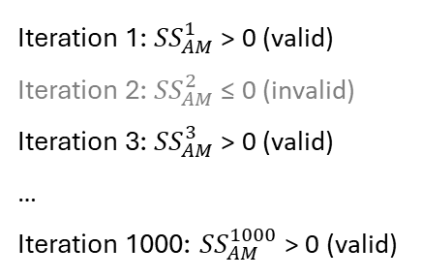
II. Modeling procedure — (1) Climate driver selection
FloodMagnitude_v1.4/01_Covariate_selection/Results02_N_iterations
Out of 9,023 streamgauges, we first select 8,283 streamgauges where the number of valid iterations ≥ 200.
Valid iteration: yields positive skill score for annual maxima prediction (${SS}_{AM}^{}>0$).
Iteration 1: ${SS}_{AM}^{1}$ > 0 (valid)
Iteration 2: ${SS}_{AM}^{2}$ ≤ 0 (invalid)
Iteration 3: ${SS}_{AM}^{3}$ > 0 (valid)
…
Iteration 1000: ${SS}_{AM}^{1000}$ > 0 (valid)
8,283 sites

Slide 6
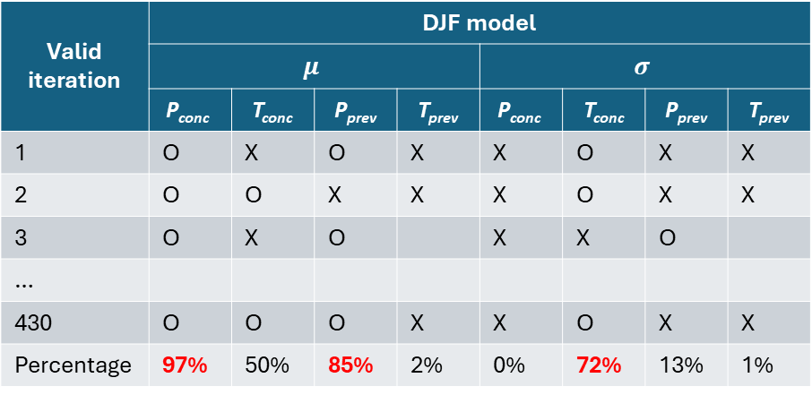
II. Modeling procedure — (1) Climate driver selection
FloodMagnitude_v1.4/01_Covariate_selection/Results03_Count_cov_selection
FloodMagnitude_v1.4/ 02_Seasonal_modeling_final / Results01_GAMLSS_Modeling
For each season, we use the climate drivers as predictors, which are selected at least 70% of valid iterations.
Valid iteration: yields positive skill score for annual maxima prediction (${SS}_{AM}^{}>0$).
Iteration 1: ${SS}_{AM}^{1}$ > 0 (valid)
Iteration 2: ${SS}_{AM}^{2}$ ≤ 0 (invalid)
Iteration 3: ${SS}_{AM}^{3}$ > 0 (valid)
…
Iteration 1000: ${SS}_{AM}^{1000}$ > 0 (valid)
e.g.) The number of valid iterations: 430
Valid iteration | DJF model
 | $$μ$$ |  |  |  | $$σ$$
 | $$\text{P}\text{conc}$$ | T_{conc} | P_{prev} | T_{prev} | $$\text{P}\text{conc}$$ | T_{conc} | P_{prev} | T_{prev}
1 | O | X | O | X | X | O | X | X
2 | O | O | X | X | X | O | X | X
3 | O | X | O |  | X | X | O
…
430 | O | O | O | X | X | O | X | X
Percentage | 97% | 50% | 85% | 2% | 0% | 72% | 13% | 1%
8,283 sites
Final DJF model: $y \sim f_{gamma}\left(μ(P_{conc},P_{prev}), σ(T_{conc})\right)$

Slide 7
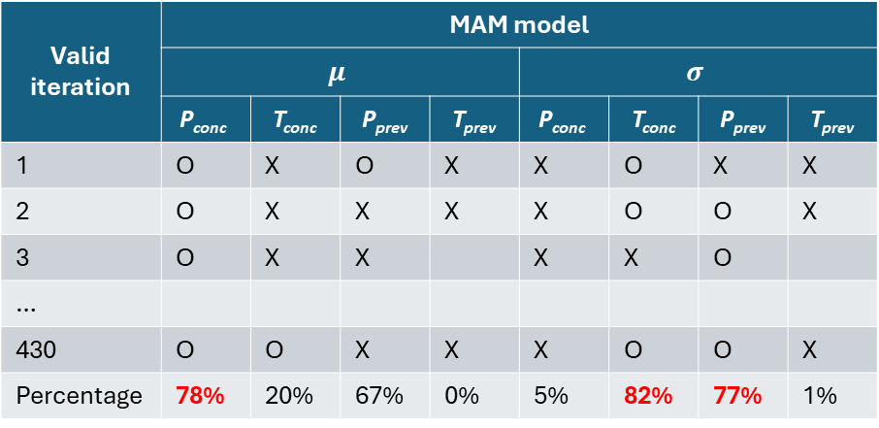
II. Modeling procedure — (1) Climate driver selection
FloodMagnitude_v1.4/01_Covariate_selection/Results03_Count_cov_selection
FloodMagnitude_v1.4/ 02_Seasonal_modeling_final / Results01_GAMLSS_Modeling
For each season, we use the climate drivers as predictors, which are selected at least 70% of valid iterations.
Valid iteration: yields positive skill score for annual maxima prediction (${SS}_{AM}^{}>0$).
Iteration 1: ${SS}_{AM}^{1}$ > 0 (valid)
Iteration 2: ${SS}_{AM}^{2}$ ≤ 0 (invalid)
Iteration 3: ${SS}_{AM}^{3}$ > 0 (valid)
…
Iteration 1000: ${SS}_{AM}^{1000}$ > 0 (valid)
e.g.) The number of valid iterations: 430
Valid iteration | MAM model
 | $$μ$$ |  |  |  | $$σ$$
 | $$\text{P}\text{conc}$$ | T_{conc} | P_{prev} | T_{prev} | $$\text{P}\text{conc}$$ | T_{conc} | P_{prev} | T_{prev}
1 | O | X | O | X | X | O | X | X
2 | O | X | X | X | X | O | O | X
3 | O | X | X |  | X | X | O
…
430 | O | O | X | X | X | O | O | X
Percentage | 78% | 20% | 67% | 0% | 5% | 82% | 77% | 1%
8,283 sites
Final DJF model: $y \sim f_{gamma}\left(μ(P_{conc},P_{prev}), σ(T_{conc})\right)$
Final MAM model: $y \sim f_{gamma}\left(μ(P_{conc}), σ({T_{conc},P}_{prev})\right)$
Final JJA model: $y \sim f_{gamma}\left(μ(P_{conc},T_{conc}), σ(P_{conc})\right)$
Final SON model: $y \sim f_{gamma}\left(μ(P_{conc},{T_{conc},P}_{prev}), σ\right)$

Slide 8
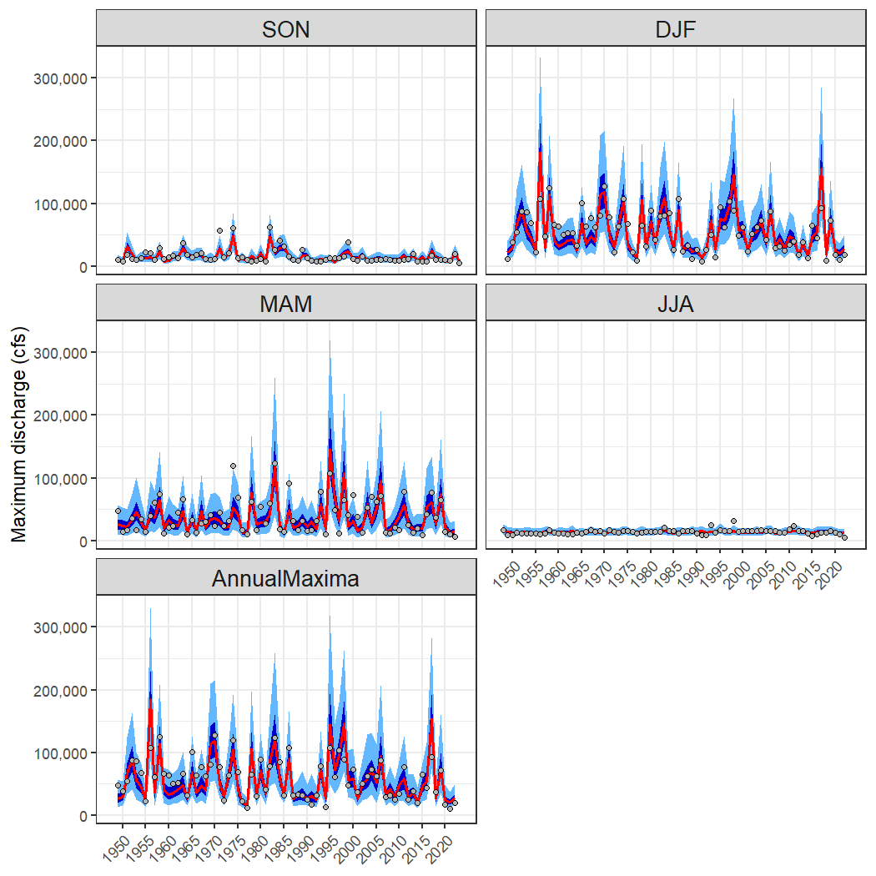
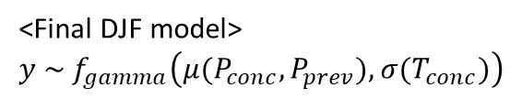
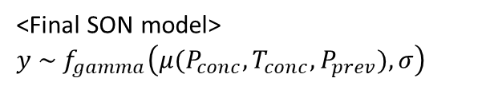
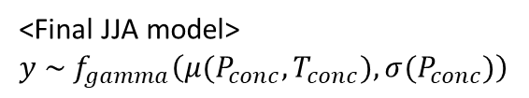
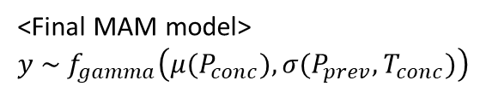
II. Modeling procedure — (2) Final model fitting and annual maxima simulation
For each season, we fit a statistical model using the entire observation years and the selected climate drivers. Then we conduct Monte Carlo simulation to simulate annual maximum peak discharges.
Training years (100%)
e.g.) USGS 11377100
<Final DJF model>
$y \sim f_{gamma}\left(μ(P_{conc},P_{prev}), σ(T_{conc})\right)$
<Final MAM model>
$y \sim f_{gamma}\left(μ(P_{conc}), σ(P_{prev},T_{conc})\right)$
Distribution of annual maximum peak discharges
<Final JJA model>
$y \sim f_{gamma}\left(μ(P_{conc},T_{conc}), σ(P_{conc})\right)$
Monte Carlo simulation
<Final SON model>
$y \sim f_{gamma}\left(μ(P_{conc},{T_{conc},P}_{prev}),σ\right)$
FloodMagnitude_v1.4\04_Evaluation\Results00_Plot_timeseries

Slide 9
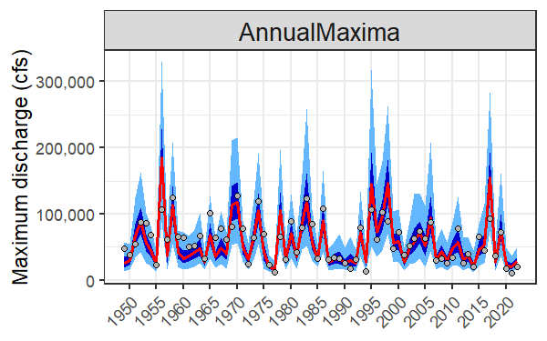
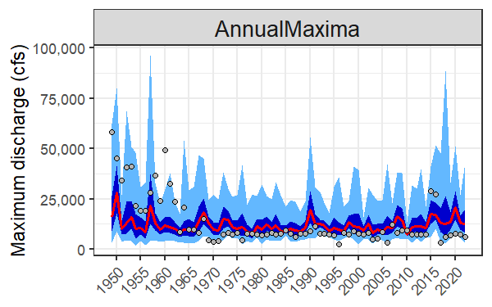
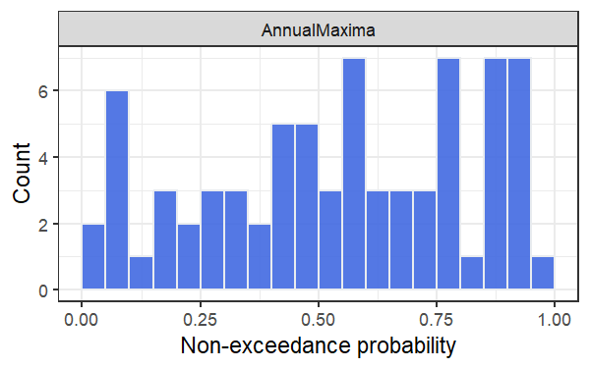
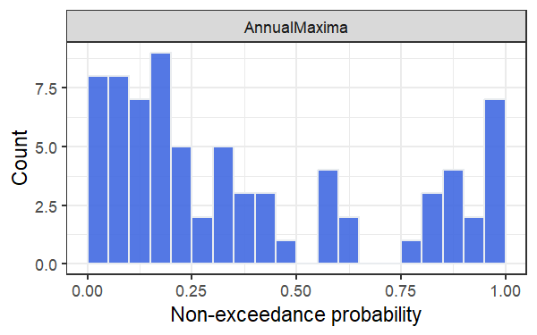
III. Model evaluations
We evaluate our modeling procedure focusing on annual maxima simulation results.
Condition #1. Skill score > 0
Condition #2. Non-exceedance probability of observations $\sim u(0,1)$ (KS test)
e.g.) USGS 11377100 e.g.) USGS 07339000
SS = 0.53
KS.test (Uniform dist.): Yes
SS = 0.14
KS.test (Uniform dist.): No

Slide 10
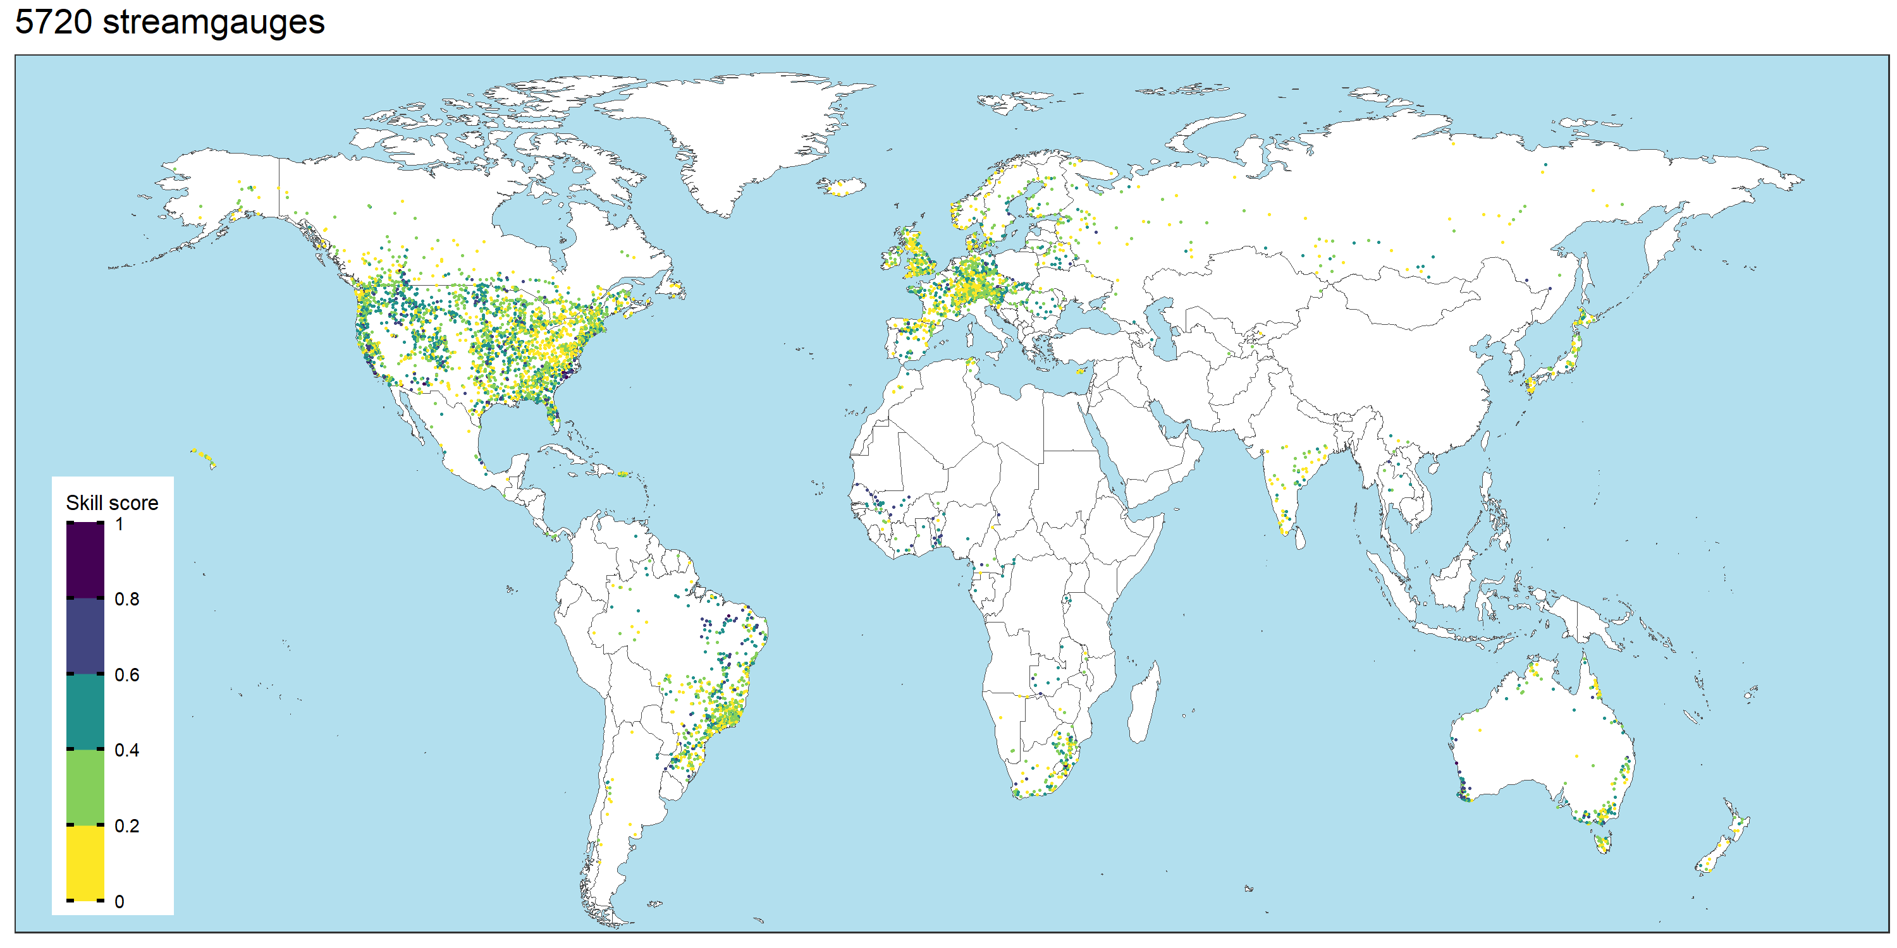
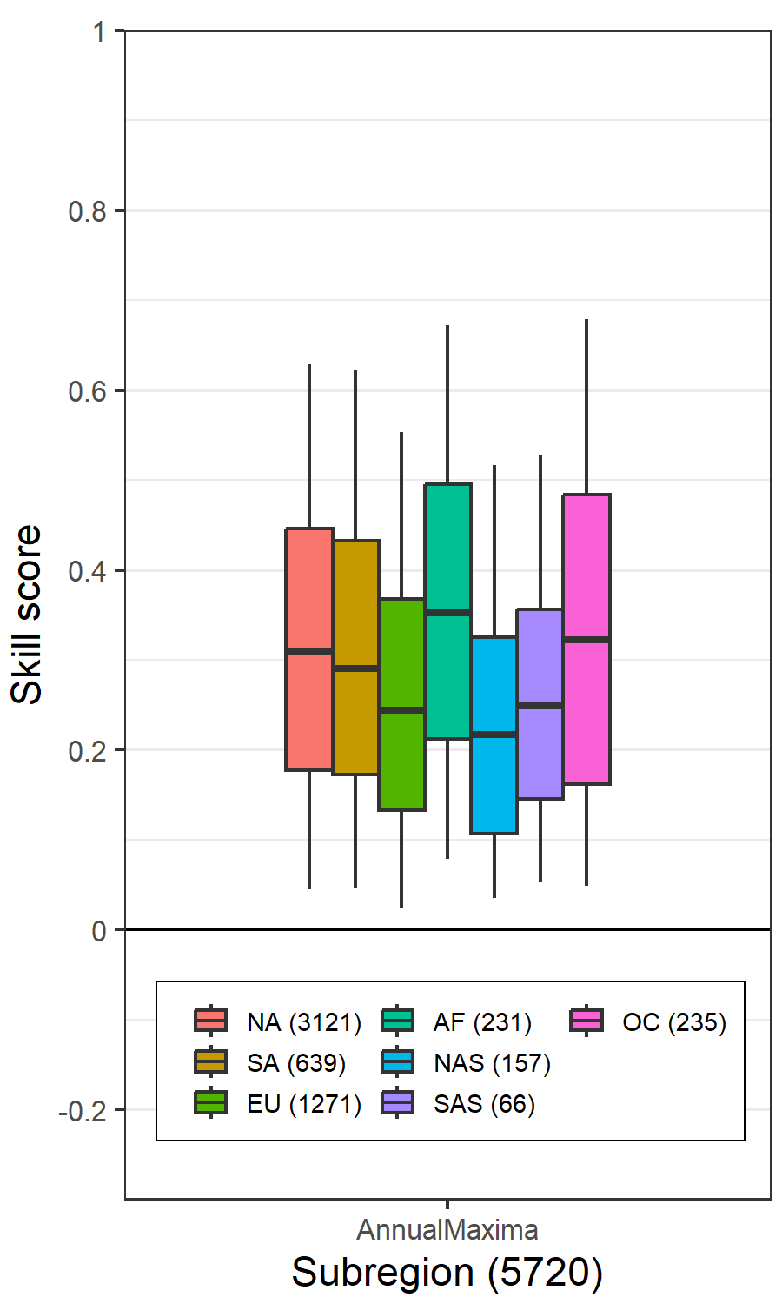
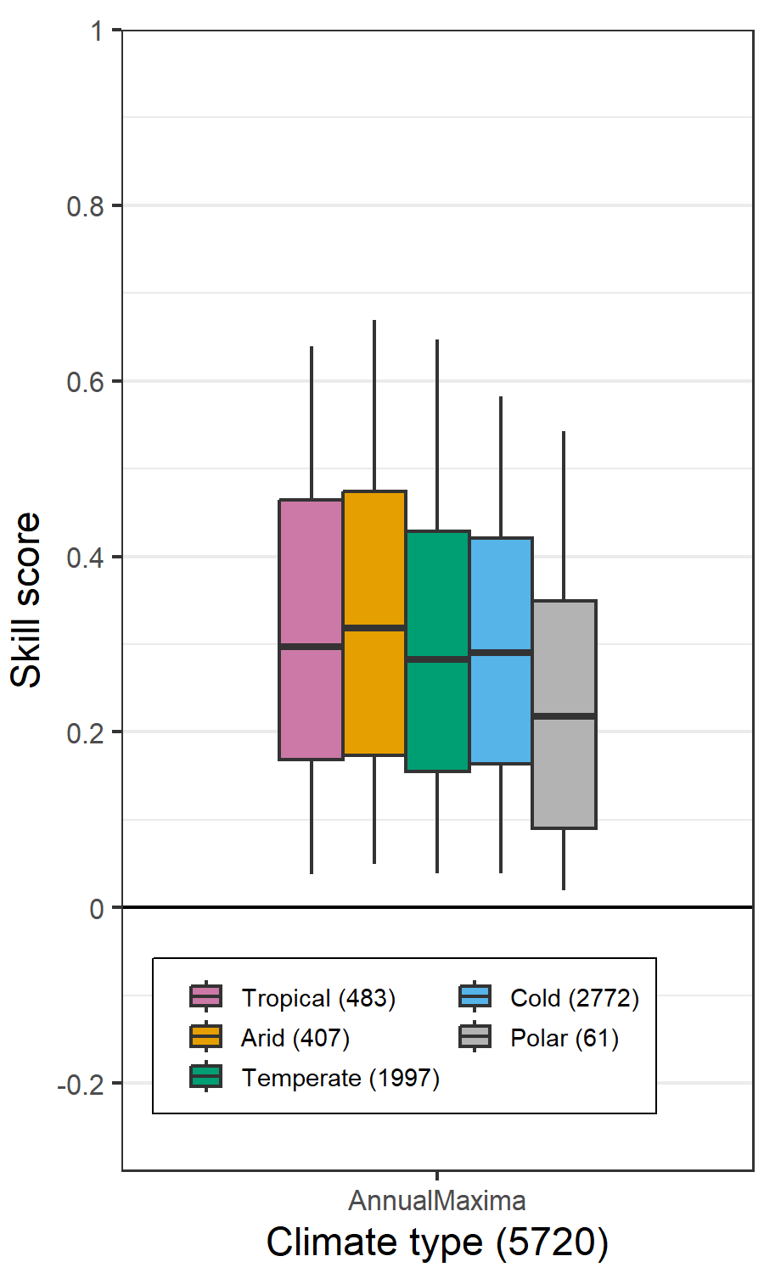
III. Model evaluations
FloodMagnitude_v1.4/04_Evaluation/
We finally select 5,720 streamgauges for further analyses.
Condition #1. Skill score > 0
Condition #2. Non-exceedance probability of observations $\sim u(0,1)$ (KS test)

