Slide 1
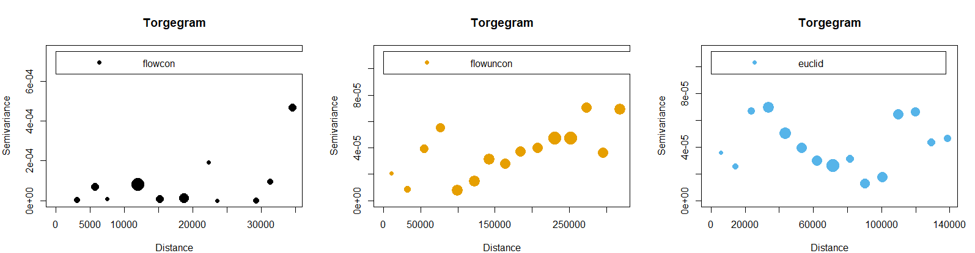
Updates
Spatial extent is larger than the stream network for the flow-connected component
Spatial autocorrelation for flow-unconnected distances up to 250000
No trend, so we don’t need to consider Euclidean autocorrelation
Notes:
Size of the points proportional to the number of data pairs
Increasing no sill: spatial extent is larger than the stream network
No trend in flow-unconnected: tail-up model is suitable (restricts correlation to flow-connected sites)
No trend in Euclidean: don’t need to consider Euclidean correlation
No trend in flow-connected: tail-down model for flow-unconnected sites

Slide 2
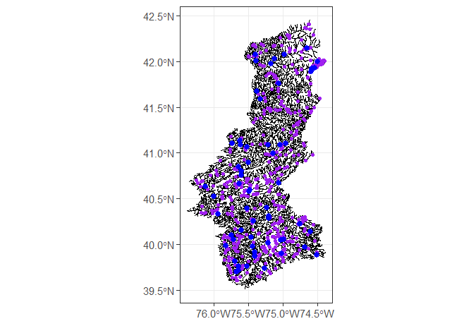
Delaware River Basin
Training on blue points; testing on purple points

Slide 3
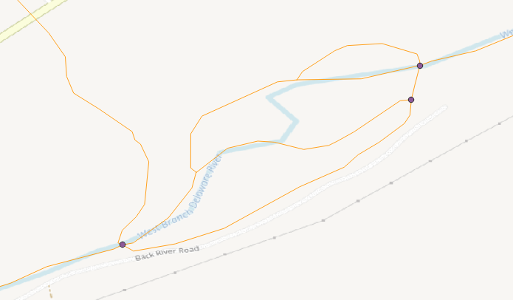
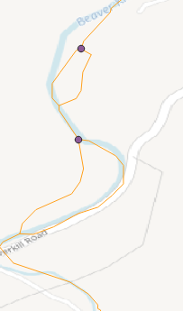
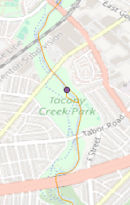
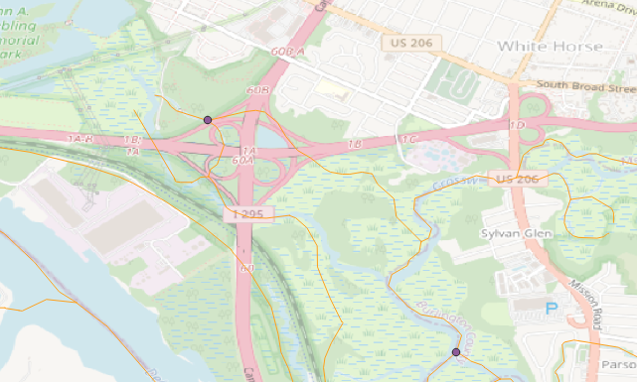
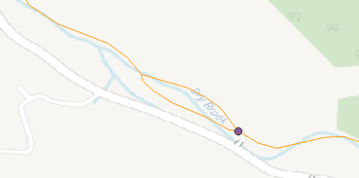
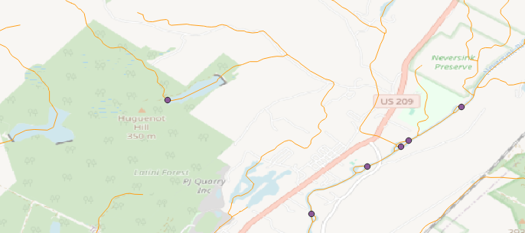
Topological Errors
Complex Confluence
Downstream Divergence
Dangling Node

Slide 4
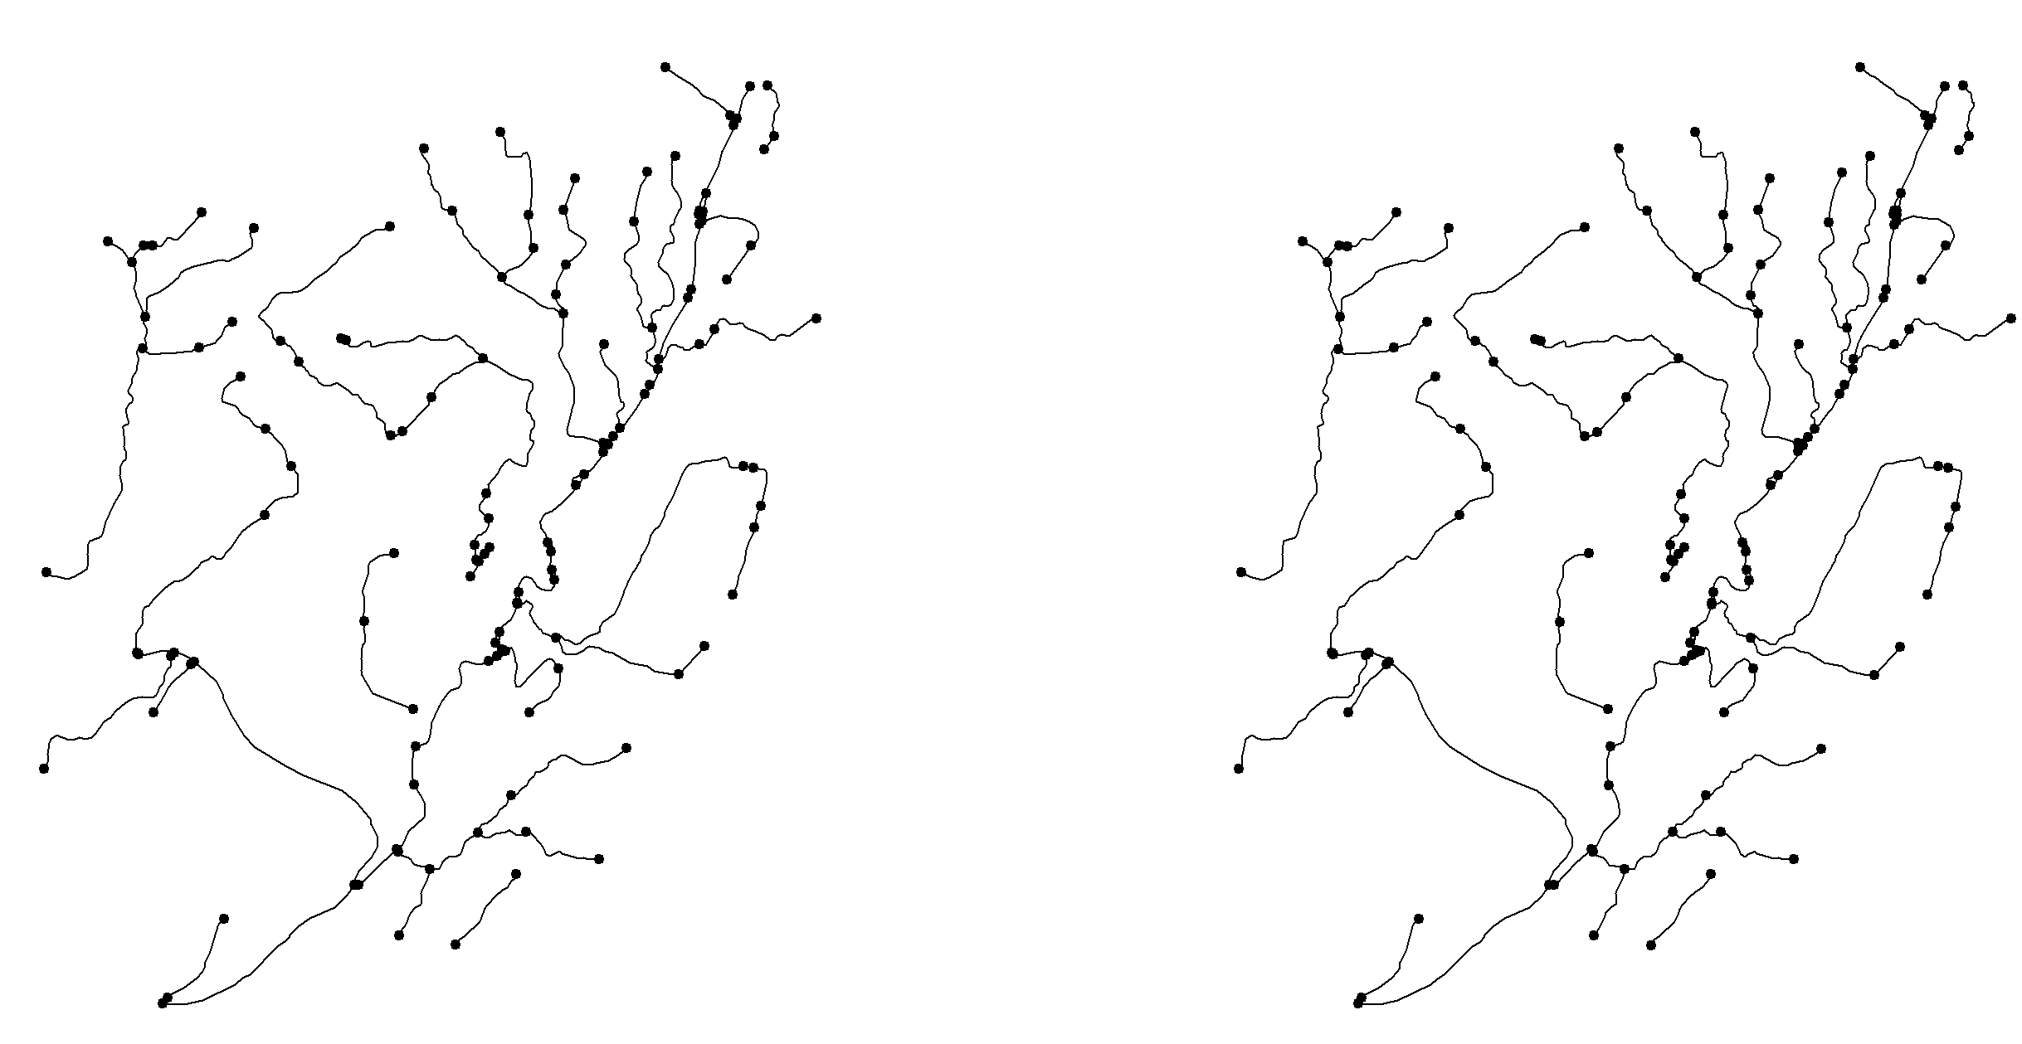
Hanging Nodes: Round to remove precision error

Slide 5
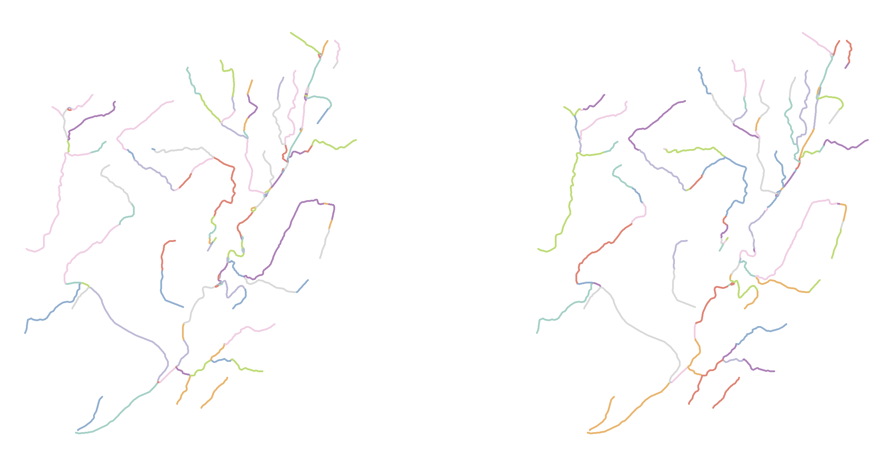
Simplify Network: remove multiple edges (edges which connect the same two nodes; ; keeping the shortest edge) and remove self-loops

Slide 6
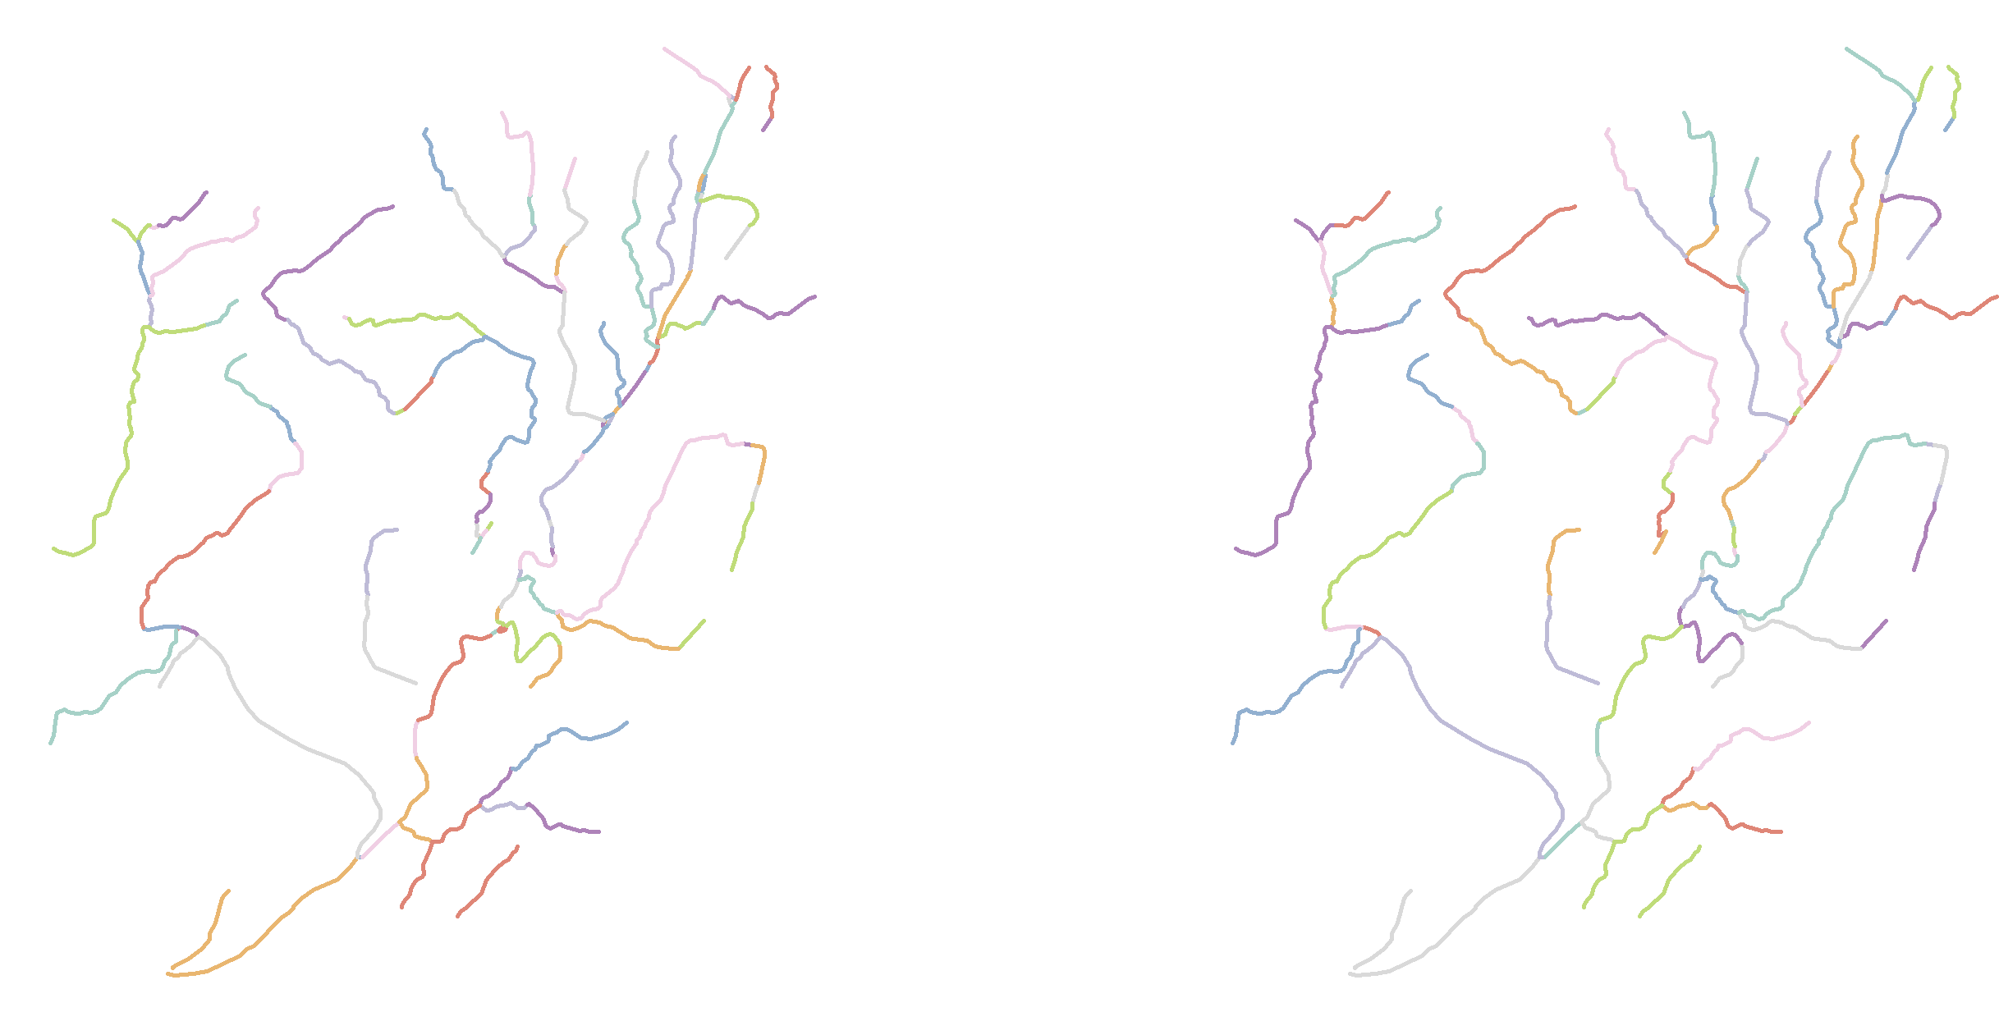
Network Contraction: Assign clusters via DBScan; reduce connected components within the same cluster to a single node

Slide 7
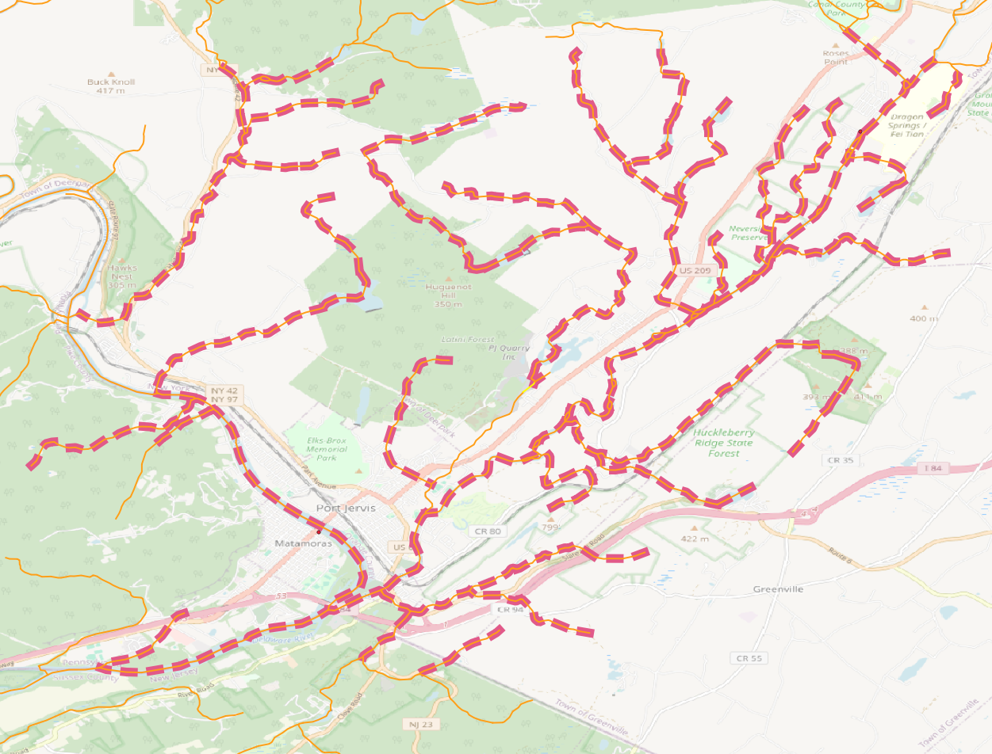
Corrected topology

Slide 8
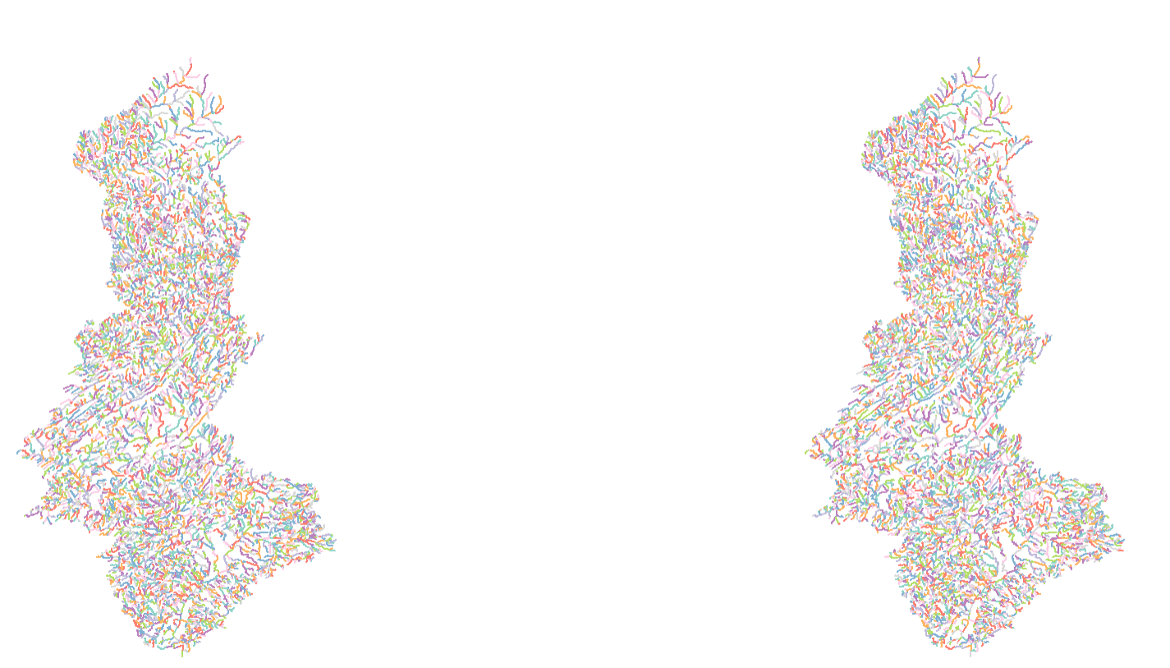
Applied to entire basin

Slide 9
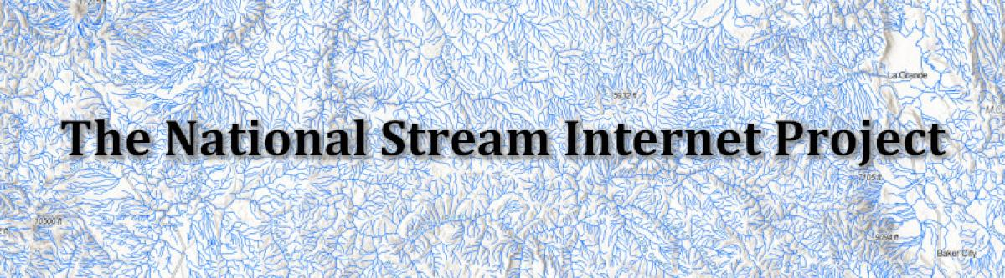
USDA already did this for CONUS: The National Stream Internet Project
Notes:
https://research.fs.usda.gov/rmrs/projects/national-stream-internet#download-data

Slide 10
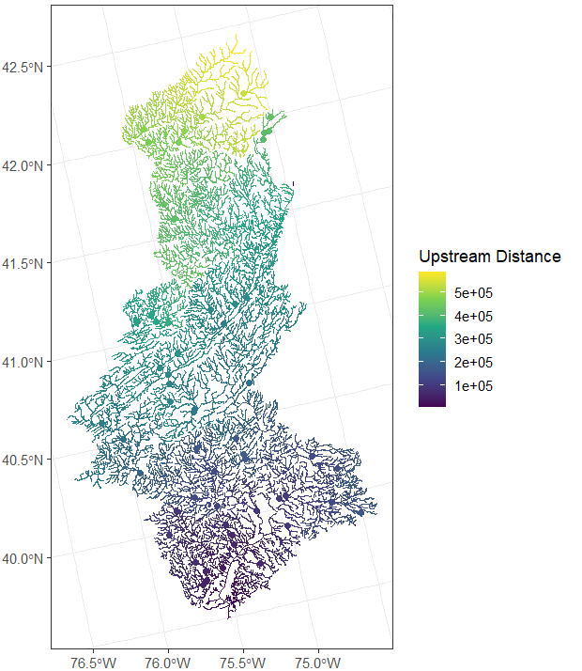
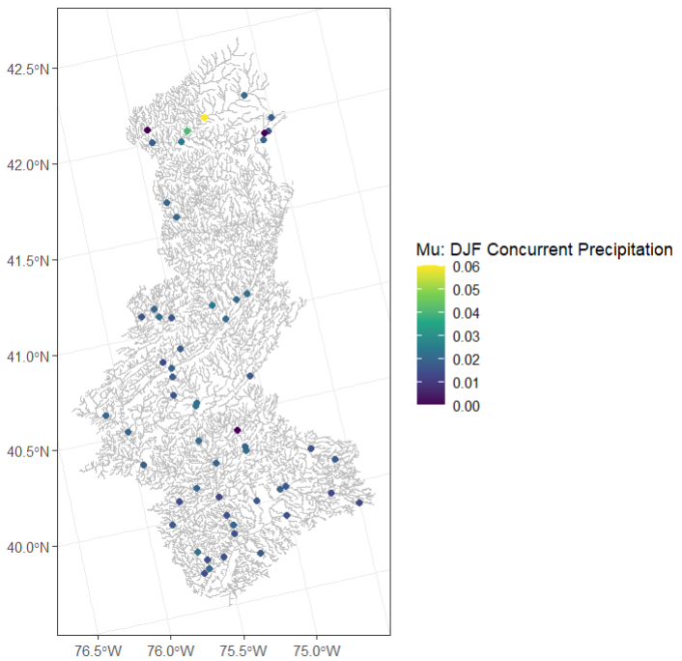
Create a Spatial Stream Network from topologically-corrected flowlines, observed stations (Hkim final model parameters), and test locations (USGS sites)
Starting with DJF Mu concurrent precipitation
SSN Object: Requires upstream distance, additive function values, and directed distance matrices
Notes:
AFV computed using total upstream cumulative drainage area

Slide 11
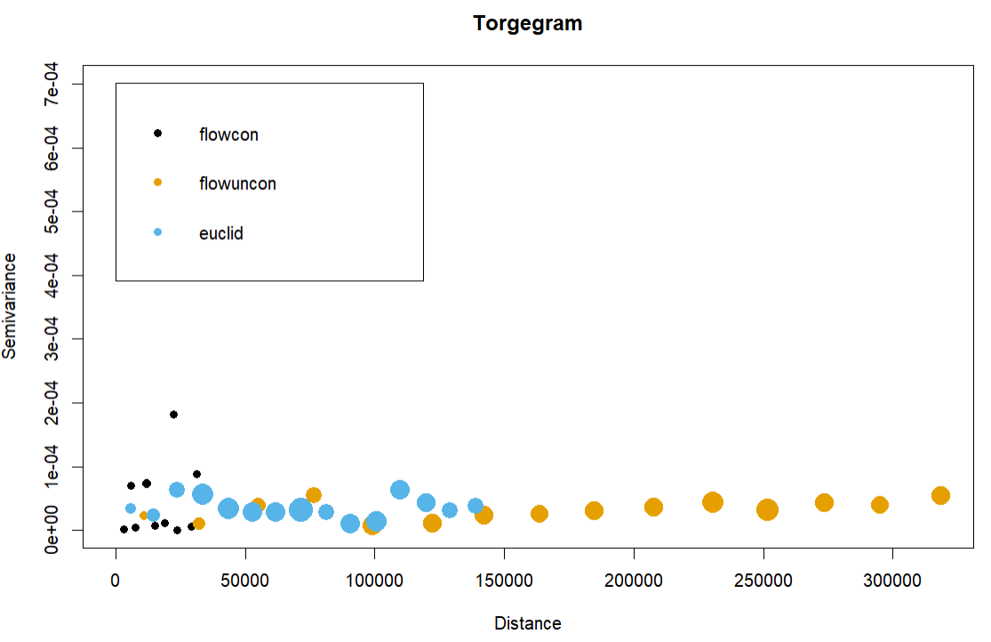
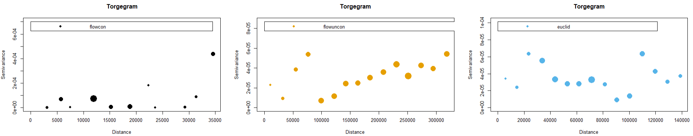
The torgegram shows whether there is a strong dependence between flow-connected sites, flow-unconnected sites, and Euclidean dependence. This informs how we structure the spatial model.
- Flow unconnected semivariance increases with distance
Notes:
Flow unconnected: function of total stream distance

Slide 12
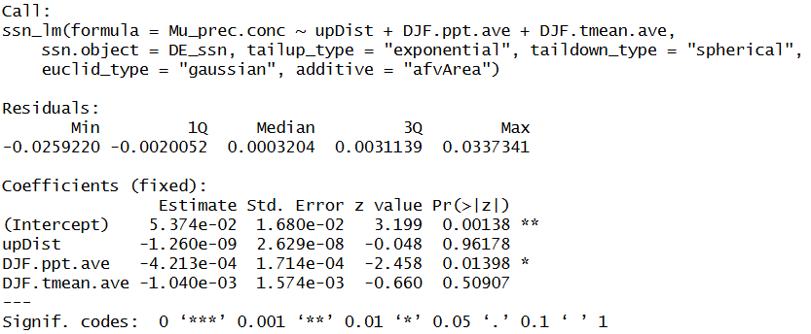
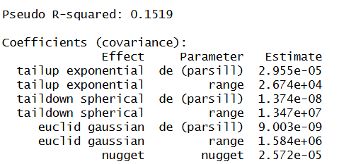
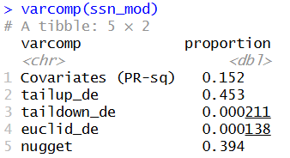
Notes:
Evidence that mu concurrent precipitation decreases with precipitation?
Larger de, more variability in the process is attributed to the relevant effect
Larger range, more autocorrelated nearby observations are with respect to the relevant effect
Variability of mu concurrent precipitation is explained by tail up component (not the fixed effects of covariates)

Slide 13
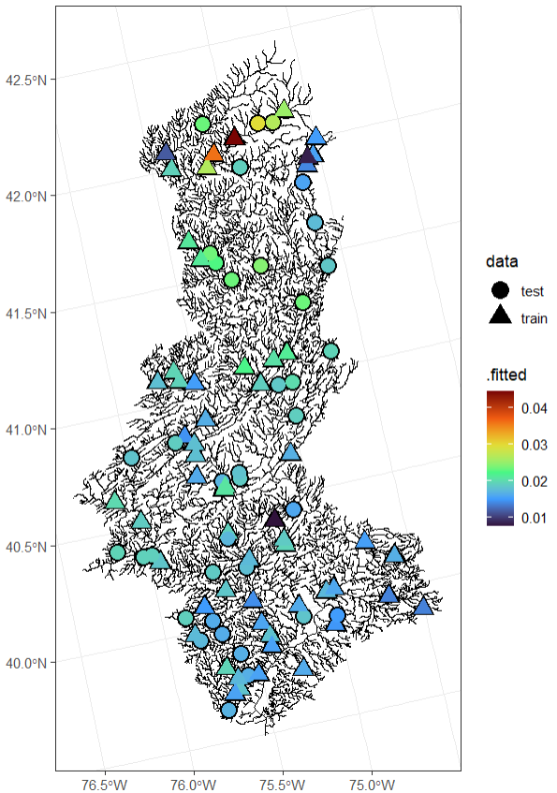
Notes:
Model predictions (Kriging)

Slide 14
Next Steps
Improve understanding of Torgegram
Add elevation?
Which functions for the tail-up, tail-down, and Euclidean components?
Try interpolated flood magnitudes instead of parameters?
How does this compare to results over the Euclidean domain?

Slide 15
Assumptions and Questions
The river network has no braided streams and flows in the downstream direction
Do nodes have to be defined by stream junctions?
Do edges have to be stream segments between junctions?

