Slide 1
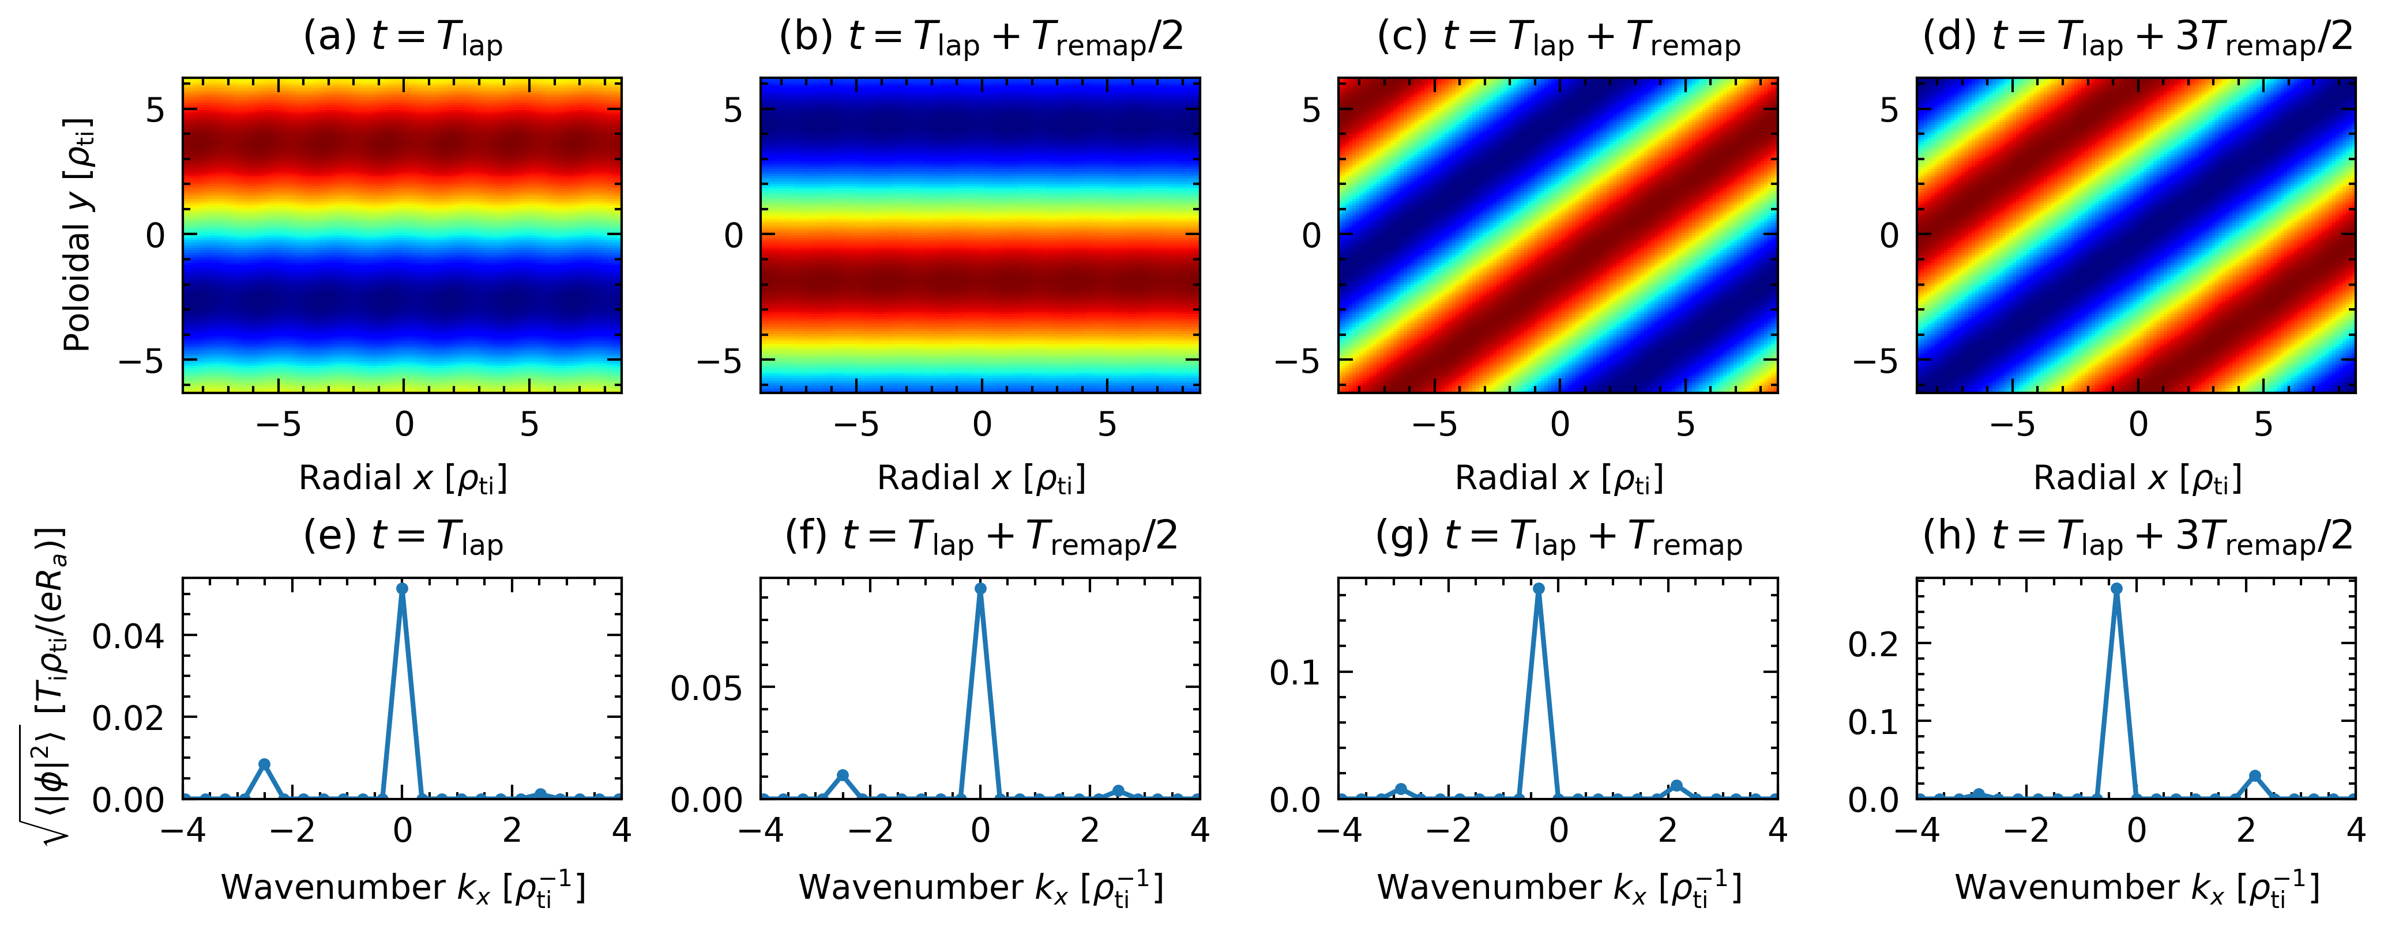
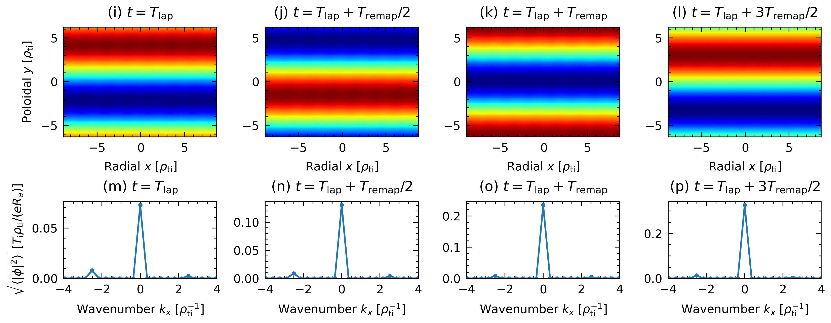
Two-dimensional co-moving frame
Rotating flux-tube model

