Slide 1
Digital Portfolio
STUDENT NAME:MAGALAKSHMI.S
REGISTER NO AND NMID: 24131131802522009/asanm11324131131802522009
DEPARTMENT: Bsc.[cs]
COLLEGE: 113-Vallalar Arts and Science College,Annamalai University

Slide 2
PROJECT TITLE WEBPAGE WITH ANIMATION…!

Slide 3


AGENDA:
Problem Statement
Project Overview
End Users
Tools and Technologies
Portfolio design and Layout
Features and Functionality
Results and Screenshots
Conclusion
Github Link
3/21/2024 Annual Review

Slide 4

PROBLEM STATEMENTS: A visual learning platform that uses animation to explain complex concepts, making them more engaging and easier to understand for learners.

Slide 5

PROJECT OVERVIEW:
*To create a webpage with animation for a project overview, you can use online website builders like Wix to add animated effects to your website elements and page transitions. You can also use animated video makers, such as Canva, to create an animated video overview that you can then embed on your webpage.

Slide 6

END USERS:
*End users for webpages with animation are primarily website visitors or users interacting with the webpage. The animations are designed to enhance their experience and achieve specific goals.

Slide 7

Tools and Technologies:
*The most effective webpages use interactive elements, 3D graphics, and dynamic scrolling to create an immersive experience. This technique is often used for tech portfolios or corporate websites to engage visitors and explain complex systems visually.

Slide 8

POTFOLIO DESIGN AND LAYOUT:
8

Slide 9
FEATURES AND FUNCTIONALITY:
*The future of web page animation is characterized by a blend of enhanced visual appeal, improved user experience, and deeper functionality, moving beyond purely decorative elements.

Slide 10

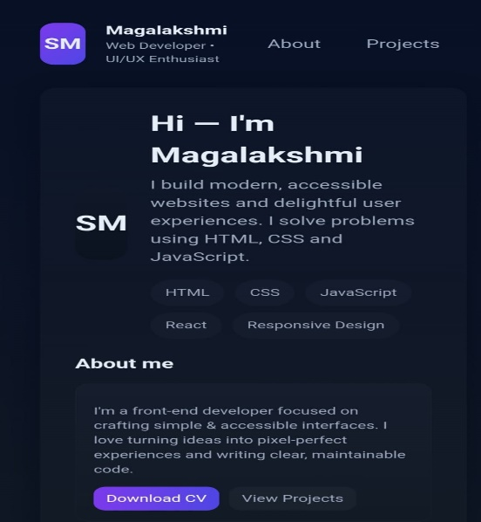
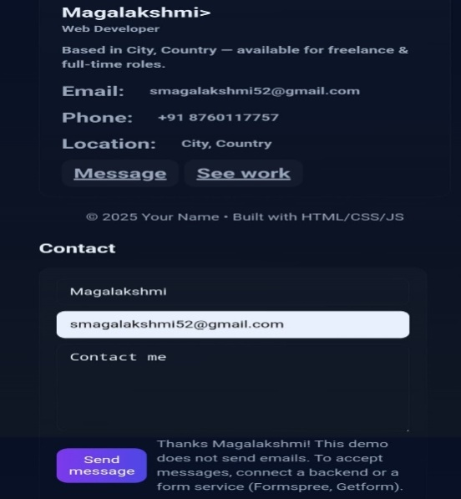
RESULTS AND SCREENSHOTS:
A website that effectively uses animations to improve user experience, guide attention, and create an engaging, dynamic, and immersive experience,
3/21/2024 Annual Review
10

Slide 11
CONCLUSION:
*The conclusion of a webpage can provide a visually engaging and memorable final impression. The animation should serve a clear purpose, such as reinforcing the main message or guiding the user to a final call-to-action, rather than being purely decorative.
11

