Slide 1

Moving to Las Vegas
Coursera IBM Data Science Capstone
Aug 1st, 2019
Stefano Magarotto

Slide 2
Table of Contents
1. Introduction / Business problem
2. Data Section

Slide 3
1. Introduction / Business problem
1.1 Scenario
I am curretly living in Italy in a sparkling university town called Padova/Padua. I have plenty of venues and attractions especially parks for children, shopping venues for wife and theatres for me. I got a job in Las Vegas and I am planning to relocate if I can find a place to live with similar venues.
1.2 Problem to be solved
I need to find a Las Vegas area with:
similar venues
availability of a single house with min 2 bedrooms, 2 bathrooms, a garage and a garden with swimming pool, no HOA fees, build after 2009 and a budget of $500k
nearby primary, middle and high schools
maximum distance from Caesars Palace Casino (job location): 10 miles

Slide 4
1. Introduction / Business problem
1.3 Potential audience
This project can be useful for all those people that need to relocate with their families in the same country or in different countries or even continents.
It can be useful for businesses that are planning to relocate and are considering their employees needs in the global balance of pros and cons.
It can be adapted to the case of evaluating a new business opportunity in a certain area.
Last, but not least, it can be useful for everyone interested in Data Science as a possible solution for a practical case.

Slide 5
2. Data
2.1 Data sources
Geodata for Padova/Padua with venues (Nominatim or geocode, Foursquare and Folium)
Geodata for Las Vegas neighborhoods including the sorrounding cities of North Las Vegas and Henderson, plus the Census-designated places of Blue Diamond, Enterprise, Paradise, Spring Valley, Summerlin South, Sunrise Manor, Whitney and Winchester with venues (Wikipedia, Nominatim or geocode, Foursquare and Folium)
List of houses to buy (zillow, Nominatim or geocode and Folium)

Slide 6
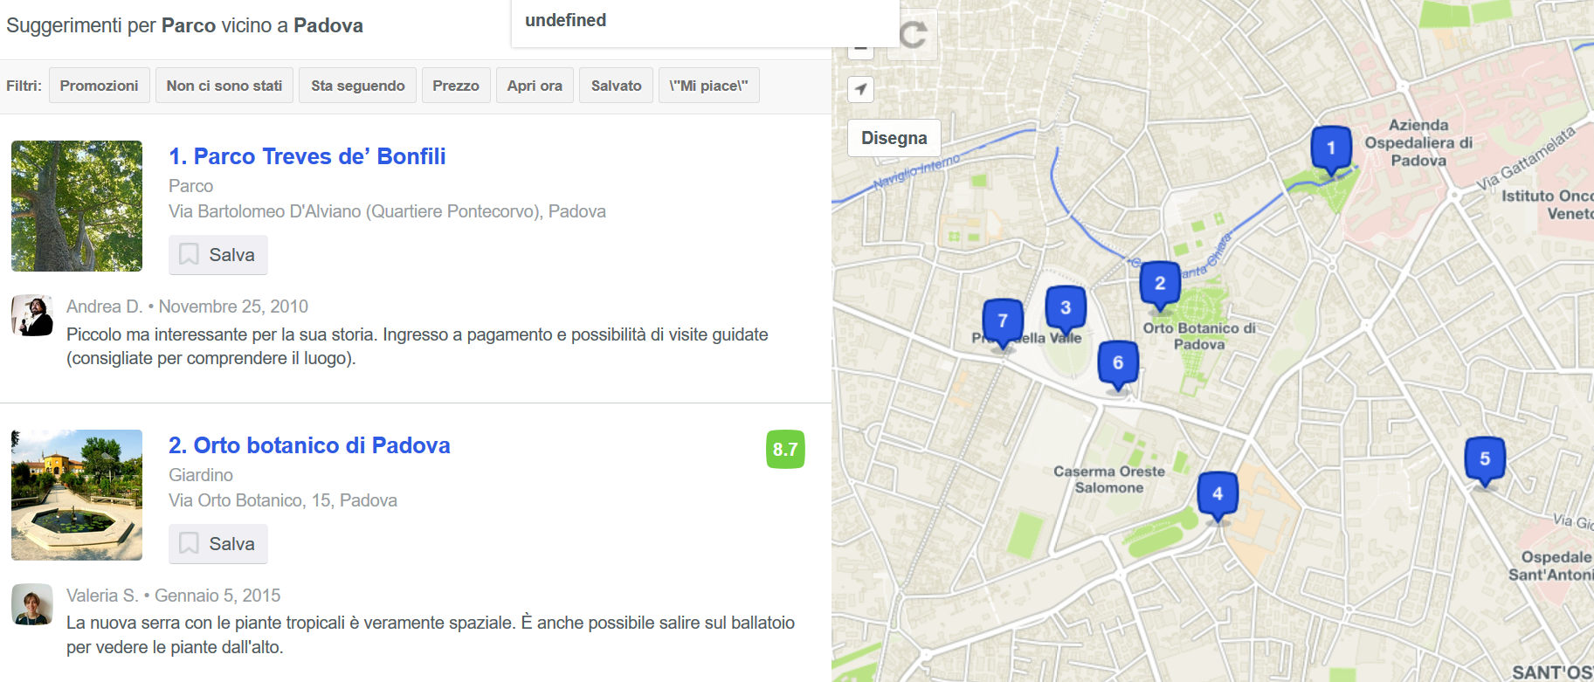
2. Data
2.2 Data features
Padova/Padua
My location: latitudine and longitude (45.3959547,11.8802724)
Parks: from Foursquare with a specific radius of 2.5km
The same for schools, shopping venues, theatres (from Foursquare) and a specific radius of 2.5km.
The features we are interested are distance, review score, opening hours and if they are trending.

Slide 7
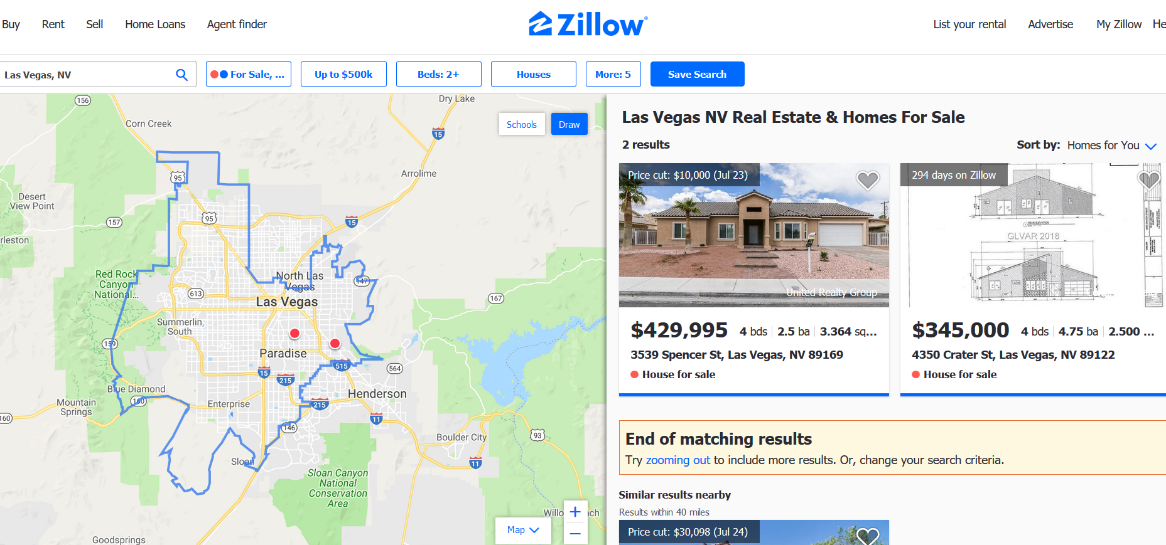
2. Data
Las Vegas
Potential houses to buy (with latitude and longitude)
As for Padova/Padua, in Las Vegas we use foursquare with a radius of 8km (5mi) because it is easier to reach a more far away destination.
So parks, schools, shopping venues, theatres (from Foursquare) and a specific radius of 8km (5mi).
The features we are interested are distance from house, review score, opening hours and if they are trending.
We consider also the distance of the house from the jobplace (Caesars Palace Casino Las Vegas).

