Slide 1
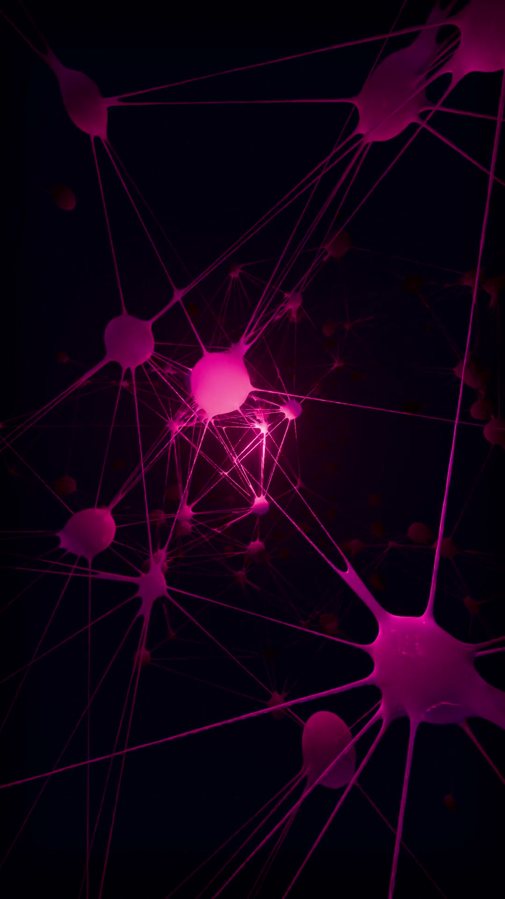

RESEARCH SPOTLIGHT
2 OF 3 SOURCES
⚡
Proceedings of CHI 2025 · Microsoft Research × Carnegie Mellon
“
The Impact of Generative AI
on Critical Thinking
Lee, H., et al. (2025)
Survey of 319 knowledge workers
“Trust the AI more, and
you stop checking its work.
Trust YOURSELF more, and
you start questioning it.”
KEY FINDING
When people trust the AI more, they accept its answer at face value — less checking, less scrutiny. When people trust themselves more, they verify and question what the AI gives them.
319
936
professionals
surveyed
real AI
use cases
— it's the confidence balance, not the AI, that drives the outcome
Dr. H. Lee, lead author
Source: Lee et al., “The Impact of Generative AI on Critical Thinking,” CHI 2025.
1

