Slide 1
41012 Programming for Mechatronic Systems
Week 2

Slide 2
Overview
Staff
Link to Industry Needs
Objectives
Class Structure
Assignments
General Rules
Plagiarism
Late submissions
Peer Review
In-class exercises

Slide 3


Subject Staff
Subject Coordinators
Alen Alempijevic
Teaching Staff
Alex Virgona

Slide 4
Mechatronic Systems
6.4B Devises Interconnected + System on
Chip Devices Explosion
Beyond Single Monolithic Code
OO Paradigm – More Admissible to Systems
C++ Essential on Many Layers
Android Backbone, Libraries, Applications
Code Reuse / Testing / Documentation
Robotics Jobs (demand)

Slide 5
Subject objectives
1. Design classes that are reusable, reliable and maintainable
2. Apply theoretical knowledge of sensors and control to practical programming problems
3. Select appropriate class structures and data handling methods for task at hand
4. Implement and test object-oriented applications of moderate complexity
5. Communicate programming design decisions, dependencies, interconnections, use cases and testing procedures in a written document

Slide 6
Class Structure
Pre-readings given
Students view readings, attempt and come to class
We clarify concepts and push forward with examples
We build knowledge base (stratify knowledge) towards the assignments; more complex layers of understanding

Slide 7
Assessment
1) Assessment I:
Developing Sensor Class (5%)
2) Assessment II:
Utilising Abstraction for a Range of Sensor Classes (20%)
3) Assessment III:
Threading, Synchronization and Data Integrity
(20%)
4) Individual Project: (40%)
5) Code Review: (9% : 3%+3%+3%)
6) Quizes (beginning of class): 6% ( 6 x 1%)

Slide 8
Practise Quiz

Slide 9
Teaching Delivery
OS: Ubuntu
C++11
Compilation + Tools: CMake
Documentation: Doxygen
IDE: QTCreator
Unit Testing: gtest
OpenCV (Library)
ROS (Middleware CBSE)

Slide 10
What you should have done in Week 1
Download the examples from Lynda.com
Enable compiling of working.cpp from Chap1
with CMake
Command line
QTCreator / Eclipse
Reviewed C

Slide 11
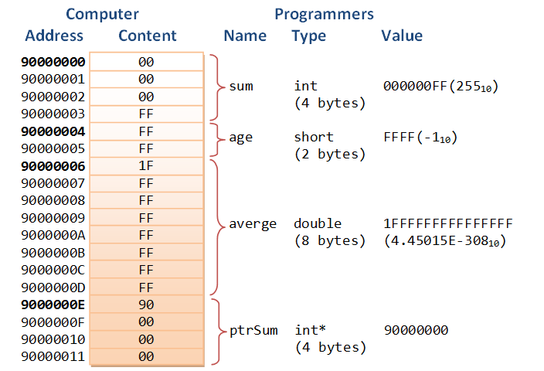
Pointers & Reference
Pointers are extremely powerful, allow access to memory (memory address) and to manipulate their contents

Slide 12
Pointers & Reference
The address-of operator (&) operates on a variable, and returns the address of the variable
Pointer:
stores a memory address
must be declared before they can be used
syntax of declaring, place a * in front of the name
is associated with a type

Slide 13
Dereference / Indirection
To get the value pointed to by a pointer (retrieve or modify), you need to use the dereferencing operator *

Slide 14
Pointers & Reference
int number = 88;
int * pNumber = &number;
cout << pNumber<< endl;
cout << *pNumber << endl;
*pNumber = 99;
cout << *pNumber << endl;
cout << number << endl;

Slide 15
Functions
Functions allow to structure programs in segments of code to perform individual tasks.
Generally segmented to be able to be reused
type name ( parameter1, parameter2, ...) { statements }
What about void

Slide 16
Functions
Create a function that accepts a double value as a parameter and
1. Returns a square value
2. Returns a bool value if the double is greater than zero and the square value instead of initial passed value
3. Returns bool value if the double is greater than zero, the square value, the cube value and the passed value incremented by one

Slide 17
Header / Source File
Why needed?
It allows you to separate interface from implementation
It speeds up compile time
Generally the interface file is all that is needed
Allows to have a library with header, inner implementation hidden
Further Details
http://www.cplusplus.com/articles/Gw6AC542/

Slide 18
Coding Style Guide
Code style important for readability of code
Most important : CONSISTENCY
Common to Adopt Coding Standard
http://wiki.ros.org/CppStyleGuide
https://google.github.io/styleguide/cppguide.html
We will use ROS C++ Style Guide

Slide 19
Classes
Classes are an expanded concept of data structures:
they can contain data members
they can also contain functions as members.
C Struct?
Arguably not the same beast!

Slide 20
Classes
class Rectangle {
Rectangle();
~Rectangle();
public:
void setValues (int,int);
int getArea (void);
int getPerimeter (void);
private:
int width_, height_;
};
Notes:
Constructor / Desctructor

Slide 21
Classes
class Rectangle {
public:
void setValues (int,int);
int getArea (void);
int getPerimeter(void);
private:
int width_, height_;
};
Questions:
What are the functions of the class?
What do they take / return?
What are the access specifiers?
Why do we have the setValues method?
What do the access specifiers guarantee
Where is the implementation of this class
What might be the pitfall of this class?
How can we resolve the pitfall?
Notes:
Access specifiers

