Slide 1

filechecker
PASS
CS532: OS Foundations
Lab Assignment

Slide 2
Instructions: Make a copy of this document, move your copy to your submissions folder and fill the document with your responses. Use the space on each slide to show your responses, and add additional slides as needed.
When ready for grading: complete the lab assignment submission form and include a link to your filled document

Slide 3
filechecker -- check that files are sorted correctly
create a new C language program called filechecker.c
That inputs D and T as command line arguments:
D - directory containing unsorted files. filechecker should check to see that D has a sub-directory called "sorted" that contains a sorted version of each file in D. If it cannot open D or cannot open the sub-directory then it should print a helpful error message and exit.
T - number of checker threads
the program should create T threads and then each of those threads independently checks a subset of the files in <D>/sorted to make sure that each file is a correctly sorted version of the corresponding file in D. it should assume that the file D/unsorted_<id>.bin has a sorted version called <D>/sorted/sorted_<id>.bin

Slide 4
filechecker should exit with 0 (success) if it verifies that all files are properly sorted, and exit with -1 and a helpful error message if it finds that any sorted_<id>.bin file is not a proper sort of the corresponding unsorted_<id>.bin file.
implementation detail: all file reads must be done with memory mapped files (instead of using read()). The memory maps should be implemented with the mmap(), munmap() and msync() system calls. read the man pages for mmap, munmap and msync to learn more about these important, useful system calls.

Slide 5
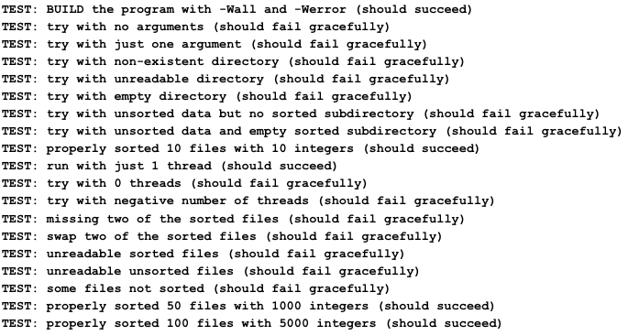
1. Test your filechecker.c. On this page describe how you tested filechecker.c to make sure that it is functioning correctly.
Answer : I used the below tests to verify the functioning: -

Slide 6
2. Writing I/O code with mmap() is different from writing I/O code with read() and write(). Comment here about your experiences and preferences with writing I/O code in each style (read/write vs. mmap).
Answer : In code I can observe that while using mmap I got a pointer back, which can be accessed as per my need, but in case of write/read, I had to read the whole file and store it. It will be heavy for large files. A file can be accessed in a program like an array when it is mapped to a process address space. mmap is faster for accessing file data. The mmap method just makes one system call and a few more for setup, but the other approaches make numerous system calls.

Slide 7
3. Upload your completed filechecker.c to your submissions folder and provide a link to it here: <link>
Here are the tests that we will run with your code:
TEST: BUILD the program with -Wall and -Werror (should succeed)
TEST: try with no arguments (should fail gracefully)
TEST: try with just one argument (should fail gracefully)
TEST: try with non-existent directory (should fail gracefully)
TEST: try with unreadable directory (should fail gracefully)
TEST: try with empty directory (should fail gracefully)
TEST: try with unsorted data but no sorted subdirectory (should fail gracefully)
TEST: try with unsorted data and empty sorted subdirectory (should fail gracefully)
TEST: properly sorted 10 files with 10 integers (should succeed)
TEST: run with just 1 thread (should succeed)
TEST: try with 0 threads (should fail gracefully)
TEST: try with negative number of threads (should fail gracefully)
TEST: missing two of the sorted files (should fail gracefully)
TEST: swap two of the sorted files (should fail gracefully)
TEST: unreadable sorted files (should fail gracefully)
TEST: unreadable unsorted files (should fail gracefully)
TEST: some files not sorted (should fail gracefully)
TEST: properly sorted 50 files with 1000 integers (should succeed)
TEST: properly sorted 100 files with 5000 integers (should succeed)
MANUAL TEST: trace the system calls to make sure mmap() and munmap() are used
Code works well. All tests pass. Nice work Shreyoshi!

