Slide 1

Docker Fundamentals
TGIF Series
Sujil Maharjan

Slide 2
What is Docker?
Platform as a Service that uses containerizes your applications for deployment
Flexible, modular, easy to migrate, secure, easy to scale

Slide 3
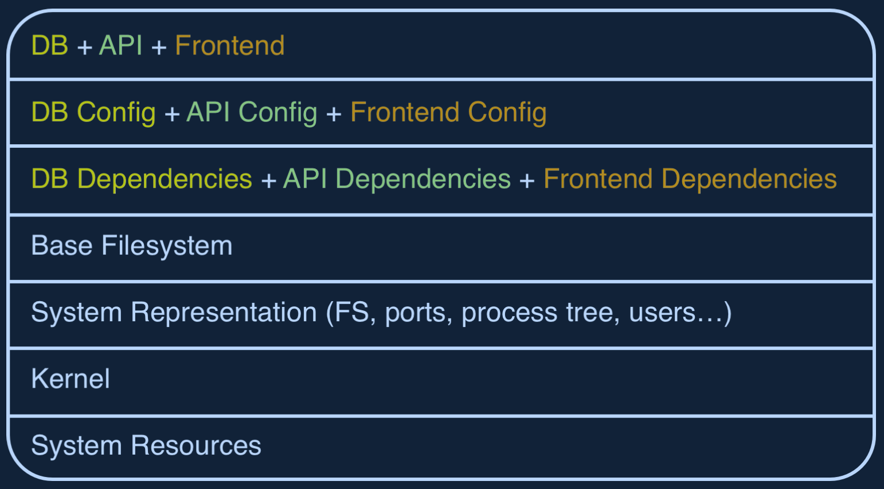
Without Containerization

Slide 4
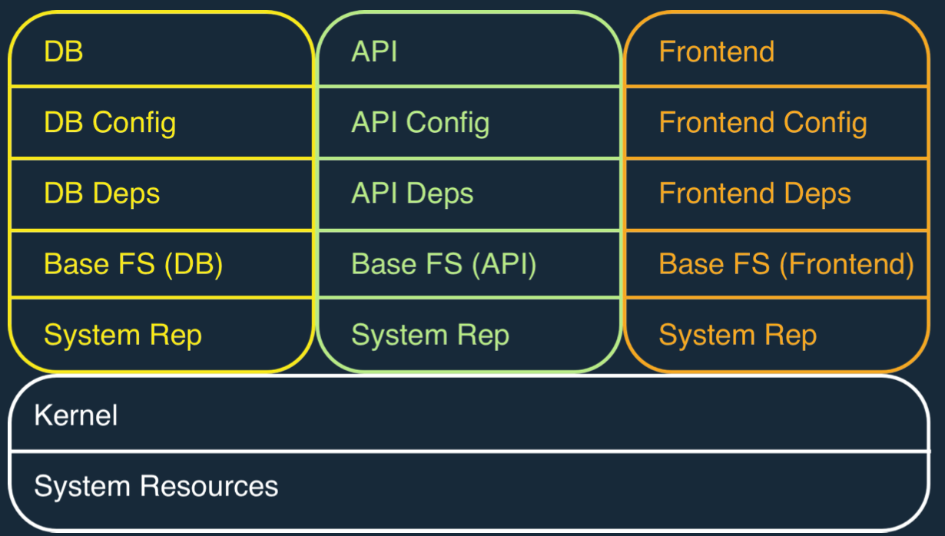
With Containerization

Slide 5
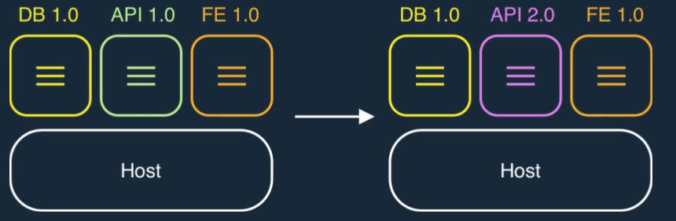
Rapid Development
Containers can be replaced easily with minimal impact on other components

Slide 6
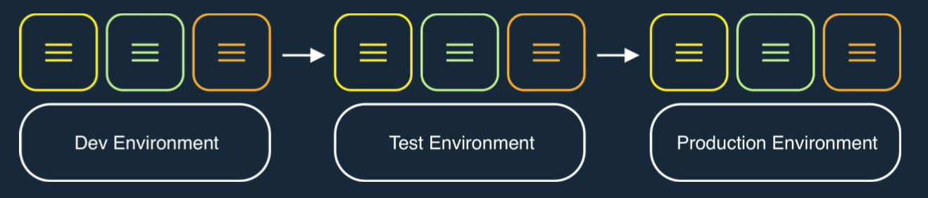
Smooth Migration
Migrating the application across various environments is very simple and keeps minimal impact on the hosts that run them

Slide 7
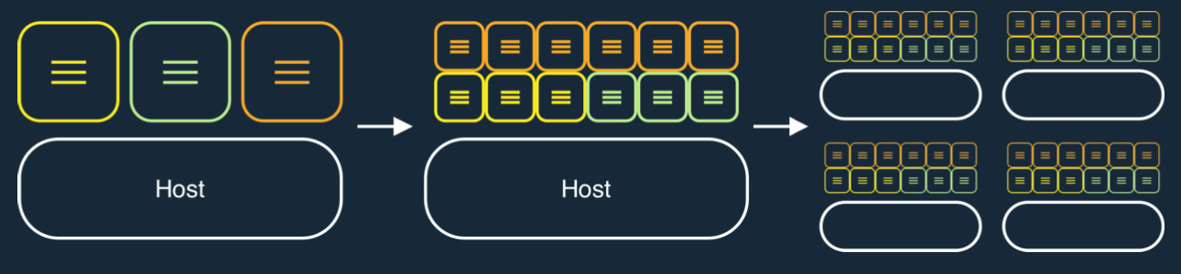
Simple Scale & Maintainance
There is weak coupling between containers. So, scaling is simplified

Slide 8
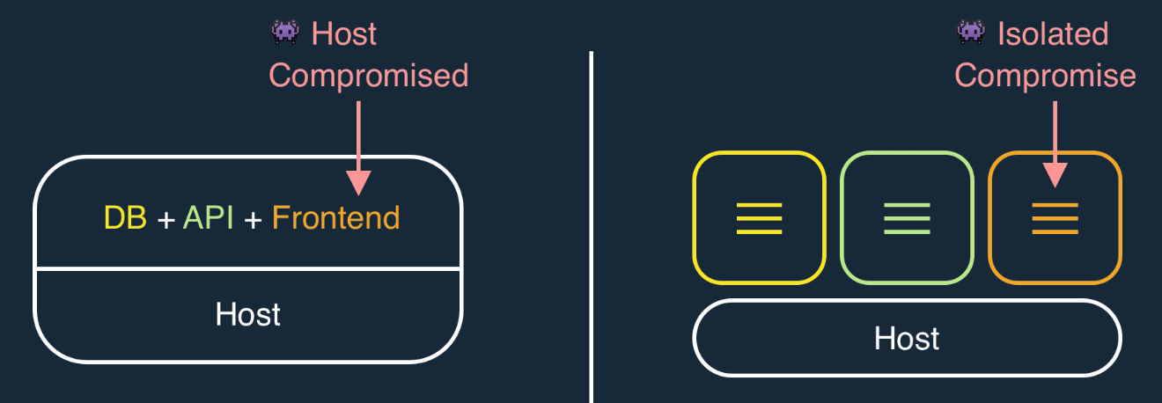
Secure by Default

Slide 9
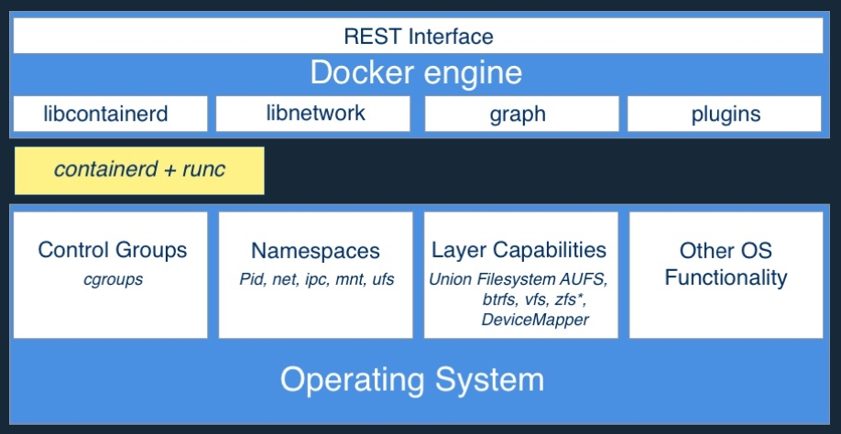
Architecture

Slide 10
Docker Images
Filesystem for container process
Made up of stack of immutable layers
Starts with a base image and adds layers with each addition/action
3. Add files related to your application
2. Add IIS
1. Environment / nano servers

Slide 11
Sharing Layers and Writable layer
 | R/W container layer
R/W container layer | 4. Add .jar
3. Add build step | 3. Add dependencies
2. NPM install | 2. Add Java Runtime
1. Base Image Layer (windows/linux)
Host Kernel

Slide 12
Creating Images
Using Commit
docker container commit <container_id>
Define a Dockerfile (Recommended)
Import a tarball into Docker

Slide 13
Dockerfiles
Provides Image Layer documentation
Commands
FROM command defines a base image
Each additional command adds a layer
docker image build… builds the image

Slide 14
Image Creation Demo

Slide 15
More Dockerfile commands
CMD and ENTRYPOINT defines what to run in the default process PID 1
CMD alone: default command and list of parameters
CMD + ENTRYPOINT: Entrypoint provides command, CMD provides parameters
COPY: Copies the files from build context to image
RUN: Runs commands
ADD: Fetches tar files or urls

Slide 16
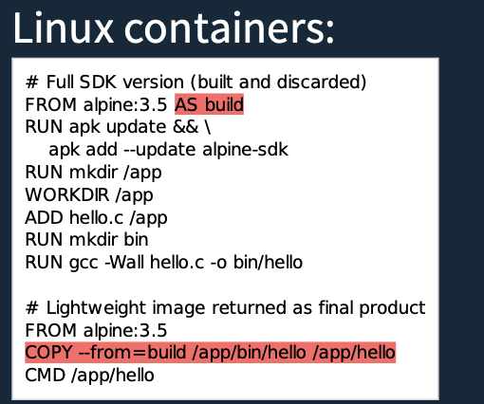
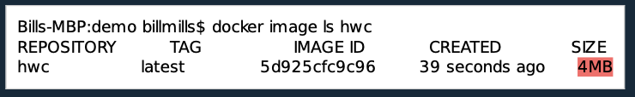
Multi-Stage Build
Notes:
https://github.com/garethr/multi-stage-build-example

