Slide 1

Nata & Co
BATH SALES DATA ANALYSIS FOR SEP 2023
Smahi
10 Oct 2023

Slide 2
INTRODUCTION
I was provided with daily sales report for the month of September. In order to start the analysis, the first step was to clean and merge the daily data. The analysis conducted reflects the monthly sales of the most popular products at the Bath store.

Slide 3
TABLE SHOWING DIFFERENT ITEMS SOLD IN SEP 2023
Sno | Category | Total Sold
----- | ---------------------------------- | ------------
0 | TOTAL | 12133.0
1 | Total (Pasteis de nata) | 7296.0
2 | Total (Coffee Deal) | 1181.0
3 | Total (Savouries) | 1002.0
4 | Total (Flavour Natas) | 668.0
5 | Total (Hot Drinks) | 646.0
6 | Total (Soft Drinks) | 580.0
7 | Total (Cold Drinks) | 250.0
8 | Total (Cakes) | 179.0
9 | Total (Sliced Cakes) | 131.0
10 | Total (Bread) | 54.0
11 | Total (Alcoholic Drinks) | 41.0
12 | Total (Toasties) | 37.0
13 | Total (Portuguese Dishes) | 34.0
14 | Total (Birthday Cakes) | 12.0
15 | Total (Uncategorized) | 11.0
16 | Total (Seasonal) | 5.0
17 | Total (Soups) | 3.0
18 | Total (Desserts) | 2.0
19 | Total (Bottles Wine/Liqueur) | 1.0

Slide 4
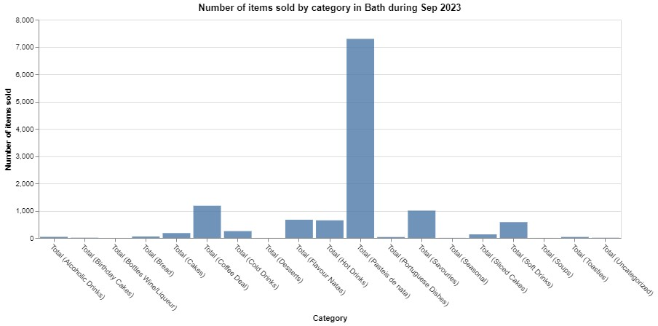
VISUAL REPRESENTATION OF ALL THE ITEMS SOLD

Slide 5
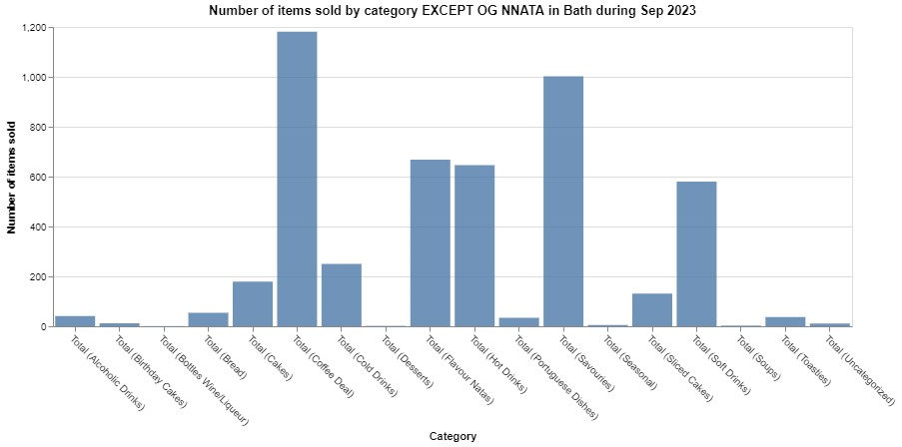
PLOT FOR ALL THE ITEMS EXCEPT THE OG NATAS

Slide 6
INSIGHTS
From the previous table and graphs it can be concluded that top 4 most sold items are:
  Pastel de nata
  Coffee deal
  Savouries
  Flavoured nata
Therefore, I decided to conduct further analysis on the above 4 categories.

Slide 7
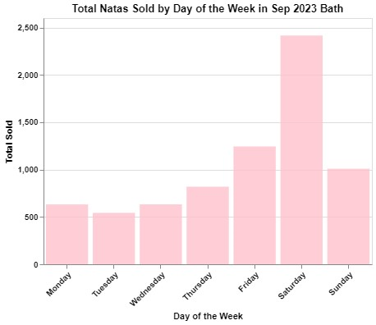
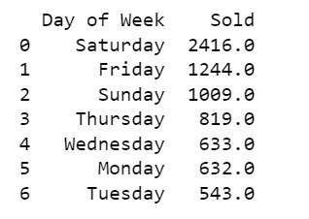
PASTEL DE NATA ANALYSIS
I filtered out the data for pastel de nata and used the day of the week as one of the factors. Below is the table and the graph showing the number of natas sold on each day of the week aggregated.
We sell most natas on Saturday. Almost 200% more than the Tuesday sales.

Slide 8
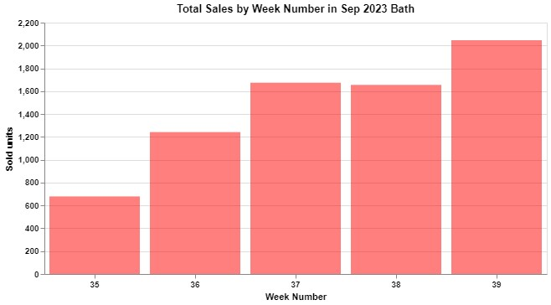
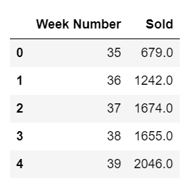
PASTEL DE NATA ANALYSIS
Another factor I considered was week number. So here's the table and plot showing number of natas sold in each week.
Last 3 weeks of September has been consistent in terms of natas sales.

Slide 9
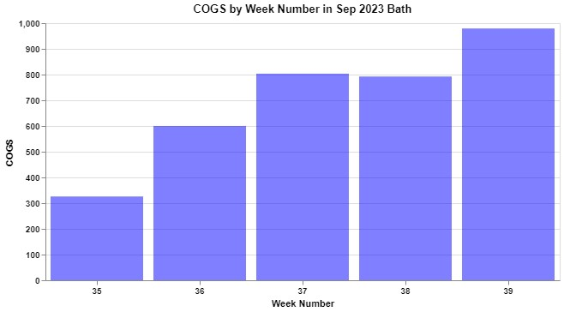
PASTEL DE NATA ANALYSIS
I decided to see how the nata sales affect COGS and turns out the pattern followed is same, which basically means that COGS is directly proportional to Sales of nata

Slide 10
COFFEE DEALS ANALYSIS
The second most sold item on the list is Coffee deals. For this analysis, I found the answers to below questions:
  Max number of coffee deals sold and when was it.
  The number of coffee deals sold each week of Sep.
  Find which week has the most coffee deals sold and which coffee was sold the most.
  Which day of the week most coffee deals are sold

Slide 11
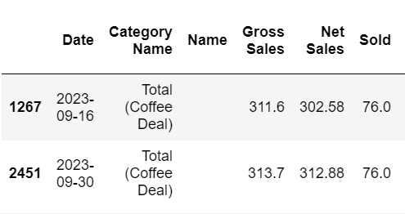
COFFEE DEALS ANALYSIS
Max coffee deals were sold on 16th and 30th of September.
76 Coffee deals were sold on both the above-mentioned days.

Slide 12
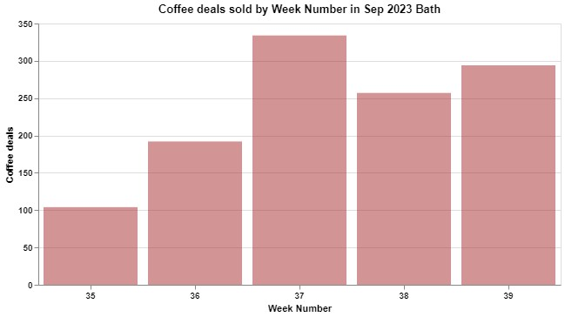
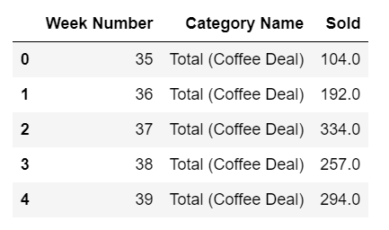
COFFEE DEALS ANALYSIS
Weekly distribution of coffee deals sold, in table and plot. Week 37 has the highest sale of coffee deals which is 11th -17th September. Week 39 is also pretty good in terms of sales which is 25th -30th September, almost 300 deals sold.

Slide 13
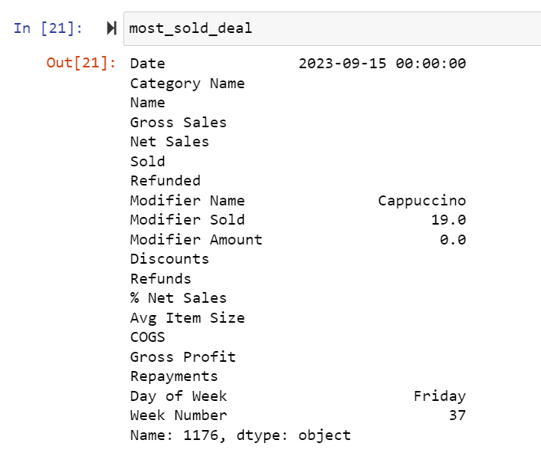
COFFEE DEALS ANALYSIS
As week 37 has the highest sale of coffee deals, I checked that we sold 19 Cappacinos on 15th Sept which was the highest in that week.

Slide 14
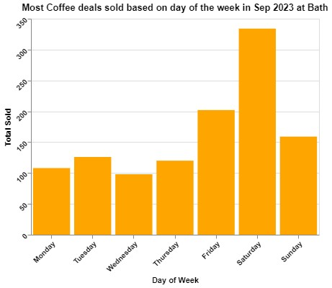
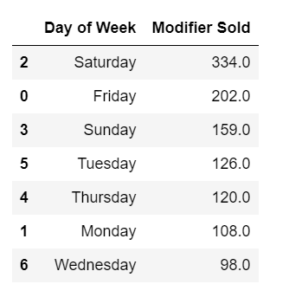
COFFEE DEALS ANALYSIS
Distribution of coffee deals based on the day of the week. We sell 3.4X more coffee deals on Saturdays than Wednesdays.
We sell almost 1.5X more coffee deals on Weekends than Weekday.

Slide 15
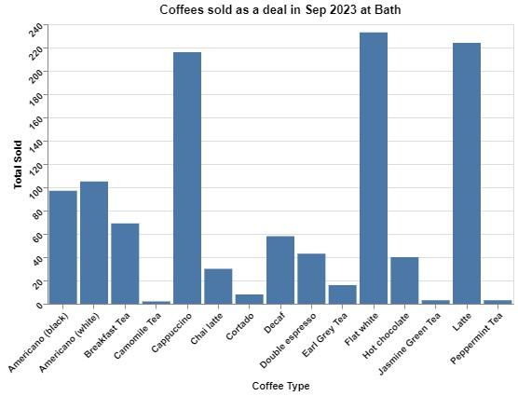
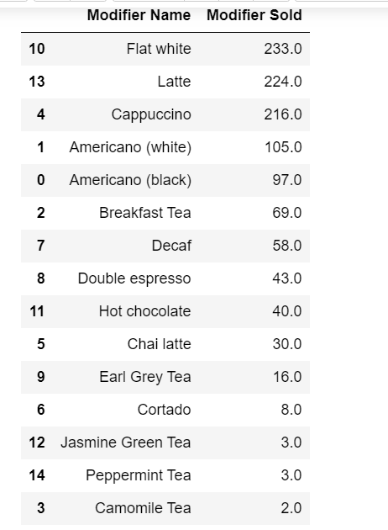
COFFEE DEALS ANALYSIS
Distribution of different coffee deals sols. Most popular coffee ordered in a deal is Flat white, followed by Latte and Cappuccino.

Slide 16
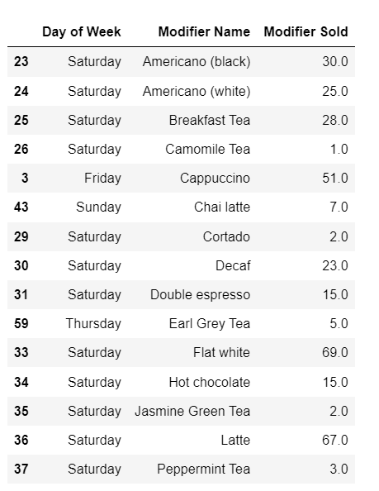
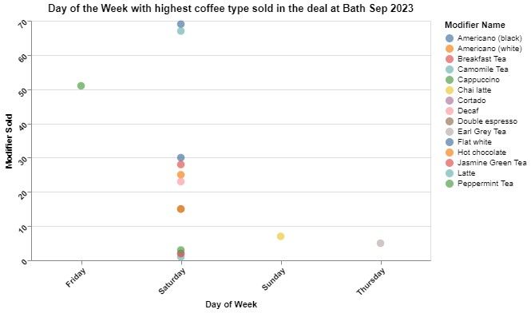
COFFEE DEALS ANALYSIS
This table represents the day on which that particular type of coffee had the maximum sales. So Max Black Americanos were sold on a Saturday, whereas Max Earl Grey teas were sold on a Thursday.

Slide 17
SAVOURIES ANALYSIS
The third most sold item on the list is Savouries. For this analysis, I found the answers to below questions:
  Max number of Savouries sold and when was it.
  The number of Savouries sold each week of Sep.
  Find which week has the most Savouries were sold and which savory was sold the most.
  Which day of the week most Savouries are sold.

Slide 18
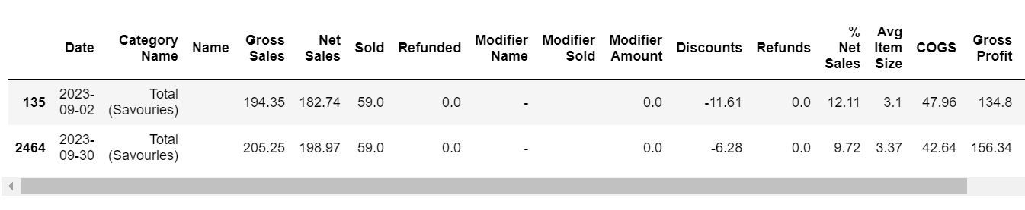
SAVOURIES ANALYSIS
Maximum number of Savouries were sold on 2nd and 30th Sep . 58 units of savouries were sold on these 2 days.

Slide 19
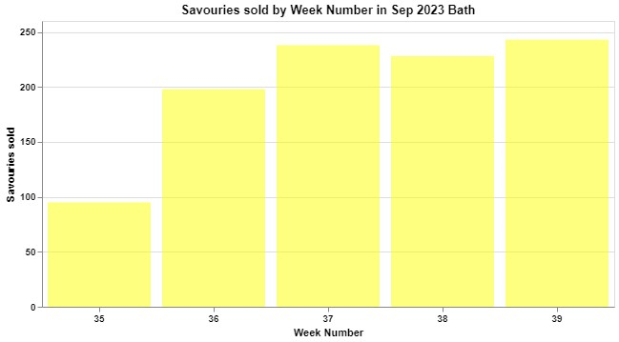
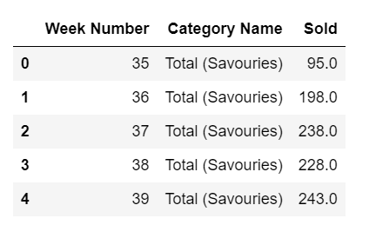
SAVOURIES ANALYSIS
Weekly distribution of savouries sold, in table and plot. Week 39 has the highest sale of coffee deals which is 25th -30th September. Week 37 is also pretty good in terms of sales which is 11th -17th September, over 200 different savouries sold.

Slide 20
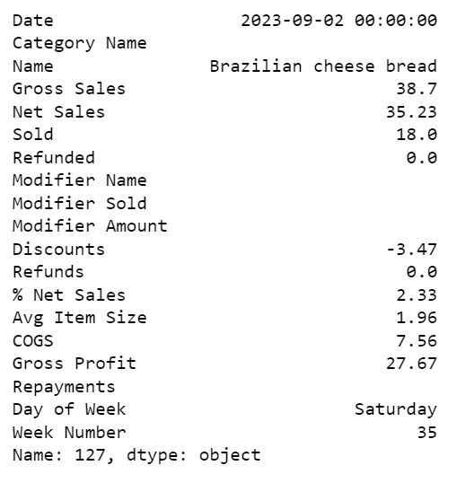
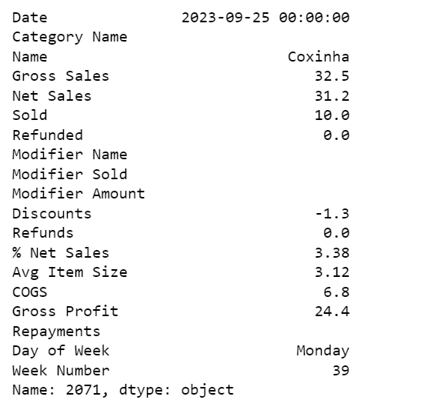
SAVOURIES ANALYSIS
Max number of savoury sold in a day was Cheese bread, we sold 18 of those on 2nd September.
As week 39 has the most sales in savouries, on checking I found we sold 10 coxinha on 25th September.

Slide 21
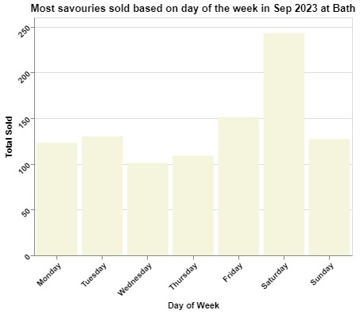
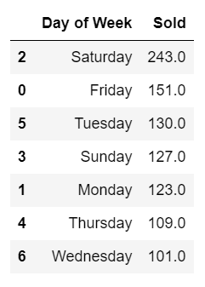
SAVOURIES ANALYSIS
Total units of Savouries sold based on the day of the week. Again Saturday is the highest with 2.5X more than Wednesday.
Clearly Saturday is the busiest and Wednesday is least active.

Slide 22
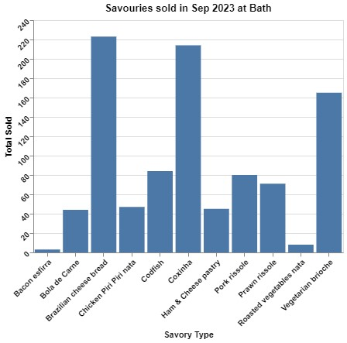
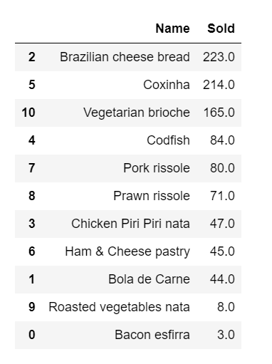
SAVOURIES ANALYSIS
Apparantly the most sold savoury is cheese bread followed by coxinha and veg brioche.

Slide 23
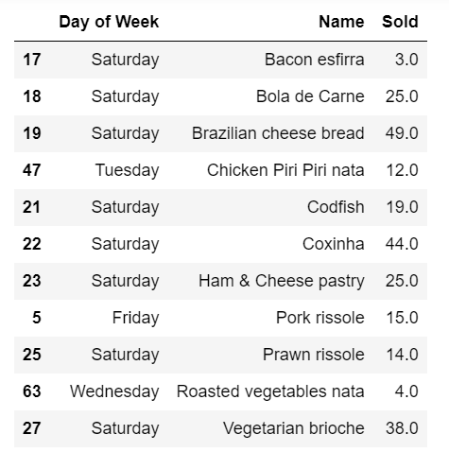
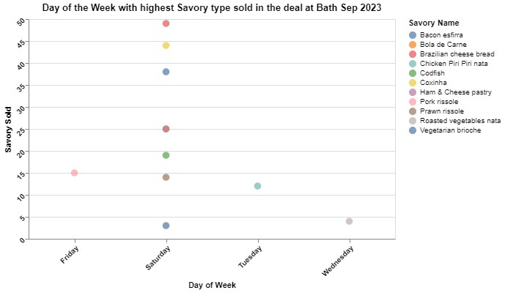
SAVOURIES ANALYSIS
This table represents the day on which that particular type of savory had the maximum sales. The majority of coxinha are sold on Saturdays but most chicken piri piri nata was sold on a Tuesday

Slide 24
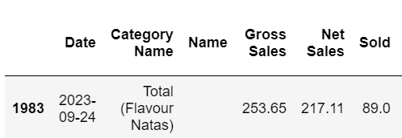
FLAVOURED NATAS ANALYSIS
Followed the set of questions as the previous two. The highest flavoured natas were sold on 24th September with a total of 89 flavoured natas sold.

Slide 25
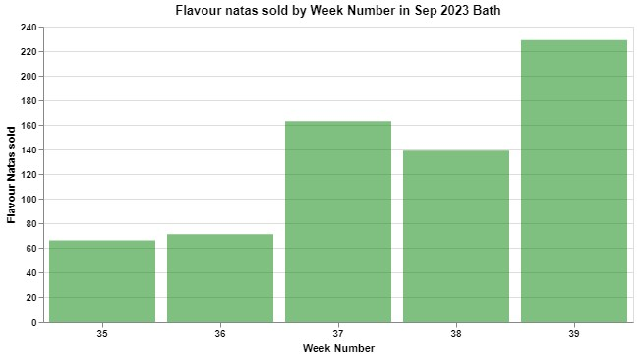
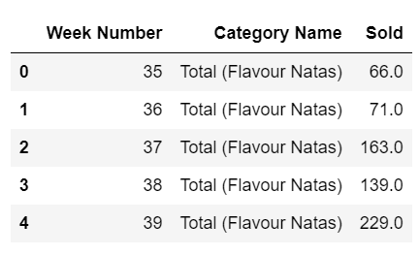
FLAVOURED NATAS ANALYSIS
Weekly distribution of flavoured natas sold and again Week 39 wins.

Slide 26
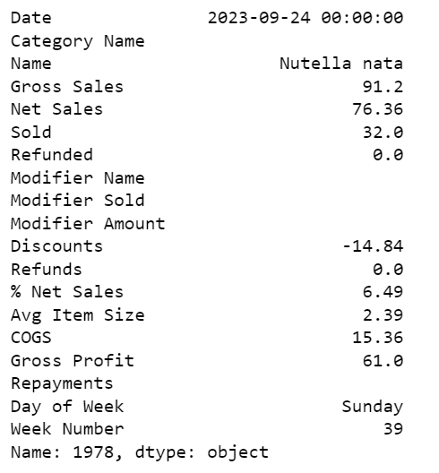
FLAVOURED NATAS ANALYSIS
The most sold flavoured nata of the month is Nutella nata, we sold 32 of those on 24th Sep

Slide 27
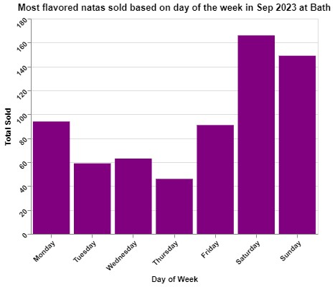
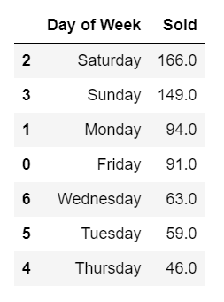
FLAVOURED NATAS ANALYSIS
The least amount of flavoured natas are sold on Thursdays and most on Saturdays.

Slide 28
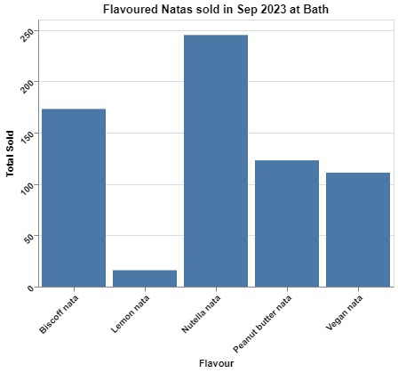
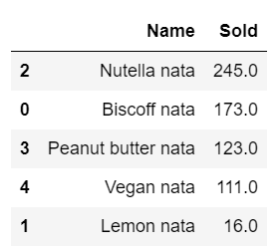
FLAVOURED NATAS ANALYSIS
We sold 245 Nutella nata in sep and 173 Biscoff which is the second highest, but nutells is 1.4X more than Biscoff's sale.

Slide 29
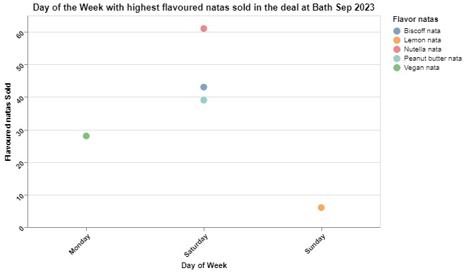
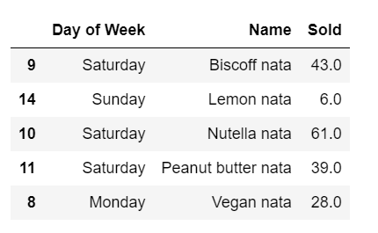
FLAVOURED NATAS ANALYSIS
Saturday and Sunday as expected have the most sales for majority of flavoured natas, except the vegan ones most vegan natas are sold on Mondays.

Slide 30


