Slide 1


Dependent Types, Twelf and Its Application in Proof
Seyed Mohammad Mehdi Ahmadpanah
smahmadpanah@aut.ac.ir
Supervisor
Dr. Mehran S. Fallah
Formal Security Lab.
CEIT@AUT
Feb. 13, 2018

Slide 2

Outline
Motivation
The Curry-Howard Correspondence
Logical Frameworks
Pure First-Order Dependent Types
Dependent Sum Types
The Calculus of Constructions
Twelf in Practice
Programming with Dependent Types
Conclusion

Slide 3


Motivation
Dependent types are type-valued functions
Those functions which send terms to types
Type family of vectors (one-dimensional arrays)
Kinding assertion: Vector maps a k:Nat to a type
type Vector k contains vectors of length k of elements of some fixed type, say data
Initialization function:
init : Πn:Nat. data → Vector n
Notes:
Kind: type class, family of types

Slide 4
Motivation (cont.)
init : Πn:Nat. data → Vector n
Dependent Product Type (Pi type)
Πx : S . T
Generalizes the arrow type of the simply typed λ-calculus
S → [x ↦ s] T
The result type can vary according to the argument supplied
Π-type is almost as old as the lambda calculus

Slide 5
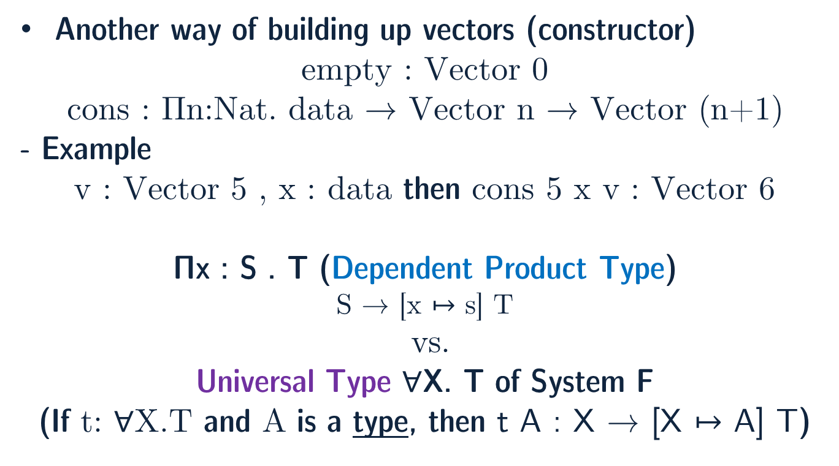
Motivation (cont.)
Another way of building up vectors (constructor)
empty : Vector 0
cons : Πn:Nat. data → Vector n → Vector (n+1)
- Example
v : Vector 5 , x : data then cons 5 x v : Vector 6
Πx : S . T (Dependent Product Type)
S → [x ↦ s] T
vs.
Universal Type $∀$X. T of System F
(If t: $∀$X.T and A is a type, then t A : X → [X ↦ A] T)
Notes:
Universal typing: type abstraction (substitution)
Dependent typing: term-level arguments (term substitution)

Slide 6
Motivation (cont.)
Why dependent typing?
It reveals more information about the behavior of the term
More precious typing
Exclude more of the badly behaved terms in a type system
We can type a function that returns the first element of a non-empty vector:
first : Πn:Nat. Vector(n+1) → data
Non-emptiness is expressed within the type system itself!
Notes:
First → returns the first element of non-empty vector

Slide 7
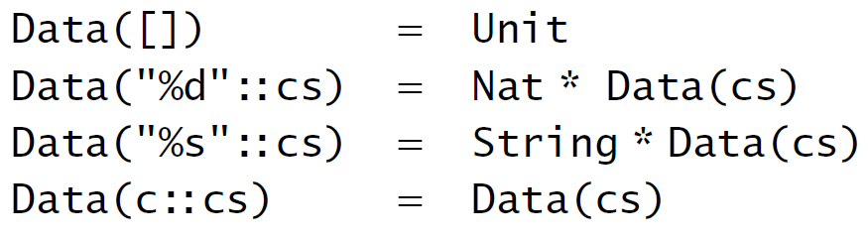
Motivation (cont.)
Another example: sprintf
sprintf : Πf:Format. Data(f) → String
Format: type of valid print formats
Data(f): type of data corresponding to format f
Vectors are uniform, here is non-uniform
More challenging!

Slide 8
Curry-Howard Correspondence
Proposition-as-Type (and Proof-as-Term)
A formula has a proof iff the corresponding type is inhabited
Example:
((A → B) → A) → (A → B) → B (formula, type)
λf. λu. u (f u) (proof, term)
Constructive proof of A ⇒ B should be understood as a procedure that transforms any given proof of A into a proof of B
A proof of A ⇒ B is simply any term of type A → B

Slide 9
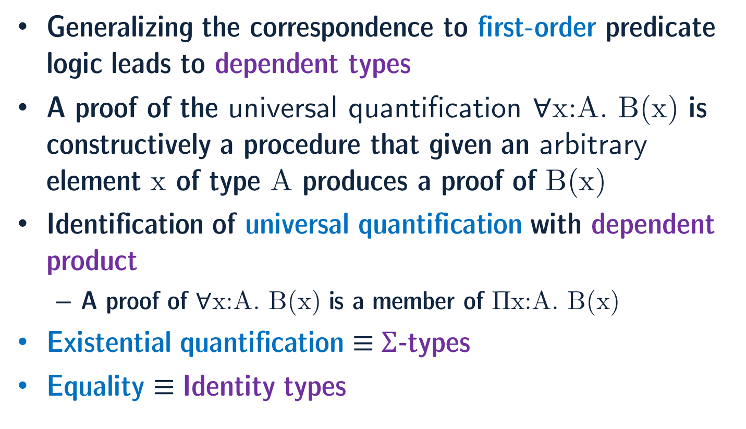
Curry-Howard Correspondence (cont.)
Generalizing the correspondence to first-order predicate logic leads to dependent types
A proof of the universal quantification $∀$x:A. B(x) is constructively a procedure that given an arbitrary element x of type A produces a proof of B(x)
Identification of universal quantification with dependent product
A proof of $∀$x:A. B(x) is a member of Πx:A. B(x)
Existential quantification ≡ Σ-types
Equality ≡ Identity types

Slide 10
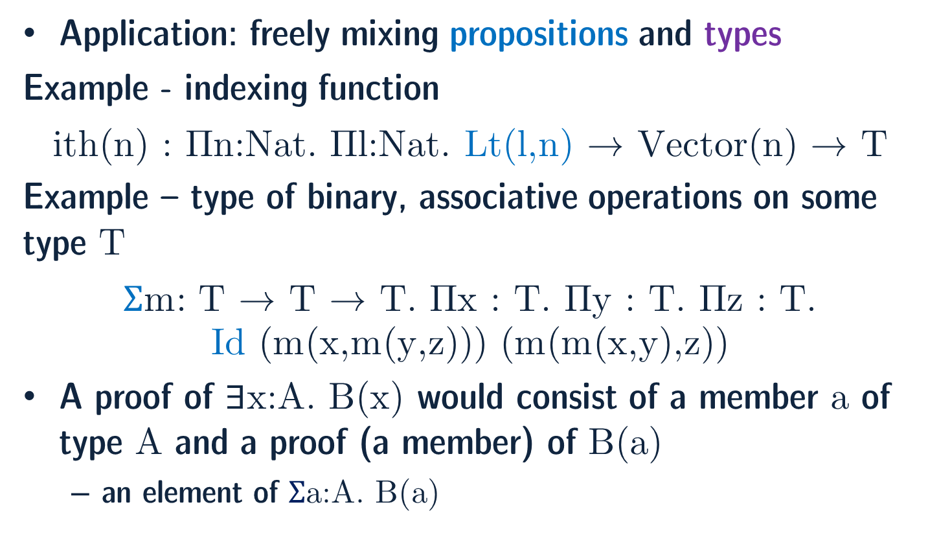
Curry-Howard Correspondence (cont.)
Application: freely mixing propositions and types
Example - indexing function
ith(n) : Πn:Nat. Πl:Nat. Lt(l,n) → Vector(n) → T
Example – type of binary, associative operations on some type T
Σm: T → T → T. Πx : T. Πy : T. Πz : T. Id (m(x,m(y,z))) (m(m(x,y),z))
A proof of $∃$x:A. B(x) would consist of a member a of type A and a proof (a member) of B(a)
an element of Σa:A. B(a)
Notes:
Ith(n) : indexing function to access elements of vectors of length n

Slide 11
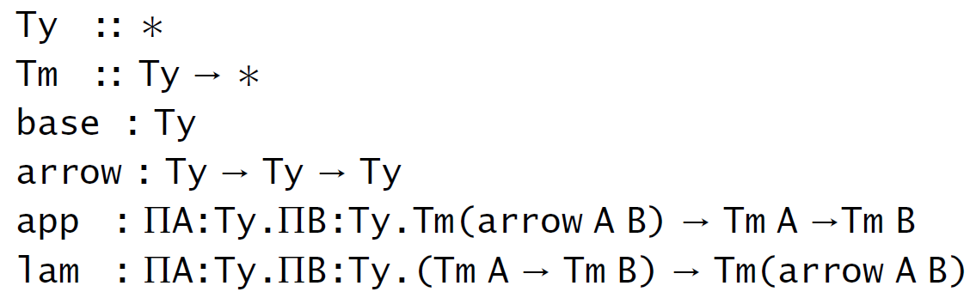
Logical Frameworks
Another application: representation of other type theories and formal systems
Example – typechecker for simply typed λ-calculus
Higher-order abstract syntax
e.g. representation of identity term: (A: Ty)
idA = lam A A (λx: Tm A. x)

Slide 12
Logical Frameworks (cont.)
Definition: systems which provide mechanisms for representing syntax and proof systems
which makes up a logic
It provides a means to define a logic as a “signature” in a higher-order type theory
Provability of a formula in the original logic reduces to a type inhabitation problem in the framework type theory
To describe a logical framework, one must provide:
A characterization of the class of object-logics to be represented
An appropriate meta-language
A characterization of the mechanism by which object-logics are represented

Slide 13

Logical Frameworks (cont.)
One approach: Edinburgh Logical Framework (LF)
Judgments-as-Types
Judgments: types of their proofs
Derivations of judgments: members
Meta-language: dependently typed λ-calculus (λΠ-calculus)
Three-level entities: terms, types, kinds
Twelf is an implementation of the logical framework LF
Twelf code describes logical systems
written in Standard ML
write out a statement
use Twelf to write out a proof (justification of why that statement is true)
Twelf will check your proof, making sure that what you said actually is true!
Notes:
Types are used to capture the judgments of a logic
The life story of a typical deductive system goes something like this: One day, a programming language designer has an idea for a new programming language. She writes down the language's abstract syntax. Then, she gives the syntax meaning by defining some judgements for it, such as a type system or an operational semantics. Next, she investigates the language's properties by proving some theorems. Maybe she fiddles with the language some to make the desired theorems true; maybe the idea doesn't work at all and she goes on to something else. Maybe she implements the language to try out some examples. Eventually, if the idea works out, she writes up a paper about the language. If it's a good idea, then she, or maybe someone who read the paper, will someday want to extend the language, or incorporate the idea into another language.
Twelf is a tool that assists people designing deductive systems: One day, a programming language designer has an idea. Then, she formalizes the syntax and judgements of the language in the LF logical framework. She uses Twelf to check her proofs of the theorems. She uses Twelf to run the language definition itself to try out some examples. Her paper includes a Twelf appendix, which makes her and her readers much more confident that the theorems in the paper are actually true. When someone goes to extend the language, he has a formal, machine-checkable artifact that he can study or perhaps even reuse directly.

Slide 14
Logical Frameworks (cont.)
Twelf includes:
an implementation of the LF logical framework, which can be used to type check LF representations
a logic programming language based on LF
a metatheorem checker, which can be used to verify proofs of theorems about LF representations
Other systems that will let you define logical systems and prove things with them:
ACL2, AUTOMATH, Coq, HOL, HOL Light, LEGO, Isabelle, MetaPRL, NuPRL PVS, and TPS
In Twelf: programming languages are also logical systems

Slide 15
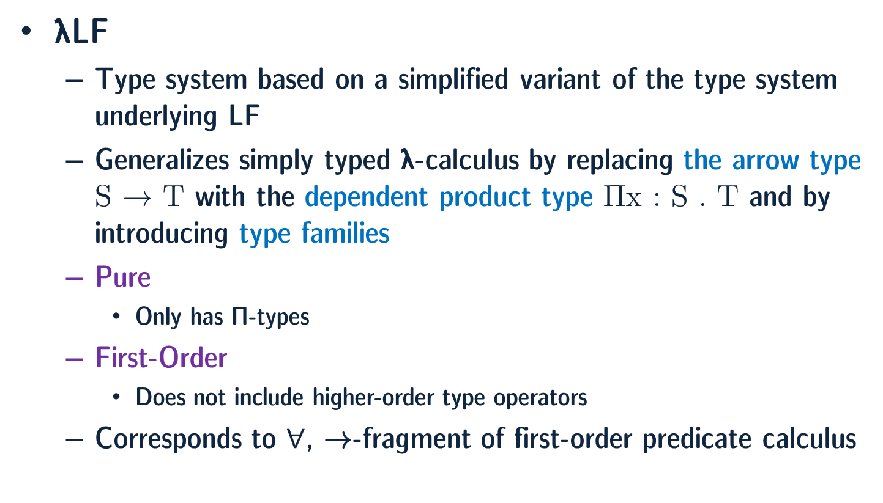
Pure First-Order Dependent Types
λLF
Type system based on a simplified variant of the type system underlying LF
Generalizes simply typed λ-calculus by replacing the arrow type S → T with the dependent product type Πx : S . T and by introducing type families
Pure
Only has Π-types
First-Order
Does not include higher-order type operators
Corresponds to $∀$, →-fragment of first-order predicate calculus

Slide 16
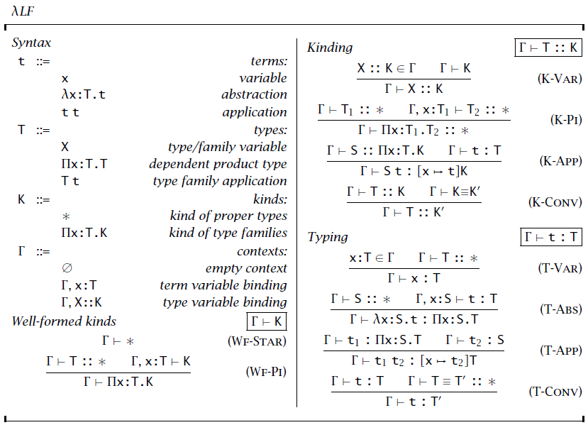
Pure First-Order Dependent Types (cont.)
Notes:
The terms are the same as those of the simply typed lambda calculus (lambda-arrow). The types include
type variables X which can be declared in the context but never appear
bound. Type variables range over proper types as well as type families such as
Vector :: Nat ! *. We may use type and term variables declared in a fixed
initial context to simulate the builtin
types and operators of a programming
language.3 Apart from variables, types may be dependent products or type
family applications. The latter allow us to instantiate families, for example,
to give types such as Vector k for k:Nat.
Kinds allow us to distinguish between proper types and type families.
Proper types have kind while type families have dependent product kinds
of the form x:T.K.
Contexts may bind term variables and type variables

Slide 17
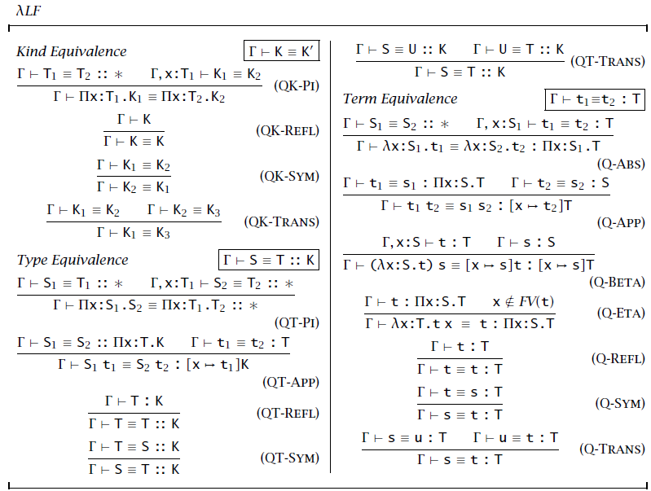
Pure First-Order Dependent Types (cont.)
Notes:
Decidability of typechecking

Slide 18
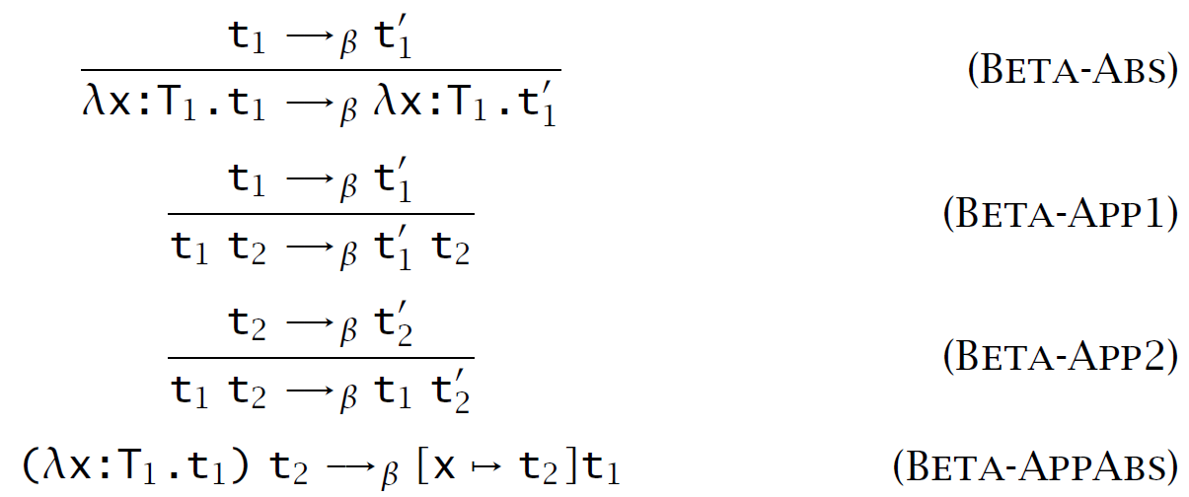

Strong Normalization
Reduction does not go inside the type labels of λ abstractions
Theorem - The relation $→_{β}$ is strongly normalizing on well-typed terms. More precisely, if $Γ⊢t :T$ then there is no infinite sequence of terms ${\left(t_{i}\right)}_{i≥1}$ such that $t=t_{1}$ and $t_{i}→_{β}t_{i+1}$ for $i≥1$.
Notes:
Decidability of typechecking

Slide 19
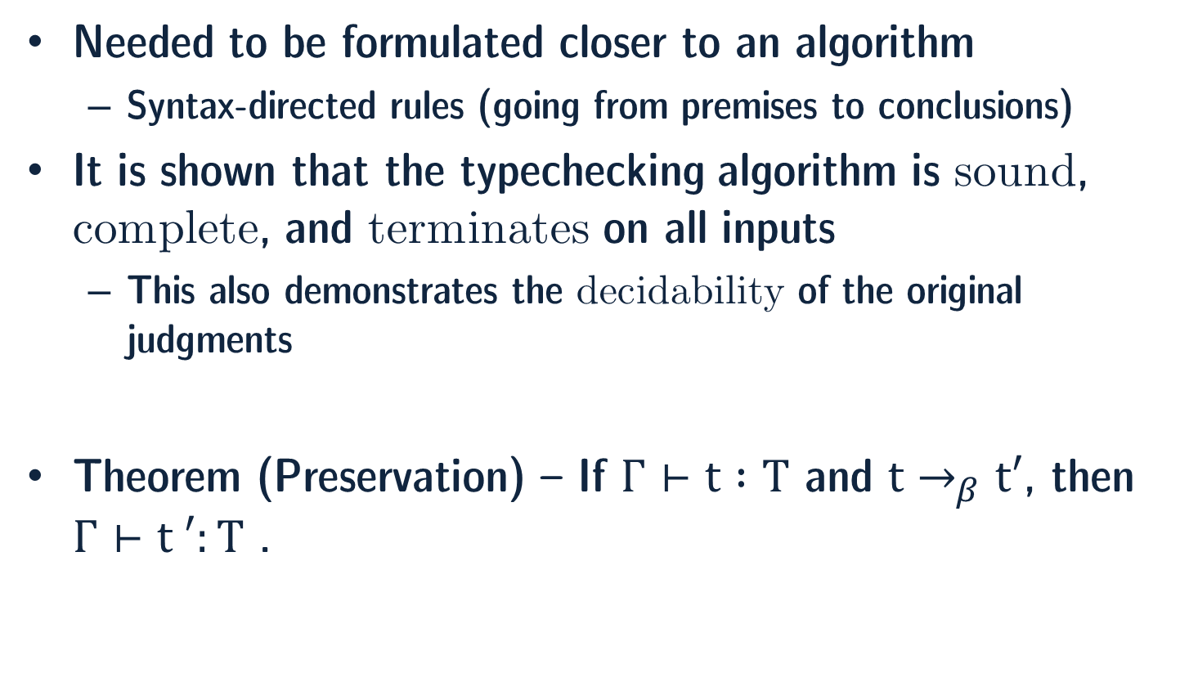
Algorithmic Typing and Equality
Needed to be formulated closer to an algorithm
Syntax-directed rules (going from premises to conclusions)
It is shown that the typechecking algorithm is sound, complete, and terminates on all inputs
This also demonstrates the decidability of the original judgments
Theorem (Preservation) – If $Γ⊢t :T$ and $t→_{β}t′$, then $Γ⊢t ′:T$ .

Slide 20
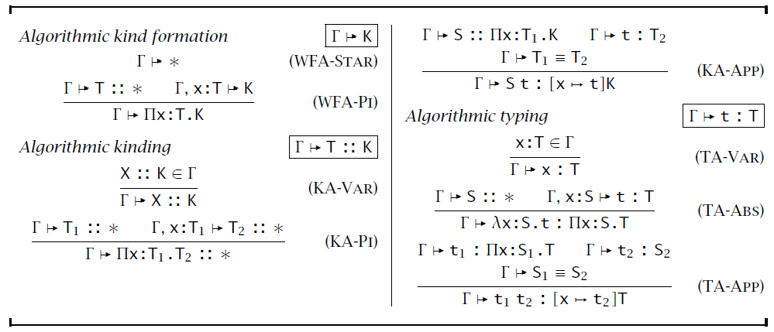
Pure First-Order Dependent Types (cont.)
Notes:
Decidability of typechecking

Slide 21
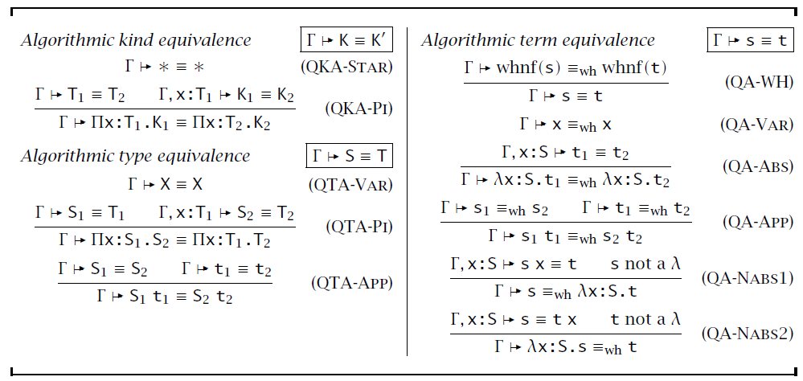
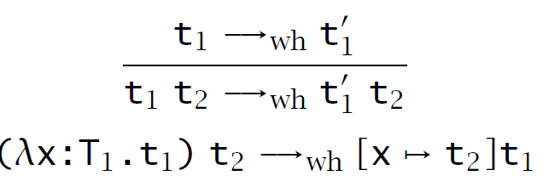
Pure First-Order Dependent Types (cont.)
Notes:
Decidability of typechecking

Slide 22
Dependent Sum Types
Σx : T₁ . T₂ (Σ-types)
Generalize ordinary product types (T₁×T₂)
If x does not appear in T₂
Σx : T₁ . T₂ ≡ T₁ × T₂
Πx : T₁ . T₂ ≡ T₁ → T₂
(t , t: Σx : T . T)
Typed pair (annotated explicitly)
If S : T → * and x : T and y : S x, then the pair (x , y) could have both Σz : T. S z and Σz : T. S x as a type.

Slide 23
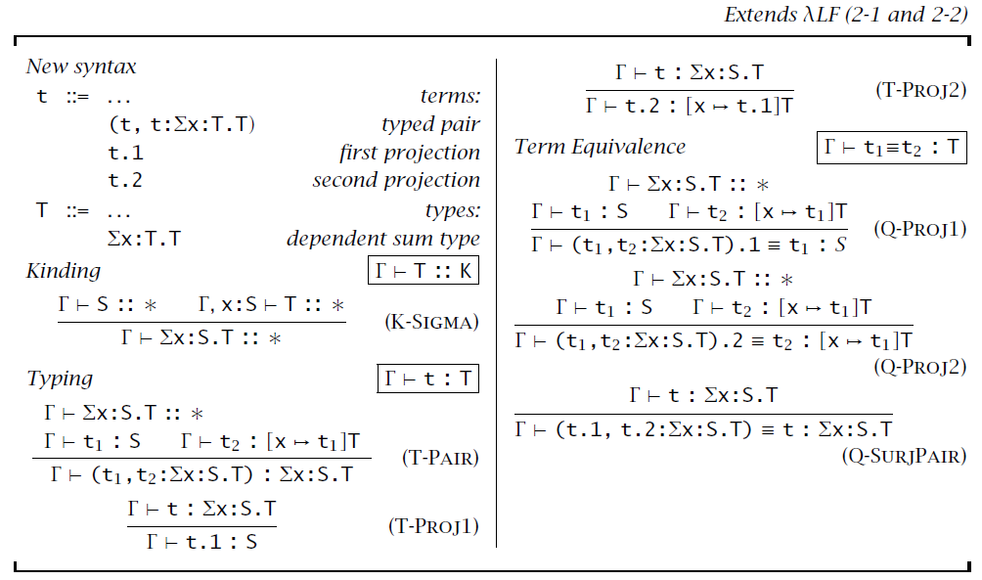
Dependent Sum Types (cont.)

Slide 24
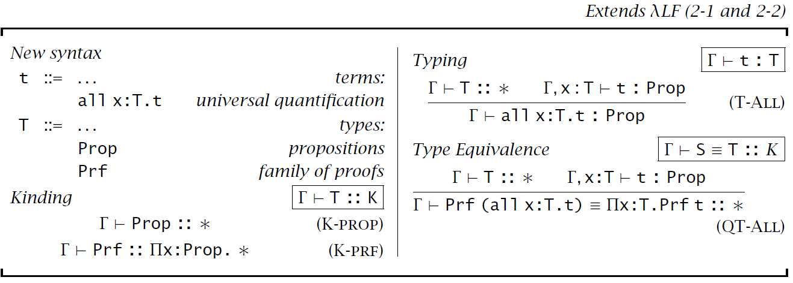
The Calculus of Construction
One of the most famous systems of dependent types
A setting for all of constructive mathematics
Simple and very expressive

Slide 25
The Calculus of Construction
Example –
nat = all a:Prop. all z:Prf a. all s: Prf a → Prf a. a
(nat is a member of type Prop)
zero = λa:Prop. λz:Prf a. λs:Prf a → Prf a. z : Prf nat
succ = λn:Prf nat. λa:Prop. λz:Prf a. λs:Prf a → Prf a. s (n a z s) : Prf nat → Prf nat
add = λm:Nat. λn:Nat. m nat n succ : Prf nat → Prf nat → Prf nat

Slide 26
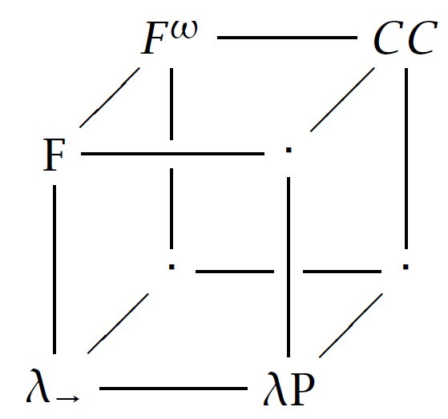
Lambda Cube

Slide 27
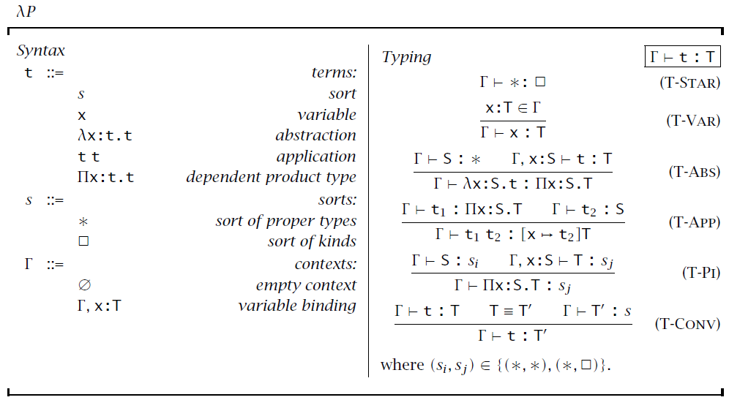
First-Order Dependent Types, PTS-style

Slide 28
Twelf in Practice
nat: type.
z: nat.
s: nat -> nat.
plus: nat -> nat -> nat -> type.
p-z: plus z N N.
p-s: plus (s N1) N2 (s N3)
<- plus N1 N2 N3.
> 2+1=3 : plus (s (s z)) (s z) (s (s (s z))) = p-s (p-s p-z).
http://twelf.plparty.org/live/

Slide 29
Programming with Dependent Types
Languages: Pebble, Cardelli’s Quest, Cayenne, Dependent ML, Haskell, Agda
Example - a zip function which can only be applied to a pair of lists of the same length
datatype 'a list with nat =
nil(0)
| {n:nat} cons(n+1) 'a * 'a list(n)
The withtype clause is a type annotation supplied by the programmer.
fun zip ([], []) = []
| zip (x :: xs, y :: ys) = (x, y) :: zip (xs, ys)
withtype {n:nat} => 'a list(n) * 'b list(n) -> ('a * 'b) list(n)
This leads to a safer and faster implementation of zip than a corresponding one in Standard ML.

Slide 30

Conclusion
Dependent Types
Product Type and Sum Type
Logical Framework LF and λLF
Algorithms for Typechecking
Programming in Twelf and DML

Slide 31
References
[1] B. Pierce “Advanced Topics in Types and Programming Languages,” Chapter 2, pp. 45-86, MIT Press, 2004.
[2] B. Pierce “Types and Programming Languages,” Chapter 29 and 30,, MIT Press, 2002.
[3] H. Xi, “Dependent Types in Practical Programming,” PhD thesis, Carnegie Mellon
University, Pittsburgh, Pennsylvania, 1998.
[4] F. Pfenning and H. Xi, “Dependent Types in practical programming,” In Proc. 26th
ACM Symp. on Principles of Prog. Lang., pp 214-227, 1999.
[5] R. Harper, F. Honsell, and G. Plotkin, “A framework for defining logics,” Journal of the ACM, vol. 40, pp. 143–184, 1993. Summary in IEEE Symposium on Logic in Computer Science (LICS), Ithaca, New York, 1987.
[6] F. Pfenning and C. Schürmann, "System description: Twelf - a meta-logical framework for deductive systems," International Conference on Automated Deduction, Springer, Berlin, Heidelberg, 1999.
[7] C. Schürmann, "The Twelf proof assistant." International Conference on Theorem Proving in Higher Order Logics. Springer, Berlin, Heidelberg, 2009.
[8] Twelf wiki, http://twelf.org/wiki
[9] DML homepage, https://www.cs.bu.edu/~hwxi/DML/DML.html

Slide 32
Recent Work
[1] R. Eisenberg, “Dependent Types in Haskell Theory and Practice,” PhD Thesis, University of Pennsylvania, 2016.
[2] U. Norell, “Towards A Practical Programming Language based on Dependent Type Theory,” PhD Thesis, Chalmers University of Technology, 2007.
[3] A. Nanevski, A. Banerjee, and D. Garg. "Dependent type theory for verification of information flow and access control policies." ACM Transactions on Programming Languages and Systems (TOPLAS) 35. no.2, 2013.
[4] De Moura, Leonardo, et al. "Elaboration in dependent type theory." arXiv preprint arXiv:1505.04324, 2015.
[5] R. Atkey, N. Ghani, and P. Johann. "A relationally parametric model of dependent type theory." ACM SIGPLAN Notices. Vol. 49. No. 1. ACM, 2014.
[6] Bizjak, Aleš, et al. "Guarded dependent type theory with coinductive types." International Conference on Foundations of Software Science and Computation Structures. Springer, Berlin, Heidelberg, 2016.
[7] A. Nuyts, A. Vezzosi, and D. Devriese. "Parametric quantifiers for dependent types.“, KU Leuven University, 2017.

Slide 33

Any Questions?

