Slide 1

Sparked
An interactive Circuit Learning app
With Simulation

Slide 2
Group Members
Sparked
Our Supervisor
1
Sabbir Mahmud Afridi
2019-3-60-112
Dr. Mohammad Salah Uddin
Associate Professor
Department of Computer Science & Engineering
East West University, Dhaka
2
Akmal Hossain
2019-3-60-123
3
Samiha Karim Chowdhury
2019-3-60-100
4
Md Mehdi Ahsan Rafsan
2019-3-60-003

Slide 3
Sparked
"Visualization and simulation bring education to life."
Neil deGrasse Tyson (Astrophysicist)

Slide 4
Sparked
Research Questions
Is the interactive circuit learning app effective in improving student engagement and understanding of circuit theory concepts?
How do 3D model simulations in the app contribute to the visualization and comprehension of abstract circuit principles?
What is the usability of the app, and how does its user interface affect the learning experience?
How do teachers perceive the app's potential as a supplementary tool for circuit theory education?
What are the areas for improvement in the app's content and functionality based on user feedback?

Slide 5
Sparked
Objectives
To evaluate the app's impact on student engagement and understanding of circuit theory concepts.
To investigate the influence of 3D model simulations on students' visualization and comprehension of circuit principles within the app.
To assess the usability of the 'Sparked' app and understand how its user interface affects the learning experience.
To gather insights into teachers' perceptions of the app's potential as a supplementary teaching tool for circuit theory.
To identify areas for improvement in the app's content and functionality based on user feedback and recommendations.

Slide 6






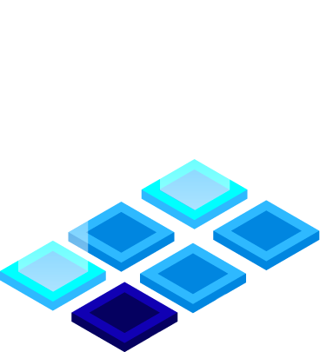


Methodology
Sparked
User Interface Design.
3D Models Design.
Application Development.

Slide 7
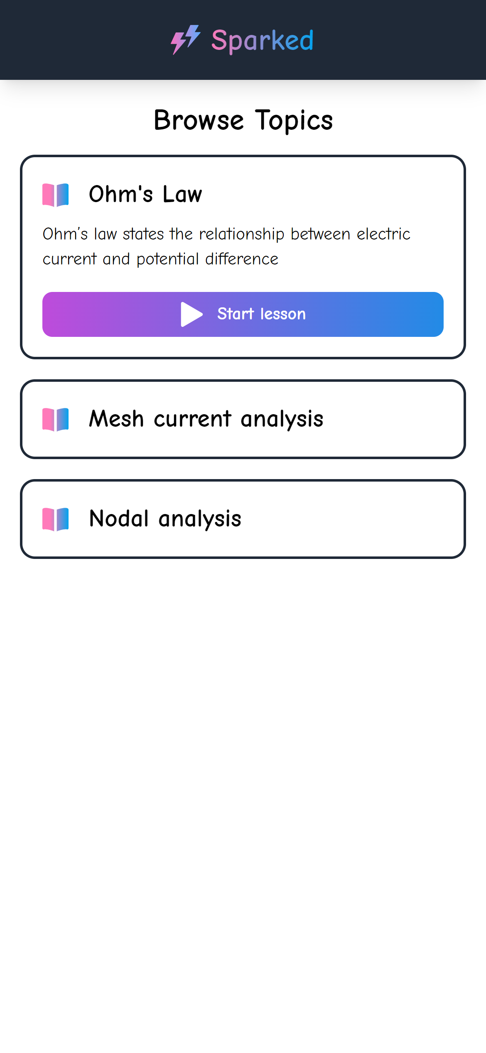
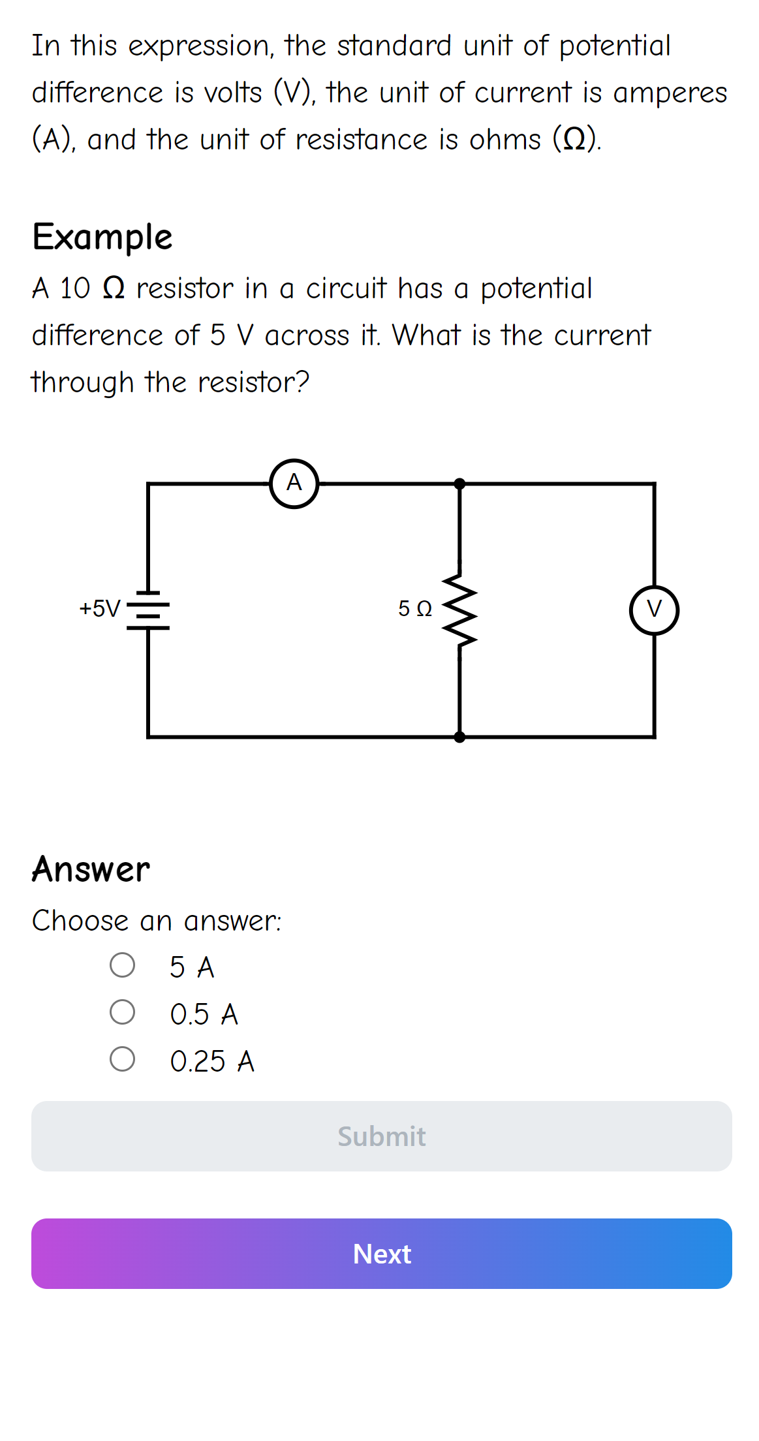
Sparked
User Interface
Design

Slide 8
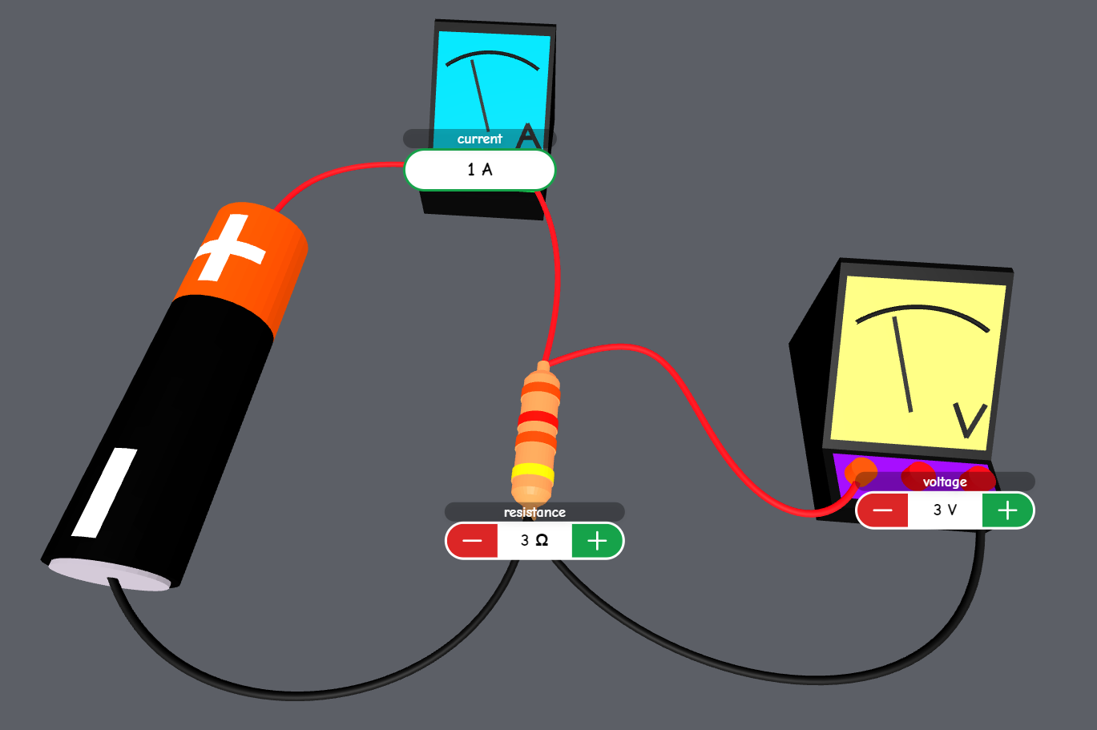
3D Models Design
Sparked
How are we designing the 3D models?
Geometry and Math behind 3D model generation.

Slide 9



Application Development
Sparked
Svelte
Three.js
Blendr

Slide 10
Theoretical lessons
Sparked
Lessons
Each lesson contains some basic theories and knowledge that is required to understand the process. We tried to also keep the lessons relative to the actual simulations.
Examples
We have set some example based on the topic.
Quiz
At the end of each lesson, we also tried to keep an interactive quiz session to give the user a better understanding of the lesson.

Slide 11
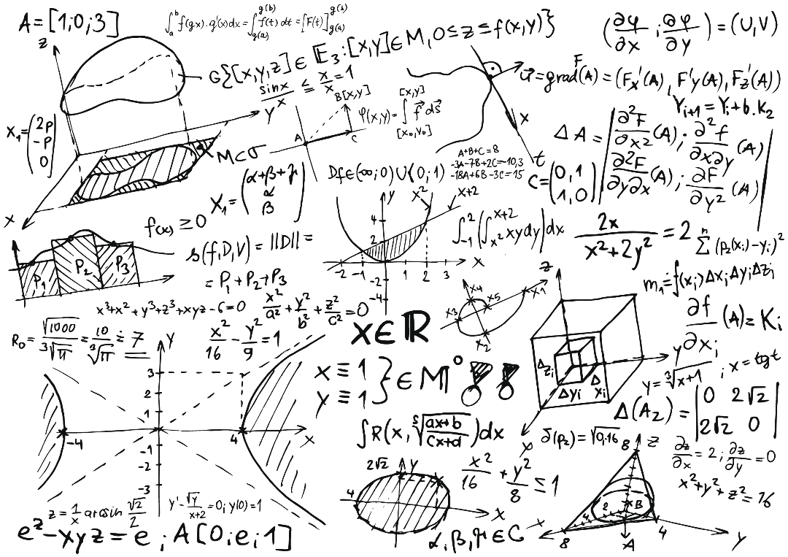
Generating generalized mathematical equations

Slide 12

Ohm’s law
Sparked
Ohm’s Law Formula
In our project we simuilate the current value.
$$I=\frac{V}{R}$$
1

Slide 13
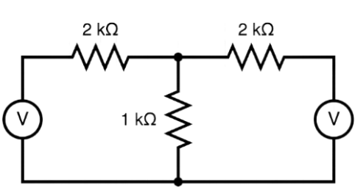


Mesh current analysis
Sparked
Mesh Analysis Formula
In our simulation all of the components are dynamic
2

Slide 14
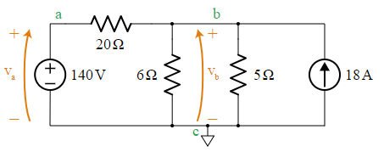

Nodal analysis
Sparked
$$\frac{V_{a}−V_{b}}{R_{1}}−\frac{V_{b}}{R_{2}}−\frac{V_{b}}{R_{3}}+I_{1}=0$$
3
Nodal Analysis Formula
For this circuit, there are 3 total nodes we need to consider. Which are marked a, b & c. In this case we are considering node c to be the reference node which has a voltage of 0V. And the node a is directly connected to the voltage source Va. Therefore, node a has voltage equal to the voltage source.

Slide 15
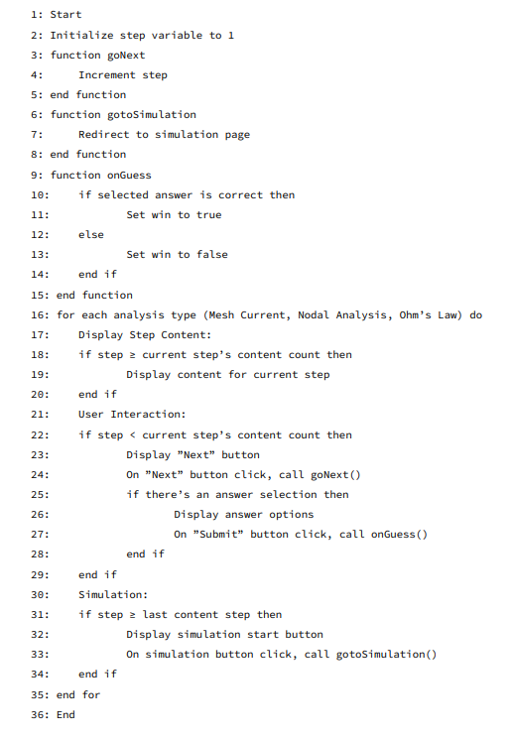
Algorithm of our system
Sparked

Slide 16

Demonstration
Sparked
Link: https://sparked.vercel.app/

Slide 17
Our Challenges
Sparked

Slide 18
Appendix (400B)
Sparked
CO3 | Analyze various aspects of the objectives for designing a solution for the capstone project. | K1- Theory-based natural science: The theory-centered concepts of natural science for our project include 3D Modeling, circuit analysis principles (Ohm's law, Kirchhoff's laws, capacitance in DC circuits, and mesh and nodal analysis). | EP1 - Depth of knowledge required: We acquired in-depth knowledge of software development and engineering principles, Svelte for web-based mobile application development, circuit analysis principles, and Three.js for rendering 3D objects.
 |  | K2- Conceptually-based mathematics, numeral analysis, statistics, and formal aspects of computers and information: In the design and development of the solution, various mathematical and computational concepts are involved. This includes applying mathematical principles such as Ohm's law and Kirchhoff's laws to analyze circuit behavior, performing numerical analysis for calculations and simulations, and utilizing statistical methods to evaluate the effectiveness of the app. Additionally, formal aspects of computers and information are considered, such as data structures, algorithms, and programming paradigms used in implementing the solution. | EP2 - Range of conflicting requirements: During the development process, conflicting requirements may arise, such as ensuring a balance between visual fidelity and performance in rendering 3D models, optimizing the user interface for intuitive interaction while maintaining simplicity, and managing the trade-offs between accuracy and real-time responsiveness in the circuit simulations. Resolving these conflicting requirements requires careful consideration and decision-making to find the most suitable solutions.
 |  |  | EP3 -: Depth of analysis required: The project demands an in-depth analysis of web-based mobile application development, circuit theory fundamentals, user interface design, and evaluation methodologies. This comprehensive analysis is vital to ensure the successful integration of theory-based engineering fundamentals with augmented reality features, resulting in an effective and engaging learning tool for circuit theory education.

Slide 19
Appendix (400B)
Sparked
 |  | K3: Theory-based engineering fundamentals Using theory-based engineering principles, the "Interactive Circuit Learning with Simulation" project creates a web-based mobile application that transforms the teaching of circuit theory. The software provides an immersive and interesting learning experience by utilizing interactive 3D models, and a user-friendly interface. The study aims to show how this novel technique has improved comprehension and implementation of circuit theory ideas through the assessment process. | EP 6: Extent of stakeholder involvement and conflicting requirements Stakeholders in this project include students, educators, instructional designers, engineers, and potential educational institutions. Their involvement is crucial for understanding the target audience, gathering requirements, and ensuring that the application meets their needs. Stakeholders may provide input on the desired features, learning objectives, user interface preferences, and evaluation criteria. EP7: Interdependence The project's success is contingent upon recognizing and managing the interdependencies among theory-based engineering fundamentals, web-based mobile application development, user interface design, stakeholder involvement, conflicting requirements management, and evaluation processes.

Slide 20
Appendix (400B)
Sparked
K5: Engineering design Our plan is to create a user interface that is simple, intuitive, and easily understandable for our target audience. We aim to make the interface visually appealing and self-explanatory, following a minimalistic design approach that prioritizes usability. To design the interface, we will utilize Figma as our chosen design tool. The application will feature a homepage where users can access a list of available lessons. Upon selecting a lesson, they will be presented with in-depth explanations of fundamental theories. Each lesson will conclude with a brief interactive quiz to reinforce learning. Finally, users will be prompted to scan a provided circuit to initiate a simulation.

Slide 21
Appendix (400B)
Sparked
CO5 | Identify and apply modern engineering and IT tools for the design and development of the capstone project. | K6: Engineering practice (technology) The application uses Svelte, a declarative framework, to create user interfaces. Three.Js for rendering 3D objects into the simulator. | Materials and Devices [EP1, EP2, EP4, EP5] The user interface will be basic, straightforward, visually attractive, and self-explanatory, using Figma as the design tool. The app will display available lessons, provide in-depth theories, and offer an interactive quiz at the end. Users will then scan circuits to begin simulations. Blender is a free 3D computer graphics tool used for animation, visual effects, artwork, and interactive apps. It allows for the modification of appealing circuit simulations and models, while maintaining relevance and resembling illustrations in the book. Our application will be web-based. Our program will be portable and easily available thanks to a web-based application. Web-based apps are fast and cross-platform. Additionally, we can quickly package and deliver the application to any mobile platform.

Slide 22
Appendix (400B)
Sparked
CO6 | Assess and address societal, health, safety, legal, and cultural aspects related to the implementation of the capstone project considering the relevant professional and engineering practices and solutions. | K7: Social and Environmental Impact of Engineering The initiative promotes accessibility, diversity, and educational justice in order to address the societal effect. Through a web-based mobile application, it seeks to connect with a wide spectrum of people and offers a user-friendly interface for various learning methods. The project considers the effects on the environment by prioritizing energy efficiency and minimizing the use of physical resources. Privacy protection and ethical simulation technology used for educational purposes are ethical issues. Overall, the project makes an effort to use engineering practices to have a beneficial social and environmental impact. | Social and Environmental Impact of Engineering [EP2, EP5, EP6] The project acknowledges stakeholder needs and viewpoints, actively involving them in the development process. The user interface design prioritizes simplicity and intuitiveness, ensuring an immersive learning experience while balancing competing requirements. The engineering design of the web-based mobile application prioritizes inclusion, accessibility, and educational fairness. It removes geographical restrictions, ensures usability for all learning styles, and promotes equitable access to circuit theory instruction. The design prioritizes energy-efficient technology and environmental factors. The initiative utilizes advanced engineering techniques and technology to improve society and the environment.

Slide 23
Appendix (400C)
Sparked
CO | CO Descriptions | K |  | EP
CSE 400C
CO7 | Assess and address the sustainability and impact of the capstone project in societal and environmental contexts | (i) Social and Environmental Impact of Engineering [K7]: The goal of the capstone project, "Interactive Circuit Learning with Augmented Reality Features," is to assess and improve the sustainability and effect of the project in relation to social and environmental settings. In order to help society, it places a high priority on accessibility, inclusion, and educational equity while also implementing eco-friendly practises to reduce its negative effects on the environment. To ensure responsible engineering, ethical norms including privacy protection and responsible technology usage are enforced. Through its comprehensive approach to sustainability and impact assessment, the project seeks to be a force for good in society and the environment. | (i) Social and Environmental Impact of Engineering (EP1, EP2, EP3, EP4, EP5, EP6, EP7): EP1: Depth of Knowledge Required: A comprehensive understanding of engineering principles, educational methods, augmented reality tech, and environmental aspects is crucial. EP2: Range of Conflicting Requirements: Managing various conflicting demands, including user experience, accessibility, education quality, and environmental responsibility, is essential. EP3: Depth of Analysis Required: Thorough examination is needed to assess the project's social and environmental impacts, encompassing aspects like accessibility, inclusivity, energy efficiency, and ethical considerations. EP4: Familiarity of Issues: Stakeholders must be well-acquainted with pertinent social and environmental concerns, such as educational disparities, energy conservation, and privacy issues. EP5: Extent of Applicable Codes: Understanding and applying relevant ethical codes and industry standards, particularly those concerning data privacy and responsible tech usage, is crucial. EP6: Extent of Stakeholder Involvement and Conflicting Requirements: Engaging stakeholders and effectively managing their varied needs, including conflicting ones from students, educators, engineers, and environmental concerns, is critical. EP7: Interdependence: Recognizing and managing the connections among different project components, such as integrating augmented reality, designing user interfaces, and practicing sustainability, is pivotal for project success.

Slide 24
Appendix (400C)
Sparked
CO8 | Apply professional and engineering ethical principles and practices for the implementation of the capstone project. | (i) Ethical principle and practices [K7] K7: Comprehension of engineering in Society: The capstone project emphasises the use of ethical practises and values in its execution, covering data protection, inclusiveness, environmental concerns, and ethical technology usage. By addressing societal requirements for sustainable development, stakeholder participation, and fair education access, it demonstrates a comprehensive understanding of engineering's position in society. This thorough strategy is an illustration of how engineering may have a good effect on society and be beneficial while preserving moral principles.
CO9 | Work effectively as an individual and a team member for successful completion of the capstone project | Effective individual and group contributions are essential for the capstone project to succeed. Each team member must be accountable, adhere to deadlines, and constantly develop their abilities. Clear communication, role clarification, conflict resolution, adaptability, and a common vision are essential within the team. When necessary, effective team members may take the lead or follow, fostering a collaborative and goal-driven project atmosphere. Project success depends on striking a balance between team and individual efforts.

Slide 25
Appendix (400C)
Sparked
CO10 | Write effective reports and design documentation, and make effective presentations of the outcome of the capstone project | The ability to write reports, record designs, and give presentations are three crucial abilities that must be mastered in order to successfully convey the findings of a capstone project. Reports: Ensure that reports are organised, clear, and succinct. Avoid using excessive amounts of technical language when including supporting facts and analysis. Consider difficulties and lessons learnt. Design documentation: Produce exact, thorough documentation that includes schematics and diagrams as necessary. To keep information current, keep version control active. Presentations: Create logical presentation structures, include the audience with visuals, and practise your delivery to sound certain. Prepare for inquiries and adjust your topic to the level of knowledge of your audience. Always keep your audience in mind, be receptive to criticism, and improve your communication with the help of peers and mentors. It's essential to communicate well if you want to share the results of your capstone project.
CO11 | Conduct economic analysis and cost Conduct economic analysis and cost | The capstone project's economic analysis and cost evaluation are essential for determining financial viability, budgeting, and resource allocation. It entails compiling a list of all project-related costs, both direct and indirect, and assessing how cost-effective certain solutions are. This procedure makes it possible to plan money wisely and makes sure the project budget is followed.
CO12 | Prepare to take part in independent and lifelong learning for adapting emerging technologies for the solution of the complex computer science and engineering problems | To adapt to new technologies and meet complex computer science and engineering difficulties, one must be prepared for active engagement in self-directed and ongoing learning. This comprises a dedication to autonomous inquiry and lifelong learning, enabling the development of fresh know-how and abilities needed to handle developing issues in the industry. To continue being proficient at resolving challenging problems in computer science and engineering, it entails keeping up with the most recent technical developments and constantly exploring chances for skill growth.

Slide 26
Sparked
References
[1] Ohm, G. S. (n.d.). In Britannica. Retrieved June 28, 2023, from https://www.britannica.com/biography/Georg-Simon-Ohm
[2] Kirchhoff, G. (n.d.). In Britannica. Retrieved June 28, 2023, from https://www.britannica.com/biography/Gustav-Kirchhoff
[3] Chen, L., & Zhang, Y. (2015). Interactive Circuit Analysis Software: A Virtual Lab Environment for Circuit Theory Education. IEEE Transactions on Education, 58(4), 245-251.
[4] Wang, X., & Song, M. (2018). Virtual Reality Simulation for Circuit Design and Analysis. Journal of Computers in Education, 5(3), 279-291.
[5] Jin, Q., & Li, J. (2019). Enhancing Circuit Theory Learning through Interactive 3D Visualizations. Interactive Learning Environments, 27(2), 192-204.
[6] Parker, R. (2017). Virtual Circuit Construction Kit: A Web-based Simulation Tool for Circuit Analysis Education. American Journal of Physics, 85(5), 338-345.
[7] Lin, T., & Wang, T. (2016). Real-Time Simulation of Electrical Circuits: A Tool for Conceptual Understanding. Journal of Educational Technology & Society, 19(2), 71-81.
[8] O'Brien, C., & Gupta, R. (2021). Virtual Circuit Lab: A Web-Based Simulation Tool for Circuit Analysis Education. Journal of Electrical Engineering Education, 48(2), 143-156.
[9] Khan, A., & Anderson, J. (2020). Enhancing Circuit Theory Learning through Interactive 3D Visualization and Real-Time Simulation. International Journal of Engineering Education, 36(3), 1134- 1146.
[10] Johnson, M., & Smith, L. (2019). Augmented Reality Circuit Simulator: A Tool for Engaging Circuit Theory Education. Computers & Education, 135, 32-43.

Slide 27
Sparked
References
[11] Chen, H., & Lee, W. (2018). Interactive Virtual Lab for Circuit Theory Education: A Case Study. IEEE Transactions on Education, 61(2), 125-134.
[12] Wang, Y., & Li, X. (2017). Virtual Reality Simulation for Circuit Design and Analysis: An Exploratory Study. Journal of Computers in Education, 4(3), 279-291.
[13] Khan Academy | Free online courses, lessons & practice. (n.d.). Khan Academy. https://www.khanacademy.org/
[14] Svelte. (n.d.). https://svelte.dev/
[15] Three.js – JavaScript 3D library. (n.d.). https://threejs.org/
[16] Foley, J. D., van Dam, A., Feiner, S. K., & Hughes, J. F. (1990). Computer Graphics: Principles and Practice (2nd ed.). Addison-Wesley.
[17] Hartley, R. I., & Zisserman, A. (2004). Multiple View Geometry in Computer Vision (2nd ed.). Cambridge University Press.
[18] Hearn, D., & Baker, M. P. (2014). Computer Graphics with OpenGL (4th ed.). Prentice Hall.
[19] Phong, B. T. (1975). Illumination for Computer Generated Pictures. Communications of the ACM, 18(6), 311-317.
[20] Perlin, K. (1985). An Image Synthesizer. Proceedings of ACM SIGGRAPH, 287-296.
[21] Alexander, C. K., & Sadiku, M. N. O. (Year). Fundamentals of Electric Circuits (Xth ed.). Publisher.

Slide 28
Credits
Sparked
Special thanks to
Dr. Mohammad Salah Uddin sir,
For his supervision and guidance for the project.

Slide 29

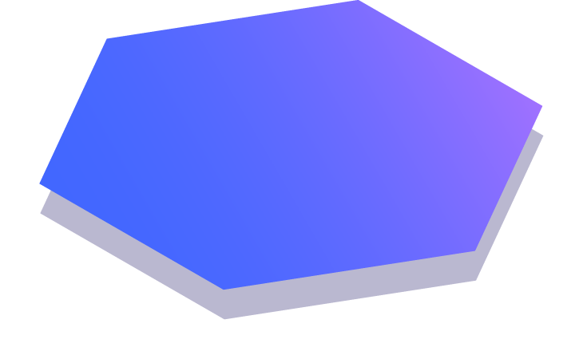
Thanks!
Any questions?

