Slide 1

Boolean Matching in Logic synthesis
Advanced Logic Design (CSE-524)
Presented by:
Sabbir Mahmud Afridi
MS Session 2022-2023
Roll: SH-2334
University of Dhaka

Slide 2
Outline
Logic Synthesis
Technology Mapping
Example of Technology Mapping
Cell Library
Negation, Permutation on Variables
Equivalence of functions
Shannon’s expansion
Example
Boolean Matching
Algorithm
Flowchart
Application of Boolean Matching

Slide 3
Logic Synthesis
To understand Logic Synthesis it’s important first to know the meanings of the key terms: logic, synthesis.
Logic
In the context of digital circuits, logic refers to the rules that govern how digital signals behave. It deals with binary values (0s and 1s) and how they are manipulated to produce output based on certain conditions.
Synthesis
Synthesis means the process of creating something. In the context of logic synthesis, it refers to the process of turning a high-level abstract description of a circuit (such as a written algorithm or equation) into a physical hardware design (a set of gates and wires).

Slide 4
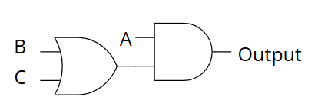
Logic Synthesis
Logic Synthesis is the process of converting a high-level design (like a Boolean expression or algorithm) into an actual set of gates and connections that can be physically implemented.
Boolean Matching: Boolean matching is a technique used during logic synthesis where the synthesis tool checks if the logic in the design can match pre-existing patterns or templates of gates.
Example:
Suppose we are given the following Boolean expression: A AND B OR A AND C
The Boolean matching process identifies that the expression can be simplified into:
A AND (B OR C)
Now that we have a simpler expression, logic synthesis converts it into gates that could be implemented in hardware:

Slide 5
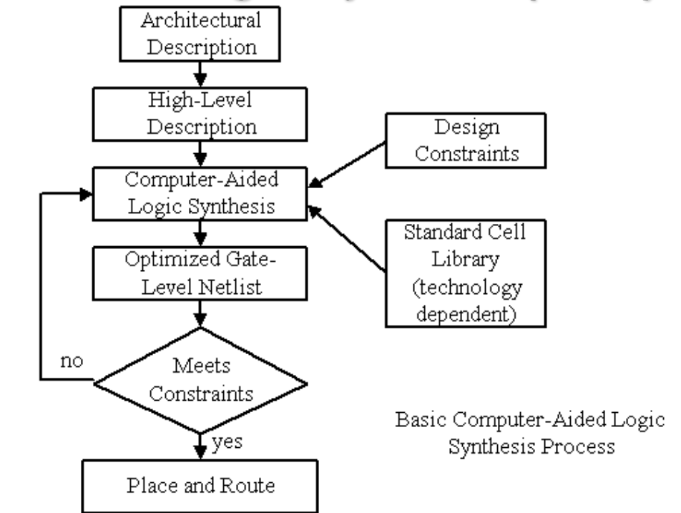
Logic Synthesis Procedure

Slide 6
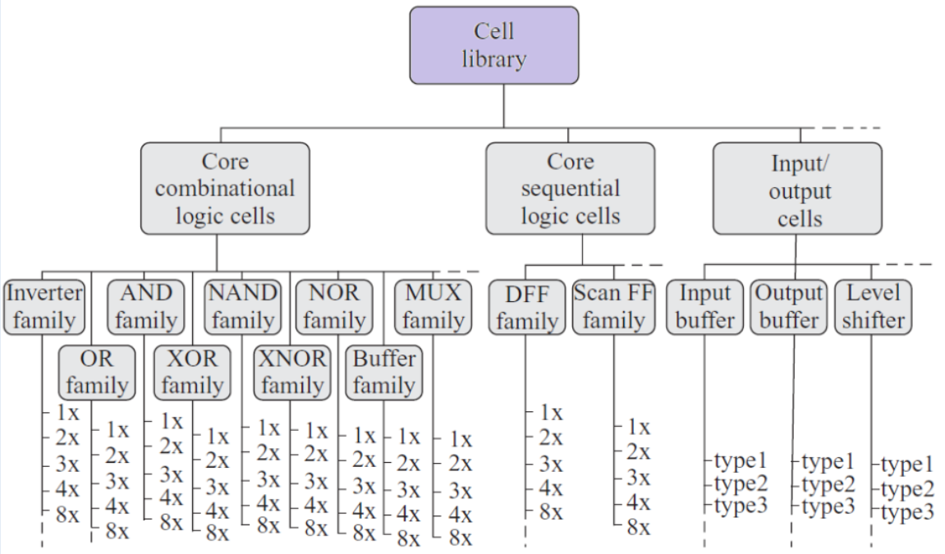
Cell Library/Standard Cell
A collection of low-level logic function such as AND, OR, INVERT, flip-flops, latches, and buffers.

Slide 7
Technology Mapping
Technology mapping is the phase of logic synthesis when gates are selected from a technology library to implement the circuit.

Slide 8
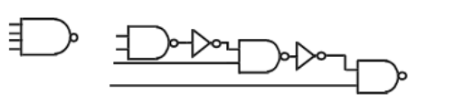
Why Technology Mapping?
Straight implementation may not be good.
For example, F = abcdef as a 6-input AND gate cause a long delay.
Gates in the library are pre-designed
They are usually optimized in terms of area, delay, power, etc.
Moreover we may don't have available gates in the Library

Slide 9
Where is Technology Mapping?
Simplification of logic equations
Reduce number of literals (and operands)
Synthesis
Map logic equations to gates (AND, OR, etc)
Gate-level optimization
Replace OR-NOT by NOR, for example : delay, power, area
Technology mapping
Map from gates to technology library
FPGA, TTL chips, standard cells, etc.

Slide 10
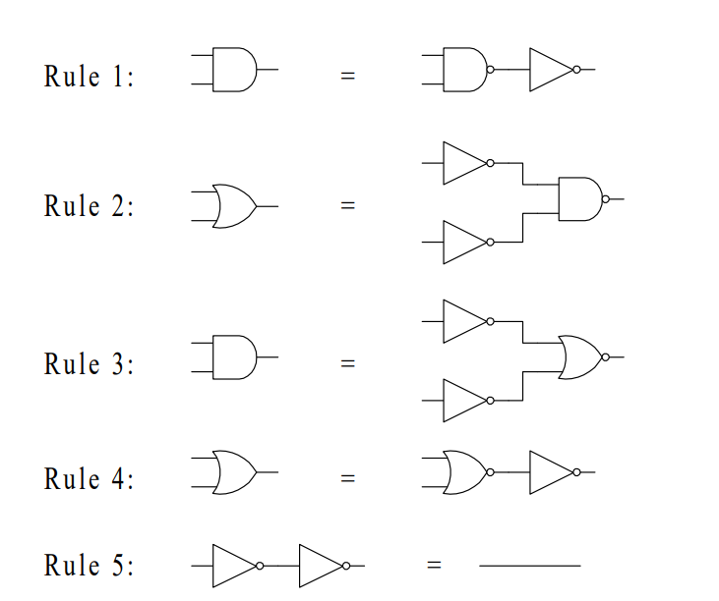
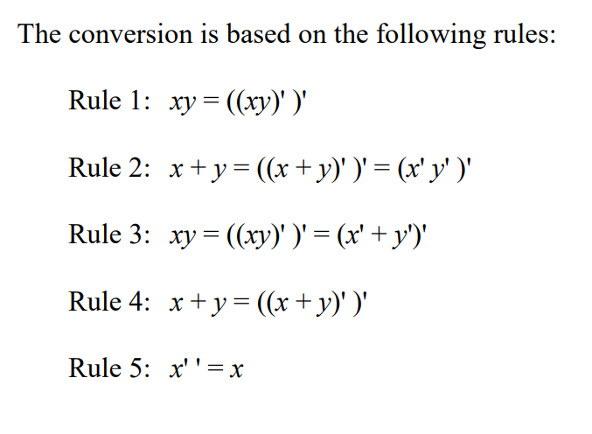
Mapping to NAND and NOR gates

Slide 11
Technology Mapping
There are Two Types of Technology Mapping:
Structural Matching
Structural matching involves mapping a high-level design (such as a Boolean expression or a logic circuit) directly to the structure of available hardware elements.
It focuses on maintaining the actual structure and organization of the hardware components (e.g., gates, multiplexers, flip-flops, etc.) while trying to meet the performance and resource constraints.
In structural matching, the design’s functionality is preserved, but the mapping is done in a way that directly reflects the available physical structures and hardware components.
Boolean Matching
Boolean matching focuses on matching Boolean expressions or logic functions to optimized sets of logic gates or blocks.
This type of mapping is primarily concerned with the logical equivalence of functions rather than the physical layout or the exact hardware structure.
The goal is to find a set of gates that can implement the Boolean functions efficiently. It usually involves simplifying the logic functions using techniques like Boolean algebra or Karnaugh maps before mapping them to the available technology.

Slide 12
Structural Mapping
Decompose:
Subject and pattern graphs into common terms
- NAND/NOR
Could have multiple representations - Decomposition is not canonical
Make DAGs into trees
Make fanouts into primary outputs
Duplicate logic
Tree matching and covering run in linear time

Slide 13
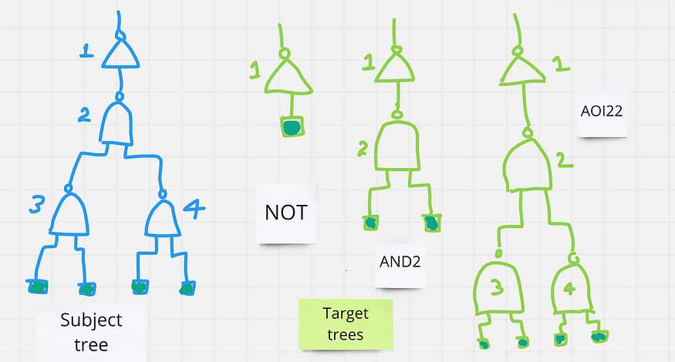
Structural Mapping

Slide 14
Structural Mapping
Structural Mapping Problems
Trees only:
No optimization across fanout nodes
No XOR gates
Imperfect matching. Example: f= xy+x′y′+y’z
g= xy+x′y′+xz
Different structure, same function
Solution: Boolean matching and covering

Slide 15
Boolean Matching
Boolean matching involves identifying when two different representations of logic functions are equivalent by applying these kinds of equivalences, such as input negation, permutation, or output negation.
The purpose of Boolean matching is to recognize these equivalent functions and simplify the logic, which ultimately helps reduce the complexity of the final circuit implementation.

Slide 16
Equivalence of functions
Equivalence of two functions defined under:
Negation of input variables
Permutation of input variables
Negation of output

Slide 17
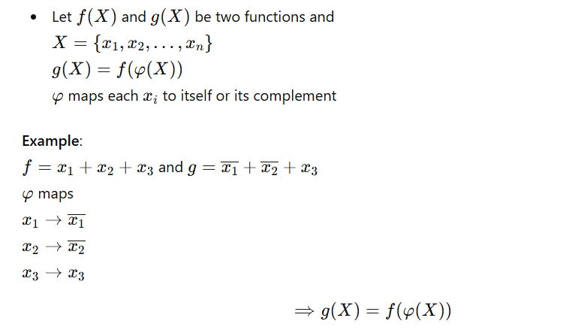
Negation of Input Variables

Slide 18
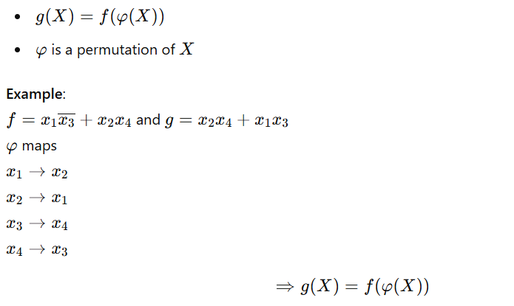
Permutation of Input Variables

Slide 19
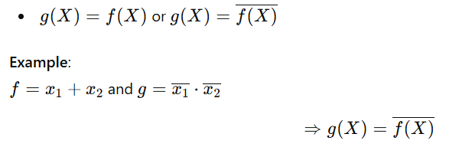
Negation of Output

Slide 20
Equivalence of Functions
NPN-Equivalent:
- Equivalent under:
Input Negation
Input Permutation
Output Negation

Slide 21
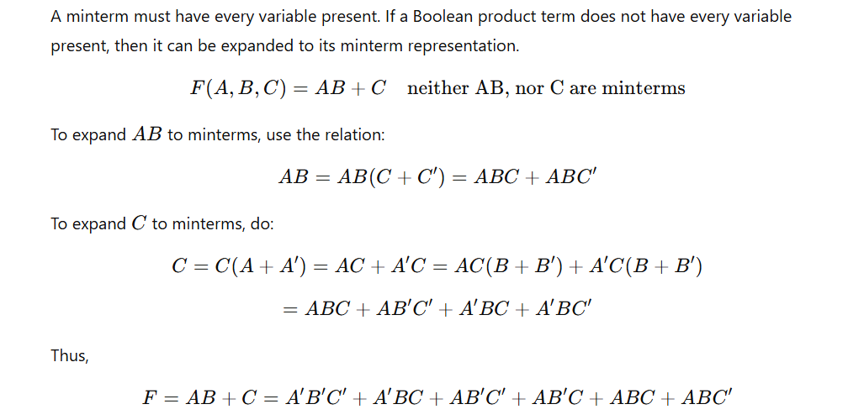
Minterm Expansion

Slide 22
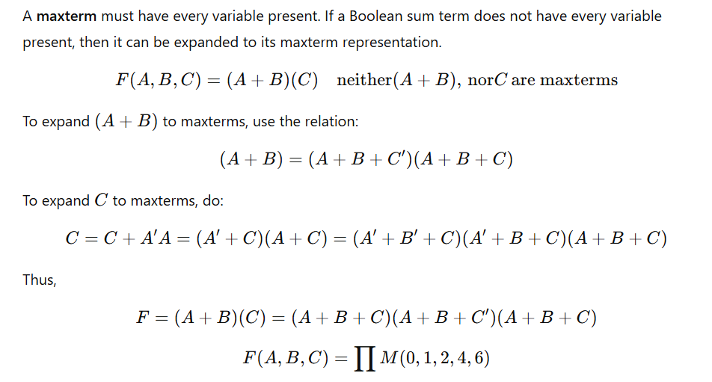
Maxterm Expansion

Slide 23
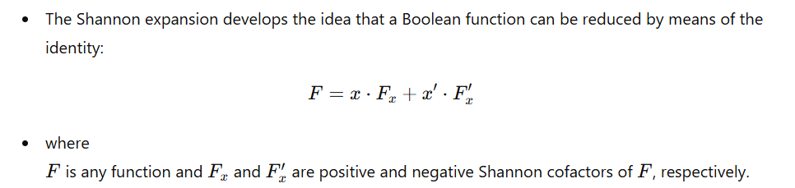
Shannon Decomposition/Expansion

Slide 24
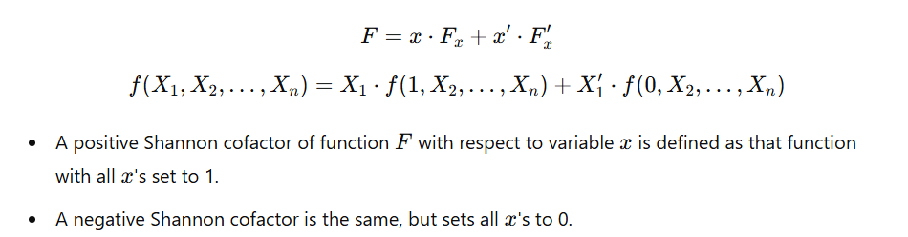
Shannon Decomposition/Expansion

Slide 25
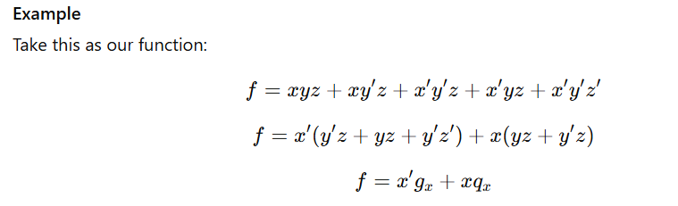
Shannon Decomposition/Expansion

Slide 26
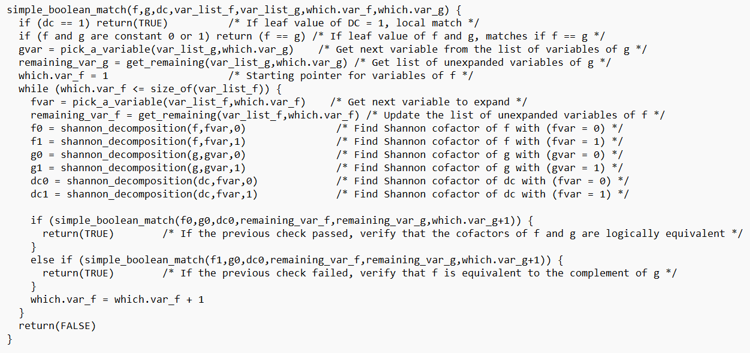
Boolean Matching Algorithm

Slide 27
Boolean Matching Algorithm
Generate functions of all possible permutations and combinations on the inputs of A.
Generate functions of all possible permutations and combinations on the inputs of B.
Try to find if any of the outcomes of A match with the outcome of B.
If matching is found, then we can say that an instance of A can be modeled with an instance of B.

Slide 28
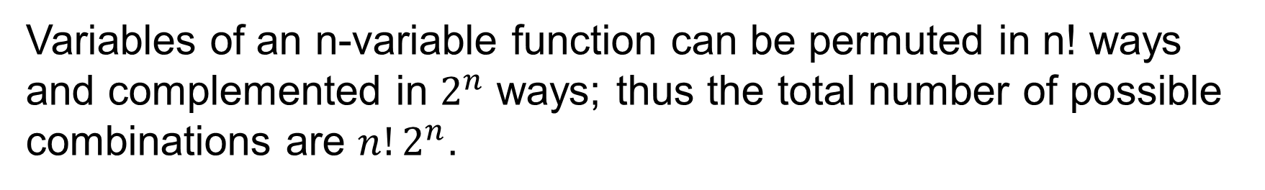
Possible Combination
Variables of an n-variable function can be permuted in n! ways and complemented in $2^{n}$ ways; thus the total number of possible combinations are $n!2^{n}$.

Slide 29
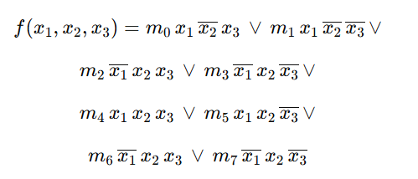
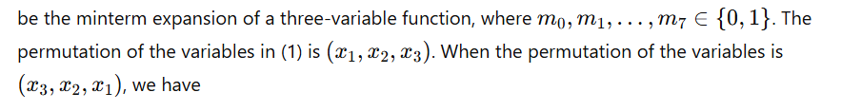
Computing NP-Representative
For example, let

Slide 30
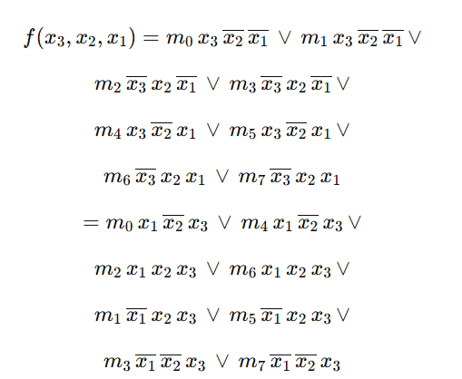
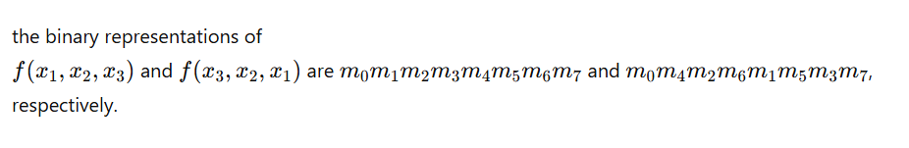
Computing NP-Representative

Slide 31
Computing NP-Representative

Slide 32
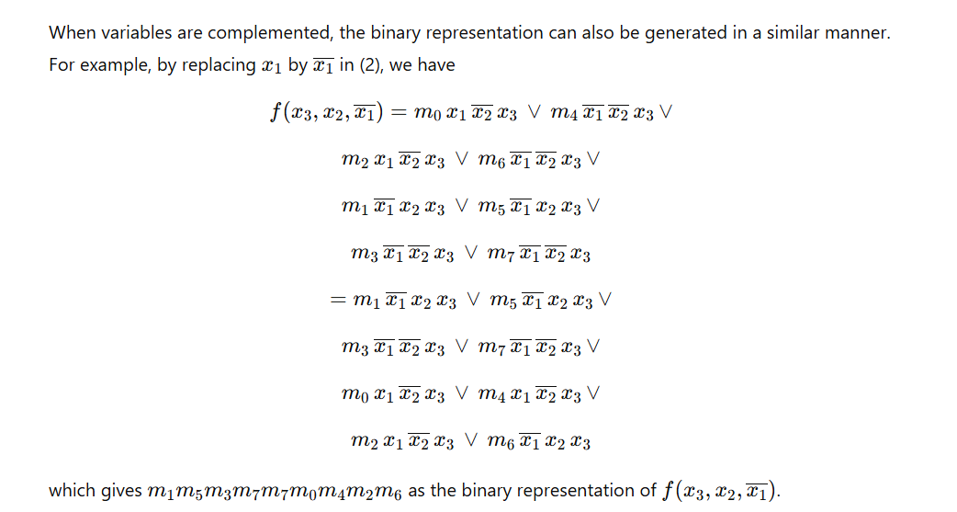
Computing NP-Representative

Slide 33
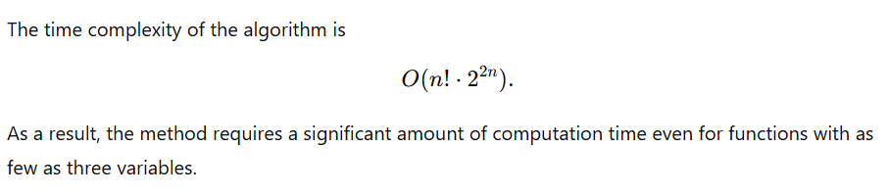
Computing NP-Representative

Slide 34
Conclusion
Although checking of functional equivalence of two functions is NP-hard problem.
Boolean matching eases this task better than other techniques like
K-map or Quin-Maclauskys.
It is used practically while logic synthesis for commonly used circuits.

Slide 35


