Slide 1

Boolean Matching in Logic synthesis
Advanced Logic Design (CSE-524)
Presented by:
Sabbir Mahmud Afridi
MS Session 2022-2023
Roll: SH-2334
University of Dhaka

Slide 2
Outline
Logic Synthesis
Technology Mapping
Example of Technology Mapping
Cell Library
Negation, Permutation on Variables
Equivalence of functions
Shannon’s expansion
Example
Boolean Matching
Algorithm
Flowchart
Application of Boolean Matching

Slide 3
Logic Synthesis
Logic synthesis is the process of converting a high-level design or description of a digital circuit into a list of basic logic gates (like AND, OR, NOT) that can be physically built in hardware.
Goal
Maximize Speed
Minimize Power
Minimize Chip/Board Size

Slide 4
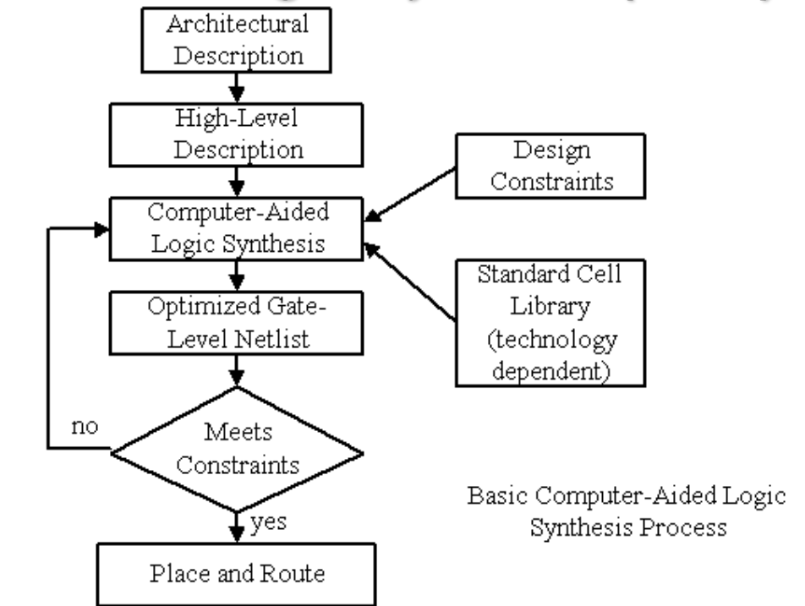
Logic Synthesis Procedure

Slide 5
Technology Mapping
• Technology mapping is the phase of logic synthesis when gates are selected from a technology library to implement the circuit.
• Technology mapping is normally done after technology independent optimization.
In Another sense
Technology mapping is the process of expressing a given Boolean network in terms of library gates (for standard cells) or look-up tables.

Slide 6
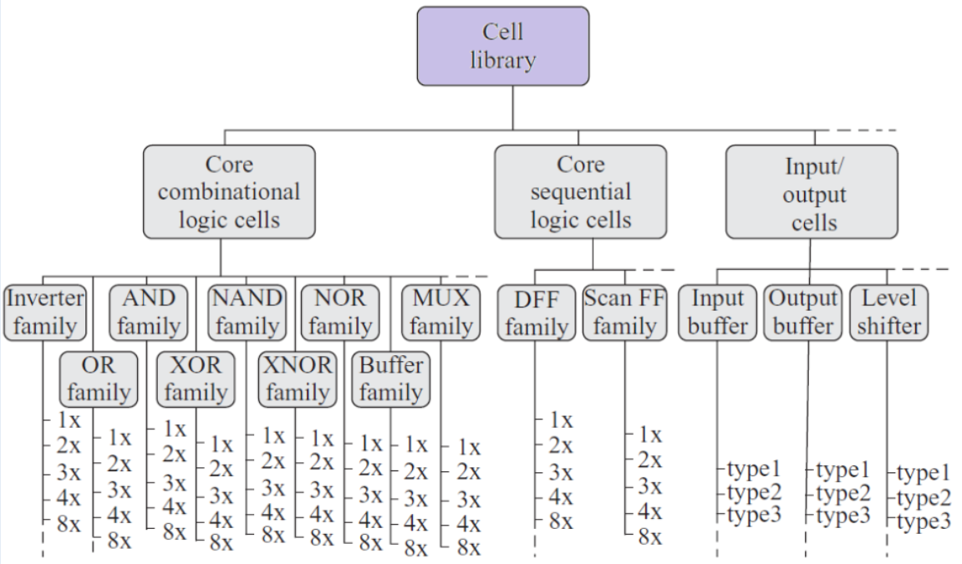
Cell Library/Standard Cell
A collection of low-level logic function such as AND, OR, INVERT, flip-flops, latches, and buffers.

Slide 7
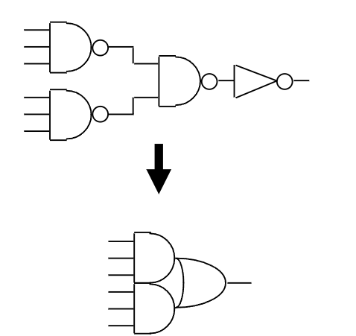
Why Technology Mapping?
Straight implementation may not be good.
For example, F = abcdef as a 6-input AND gate cause a long delay.
Gates in the library are pre-designed
They are usually optimized in terms of area, delay, power, etc.
Moreover we may don't have available gates in the Library
The circuit on the top of the figure shows a combination of different logic gates (AND, OR, NOT, etc.) connected in a certain way to perform a specific function.
The circuit on the bottom illustrates how the original design can be optimized by replacing the complex gates with more standardized gates that are available in the library.

Slide 8
Where is Technology Mapping?
Simplification of logic equations
Reduce number of literals (and operands)
Synthesis
Map logic equations to gates (AND, OR, etc)
Gate-level optimization
Replace OR-NOT by NOR, for example : delay, power, area
Technology mapping
Map from gates to technology library
FPGA, TTL chips, standard cells, etc.

Slide 9
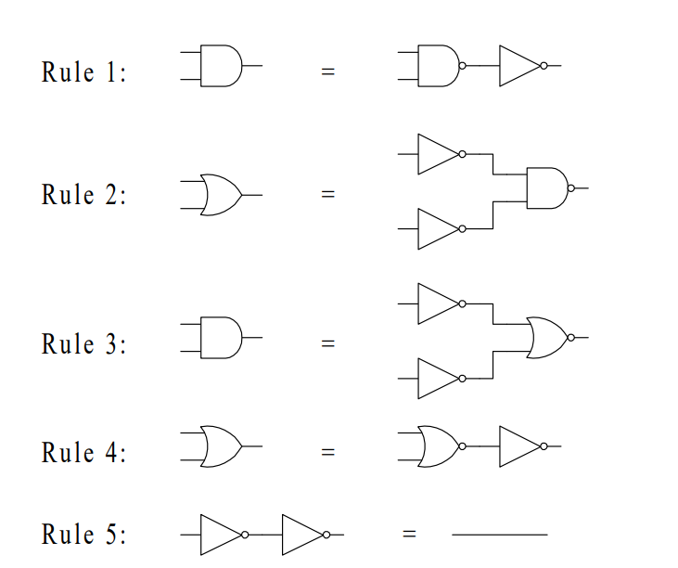
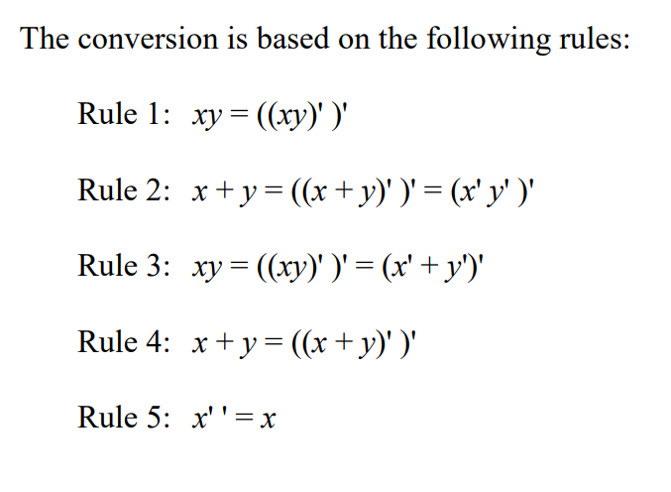
Mapping to NAND and NOR gates

Slide 10
Technology Mapping
There are Two Types of Technology Mapping:
Structural Matching
Structural matching involves mapping a high-level design (such as a Boolean expression or a logic circuit) directly to the structure of available hardware elements.
It focuses on maintaining the actual structure and organization of the hardware components (e.g., gates, multiplexers, flip-flops, etc.) while trying to meet the performance and resource constraints.
In structural matching, the design’s functionality is preserved, but the mapping is done in a way that directly reflects the available physical structures and hardware components.
Boolean Matching
Boolean matching focuses on matching Boolean expressions or logic functions to optimized sets of logic gates or blocks.
This type of mapping is primarily concerned with the logical equivalence of functions rather than the physical layout or the exact hardware structure.
The goal is to find a set of gates that can implement the Boolean functions efficiently. It usually involves simplifying the logic functions using techniques like Boolean algebra or Karnaugh maps before mapping them to the available technology.

Slide 11
Structural Mapping
Decompose:
Subject and pattern graphs into common terms
- NAND/NOR
Could have multiple representations - Decomposition is not canonical
Make DAGs into trees
Make fanouts into primary outputs
Duplicate logic
Tree matching and covering run in linear time

Slide 12
Structural Mapping
Structural Mapping Problems
Trees only:
No optimization across fanout nodes
No XOR gates
Imperfect matching. Example: f= xy+x′y′+y’z
g= xy+x′y′+xz
Different structure, same function
Solution: Boolean matching and covering

Slide 13
Equivalence of functions
Equivalence of two functions defined under:
Negation of input variables
Permutation of input variables
Negation of output

Slide 14
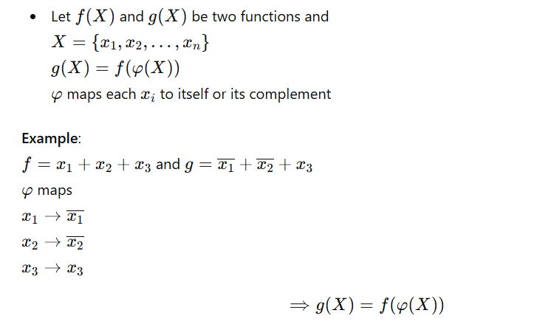
Negation of Input Variables

Slide 15
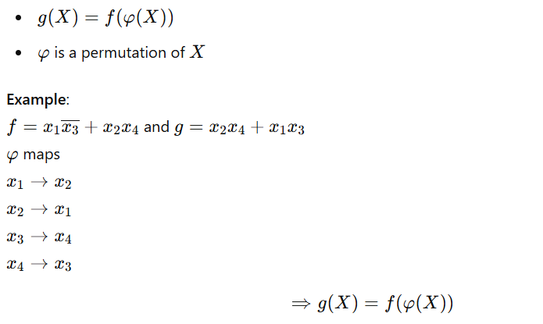
Permutation of Input Variables

Slide 16
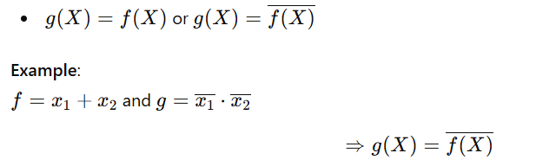
Negation of Output

Slide 17
Equivalence of Functions
NPN-Equivalent:
- Equivalent under:
Input Negation
Input Permutation
Output Negation

Slide 18
Equivalence of Functions
NPN-Equivalent:
- Equivalent under:
Input Negation
Input Permutation
Output Negation

Slide 19
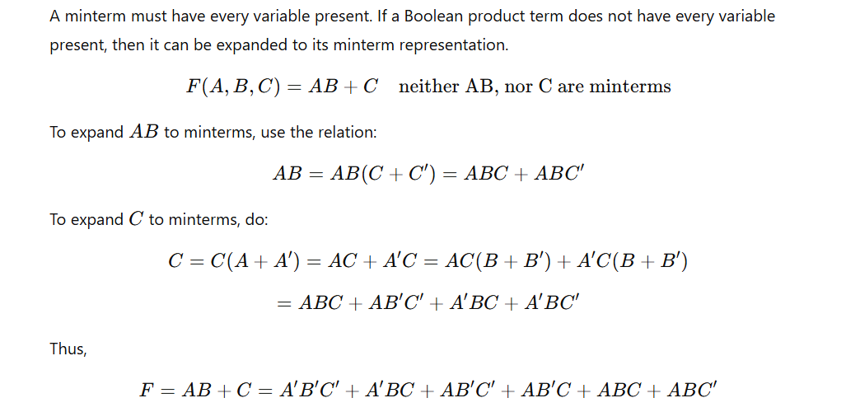
Minterm Expansion

Slide 20
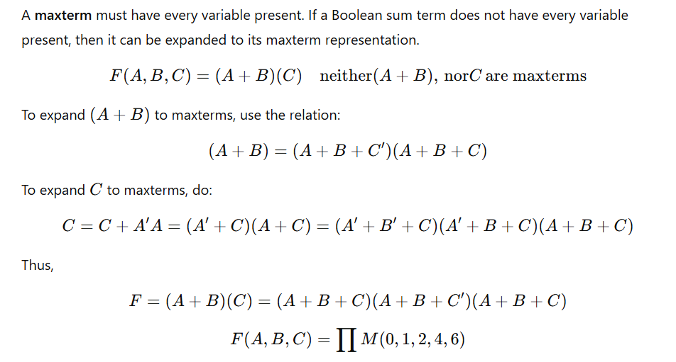
Maxterm Expansion

Slide 21
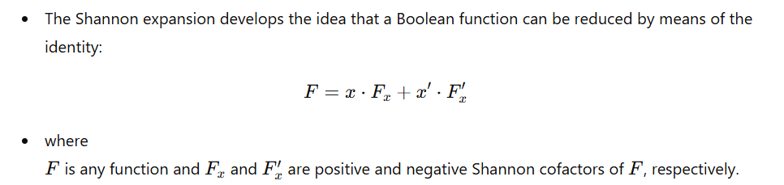
Shannon Decomposition/Expansion

Slide 22
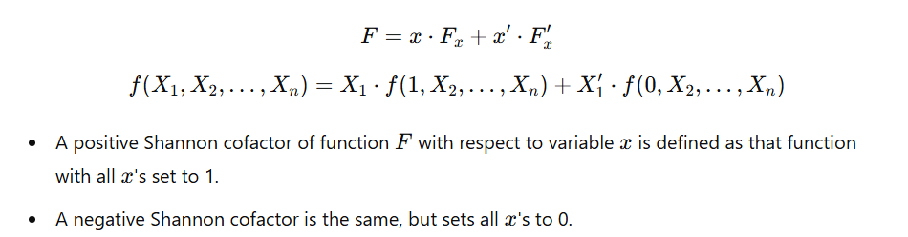
Shannon Decomposition/Expansion

Slide 23
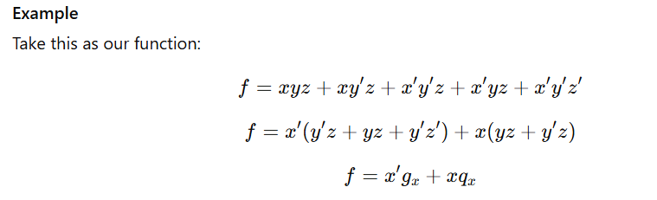
Shannon Decomposition/Expansion

Slide 24
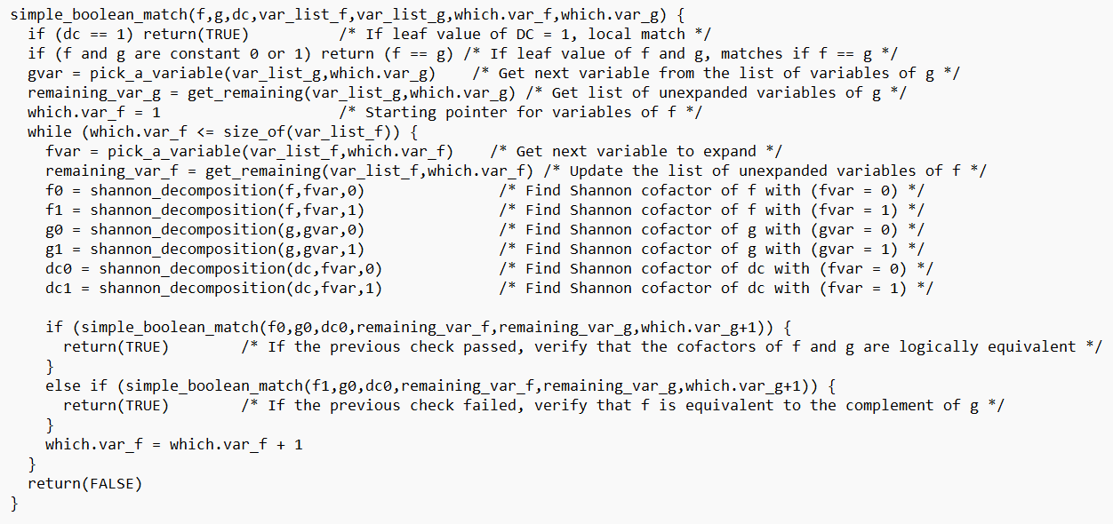
Boolean Matching Algorithm

Slide 25
Boolean Matching Algorithm
Generate functions of all possible permutations and combinations on the inputs of A.
Generate functions of all possible permutations and combinations on the inputs of B.
Try to find if any of the outcomes of A match with the outcome of B.
If matching is found, then we can say that an instance of A can be modeled with an instance of B.

Slide 26
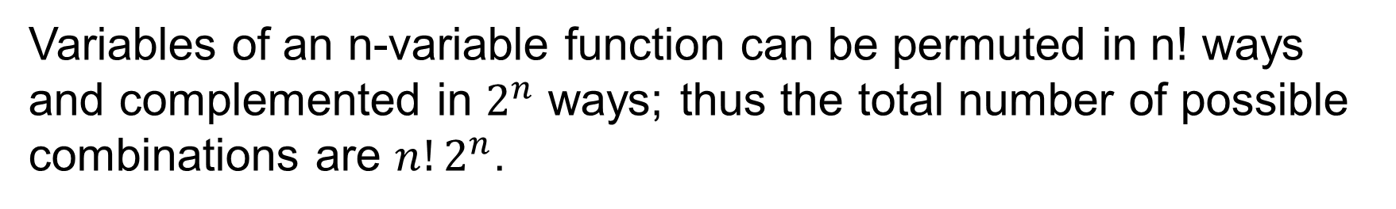
Possible Combination
Variables of an n-variable function can be permuted in n! ways and complemented in $2^{n}$ ways; thus the total number of possible combinations are $n!2^{n}$.

Slide 27
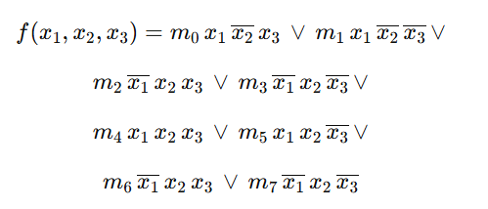
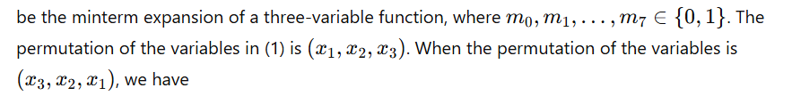
Computing NP-Representative
For example, let

Slide 28
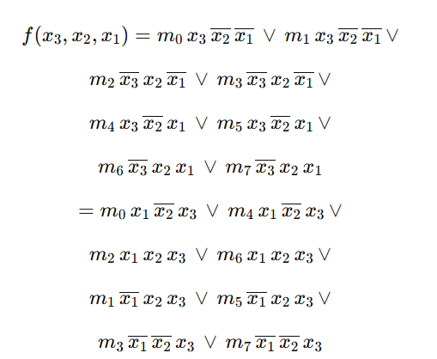
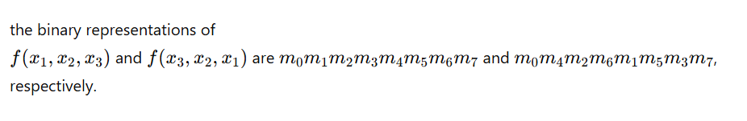
Computing NP-Representative

Slide 29
Computing NP-Representative

Slide 30
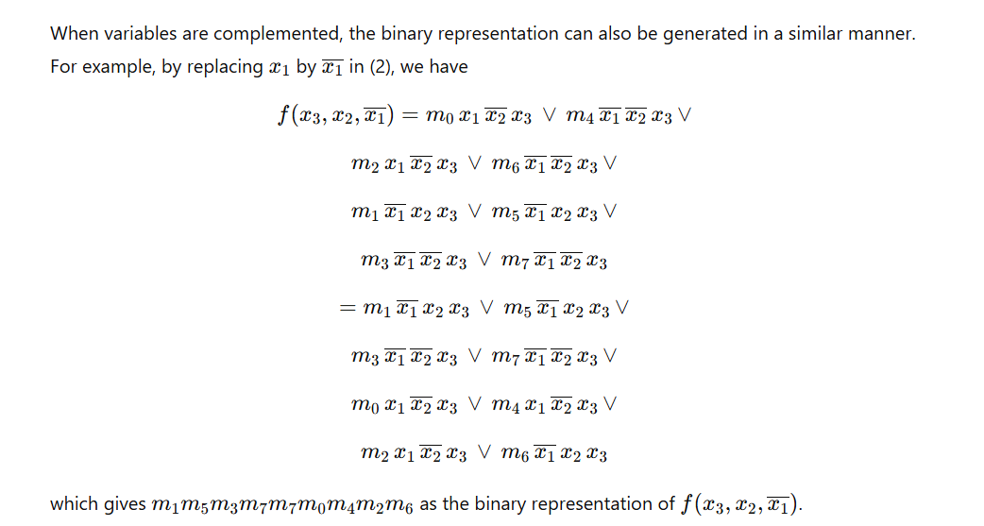
Computing NP-Representative

Slide 31
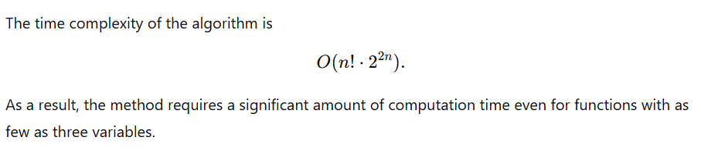
Computing NP-Representative

Slide 32
Conclusion
Although checking of functional equivalence of two functions is NP-hard problem.
Boolean matching eases this task better than other techniques like
K-map or Quin-Maclauskys.
It is used practically while logic synthesis for commonly used circuits.

Slide 33


