Slide 1
Journaling 정리 1
Motivations
Sudden power failure incurs file system inconsistency
Prevent data inconsistency through write-twice (commit & checkpoint)
Avoid traditional time-consuming consistency checks on the whole file system
Journal : a special disk area that contains the most recent disk write operations
Two Steps of Journaling
Commit : flushing in-memory contents of journal to appropriate blocks in journal with writing commit record
Checkpoint : flushing the contents of journal to their actual location on disk
Three Journaling modes
Journal : All file system data and metadata changes are logged – safest and slowest
Ordered : Only changes to metadata are logged - default
Data blocks are written to disk before the metadata
Writeback : Only changes to metadata are logged
Data blocks can be written before/after the journal is updated

Slide 2
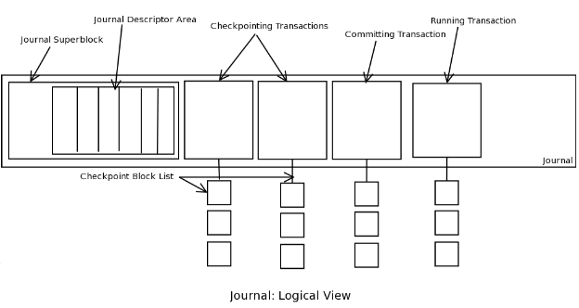
Journaling 정리 2
Journaling Block Device (JBD)
Provides a file system independent interface for journaling
Journaling is done at block level
JBD structures
Log record
A single update of a disk block (storing data or metadata)
Atomic operation handle
A set of low-level operations (log records) on the disk data structures that correspond to a single high-level operation
A handle pointer each of which represents a single atomic file system operation
Tracks all the modifications done as part of one atomic operation (a system call that modifies the file system)
Transaction
A single atomic sequence of events which guarantees file system consistency
Consist of a single handle or multiple handles for batching efficiency
JBD manages the journal by grouping the log records that belong to several atomic operation handles into a single transaction
Transaction state
Running – still alive and can accept more handles
Locked – Not accepting new handles, but the existing ones are still unfinished
Flush – The transaction is complete and is being written to the journal
Commit – The transaction is written to the journal and now the changes are being applied to the file system
Finished – The transaction has been fully written to the journal and the block device; can be deleted from the journal

Slide 3
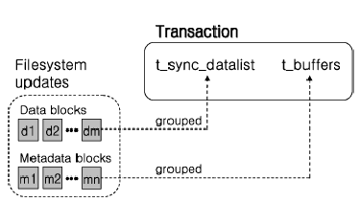
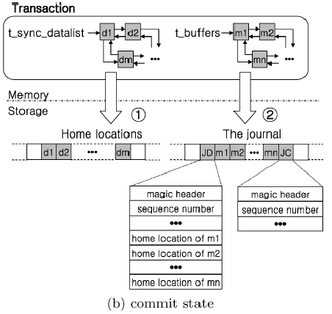
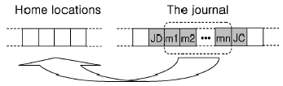
Journaling 정리 3
Ext3 journaling 과정
(transaction의 state 변화)
(a) Running state
(b) Commit state
(c) Checkpoint state

Slide 4
REMZI OS BOOK

